Slide 1
Preparing for your C-me session
Note. Certain slides can be hidden (right click ‘Hide Slide’) depending on session needs. Certain slides will need editing for each session (see below)
Checklist
Home Slide: Option to add Client’s logo/brand Slide 3
Aims: Adjust session Aims as appropriate for Client Slide 4
If delivering face-to-face, hide slides 8 and 9
Select pairs for Exercise 3 in advance Slide 16 – see notes
Slides 18-20 are currently hidden as they are not needed in this workshop if the group have already done the Communication Workshop. If this is not the case and the slides are needed, be aware of additional delivery time.
C-me profile needed

Slide 2
Session Delivery
We encourage you to run through all the slides ahead of delivering them in slideshow mode. Some slides are static and others include animations. Please check that the animations work as expected.
Brief notes are provided below each slide to give delivery guidance.

Slide 3


C-me Leadership Development Workshop
Helping teams communicate, collaborate and perform at their best
Notes:
If delivering remotely:
Welcome everyone on grid view (share slides later).
Give a very brief personal introduction
Purpose: The purpose of this workshop is ……
Programme: The timeline for today is ….
If recording the session: Let the clients know at the start.

Slide 4
Our aims for this session
01
Explore the specific leadership contributions for each colour preference
02
Reflect on your leadership style in the context of your personal profile
03
Consider how to best adapt your communication style and be more influential as a leader
04
Understand the impact of leadership style on communicating vision
What specific questions are you bringing? …..
Notes:
Check these aims are appropriate for your clients and tailor if necessary.
Give space for participants to share their session aims in the chat.

Slide 5
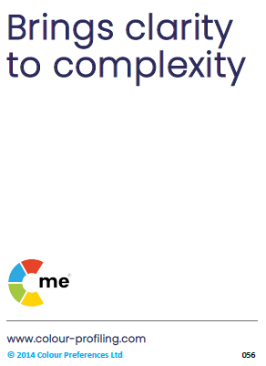
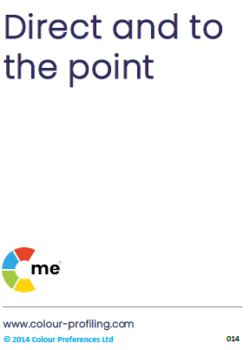
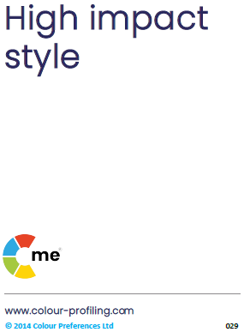


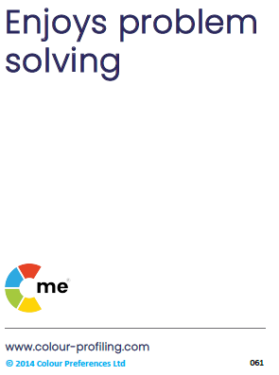

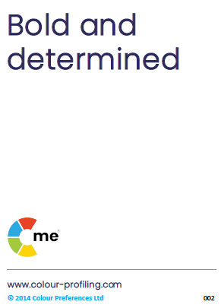
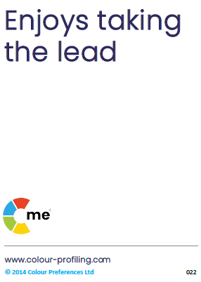
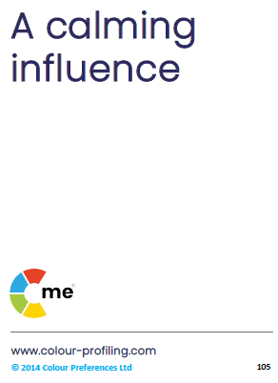
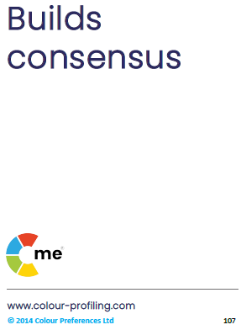
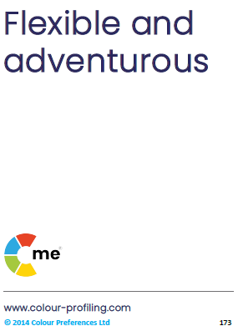
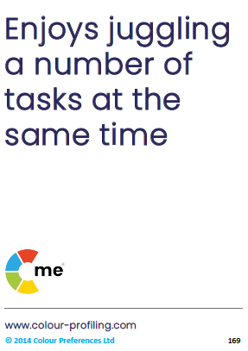
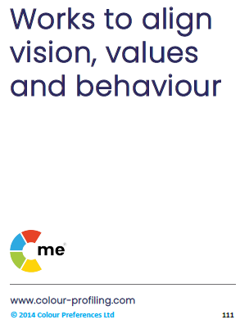
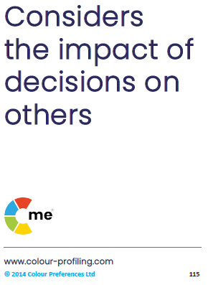
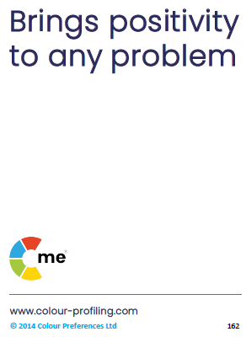
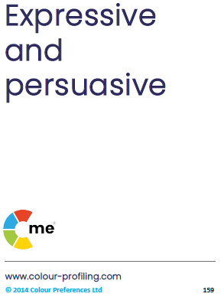

v
C-me preference around the wheel
Notes:
Reminder that different behavioural preferences can be grouped into 4 principle colours,
placed around a colour wheel.

Slide 6
v
C-me and the Jungian axes
Thinking preference
Reflective
preference
Expressive preference
Feeling preference
Notes:
Very brief recap:
How might the Jungian axes impact how a person leads?

Slide 7
v
360 Card Game
What do you observe about other team members?
Notes:
Focussing on one Leader at a time - What would you say are their top 2 colour preferences? Add to chat
Explain the 360 card game if Face-to-Face:
8 cards given to each attendee
Consider each Leader in the room
Give a leader the cards that you think best describe them – max of 3 cards per leader
If virtual session, use slide 8

Slide 8




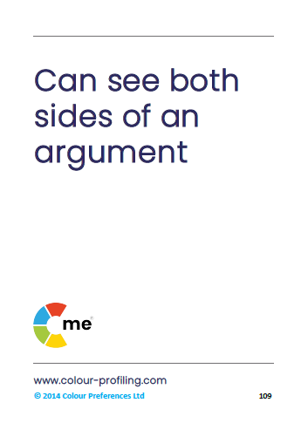



1
2
3
4
5
6
7
8
Notes:
Animated slide – Whole group to consider a Leader and the resonance of statements for that individual.
New card will be revealed on each click.
The colours of these cards will be revealed in the next slide.

Slide 9
1
2
3
4
5
6
7
8
Notes:
Colour preference will be revealed on each click.
Action: Identify the colours of the cards that you picked for that leader.
Action: Write those colours in the chat box/share with group.

Slide 10
v
Leadership and management
Notes:
Very brief recap:
You can be an effective leader/manager from anywhere around the colour wheel.
You bring your own unique colour combination to your leadership role.
No one colour combination is better for leadership than another.
Often people make the assumption that red preference makes for the best leaders or even that this is
what is needed to lead: red = leadership. This is incorrect - in reality every colour preference brings
unique strengths to leadership and management.
Note. No matter what organisation it is, if leadership only reflects a certain specific style or preference then
this runs the risk of becoming the hallmark of what constitutes leadership, becoming one dimensional and
shutting the door to opportunity and innovation.
We want organisations to flourish drawing on diversity and inclusivity to harness the full spectrum of what its people
have to offer, growing in diverse styles of leadership, drawing on different behavioural preferences, maximising
engagement and productivity across the organisation.
Exercise: what are the strengths of each leadership style around the wheel? chat box/discussion.
Red – good day: visionary, quick decisive action, clarity of purpose, bold strategies – bad day: may feel controlling
and impatient, total focus on task, with little consideration for ensuring people are following.
Yellow – motivational, empowering individuals, inspiring innovation – bad day: unfocused, overwhelmed by amount
of possibilities, juggling too many things with no set timelines.
Green – nurturing, make sure whole team involved, collaboration, focus on values, purpose and quality – bad day:
procrastination, prolonged decision making in an effort to involve and gain agreement from everyone.
Blue – organised, clear timelines, realistic, ensures follow through, grounded, high standards – bad day: over analysis
creating a bottle neck, tension between timelines and needing to explore options, micromanagement, potentially slow
to delegate, lack of communication creating issue with buy-in.

Slide 11









v
Authentic leadership style
Keeps the team on agenda
Good problem solver
Strong sense of duty
Logical + analytical
Sets high standards
Initiates vital improvements
Meets a challenge head on
Sets goals for the team
Works to tight deadlines
Explores all the options
Realistic
Well organised
Quick thinker
Builds enthusiasm
Visionary/sees big picture
Involves others
Works late till the job is done
Supportive + loyal
Spontaneous + imaginative
Thrives on variety
Positive + inspirational
Team player
Sees the good in others
Builds lasing relationships
Notes:
Authentic leadership styles come in a range of colours.
Animated slide – starting with 4 colour quadrants (Y, G, B, R) and then blends accordingly.
Question: Considering your top 2 colours and your blend, which 3 statements best describe you?
Share as whole group, small group or pairs. Aim is to explore leadership styles around the wheel.

Slide 12
v
Authentic leadership approaches
“Let’s deliver what we promised”
“Let’s do this right”
“Let’s make a big impact”
“Let’s set ourselves up for success”
“Let’s get this show on the road”
“Let’s do this together”
“Let’s give it our best shot”
“You’re the best team for the job”
Notes:
Which statements do you use the most?
Considering the colour preferences of your team, which ones are they likely to want to hear?
What will you adjust in your communication as a result? Be specific

Slide 13
v
The four postures of a leader
Take responsibility
Serve + empower
Train + equip
Set example
Notes:
Animated slide.
The dot represents the Leader in the positioning of each approach
1. Taking responsibility for everyone you are leading – leadership "down" (not bossing people
but taking responsibility)
2. Serving and empowering everyone you are leading – leadership "up"
3. Training and equipping those you lead – leading from behind (Management element)
4. Setting an example – leading from the front (Leadership)

Slide 14
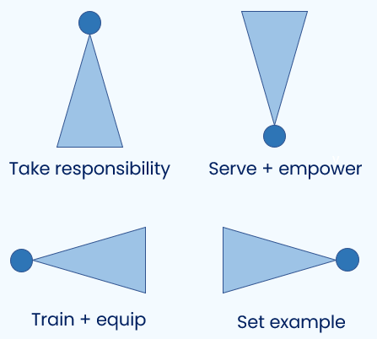
v
The four postures of a leader
Which of these postures is more intuitive for you?
Is that what others see in you?
Thinking of a current situation, how might you adapt your intuitive leadership style to better effect?
Notes:
Three questions for reflection (animated).
Can be discussed as whole group, in small groups or pairs.
NB. There is not one posture for each colour quadrant. It is a more nuanced conversation about
which postures come instinctively to each leader and which they might need to be more conscious of.

Slide 15
v
Exercise 2: Explore and filter
Look at the following sections of your personal profiles: Resilient strengths, Team contribution, Areas of development, Blind spots
In the context of leadership, which statements most resonate with you?
How are these showing up in your leadership?
What might it feel like to be led by you?
Notes:
Personal reflection on these sections of the report in the context of Leadership, initially with a
view to sharing in next exercise.

Slide 16
v
Exercise 3: Share
Working in pairs, look at your partner's statements and pick 2 that you feel best describe their leadership style.
Share how you see these qualities strengthening the whole team
Where do you see most room for growth?
Notes:
Share whatever resonates from your individual reflections on the 4 areas of your report.
Pairs could be of those with opposite or very different colour combinations or a pair who work
closely together.
Opportunity to hear another Leader's perspective on your style.

Slide 17

Break

Slide 18

v
Effective communication:
Do …
Give me time to prepare
Be clear + brief
Refer early to the objective
Be rational + practical
Demonstrate conviction
Ask me for my thoughts
Identify my role quickly
Be logical + thorough
Listen carefully
Allow conversation to be free flowing
Show sincere interest
Use visuals
Allow time for discussion
Be interactive + informal
Involve others
Let me shape the outcome
Notes:
Effective Leadership Communication
Different colours have very different preferences when it comes to effective leadership communication.
We often communicate in the style we are most comfortable with, rather than what is necessarily best for
the other person.
Action: Take a moment to look at the quadrant you’re most comfortable with and look across to the other
side of the wheel and take note of what is listed there.
For those who are a cross-type profile – use their lowest colour or the colour at the bottom of their 'C’
Visual.

Slide 19
v
Ineffective communication:
Don’t …
Interrupt my thinking
Be impatient
Be flippant
Procrastinate
Skip over the facts
Slow down the pace
Stray from the agenda
Repeat yourself
Be abrupt
Restrain my ideas
Rush me
Overwhelm with detail
Openly criticise
Dampen my enthusiasm
Talk over me
Expect me to stick to rigid timescales
Notes:
Ineffective Colour Communication
This visual is again reinforcing colour preference behaviours and encouraging people to consider
other colours than their own.
Action: Take a moment to look at the quadrant you’re most comfortable with and look across to the
other side of the wheel and take note of what is listed there. What does someone of opposite colour
preference to you really not find helpful?
For those who are a cross-type profile – use their lowest colour or the colour at the bottom of their 'C’
Visual.

Slide 20
v
Verbal style
Pragmatic
Authoritative
Structured
Direct
Professional
Fast paced
Analytical
Unambiguous
Prepared
Assured
Collaborative
Dynamic
Diplomatic
Persuasive
Thoughtful
Spontaneous
Empathetic
Positive
Meaningful
Informal
Notes:
Recap verbal style:
The most effective leaders learn to pick up nuance and the subtleties of differences in verbal style –
not about what is said but how.
Note. Pause for brief reflection to allow attendees to consider situations that occur to them relating to
this.

Slide 21
v
Exercise 4: Explore, filter, share
Look at the following sections of your own profiles
Enabling Engagement
Which 3 statements best describe what keeps you engaged and committed as a leader?
Role Agility
Which 3 statements best describe your role preference and how you respond to change?
In what ways does this impact your leadership?
Notes:
Personal reflection on these sections of the report in the context of Leadership.

Slide 22
v
Being C.L.E.A.R in our leadership
Commit
Purpose + goal of the conversation
Review
Session + process
Action
Clarify next steps
Listen
Ask exploratory questions
Explore
Look at options
Notes:
Each Click – reveals next part of the C.L.E.A.R Coaching Method for communicating as Managers
and Leaders.
This process can be used in any topic or issue that needs addressing between a Leader and one of the
team.
To develop your leadership further, in this exercise you are considering your own colour preferences and
those of someone you coach.
When coaching others, it is beneficial to go through all 5 stages, not just the ones they more naturally
focus on:
Commit – Clarifying goal or issue and the purpose of the conversation. A collaborative approach to this
is best.
Listen – Ask open questions, collect detail and information and allow time for reflection. Reflect back
what you have heard.
Explore – Explore together the avenues available to get to the agreed goal, based on what you have just heard.
Action – Gain clarity on next steps to achieve agreed goal.
Review – 1. Session review - Ask for feedback on how they found the session and consider adjusting your style
accordingly for next time. 2. Process review - Review ongoing progress. Give time for reflective input soon after
the session for those who would value it.
As coaches, our different colour preferences make some of these stages more intuitive than others.
Which stages are intuitive for you?
Which ones do you need to flex to intentionally, for the sake of the Coachee?
Do these relate to your colour preferences?
Why CLEAR model over GROW model? Firstly, it makes explicit the importance of the wider dynamics,
encouraging questions like "How did you find our conversation?", "What helps you learn?" and "What
blocks your learning?".
Secondly the CLEAR model emphasises the importance of reviewing the session. This is a powerful tool
for tuning our coaching to the evolving needs of the other person. It's easy when using the GROW model
to feel that when we have done the wrap-up, we're finished. Making reviewing the coaching effectiveness
one of the basic steps, as the CLEAR model does, reinforces the value and importance of this stage and allows
for more consideration of the other person's preferences.

Slide 23
v
Exercise 5: Applying C.L.E.A.R in our leadership
Commit
Purpose + goal of the conversation
Think of someone you are currently leading:
What is their colour preference?
Which stages are they likely to want to focus on?
Which are they likely to want to skip over?​
Listen
Ask exploratory questions
Explore
Look at options
Action
Clarify next steps
Flexing involves adjusting our own preferences to support all 5 stages in order to maximise the outcomes of the conversation.
Review
Session + process
Notes:
Animated – to reveal the flexing statement at the bottom of the slide.
As Leaders it is good to adjust ourselves to the preferences of others, potentially being more conscious
of the stages that are less conscious for the person concerned.

Slide 24
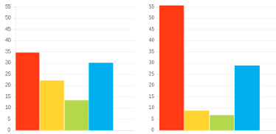
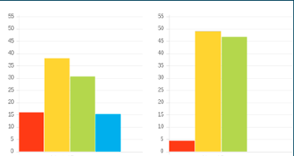
v
Exercise 6: Applying C.L.E.A.R
Commit
Purpose + goal of the conversation
Profile 1
Listen
Ask exploratory questions
Adapted Natural
Explore
Look at options
Action
Clarify next steps
Profile 2
Review
Session + process
Adapted Natural
Notes:
In pairs, explore how the C.L.E.A.R. Method could be best adjusted for 2 different profiles.
Note. Focus primarily on Adapted graph
Note. But be aware of natural ‘unconscious’ graph and ‘revert to type’ behaviours.

Slide 25
v
Personal reflection
Consider 2 key team members with different colour preferences to you:
How will you adapt your day-to-day communication style with them from now on?
What changes will you make in a coaching session with them next time?
Notes:
Give 3 mins for each individual to consider.
Questions are animated.

Slide 26
v
Vision:
Each colour preference is likely to bring a different question of focus
HOW are we doing it?
HOW?
WHY?
WHY are we doing it?
WHO?
WHAT?
WHAT can we do differently?
WHO will be impacted?
Notes:
Animated – each click reveals each colour.
Each colour preference is likely to have a different question of focus with regards to vision.
So the question each colour preference would ask might be...
Why - What is the goal?
What - What are the options?
Who – Who will be affected?
How – What is the process?
Great that we all have natural questions we would ask but we also need to ask the other questions
intentionally in order for the whole picture to be created.

Slide 27
v
Effective vision
Vision + process
= ORDER
Vision + decision
= PROGRESS
Vision + collaboration
= BUY-IN
Vision + ideas
= INSPIRATION
Notes:
Animated – each click reveals each colour.
Each colour preference's contributions bring an important part of the Vision. Which come naturally to
you? Who do you turn to for the others?

Slide 28
v
Ineffective vision
Vision - process
= CHAOS
Vision - decision
= THEORY
Vision - collaboration
= DISENGAGEMENT
Vision - ideas
= LIMITATION
Notes:
Animated – each click reveals each colour
Vision without one of the key elements quickly becomes ineffective. Thoughts?

Slide 29
Exercise 7: Powerfully communicating vision
Vision involves taking people from HERE to ..………...………… THERE
What adjustments would you make when communicating vision to people with colour preferences different to your own?
Which might you want to be more aware of in your communication of vision?
How might this be impacting your team?
Notes:
Animated questions

Slide 30
Final reflection
What more do I want to know?
What are my personal goals?
What do people most appreciate about how you lead?
How can you better release the potential in others?
How could this impact others?
How can this be applied?
How will you lead differently in light of this workshop?
Notes:
Committing to actions to put into practice what we’ve covered over these sessions helps
to increase the impact of what you’ve learned.
We’ve mapped action planning around our wheel, illustrating how different elements look
through different colour lenses.
We all draw on all 4 colour energies in our daily lives, regardless of go to preferences, it’s just
that some we may have to be more intentional about than others …
Red – what personal goals are you going to set?
Yellow – what innovative applications can you think of?
Green – what impact might this have on others – how can I leverage what I’ve learned to impact
my team?
Blue – what theory and knowledge do I want to remember from this session?
STOP/START/CONTINUE: a helpful structure for reflection. What will you Start doing? Stop doing? Continue doing?
Action: take 5mins now to complete this page.
Action: I’d like you all to enter in the chat box one key action point you’ve included in your plan …

Slide 31





Thank you and please stay in touch
colour-profiling.com
@colourprofiling
@cmeprofiling
Cmecolourprofiling
@C-me Colour Profiling
Notes:
Opportunity to thank everyone.
INSERT YOUR OWN LINKS HERE ON THIS SLIDE.

