Slide 1
C-me powerpoint brand sheet
Please stick to these protocols for brand consistency
Slide Title: Franklin Gothic Bold 36pt
  Sub-headings: Franklin Gothic Regular 24pt
    Explanatory Text: Franklin Gothic Regular 18pt
    Background Colour Palette:
    Text Colour Palette:
C 91
M 54
Y 26
K 40
R 20
G 62
B 86
C 74
M 28
Y 16
K 5
R 65
G 134
B 162
C 52
M 10
Y 11
K 1
R 117
G 179
B 196
©2014 Colour Preferences Ltd | www.colour-profiling.com

Slide 2
Preparing for your C-me session
N.B. Certain slides can be hidden (right click ‘Hide Slide’) depending on session needs N.B. Certain slides will need editing for EVERY different delivery (see below)
CHECKLIST
You may wish to add in an animated Timer at the Break point Slide 50 (Go to "Insert" tap > "Add ins")
Home Slide: Option to add Client’s / Team's logo/brand Slide 4
Session Aims and Outline Slides 8 & 9 - remember to adjust if you adapt the slide deck
If delivering virtually, hide Slide 19. If delivering face-to-face, hide Slides 10-18
Opportunity to change Celebrities Slides 27-438 if required (We suggest selecting 5-6 and hiding the rest)
(Right Click > "Hide Slide")
History slides: 2 options: short or long Slides 39 & 40
Check what Profile Report the client is using & ensure page numbers on Slides 49 & 53 are correct
Insert bespoke Team Wheel Slide 59
©2014 Colour Preferences Ltd | www.colour-profiling.com

Slide 3
Session Delivery
We encourage you to run through all the slides ahead of delivering them in slideshow mode. Some slides are static and others include animations. Please check that these animations work.
Brief notes are provided below each slide to give delivery guidance.
©2014 Colour Preferences Ltd | www.colour-profiling.com

Slide 4


Welcome to your
C-me Foundation Workshop
Helping you and others to perform at their best
Insert bespoke logo here
©2014 Colour Preferences Ltd | www.colour-profiling.com
Notes:
If delivering remotely:
WELCOME everyone on grid view (share slides later).
Give a very brief personal introduction
PURPOSE: The purpose of this workshop is ……
PROGRAMME: The timeline for today is ….
If RECORDING SESSION: Let the clients know at the start.

Slide 5
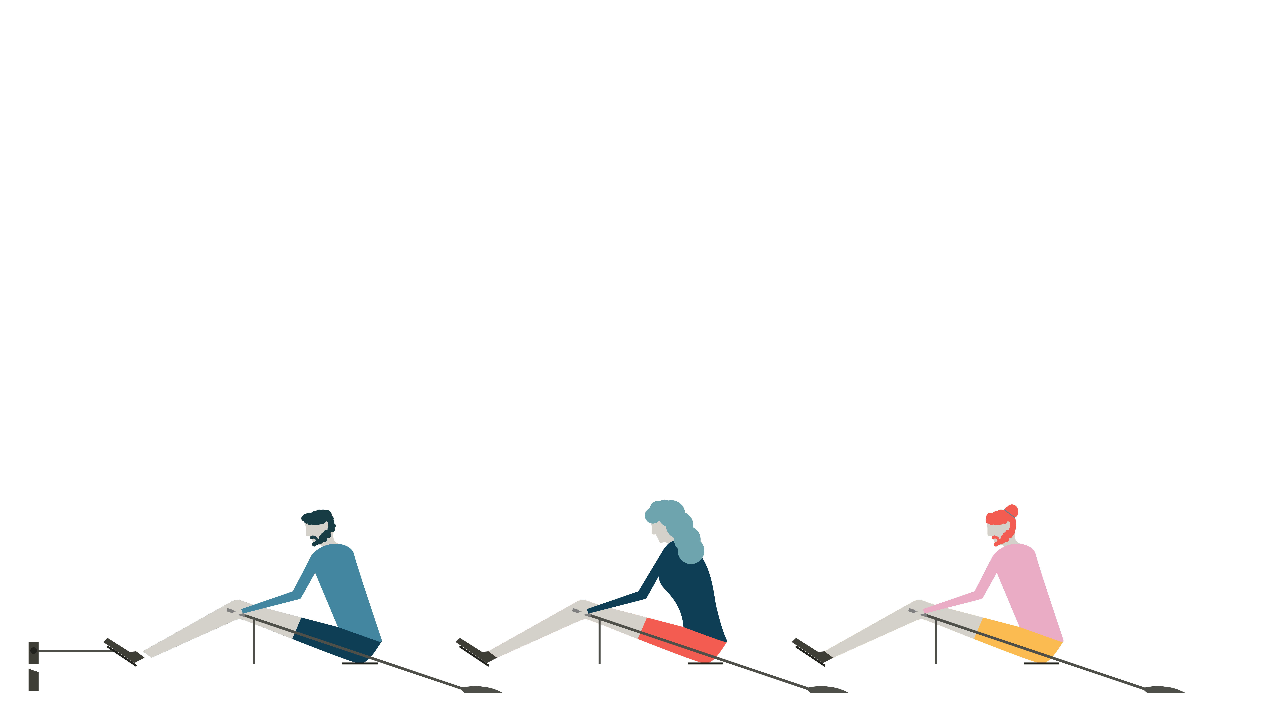
Introducing C-me
Individuals
Teams
Organisations
©2014 Colour Preferences Ltd | www.colour-profiling.com
Notes:
C-me is an independent company which has been operating for 8 years, specialising in behavioural profiling.
C-Me combines modern technology and psychometric insights to help:​
1. Individuals​
2. Teams​
3. Organisations perform at their best.
The profiles have been designed with application in mind. ​​
They are simple yet contain highly valuable information.
​

Slide 6






















©2014 Colour Preferences Ltd | www.colour-profiling.com
Notes:
C-me has a broad and rich pool of experience in different sectors including: (suggest highlighting those most relevant to your clients)
Education
Health & Fitness
Defence
Entertainment
Not-for-profit and FTSE 500 companies
Local schools and individuals.

Slide 7
Our Values
F
C-me is adaptable to meet the participant or organisation’s purposes, industry, and bespoke needs.
Flexible
A
The C-me method is underpinned by years of research, development work and practical learning.
Accurate
C
C-me makes all reports, workshops and communication simple and easy to understand.
Clear
E
The reports are quick to complete (just 10 minutes) and simple to understand.
Easy use
©2014 Colour Preferences Ltd | www.colour-profiling.com
Notes:
We suggest picking out the key features that will resonate with your clients.
​
​

Slide 8

Our Aims for this session
Lay a foundation for how C-me works
Provide a language for describing behavioural difference
Explore and discuss your C-me Profile
Apply learning to maximize personal performance and team dynamics
What are your aims?
©2014 Colour Preferences Ltd | www.colour-profiling.com
Notes:
Check these aims are appropriate for your clients and tailor if necessary.
Give space for participants to share their session aims in the chat.

Slide 9
Session Outline
Introduction to Colour and Behavioural Profiling
Brief history of psychometric testing
Understanding your profile
Effective communication
Personal and Team reflection
©2014 Colour Preferences Ltd | www.colour-profiling.com
Notes:
Remember to amend this slide if you adapt the session content.

Slide 10

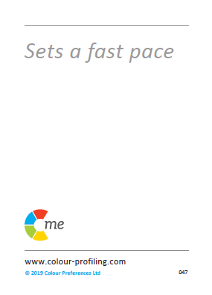
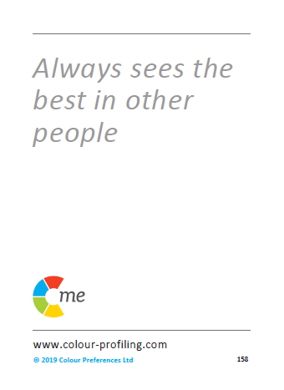
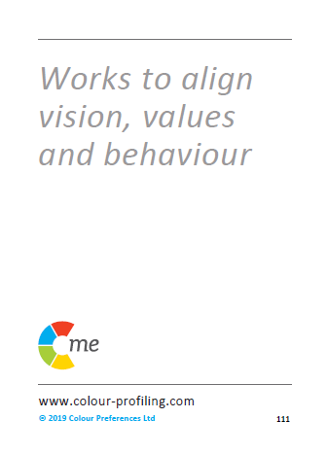
C-me virtual card game
©2014 Colour Preferences Ltd | www.colour-profiling.com
Notes:
N.B. Use the following slides ONLY if delivering remotely:
On this slide you will see the cards you can use if delivering in person (available to purchase direct from C-me).
On one side of the cards are statements and on the other side are colours.
TODAY we are playing the Card Game REMOTELY.
Refer to Accreditation Manual (Chapter 5) for ideas of alternative exercises.

Slide 11
C-me virtual card game
1.
2.
3.
4.
5.
6.
7.
8.
9.
10.
11.
12.
13.
14.
15.
16.
©2014 Colour Preferences Ltd | www.colour-profiling.com
Notes:
ACTION: Please recreate this grid on your paper, drawing three columns with the numbers 1-16 down the side in the first column.
N.B. Whilst your clients are drawing the grid, it’s helpful for you to draw the grid at the same time in order to get your pace right.

Slide 12
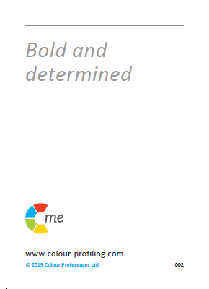
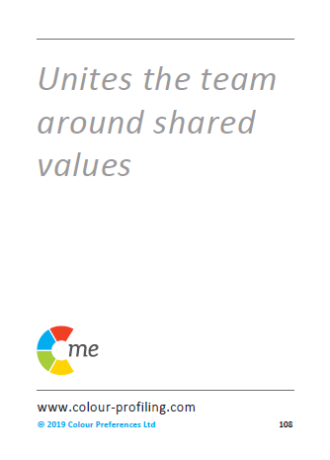

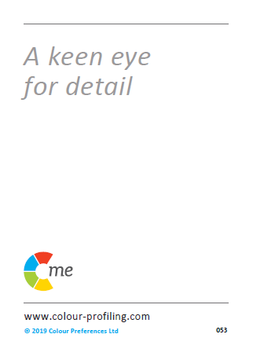
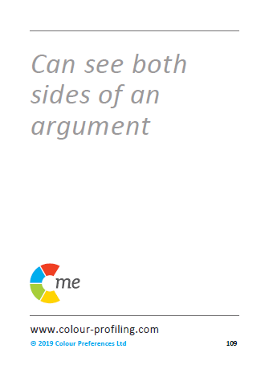
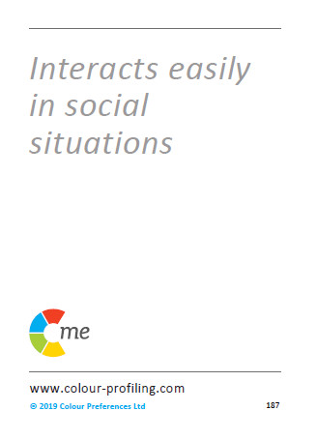
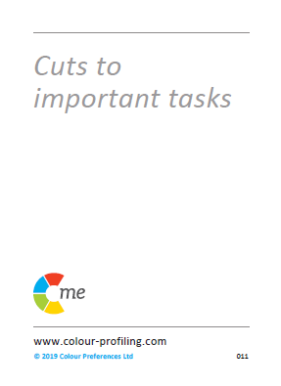

1.
2.
3.
4.
5.
6.
7.
8.
©2014 Colour Preferences Ltd | www.colour-profiling.com
Notes:
Read out the 16 statements (each one corresponds to a number from 1-16). New card appears after every ‘click’.
ACTION: If the statement on the card describes you, put a tick for ‘Yes’ in the second column next to the corresponding card number.
If not, put a cross for ‘No’.
Don’t think too much about the statements - just go with your gut response. This is just a game.

Slide 13
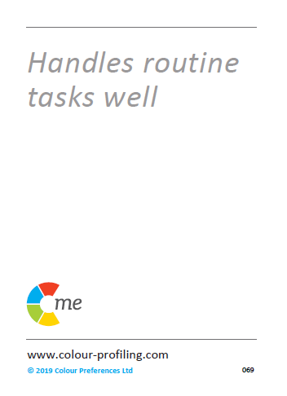
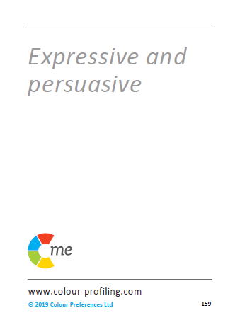
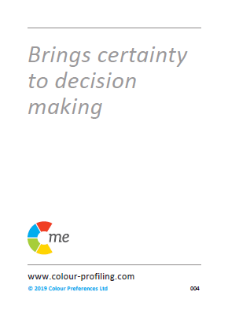

9.
10.
11.
12.
13.
14.
15.
16.
©2014 Colour Preferences Ltd | www.colour-profiling.com

Slide 14

C-me virtual card game
1.
2.
3.
4. | x
5. | x
6.
7.
8. | x
9. | x
10.
11.
12. | x
13.
14. | x
15. | x
16.
©2014 Colour Preferences Ltd | www.colour-profiling.com
Notes:
Part 1 is complete!
You should now have a table that looks something like this.
Now let’s complete the right-hand column.

Slide 15
1.
2.
3.
4.
5.
6.
7.
8.
©2014 Colour Preferences Ltd | www.colour-profiling.com
Notes:
Reveal the colour of each of the 16 cards one at a time.
ACTION: As I reveal the colours of the cards please write the first letter of the colour in the 3rd column, next to the corresponding card number e.g. R, Y, G, B

Slide 16
9.
10.
11.
12.
13.
14.
15.
16.
©2014 Colour Preferences Ltd | www.colour-profiling.com

Slide 17
C-me virtual card game
1. |  | Red
2. |  | Green
3. |  | Yellow
4. | x | Blue
5. | x | Green
6. |  | Yellow
7. |  | Red
8. | x | Blue
9. | x | Blue
10. |  | Yellow
11. |  | Yellow
12. | x | Red
13. |  | Red
14. | x | Blue
15. | x | Green
16. |  | Green
Total number of 'Yes' cards
Reds | 3
Yellows | 4
Greens | 2
Blues | 0
©2014 Colour Preferences Ltd | www.colour-profiling.com
Notes:
ACTION: Please add up the ticks (your 'yes' cards for each colour) and add the totals in the box like this on the right.
N.B. One of the great things about this game is it engages people into action before listening for too long. The idea is to start the session with energy and active learning.

Slide 18
C-me virtual card game
1?
2?
3?
4?
How many different colour cards have you ticked?
What do you think this tells us?
What are your top two colour cards?
©2014 Colour Preferences Ltd | www.colour-profiling.com
Notes:
How many different colour cards have you ticked? (4 x ’Click’ to reveal number options).
ACTION: in the chat, please list how many colours you have? 1,2,3, or 4?
‘What does this tell us?’ ….. There may be a preference but we are all a blend of more than one colour.
ACTION: In the chat, put your top 2 colours.
We’ll come back to this when we look at the Team Wheel to display our leading colours and how they interact.

Slide 19
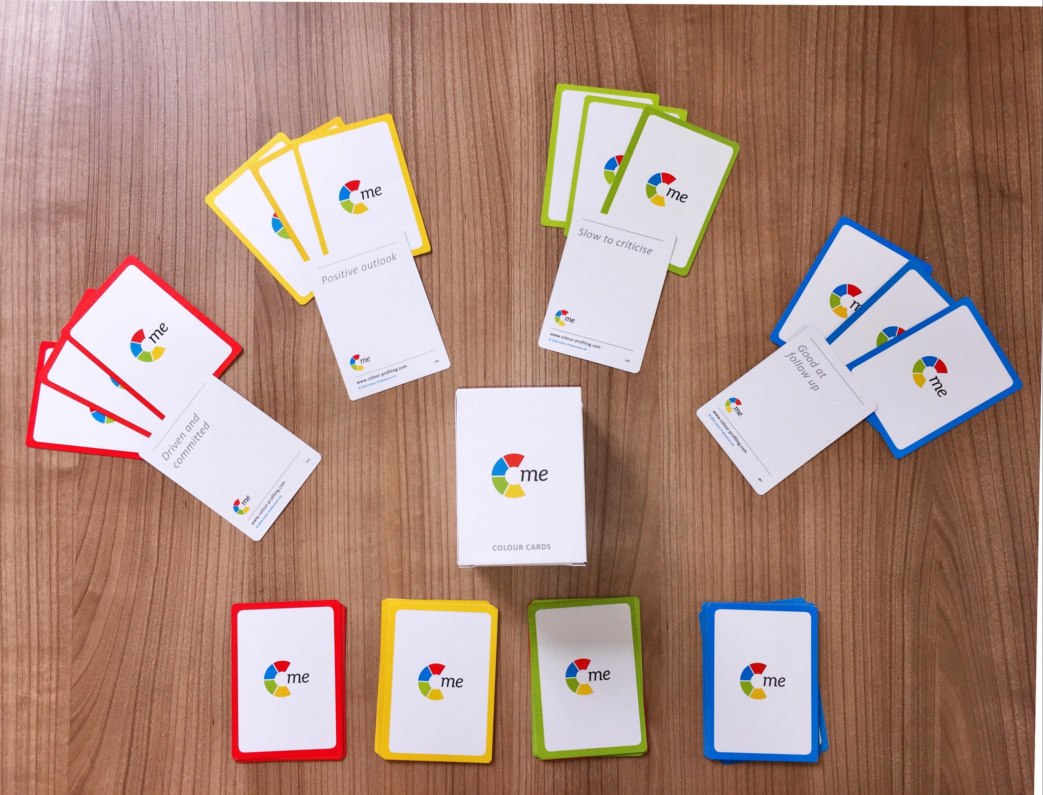
C-me card game
©2014 Colour Preferences Ltd | www.colour-profiling.com
Notes:
Have this slide on screen only if playing the Card Game face-to-face.
N.B. Refer to Accreditation Manual (Chapter 5) for ideas of alternative exercises.
FACE-TO-FACE CARD GAME INSTRUCTIONS – This game is also explained in your Accreditation Manual
Before your guests enter the room, create a pack of cards for each one of them with 4 of each of the colours cards e.g. 4 red, 4 yellow, 4 blue, 4 green (i.e. Total = 16 cards per person).
Shuffle the cards together and put them with statements face up, perhaps underneath their chair. One pack per person.
Before the workshop begins we recommend you delegate 4 corners or spaces in the room to the 4 colours in the following order: Yellow, Green, Blue, Red. (Perhaps put a visual of each colour in each corner as a reminder).
Within 90 seconds of the start of your workshop, ask your attendees to pick up their pack of cards and read the statements on the front.
Then make a pile of the statement cards they feel describe them and a pile of the cards they don’t feel describe them
or they aren’t sure of. Give them 1 minute to sort the pack into these two piles.
Ask them to leave the pile of ‘yes’ cards but pick up the pile of 'no' cards and then get them up on their feet and interacting together to try and give away their ‘no’ cards to others who do agree with those statements. Give them 3 minutes to do this.
Next ask your guests to combine their initial ‘yes’ cards and those they have accepted in the swap.
Instruct them to turn their cards over and count how many of each colour card they have.
Ask which colour they have the most of and then to go and stand in the matching colour corner in the room.
Starting with the yellow corner ask everyone in one colour group at a time to read their cards aloud to the rest of the group.
Ask the rest of the group to feedback what they are hearing about that colour – on a good day/bad day. Go round the room.
TYPICAL QUESTIONS AT THIS POINT:
What if people have even numbers of two colours? Ask them to go to the corner with the least number of people in.
Why yellow first? Often most willing to contribute. Highest energy group.

Slide 20

©2014 Colour Preferences Ltd | www.colour-profiling.com
Notes:
Briefly introduce the concept of the colour wheel (N.B. opportunity to return to this in more detail later in the workshop).
Blended colour wheel – it reflects that we flex our behaviours and move around the wheel. Colours blend, numbers and letters don't. This is a non-binary approach.
We have grouped similar behaviours by colour and then mapped these onto the colour Wheel.
N.B. The closer your position is to colleagues, the more behaviours you are likely to have in common.
N.B. The further you are from a colleague, the more you may differ in your perception of the "right" way to do things.
N.B. Those on the opposite side of the wheel may be more difficult to understand.

Slide 21

Good day/resilient strengths
  Energetic and enthusiastic
  Positive outlook
  Fast paced
  Sees the opportunities
  A real excitement for life
  Embraces change
  Sociable and outgoing
  Inspirational and visionary
  Not afraid to take risks
  Spontaneous and imaginative
On a bad day
  May miss details
  Can appear disorganised
  Jumps between ideas
  Can be idealistic and impractical
  Lax time management
  Everything to excess
  Inclined to talk too much
Notes:
LOOKING AT EACH COLOUR GROUP IN MORE DETAIL.
Read out the statements on the cards.
1st APPEAR: “Good day/resilient strengths” - we're not speaking of competence but more about a person’s “happy space” where they perform best, for longest.
ACTION: Please put in the chat some other words you would use to describe yellow preference behaviour on a good day.
N.B. Focus only on the positive things people write (this is a time to celebrate this colour energy).
Once you've acknowledged their response, reveal the list we have.
2nd APPEAR: We also all have “bad day behaviours”
ACTION: Again, in the chat, please list behaviours those with a yellow preference could display on a not-so-good day.
N.B. Keep an eye out for when people write 'leader' for any of the colours. This is the perfect opportunity to pick this up and say "that's an interesting observation, we'll address this in a minute". Later make the point that you can lead from any position on the wheel.

Slide 22
Good day/resilient strengths
  Respects others' values
  Supportive and loyal
  Builds consensus
  Generous
  Works for democratic solutions
  Tactful and diplomatic
  Dedicated to the team
  Considerate and attentive
  Tolerant and open-minded
  Reliable and dependable
On a bad day
  Appears to lack urgency
  Can be indecisive
  Often self-critical
  Procrastinates
  Slow to venture an option
  Difficulty setting priorities
  Constantly checking consensus
Notes:
Repeat exercise for GREEN preference behaviour:
Read out the statements on the cards.
1st ACTION: please put in the chat some other words you would use to describe green preference behaviour.
2nd ACTION: And on a bad day what might green preference behaviour display?

Slide 23
On a bad day
  Tends to over analyse
  May appear aloof
  Tends to point out the downside
  Obsessive about the detail
  Slow to trust
  Lacks spontaneity
  Constrained by the rules
Good day/resilient strengths
  Logical and analytical
  Enjoys problem solving
  Realistic
  Sets high standards
  Methodical and systematic
  Sorts out the details
  Strong sense of duty
  Structured and disciplined
  Focuses on details
  Considers all the facts
Notes:
Repeat exercise for BLUE preference behaviour:
Read out the statements on the cards.
1st ACTION: please put in the chat some other words you would use to describe blue preference behaviour.
2nd ACTION: And on a bad day what might blue preference behaviour display?

Slide 24
On a bad day
  Can be intolerant
  Can dominate discussion
  Too focused on results
  Overly competitive
  Can be dismissive of others’ views
  May not be listening
  Action overrides planning
Good day/resilient strengths
  Bold and determined
  Drives hard for delivery
  Focuses on results
  Decisive
  Powerful advocate
  Confident
  Enjoys stretching goals
  Brings clear direction
  Sets a winning mentality
  Direct and to the point
Notes:
Repeat exercise for RED preference behaviour:
Read out the statements on the cards.
1st ACTION: please put in the chat some other words you would use to describe red preference behaviour.
2nd ACTION: And on a bad day what might red preference behaviour display?

Slide 25
Leadership/Management
©2014 Colour Preferences Ltd | www.colour-profiling.com
Notes:
Discuss the different leadership qualities for each of the 4 colours.
Take this opportunity to explain that leadership influence can come from ANY colour combination (Dispel the myth that Red Colour Energy = Leadership)
What are the different leadership qualities for each of the 4 colours?
Opportunity to explore each colour or invite discussion.

Slide 26
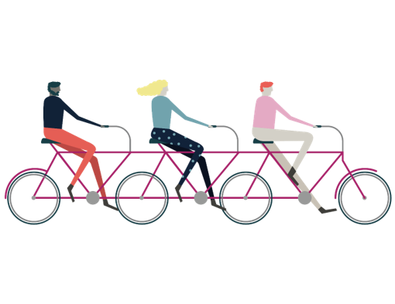
Guess the colour
©2014 Colour Preferences Ltd | www.colour-profiling.com
Notes:
We're going to have a go at reading the behavioural colours of other people, and we've just selected some well known celebrities to have a bit of fun with.
(N.B. Remember to hide the slides you don’t want to use – we suggest you pick 5 or 6).
(N.B. Opportunity to replace the celebrities given here with industry specific images most applicable to your clients).
Use 'chat' for responses if leading session remotely.
ACTION: Reveal Celeb photo and provide brief bio for those who are unfamiliar . Then reveal colours on second click.

Slide 27
Rishi Sunak
Chancellor
©2014 Colour Preferences Ltd | www.colour-profiling.com
Notes:
Rishi Sunak
British politician. Chancellor of the Exchequer since Dec 2020.
- Detailed, process driven, empathetic and connects well with public’s values.

Slide 28
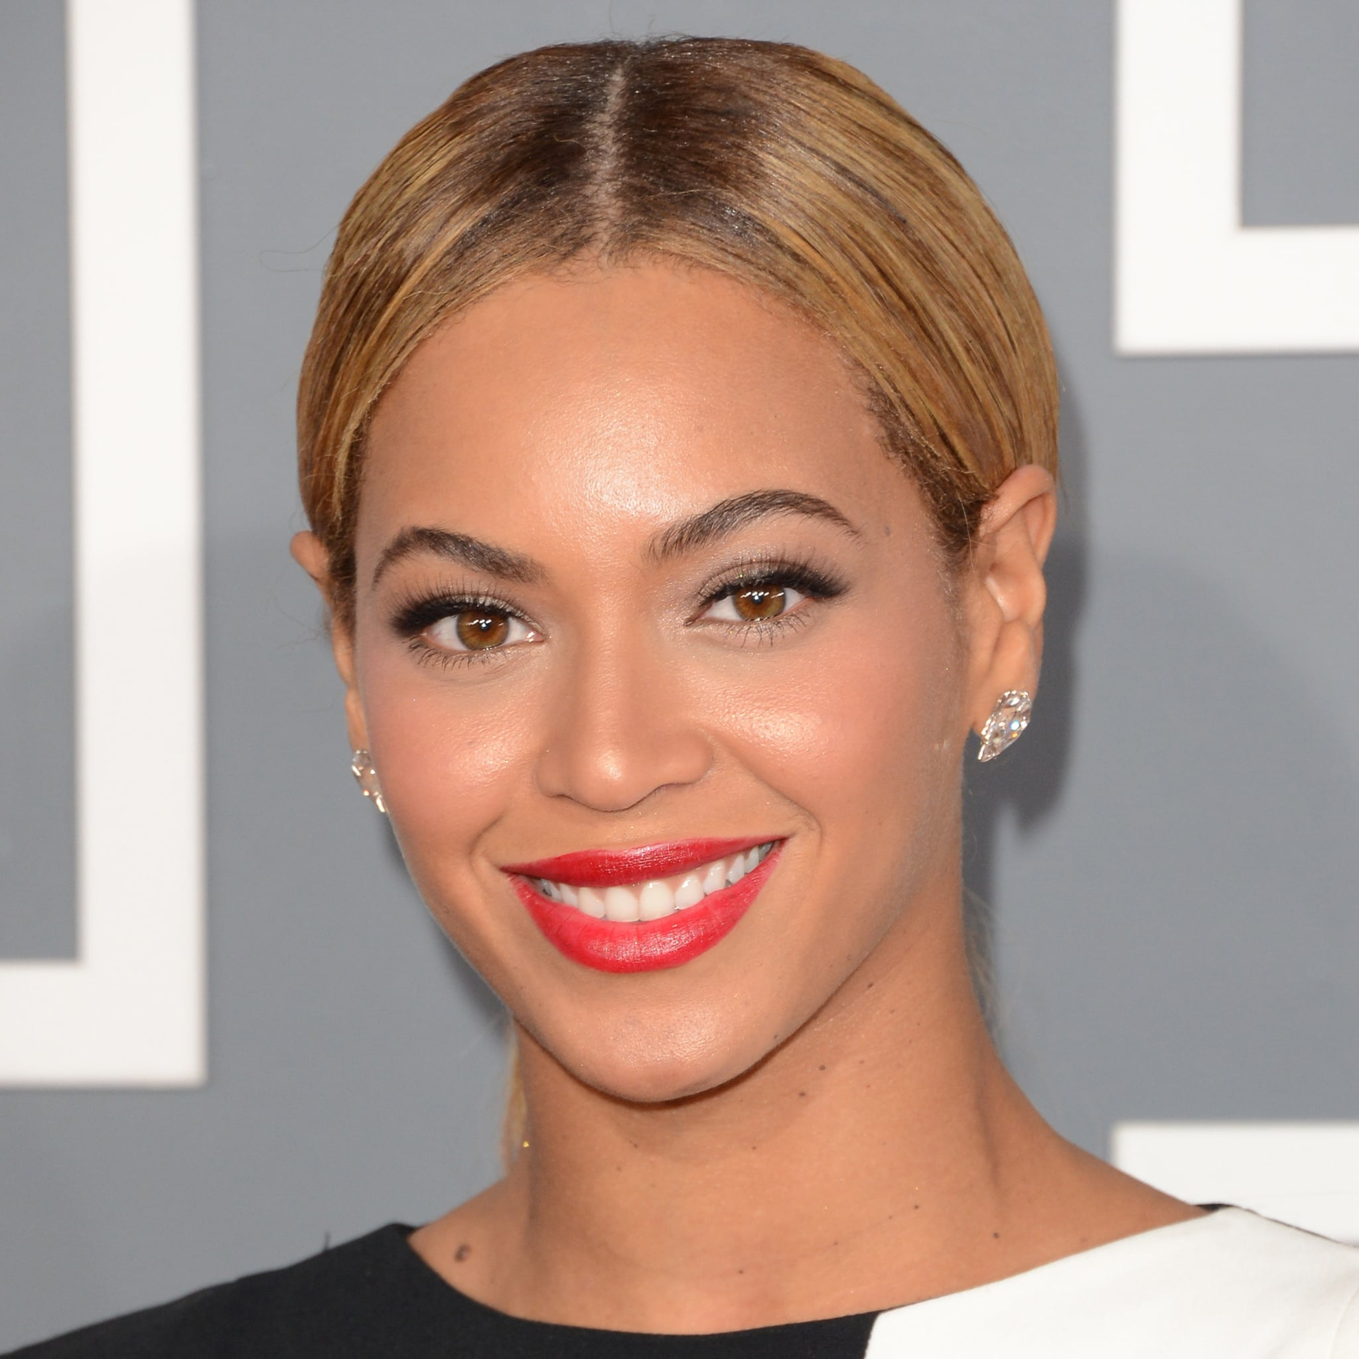
Beyoncé Knowles
Singer/Songwriter
©2014 Colour Preferences Ltd | www.colour-profiling.com
Notes:
Beyoncé Knowles
American Singer/Songwriter.
- Sociable, Visionary, Creative, Driven, Ambitious.

Slide 29
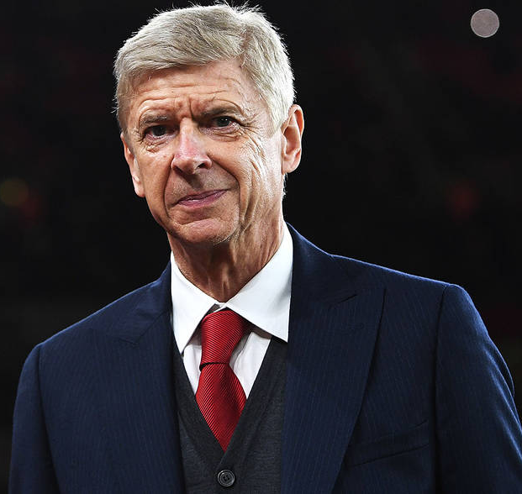
Arsène Wenger
FIFA’s Chief of Global Development
©2014 Colour Preferences Ltd | www.colour-profiling.com
Notes:
Arsène Wenger
Former Arsenal Manager/Now FIFA’s Chief of Global Development.
- Team Builder, Reflective, Detailed, Organised.

Slide 30
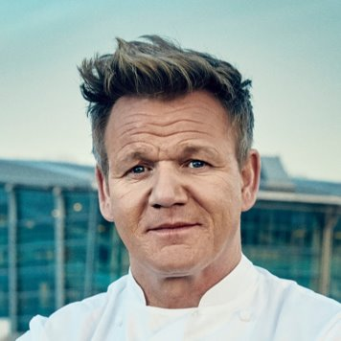
Gordan Ramsay
Chef
©2014 Colour Preferences Ltd | www.colour-profiling.com
Notes:
Gordon Ramsay
Cook and TV personality.
- Straight talking, direct, loud, likes his own advice, enthusiastic.

Slide 31
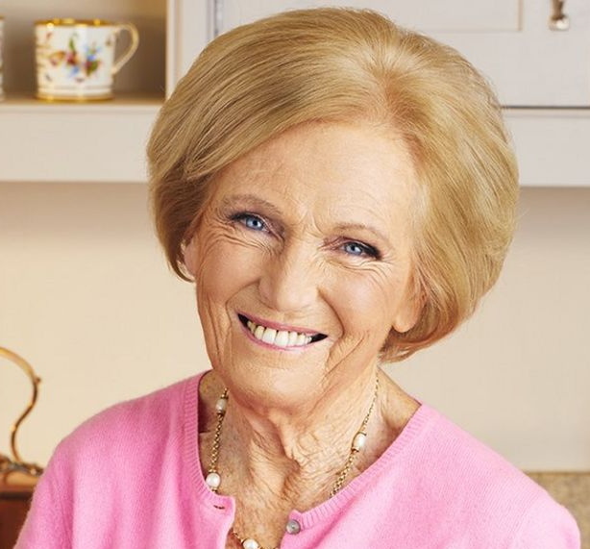
Mary Berry
Cook
©2014 Colour Preferences Ltd | www.colour-profiling.com
Notes:
Mary Berry
Cook and TV personality.
- Sociable, calm, gentle, methodical.

Slide 32
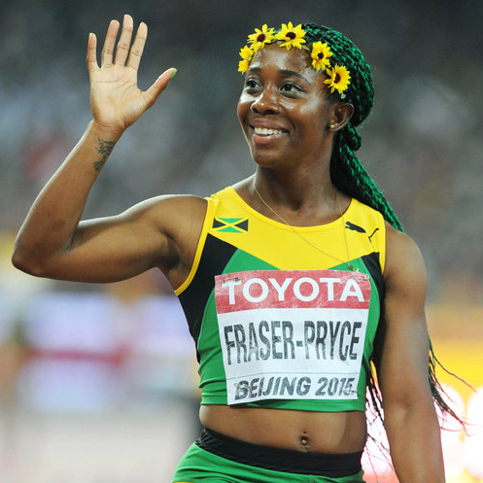
Shelly-Ann Fraser-Pryce
World Champion Athlete
©2014 Colour Preferences Ltd | www.colour-profiling.com
Notes:
Shelly-Ann Fraser-Pryce
Professional Athlete/2020 World Sprint Champion.
- Meticulous, purposeful, detailed prep (training/diet), driven, action orientated, winning mentality.

Slide 33
Ferrari
©2014 Colour Preferences Ltd | www.colour-profiling.com
Notes:
Ferrari
- Fast paced, driven, centre of attention, talk of the party, bold.

Slide 34
VW Camper Van
©2014 Colour Preferences Ltd | www.colour-profiling.com
Notes:
VW Camper Van
- Fun, free-spirited, adventurous, relational, slower pace.

Slide 35
Toyota Hybrid
©2014 Colour Preferences Ltd | www.colour-profiling.com
Notes:
Toyota Hybrid
- Environmentally friendly, family and business use, efficiency.

Slide 36
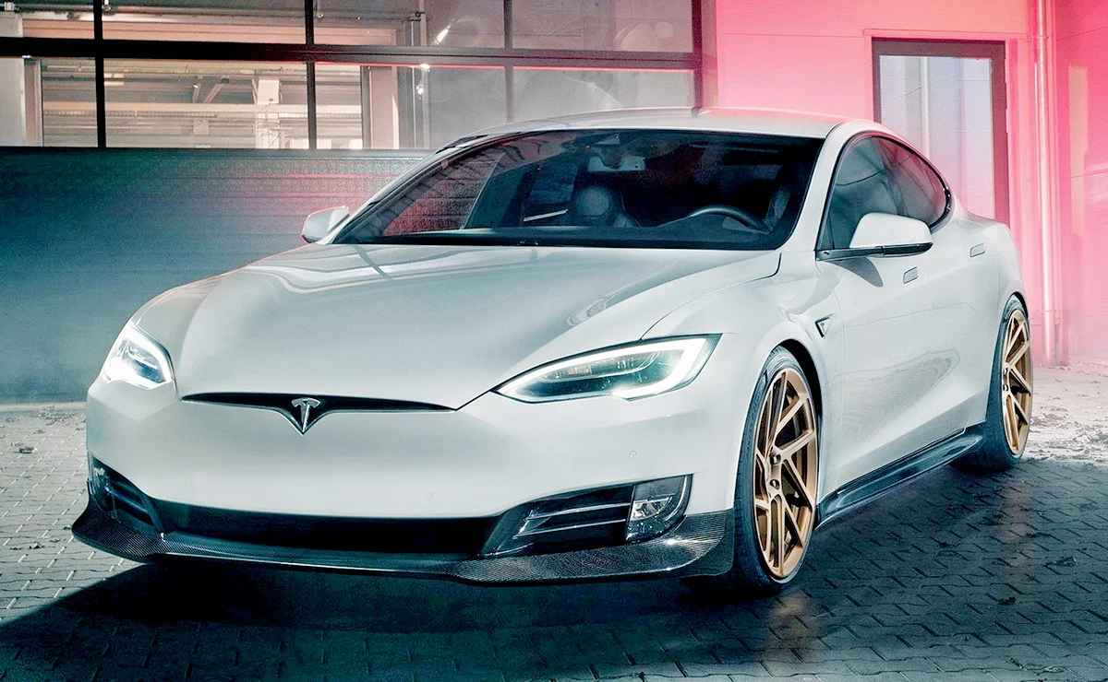
Tesla
©2014 Colour Preferences Ltd | www.colour-profiling.com
Notes:
Tesla
- Precision, detail in styling, efficient, fast paced, high performance.

Slide 37

Superman
©2014 Colour Preferences Ltd | www.colour-profiling.com
Notes:
Superman
- Strong, determined, action-focused, caring, thoughtful.

Slide 38

!
Smurf
©2014 Colour Preferences Ltd | www.colour-profiling.com
Notes:
Smurf
- Blue!

Slide 39
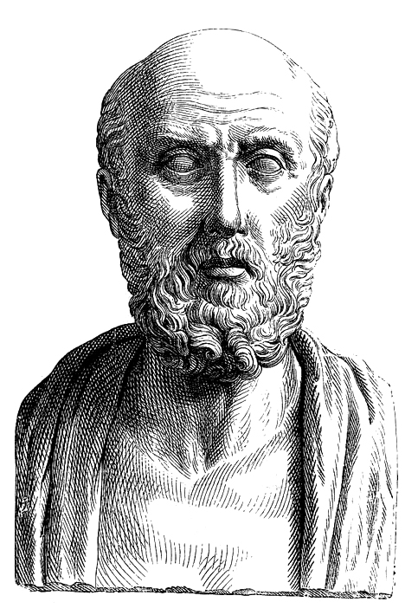

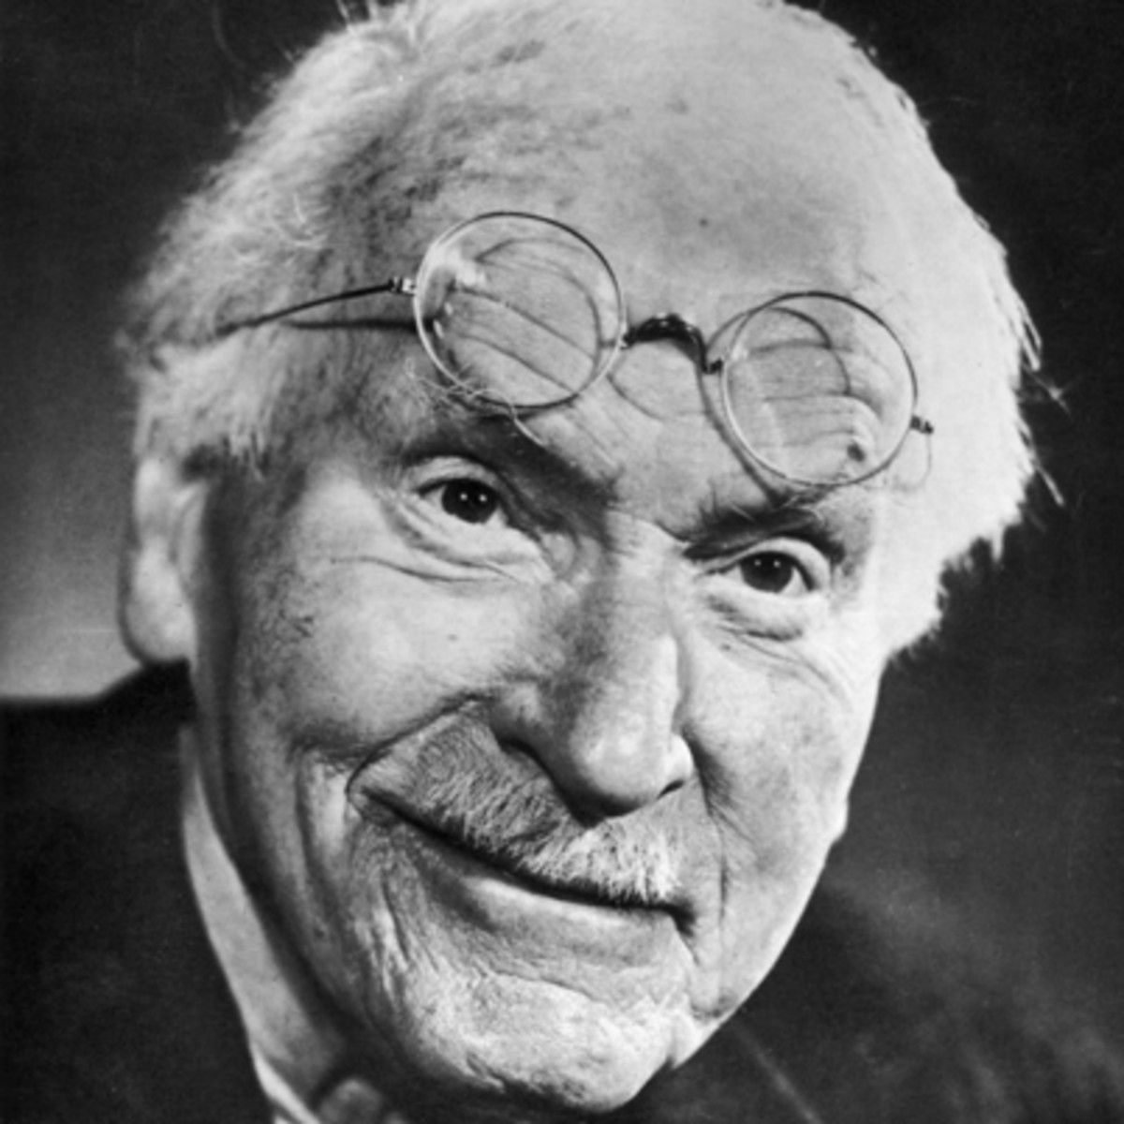
Key figures in the development
of psychometric testing
Hippocrates
500 BC
Jung
1923
2013
©2014 Colour Preferences Ltd | www.colour-profiling.com
Notes:
Key figures in the development of psychometric testing
(N.B. For more information, please refer to the Accreditation manual).
Throughout history it has been observed that there are differences between people and how we interpret these differences.
Hippocrates in 500BC (Greek physician)
- Identified 4 different types of people based on where they lived, which he believed would affect temperament and the body fluid and bile responses.
- Modern development: WHY we are different.
Carl Jung early 1900s (Swiss psychiatrist and psychoanalyst)
- Jung was key in developing analytic psychology (now referred to as Jungian analysis).
- Developed an axis of psychology (thinking/feeling) - this axis displayed behaviour as a scale rather than as absolutes.
C-me was founded in 2013
- Developed our own more accurate algorithm (based on database of 35,000+ statements).
- Removed labels and numbers.
- Developed reports that speak to observable behaviour which we can shape.
- Assess Conscious and Unconscious preferences.
Why colour? Colours blends, whereas words and numbers don’t. They can leave people feeling boxed.

Slide 40
Developmental history
underpinning C-me
Insights,
1993
2010
2013
Myers-Briggs (MBTI),
1962
Bonnstetter, 1984
Jung,
1923
Marston, 1928
led to DISC Personal profile system in 1994
Hippocrates,
500 BC
©2014 Colour Preferences Ltd | www.colour-profiling.com
Notes:
Developmental history underpinning C-me.
N.B. Either use this slide or the briefer previous one.
N.B. More information can be obtained from C-me if you wish to give a fuller explanation.
Throughout history it has been observed that there is difference between people and how we interpret these differences.
Hippocrates in 400BC (Greek physician)
- Identified 4 different types of people based on where they lived, which he believed would affect temperament and the body fluid and bile responses.
- Modern development: WHY we are different.
Carl Jung early 1900s (Swiss psychiatrist and psychoanalyst)
- Jung was key in developing analytic psychology (now referred to as Jungian analysis).
- Developed an axis of psychology (thinking/feeling), this axis displayed behaviour as a scale rather than as absolutes.
Marston 1928
- His work led to the Development of DISC analysis.
Myers-Briggs 1962
- 16 personality types represented in the MBTI grid.
Bonnstetter 1984 (American)
- First person to apply Colour Wheel to psychometric testing.
- Used profiling to increase business effectiveness.
Insights 1993
- Similar to C-me but assigns labelling.
- Unconscious graph is not as accurate.
C-me was founded in 2013
- Developed our own more accurate algorithm (based on database of 35,000 statements).
- Removed labels and numbers.
- Developed reports that speak to observable behaviour which we can shape.
- Assess Conscious and Unconscious preferences.
Why colour? Colours blends, whereas words and numbers don’t. They can leave people feeling boxed.

Slide 41
C-me and the Jungian axis
THINKING preference
Objective, Analytical, Task orientated, Strong minded
Subjective, Personal, Considerate, Involved, Relationship orientated, Accommodating
FEELING preference
©2014 Colour Preferences Ltd | www.colour-profiling.com
Notes:
Let's look at the axis C-me uses to represent Jungian psychology on the colour wheel - to give you clear understanding of how the colour wheel works.
HORIZONTAL AXIS: Looks at how we’re making our decisions and relate to different situations in life.
EXPLAIN THE SLIDE:
Top of wheel = THINKING PREFERENCE – ‘head’.
Bottom of wheel = FEELING PREFERENCE – ‘heart’.
(N.B. Chapter 5 of the Accreditation Manual provides further notes on the Jungian foundations of C-me).

Slide 42
C-me and the Jungian axis
Reflective preference
Extraverted preference
Observant
Inward focus
Depth
Thoughtful
Cautious
Action orientated
Outward focus
Breadth
Outspoken
Bold
©2014 Colour Preferences Ltd | www.colour-profiling.com
Notes:
VERTICAL AXIS: Looks at what energises us and how we process information.
EXPLAIN THE SLIDE:
Right side of wheel = EXTRAVERTED PREFERENCE.
Left side of wheel = REFLECTIVE PREFERENCE (N.B. Reflective (not introverted) – language changes and the meanings of words change in time. We have found that there aren’t as many negative associations with the word ‘reflective’ as there are with the word ‘introverted’ in our culture today.
N.B. Sometimes top & bottom/left & right are more obvious than someone’s colours, until you see their profile.

Slide 43
Impact on others
Behaviours
Personality
(values, beliefs)
©2014 Colour Preferences Ltd | www.colour-profiling.com
Notes:
Emphasize that C-me focus on BEHAVIOURS, not personality.

Slide 44
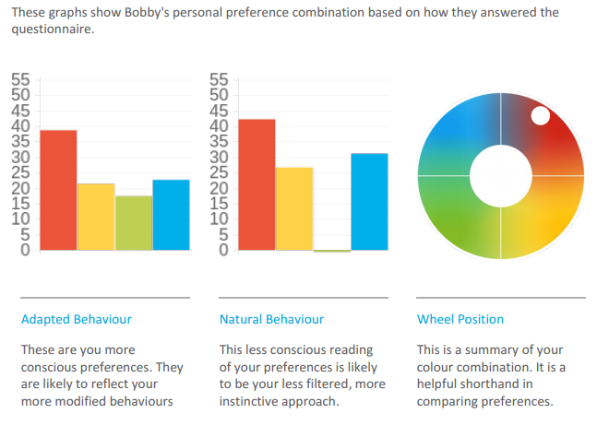
C-me Report Graphs
©2014 Colour Preferences Ltd | www.colour-profiling.com
Notes:
Brief Explanation of 3 graphs.
Adapted Behaviour
- Conscious graph.
How behaviours are adapted, modified in particular circumstances.
Metaphor: Like preparing yourself for a photo that the world will see #selfie.
Individual statements in profiles and Colour Wheel Position drawn from information from this Adapted graph.
A score of more than 23 is considered a resilient strength.
Natural Behaviour
- Less conscious graph.
Illustrating behaviours in situations of rest and stress.
Revert to type behaviour.
Metaphor: Like having a photo taken of you across the room #nofilter.
Less filtered behaviour.
A score of more than 23 is considered a resilient strength.
Wheel Position
Not boxing you but highlighting colour balance and resilient behavioural colours.
Based on Adapted Graph.
It would be too simplistic to say this individual has yellow preference energies only. Their second resilient colour preference is red. This is reflected by the position of the white dot on the wheel. It isn't just the first and second colours that influence the wheel position but all four colours.

Slide 45
C-me Report Graphs
Actual position
©2014 Colour Preferences Ltd | www.colour-profiling.com
Notes:
Our profiles are blends of all 4 colours.
Let's look at how the position on the wheel reflects the Adapted graph and our personal colour blend.
The second colour is the most important modifier.
ACTION: Reveal the dots.
Position 1 – clearly Yellow preference.
Position 2 – This person's top two colours are Yellow/Red. How might this influence their behaviours?
Position 3 - What about if this person's top two colours were Yellow/Green? How might this be reflected in their behaviours?

Slide 46
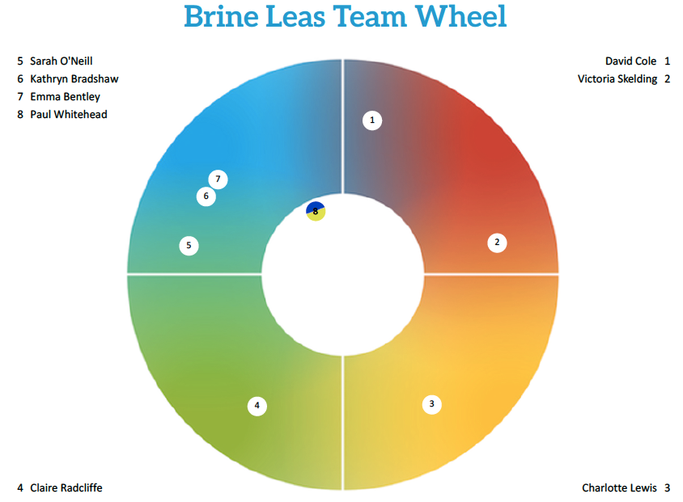
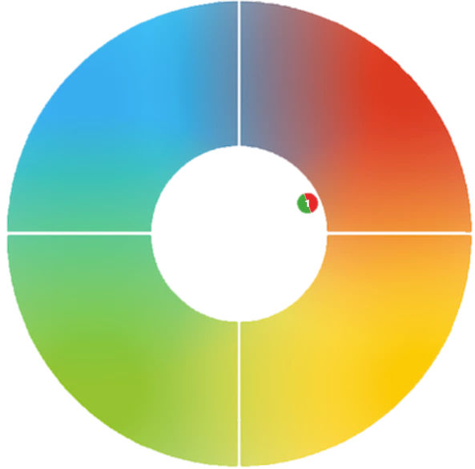
C-me Report Graphs
©2014 Colour Preferences Ltd | www.colour-profiling.com
Notes:
Within a colour quadrant, the position relative to the center of ther Colour Wheel denotes how many colours are particularly strong on your Adapted Graph
Position 1 (outside of Colour Wheel) = 1 colour high
Position 2 (middle of Colour Wheel) = 2 colour high
Position 3 (inside of Colour Wheel) = 3 colour high
A colour is considered high and therefore a resilient strength when it is over 23.
Position 4 (Cross Type) = top two colours are psychological opposites
Position 5 (Different Cross Type)
And explain that the colours can be reversed. Blue-Yellow Cross Type might be a Yellow-Blue (depending on strongest colour)
Cross Types
Normally, a person’s top 2 colours will be 2 adjacent colour quadrants on the colour wheel e.g. Red/Blue or Green/Blue.
For around 8% of the population, their top two colours are on opposite sides of the Colour Wheel e.g. Red/Green or Blue/Yellow.
On this slide, you can see how a Red/Green Cross Type is represented. Their positional dot is coloured half red, half green. It is then placed next to the Red quadrant to indicate that red is the top colour.
Cross types have the ability to switch between opposite colours with great ease.
More information can be found in the Accreditation Manual, Section 4.

Slide 47

Resilient Strengths
Realistic
Focuses on details
Considers all the facts
Strong work ethic
Brings clarity to complexity
Gets the facts in place
Sticks to principles
Bold and determined
Drives hard for delivery
Plays to win
Focuses on results
Decisive
Powerful advocate
Enjoys a challenge
Tactful and diplomatic
Dedicated to the team
Works until the job is done
Kind and considerate
Tolerant and open-minded
Can see both sides
Steady and reliable
Energetic and enthusiastic
Positive outlook
Embraces change
Social and outgoing
Generous and open-minded
A real zest for life
Sees the bright side
©2014 Colour Preferences Ltd | www.colour-profiling.com
Notes:
This is a particularly important slide to dwell on if there is a value judgement being made in an organisation, against one/some of the colours.
Example: A Heavily dominant engineering orientated company that values blue behavioural preference but not yellow behavioural preference.
Key Question: What happens if we have no yellow preference?
Let them do the thinking: perhaps there might be no innovation … we might not grow …
Let’s take a moment to look at the resilient strengths and development areas of each colour – remember we’re looking at resilience not competence.
Resilience = where we perform at our best and for the longest time given any task.
Not about what we’re good at but what gives us life and energy.
You may be very good at things that are our lowest colour but it might drain you to do it.
Example: Someone who is good at detailed, systematic administrative tasks but when their energy is low, planning goes out the window, details are missed and balls are dropped. Competence is high but resilience is low.
Colour does give us clues as to where we gather energy, so if we’re in a role that demands our lowest colour we need to look at how to structure our day in practical ways to work effectively for longer.

Slide 48
Areas for Development
Emotionally detached
Hypercritical
Obsessive about the detail
Slow to trust
Undemonstrative
Lacks spontaneity
Constrained by the rules
Only results matter
Can be controlling
Rocks the boat
Short fuse
Not diplomatic
May not be listening
Action overrides planning
Appears to lack urgency
Can be indecisive
Often self-critical
Procrastinates
Reluctant to change
Setting priorities is difficult
Constantly checking consensus
Energetic and enthusiastic
Can appear disorganised
Jumps between ideas
All talk no action
Lax time management
Everything to excess
Inclined to talk too much
©2014 Colour Preferences Ltd | www.colour-profiling.com
Notes:
Good slide if you're looking to coach observable behaviours to help your clients grow.
These are the bad day behaviours where colour preferences are naturally weaker.
Think of it like weight lifting, some muscles take some working out to get stronger.
So it’s not that you can’t operate out of all the other colour strengths but just that you may need training.
C-me’s selling point as a tool is that it’s looking at observable behaviours, it’s not challenging people’s values or beliefs but what behaviours someone is choosing to display and adapt in their context. It is easier to coach and adapt behaviour than personality.

Slide 49
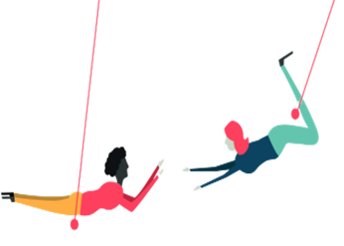
BREAK
©2014 Colour Preferences Ltd | www.colour-profiling.com
Notes:
PAIRS/GROUP EXERCISE as per the slide.
Last bullet point: We would normally suggest allowing 5 minutes for this sharing time.

Slide 50
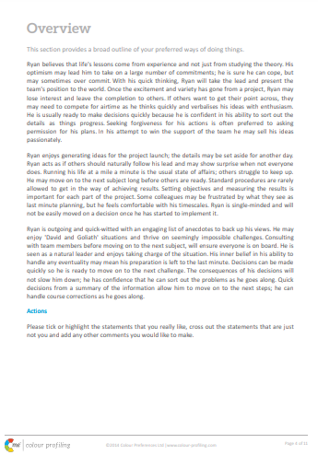
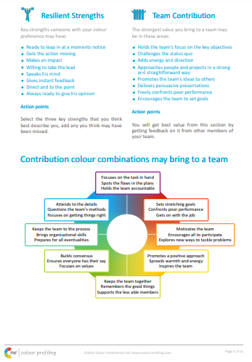
Your Profile: Exercise 1
  On your own: EXPLORE – FILTER – SHARE
  Read through pages X & Y of your profile
  Select 3 statements which standout from each section
  What % accuracy would you give your report?
  Which of your colours have a score of 23+ on your Adapted graph?
  Please come back ready to share
©2014 Colour Preferences Ltd | www.colour-profiling.com
Notes:
For this exercise, you have options to focus on Overview/Resilient Strengths/Team Contribution sections of the reports – please choose as appropriate.
Opportunity for some personal reflection.
Ensure questions are relevant to the report that the client has used.
Ensure pages correspond to report used.
Outline principle of: EXPLORE FILTER SHARE
ACTION: In the chat can you write down what initial % accuracy this report has for you?
…………………………………
Speak to the percentages they write:
We are regularly getting 80-85% accuracy as a norm. (And continually increasing our statement database to further improve accuracy).
IF LOWER THAN 70%
We suggest people work with the reports for a few months and see how accurate it is in context and with feedback from colleagues.
IF LOWER THAN 60%: possible reasons for this:
in a rush,
thinking of another context,
going through a big time of change (try again after change has taken place)
second guessing how to answer,
getting the scale wrong etc.

Slide 51
Exercise 2
In Pairs/Groups:
  Introduce yourself
  Share and discuss the 3 statements from each section
What did you learn?
©2014 Colour Preferences Ltd | www.colour-profiling.com
Notes:
PAIRS/GROUP EXERCISE as per the slide.
Last bullet point: We would normally suggest allowing 5 minutes for this sharing time.

Slide 52
Communication
Miscommunication leads to:
Lost sales
(18%)
Missed performance goals
(25%)
Low morale
(31%)
Delay in completion of projects
(44%)
Higher stress levels
(52%)
The Economist Intelligence Unit 2018
©2014 Colour Preferences Ltd | www.colour-profiling.com
Notes:
Economist Group - provide forecasting and advisory services through research and analysis.
Recent research on communications
500 senior leaders
Key findings:
1. Effective communication has tremendous impact in the workplace
2. Different communication styles have a profound impact on communication

Slide 53
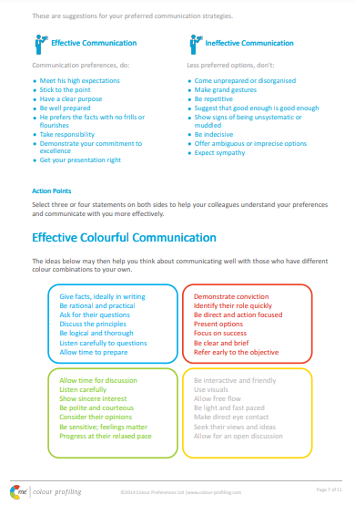
Communication: Exercise 3
  Turn to page X
  Select 2 effective ways for people to communicate best with you
  Select 2 ineffective ways for people to communicate with you
  What did you learn? Share and discuss
©2014 Colour Preferences Ltd | www.colour-profiling.com
Notes:
Opportunity to share and learn about other people’s Communication Preferences.

Slide 54



Effective communication within teams
Name | C’s | Do | Don’t
Jonny |  | Get people involved Value his opinion Direct eye contact | Make him follow process Return to the rule book Restrict free flowing ideas
Sally |  | Provide detail Be polite Keep timescale relaxed | Be overly competitive Stick coldly to the task Give vague instructions
Fred |  | Present options Ask their advice Stick to matter in hand | Show frustration Focus on personal issues Delay conclusions
©2014 Colour Preferences Ltd | www.colour-profiling.com
Notes:
Illustrate how teams can be proactive in being more effective in Communications.
Encourage the team to produce a similar grid for themselves, to develop even better communication between them.

Slide 55
Effective Colour Communication
Give facts, ideally in writing
Be rational and practical
Ask for their questions
Define the process
Be logical and thorough
Listen carefully to questions
Allow time to prepare
Demonstrate conviction
Identify their role quickly
Be direct and action-focused
Present options
Focus on success
Be brief and clear
Refer early to the objective
Exercise 4
Identify your lowest 2 colours
Pick 2 or 3 bullet points from these colours that you want to try to put into practice
Allow time for discussion
Be patient and sincere
Show genuine interest
Be generous
Be polite and courteous
Consider their opinions
Progress at their relaxed pace
Be interactive and friendly
Use visuals
Make it fun
Be light and fast paced
Make direct eye contact
Seek their views and ideas
Allow for an open discussion
©2014 Colour Preferences Ltd | www.colour-profiling.com
Notes:
Effective Colour Communication
Identify your lowest 2 colours. Be aware that these will be other people’s highest colours. You will therefore need to flex your approach in order to communicate more effectively with them.
Pick 2 or 3 specific bullet points from your lowest colour that you want to try to put into practice.

Slide 56
Ineffective Colour Communication
Interrupting their thinking
Being unrealistic
Leaving things unfinished
Being flippant
Straying from the agenda
Skipping over the facts
Poorly evidenced conclusions
Impatience
Belittling accomplishments
Procrastination
Attempts to direct or overpower them
Focusing on too much detail
Slowing down the pace
Repetition
Exercise 5
Identifying your lowest colour
What statements might help you avoid ineffective communication with others?
Expecting an instant decision
Being abrupt
Open criticism
Ruining team harmony
Being overly competitive
Talking over them
Rushing them
Preventing them dreaming
Cutting them off mid-flow
Restraining their ideas
Overwhelming with detail
Assuming they’re listening
Forcing them to follow process
Expected adherence to rigid timescales
©2014 Colour Preferences Ltd | www.colour-profiling.com
Notes:
Ineffective Colour Communication
Again, looking at the same colour, identify two or three specific statements that you may need to avoid in order to communicate effectively with people of that colour preference.

Slide 57

Communicating to Influence
Exercise 6
Selling Staff Party Tickets
Practice communicating in your lowest colour preference
(1 minute each)
What did you learn?
©2014 Colour Preferences Ltd | www.colour-profiling.com
Notes:
Refer to Accreditation Manual (Chapter 5) for ideas of alternative exercises.
Provide demonstration.
Role play: live or in Breakout Rooms (if remote workshop).
2nd click - FEEDBACK: What did you learn? How easy/hard did you find flexing?

Slide 58
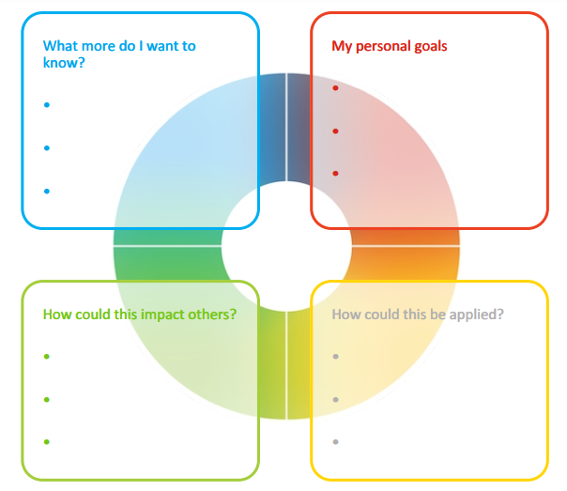
Personal Reflection
Each colour has a different perspective on the focus for action.
Consider all 4 colours to reflect on what you have learnt today.
What do you want to commit to Stop, Start and Continue?
©2014 Colour Preferences Ltd | www.colour-profiling.com
Notes:
Opportunity for PERSONAL and TEAM Reflection – vital to help embed the learning from this workshop
Encouragement to reflect on behaviours through the lens of all 4 colours (Whilst we have a behavioural preference, we are all a blend of all 4 colours) for Action Plans that are more thorough.
STOP/START/CONTINUE: a helpful structure for reflection. What will you Start doing? Stop doing? Continue doing?

Slide 59
Team Reflection
Reflect on what you have learnt today through the lens of all 4 colours.
As a team, what do you want to
Insert Team Wheel here
Stop?
Start?
Continue?
©2014 Colour Preferences Ltd | www.colour-profiling.com
Notes:
Opportunity for TEAM Reflection – vital to help embed the learning from this workshop in a collective way.
Encouragement to reflect on team group behaviours through the lens of all 4 colours (whilst we have a behavioural preference, we are all a blend of all 4 colours).
STOP/START/CONTINUE: a helpful structure for reflection.

Slide 60




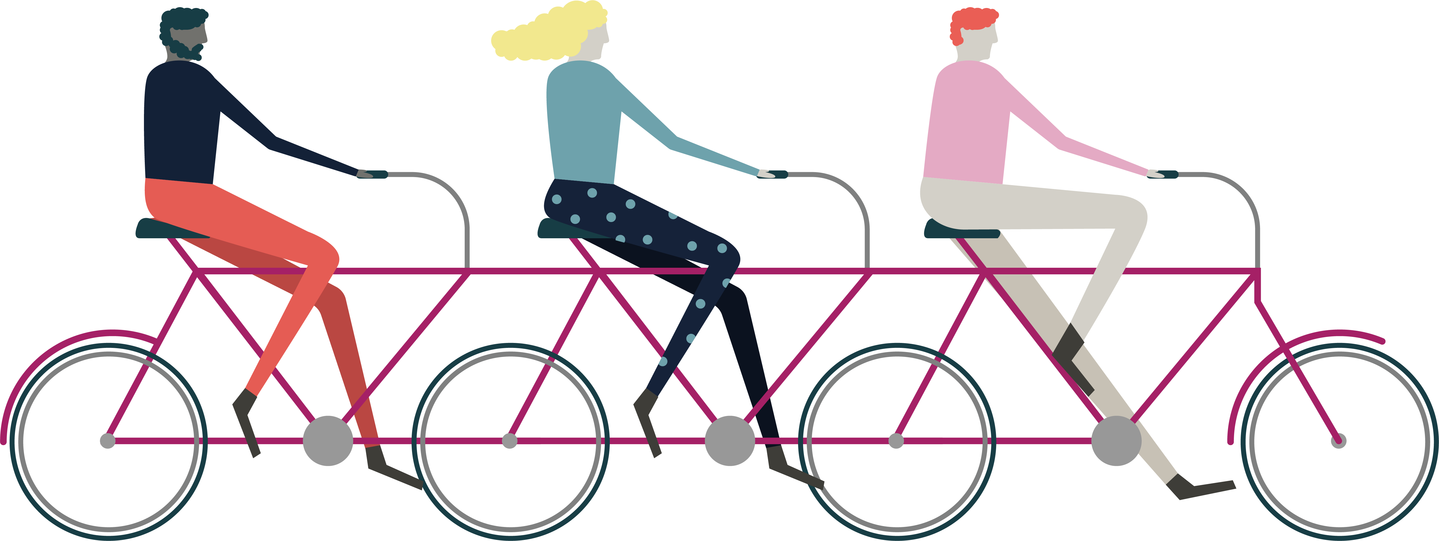

Thank you and please stay in touch!
Colour-profiling.com
@colourprofiling
@cmeprofiling
Cmecolourprofiling
@C-me Colour Profiling
©2014 Colour Preferences Ltd | www.colour-profiling.com
Notes:
Opportunity to thank your guests!
Please add in your own contact details if you want to.

