Slide 1



Welcome to your
Activator Slides
Part 2
Behaviour profiling to help you, your team or organisation harness natural talent and build long-term success.
Notes:
WELCOME EVERYONE ON GRID VIEW.
START THE ENERGY AND INTERACTION GETTING THEM TO SHARE SOMETHING LIKE WHAT THEY HAD FOR BREAKFAST?
WHAT THEY DID LAST NIGHT ETC.?
We are looking forward to our time together today.
I think you’re going to have some ah-ha moments today.
And go away with your own personal reflections and how you can bring impact and breakthrough moments to your clients.
ENCOURAGE THEM ON ANYTHING ELSE YOU SAW HAPPEN PREVIOUSLY.

Slide 2


Guess the colour
Notes:
SELECT 4 OF THESE OPTIONS FOR YOUR WORKSHOP
A fun game designed to apply what your clients have learned so far.
We have come up with a range of celebrities we hope most people will know, and who we think show a range of different colour combinations.
You could choose any character/celebrity or even car brands.
Could be industry specific.
ACTION: Using the chat box ask people to write in what top 2 colours they think each celebrity displays. If they’ve never heard of the celebrity ask them to have a guess based on the description given.
Then reveal what you think.

Slide 3
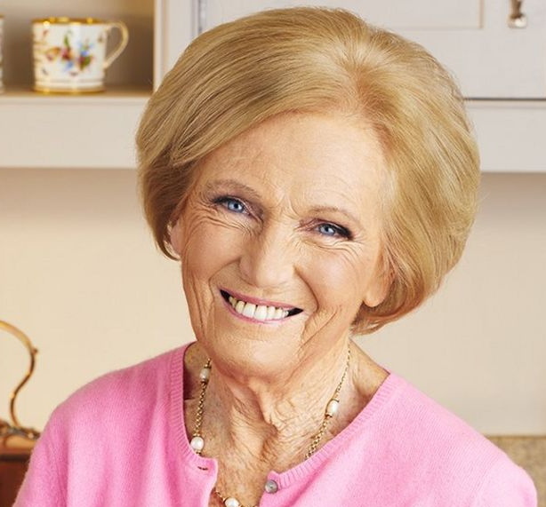
Mary Berry
Cook
Notes:
Mary Berry
Cook and TV personality
- Sociable/calm/gentle/methodical

Slide 4
Rishi Sunak
Chancellor
Notes:
Rishi Sunak
British politician. Chancellor of the Exchequer since Dec 2020
- Detailed, process driven, likeable, creative

Slide 5

Gordan Ramsay
Chef
Notes:
Gordon Ramsay
Cook and TV personality
- Straight talking, direct, loud, likes his own advice, enthusiastic

Slide 6
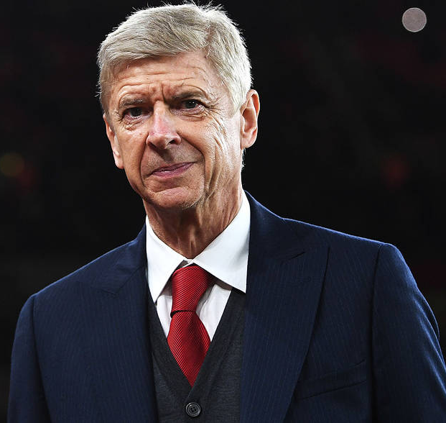
Arsène Wenger
FIFA’s Chief of Global Development
Notes:
Arsène Wenger
Former Arsenal Manager/Now FIFA’s Chief of Global Development
- Team builder, reflective, detailed, organised

Slide 7

Michelle Obama
Former First Lady
Notes:
Michelle Obama
Former First Lady to Barak Obama
- Confident, driven, visionary, compassionate, advocate

Slide 8

Shelly-Ann Fraser-Pryce
World Champion Athlete
Notes:
Shelly-Ann Fraser-Pryce
Professional Athlete/2020 World Sprint Champion.
- Meticulous, purposeful, detailed prep (training/diet), driven, action orientated, winning mentality.

Slide 9
Ferrari
Notes:
Ferrari
- Fast paced, driven, centre of attention, talk of the party, bold.

Slide 10
VW Camper Van
Notes:
VW Camper Van
- Fun, free-spirited, adventurous, relational, slower pace

Slide 11
Toyota Hybrid
Notes:
Toyota Hybrid
- Environmentally friendly, family and business use, efficiency

Slide 12

Tesla
Notes:
Tesla
- Precision, detail in styling, efficient, fast paced, high performance

Slide 13

Session 3
Exploring your report:
Explore, Filter, Share
Stop, Start, Continue
Notes:
Introduce them to Explore, Filter, Share coaching model:
Explore the report
Filter what resonates most and re-word phrases to tailor the report to you
Share with others in order to understand differences and increase self reflection
This fits really well for personal development plans - looking at what your client wants to
Stop
Start
Continue

Slide 14
Reflection Exercise: Explore, Filter, Share
What % of accuracy?
Breakout room in pairs (15 mins):
  Share 3 Resilient Strengths
  Share 3 Team Contributions
  Share 3 Areas for Development
  Stop – Start – Continue?
  What was valuable about this exercise and what did you learn?
Notes:
You have now explored and filtered part of your report.
1st APPEAR:
ACTION: Before we go into Breakout Rooms, please share the % accuracy of your report in the chat box/out loud.
SPEAK IN TO LEVELS OF ACCURACY:
C-me regularly get 80-85% accuracy as a norm. C-me are always working on this, increasing their statement database.
IF SOMEONE SAYS THAT THEY HAVE A LOWER RESONANCE LEVEL THAN 70%.
We suggest people work with the reports for a few months and see how accurate it is in context and with feedback from colleagues.
IF LOWER THAN 60% LIST POSSIBLE REASONS FOR THIS –
In a rush,
Thinking of another context,
Going through a big time of change (try again after change has taken place),
Second guessing how to answer,
Getting the scale wrong etc.
2nd APPEAR:
You’re now going to share in Breakout Rooms what statements you resonated with.
3 Resilient Strengths: What are the strengths that you would like to use more?
3 Team Contributions: What are the strengths your team needs you to bring at the moment in your role?
3 Areas for Development you want to work on.
SEND IN TO BREAKOUT ROOMS FOR 15mins IN PAIRS.
3rd APPEAR: REFLECTION TIME.
How valuable was that exercise for you?
What have you learned?

Slide 15
What’s in your report?
Overview
Resilient Strengths
Team Contribution
Areas for Development
Blind Spots
Effective Communication
Ineffective Communication
Productive Remote Working
Remote Working Challenges
Enabling Engagement
Role Agility
Ways of Handling Setbacks
Managing Stress
Notes:
Sections included in the High Performance Report.

Slide 16
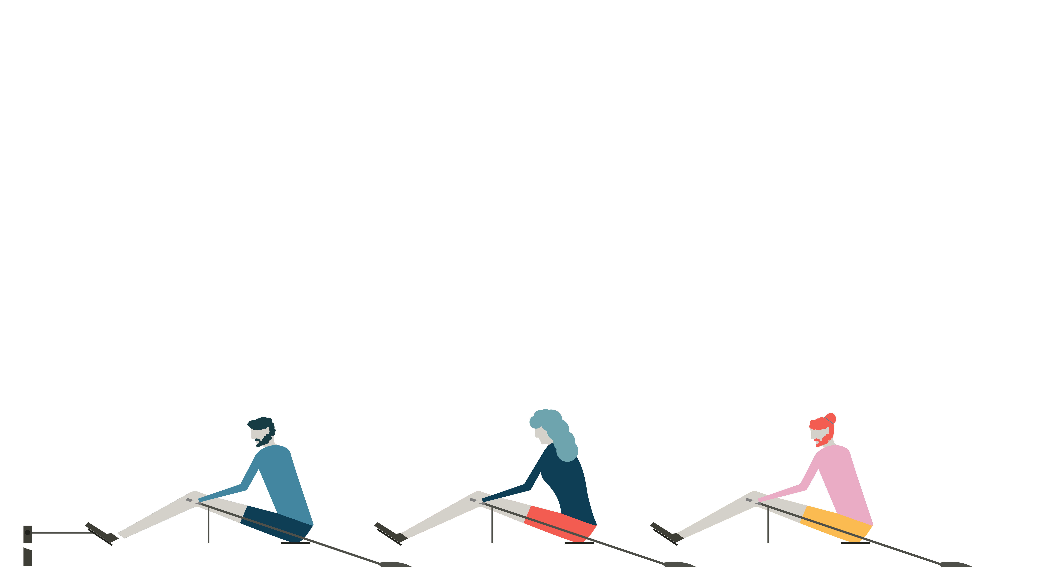
Communication
Miscommunication leads to:
Lost sales
(18%)
Missed performance goals
(25%)
Low morale
(31%)
Delay in completion of projects
(44%)
Higher stress levels
(52%)
The Economist Intelligence Unit 2018
Notes:
Introduce this slide however you feel it’s appropriate.
Economist Group - provide forecasting and advisory services through research and analysis.
Recent research on communications (Conducted in 2018)
500 senior leaders
Key findings: What they found was miscommunication leads to:
Tremendous impact in the workplace
Causes a communications barrier…. Different communication styles need to be appreciated to bridge the barrier
There is a stark difference between the most effective communication tools and the ones people actually use.
BULLET POINTS REVEALED ONE AT A TIME
ACTION: In the chat box please write what % impact you think each of the factors I’m about to read out had on lost leads.

Slide 17
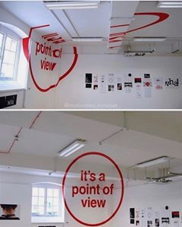
Viewpoint
Notes:
POSSIBLE SLIDE TO USE IF YOU HAVE TIME:
Perspective is everything.

Slide 18

Effective Colour Communication
Give facts, ideally in writing
Be rational and practical
Ask for their questions
Define the process
Be logical and thorough
Listen carefully to questions
Allow time to prepare
Demonstrate conviction
Identify their role quickly
Be direct and action-focused
Present options
Focus on success
Be brief and clear
Refer early to the objective
Allow time for discussion
Be patient and sincere
Show genuine interest
Be generous
Be polite and courteous
Consider their opinions
Progress at their relaxed pace
Be interactive and friendly
Use visuals
Make it fun
Be light and fast paced
Make direct eye contact
Seek their views and ideas
Allow for an open discussion
Notes:
Effective Colour Communication
You may need these slides handy if you are running a workshop for people to refer to during exercises.
Colours have an influence both on what we do say but also on what we don’t say.
ACTION:
Identify your lowest 2 colours. Be aware that these will be other people’s highest colours. You may therefore need to flex your approach in order to communicate more effectively with them.
Pick 2/3 specific bullet points from your lowest colour that you want to try to put into practice.

Slide 19
Ineffective Colour Communication
Interrupting their thinking
Being unrealistic
Leaving things unfinished
Being flippant
Straying from the agenda
Skipping over the facts
Poorly evidenced conclusions
Impatience
Belittling accomplishments
Procrastination
Attempts to direct or overpower them
Focusing on too much detail
Slowing down the pace
Repetition
Expecting an instant decision
Being abrupt
Open criticism
Ruining team harmony
Being overly competitive
Talking over them
Rushing them
Preventing them dreaming
Cutting them off mid-flow
Restraining their ideas
Overwhelming with detail
Assuming they’re listening
Forcing them to follow process
Expected adherence to rigid timescales
Notes:
Ineffective Colour Communication
ACTION: Again, looking at your lowest 2 colours, identify 2/3 specific statements that you may need to avoid in order to communicate effectively with people of that colour preference.

Slide 20
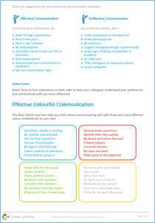
Communications (pg 7)
You have 1 minute to:
  Select 3 effective ways to communicate with me
  Select 3 ineffective ways to communicate with me
  Use Explore, Filter, Share in BOR (10mins: 5mins each)
Notes:
The Communication sections of the report – starting on pg 7.
We understand that communication is one of the key ways for teams to work together more effectively and when this isn’t working problems arise.
Please take 1 minute to complete this exercise – READ SLIDE.
Feel free to take statements from the diagram at the bottom of the page if they suit you.
PUT PEOPLE IN BREAKOUT ROOMS FOR 10 MINS (5 MINS EACH)
We’re now going to put you back in Breakout Rooms to explore, filter and share again.
FEEDBACK
ACTION: In the chat box/verbally, can a few of you write what you got from that exercise?

Slide 21
Communications
Possible one-to-one coaching questions:
Can you think of a relationship you would like to improve?
Can you guess this person's colour preference from the diagram at the bottom of the page?
How could you flex to better connect with them?
How could you use your colour strengths to better connect with them?
Growing confidence in communication:
What could you do more of/less off?
Who could you share these dos and don’ts with?
Notes:
READ THROUGH SLIDE.

Slide 22
Communications
Possible team coaching questions:
Can you think of situation where you can apply your dos and don’ts?
Can you identify who you need to communicate well with most often? How could you apply these?
How could you apply this new information to bring the most benefit in your team?
Who do we need to share/discuss this with?
Team Leader: How can this information be embedded in your team's annual reviews?
Notes:
READ THROUGH SLIDE.

Slide 23



Effective communications with Teams
Name | C’s | Do | Don’t
Jonny |  | Get people involved Value his opinion Direct eye contact | Make him follow process Return to the rule book Restrict free flowing ideas
Sally |  | Provide detail Be polite Keep timescale relaxed | Be overly competitive Stick coldly to the task Give vague instructions
Fred |  | Present options Ask their advice Stick to matter in hand | Show frustration Focus on personal issues Delay conclusions
Notes:
A model for clients to share their communications DOs and DON’Ts within teams.
Help prepare for meetings
Selling to clients
Influencing other teams
SEE ACCREDITATION MANUAL FOR A BLANK TEMPLATE.
The grid includes a personalized C visual - A visual snapshot of a person’s colour preferences.
Some clients include on their email footer or display it on their employee office doors.
POSSIBLE ACTION:
In the chat box/verbally - how could you use the C?
How would you use the effective communications grid?

Slide 24
Team DOs and DON’Ts
Notes:
DEPENDING ON SIZE OF THE GROUP & IF THE’YRE WORKING IN THEIR WORKING TEAMS YOU COULD CHOOSE FROM:
1. Please write in the chat box your three effective communication needs (DISCUSS).
2. We’re now going to send you in to BORS in your working teams to share with the team each person’s effective (DOs) and ineffective communication (DON’Ts) needs.
3. We’re now going to give everyone an opportunity to share your DOs and DON’Ts verbally.
4. We're now going to send you in to Breakout Rooms to share ideas on how this information can be applied in your team/organisation.

Slide 25

Verbal Style
Pragmatic
Structured
Prepared
Questioning
Analytical
Professional
Focused on detail
Authoritative
Direct
Fast paced
Responds quickly
Unambiguous
Forthright
Assured
Collaborative
Diplomatic
Thoughtful
Active listening
Non-judgemental
Empathetic
Meaningful
Dynamic
Persuasive
Spontaneous
Expressive
Positive possibilities
Energetic
Personal
Notes:
How do we like to talk to people?

Slide 26
Effective Communication by Email
Be clear and succinct
Include all necessary detail
Include an agenda
Schedule any follow up in advance
Provide context and expectations for a response
Maintain focus
Use bullet points
Quickly outline the objective
Be succinct
Detail action needed
Enquire about them
Be collaborative
Show you value them
Be pragmatic
Give them time to reflect and respond
Be personal and engaging
Include visuals
Avoid too much detail
Ask for their feedback and ideas
A call is preferable when possible
Notes:
Non-verbal communications too: Email
Applicable to:
How do I lay out the email?
Do I send a preparation document for them beforehand? Or with the email?
Do I need to follow-up with a phone call?
This is showing that C-me can be applied in a practical and tangible way.
Especially important at the moment with increased remote working – this is developed further in our ‘remote working’ webinar

Slide 27
Effective Communication by Email exercise
Design a scenario where you must communicate by email.
Compose 4 emails, each reflecting one colour preference but communicating the same desired output.
Things to consider:
  How do I lay out the email?
  What type of information is important to each colour?
  Do I send a preparation document for them beforehand? or with the email?
  Do I need to follow up with a phone call?
Notes:
DECIDE TOGETHER WITH THE GROUP WHAT THE EMAIL WILL BE.
GIVE THEM 3 MINUTES TO WORK ON ONE COLOUR AND THEN SHARE AS A GROUP TO SEE IF THEY HAVE GRASPED THE EXERCISE AND SHARE LEARNINGS.
THEN MOVE ON TO GO THROUGH ALL 4 COLOURS.

Slide 28

Communicating to influence
Practice conversation:
Invite someone to your annual Christmas party
In BOR’s practice your 2 lowest colours
(In pairs, 2 mins each – 5 mins total)
Notes:
SEE CHAPTER 5 IN YOUR MANUALS FOR A VISUAL ON HOW TO FLEX TO DIFFERENT COLOURS AND DIFFERENT EXERCISES TO TRY.
An exercise in flexing and adapting our colour energy.
This is needed every day in our working lives and personal lives.
We’re constantly trying to adapt to the needs of those around us to influence and get the job done.
We can always get better!
In this exercise you’re asking people to flex to their lowest colour preference. Firstly, I’ll role play this for you to demonstrate then I will give you the opportunity to have a go.
ROLE PLAY WITH A COLLEAGUE OR A MEMBER OF THE GROUP.
ACTION: In the chat box, can you guess the colour I’m trying to flex to?
ACTION:
In to BORS - you have 5 minutes, so 2 mins each and please give each other feedback.
You can either go with this role play
or a real client/colleague situation you’re in right now
or try to pitch your favourite hobby to somebody.
SEND IN TO BORS IN PAIRS - 5 mins
REFLECTION
What did you learn?

Slide 29
Behavioural Intelligence/Flexing
  Scenario 1: You’ve been asked to provide a planned strategy to a steering group
  Scenario 2: You are in a meeting and ideas are being talked about but there is very little action
  Scenario 3: A colleague is asking how your weekend was and asking how are you doing
  Scenario 4: In lockdown the team has been very functional and you would like to inject some life and laughter to team meetings
Notes:
POSSIBLE EXTRA SLIDE TO USE IF YOU HAVE TIME
Here is a list of scenarios that may require different behaviour:
ACTION: What behavioural strengths do you think will be required in these situations?
PUSH THEM TO DRAW ON TWO COLOUR STRENGTH BLENDS, NOT JUST ONE COLOUR
Further thought – what would happen if…
Scenario 1: The steering group all lead with yellow preference, how would you communicate?
Scenario 2: If it’s a team that lead with green preference, how do you influence them to turn it in to action?
Scenario 3: Maybe you're in a rush and you can't talk but it's someone who leads with blue preference so how would you do this?
Scenario 4: Depends on team, how could you bring this with different colours?

Slide 30
Welcome to session 4
Unpacking the rest of the report
Report types
Getting started
Personal action plan
Notes:
WELCOME EVERYONE BACK - READ THE SLIDE.

Slide 31
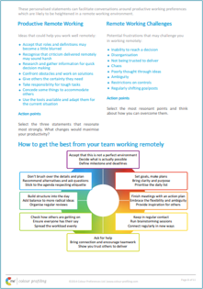
Remote Working chapter (pg 8)
Exercise: Explore, Filter, Share
3 actions to focus on/start doing?
  How will you implement these?
2 challenges to address/stop doing?
  How will you implement these?
  Who will you tell?
  Which points will be most relevant when working face-to-face?
Notes:
Remote Working chapter = Information for productive working as well as challenges when we’re working remotely.
We may find we face the same challenges when in the office, but they are heightened when working remotely.
Report page layout:
Top half of the page is personalized to you - action oriented statements.
Bottom half is a diagram to plot where you sit in relation to others, helping you to identify your place in your team/organization.
READ THE SLIDE
These are our ideas of how you can help someone get the most out of this section:
Take 2 minutes to explore the statements in both columns.

Slide 32

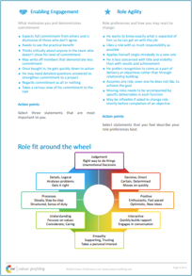
Engagement and Agility (pg 9)
Think of a specific project, working situation, role where you are not 100% engaged.
Drawing from 2 actions, how can you increase your engagement with specific actions beyond the statements?
What positive influence can you bring to a situation during change?
Is there another setting where you need to flex your behaviour around the wheel to fill a gap?
Notes:
Engagement and agility. This section is looking at:
what factors are important to the person to ensure engagement with their role
what are their preferred ways of working
For those working in learning & development this will be really important for you looking at how we keep our people engaged.
1ST APPEAR: READ FIRST BULLET POINT – GIVE THEM A MOMENT TO THINK.
2ND APPEAR: READ BULLET 2 - GIVE THEM A MOMENT
Drawing from the left hand column (list of actions), you’re now thinking of ways to implement and apply those actions:
What tangible things can you do to increase your engagement?
What can you do to motivate yourself?
What can you bring to the team?
3RD APPEAR: READ BULLET 3 - GIVE THEM A MOMENT
What value can you bring?
This will help to build confidence in the client and help them see what positive change they can bring
4TH APPEAR: READ BULLET 4 - GIVE THEM A MOMENT

Slide 33
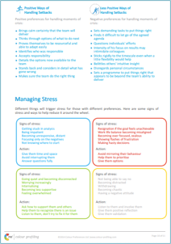
Setbacks and Stress (pg 10)
Setbacks:
What would you define as a setback?
Rate yourself 1-10 on how you believe you handle setbacks.
Think of a recent setback you have experienced. To plan for the future, drawing from the statements, how can you turn the issues you faced into opportunities?
Notes:
Everyone experiences setbacks and stress but we respond to them in different ways - what is helpful/unhelpful varies for people.
These questions can be set for 1-2-1 or team coaching.
This is a section to help people prepare for times of setbacks and stress that may come.
We encourage you to do a whole session on this, once you’ve done a foundation workshop.
In an ideal world we would have a one hour seminar on each page, once we’ve done an introductory session. As an ongoing learning journey.
ACTION: Go through questions if you have time.

Slide 34
Setbacks and Stress (pg 10)
Stress:
What are your stress triggers?
  How do you react?
Pick 4 'Signs of Stress' from any of the colour boxes in the Managing Stress diagram, and an action for each one that you could work on.
  How could you implement these?
Identify someone you know. Looking at the Managing Stress diagram, which 'Signs of Stress' do they primarily display?
  What colours does this indicate they might lead with?
  What actions could you take to help them?
Notes:
These questions can be set for 1-2-1 or team coaching.

Slide 35
Designing a Foundation Workshop
 | PART 1 |  | PART 2
10 mins | Introductions & aims | 15 mins | Flexing exercise
15 mins | Exploration of typical colour behaviours Card game and overview of each colour In person - recreate the colour wheel in the room, discuss colour behaviours Virtually – using slides discuss good/bad day behaviours around the colour wheel | 15 mins | Behavioural intelligence/flexing: For working teams – Real Life Scenarios For learning groups – Common scenarios
10 mins | Background of C-me & principals of graphs | 15 mins | Team wheel
 | **Hand out reports** | 5 mins | Personal Development Plan
10 mins | Break: Give attendees times to read reports | 5 mins | Reflections on the day
1 hour | Intro to the reports: Explore, Filter, Share, first in pairs or threes and then as a whole group | 10 mins to spare for runover
10 mins | Break
Notes:
We're now going to move on to look at how you might design a workshop
ACTION:
TALK THROUGH REASONS FOR THIS ORDER OF ACTIVITES
ASK FOR QUESTIONS AND IDEAS, INPUT TO HELP THEIR LEARNING.
SEE CHAPTER 7 OF YOUR ACCREDITATION MANUALS FOR SAMPLE WORKSHOP AGENDAS, INCLUDING THIS ONE.

Slide 36
C-me Solutions and next steps
Notes:
High Performance Influencer report – for sales
Your sales contribution
Your sales improvement areas
Your sales tendency predictor
Really good for overcoming those who lack confidence influencing others and affirming that they do have a contribution to bring.
Particularly useful for companies who are either technical or averse to seeing themselves in a selling/influencing role.
Helps them look at what they can do.
Also used by organisations looking at who to move in to a sales/influencing role so they want a report to see what sales contribution an individual would make.
Whether this would be a good fit for them.

Slide 37

Report types
Report Title | Info | Chapters included
 |  | Overview | Strengths | Areas for Development | Blind Spots | Comms: Dos & Don'ts | Team Contribution | Engagement | Role Agility | Setbacks | Remote Working
High Performance | Most comprehensive report plus visuals
Core | Basic report format
Recruitment 3 Pages | For Hiring Managers
Youth | Pre-workplace. 14 yrs + |  |  |  |  | Dos only
360 | Maximum of 8 feedback providers | Graphs Bespoke questions designed with the client
Notes:
We also have sector specific reports for:
Safety
High Performance Influencer – sales and anyone who wants to grow in influencing (e.g. leadership/management training)

Slide 38
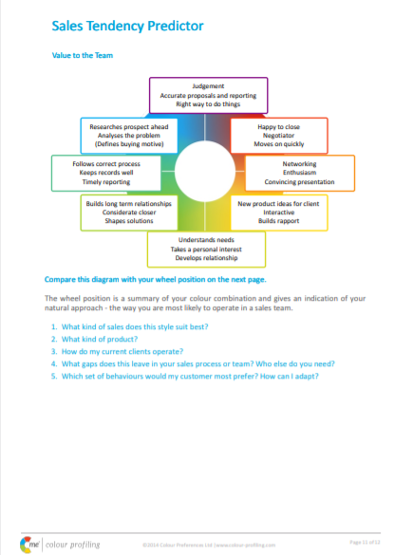
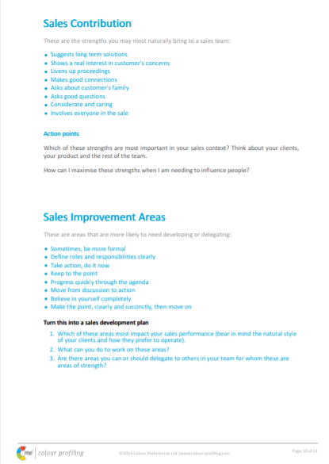
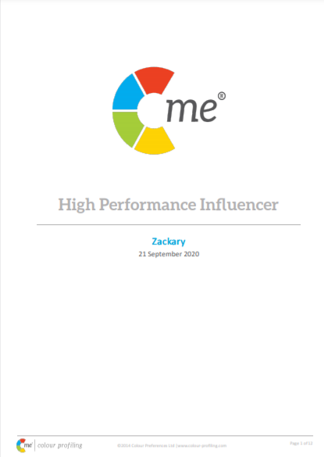
High Performance Influencer Report
Notes:
High Performance Influencer report – for sales
Your sales contribution
Your sales improvement areas
Your sales tendency predictor
Really good for overcoming those who lack confidence influencing others and affirming that they do have a contribution to bring.
Particularly useful for companies who are either technical or averse to seeing themselves in a selling/influencing role.
Helps them look at what they can do.
Also used by organisations looking at who to move in to a sales/influencing role so they want a report to see what sales contribution an individual would make.
Whether this would be a good fit for them.

Slide 39
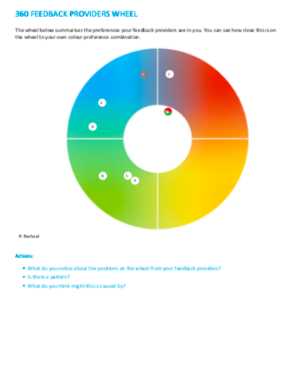
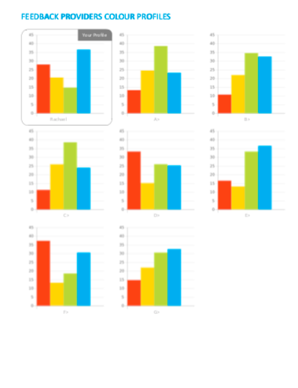
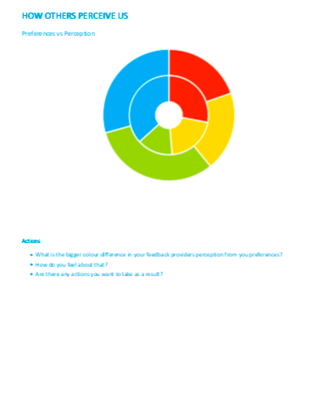
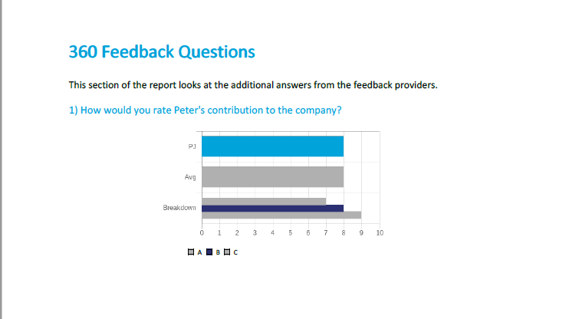
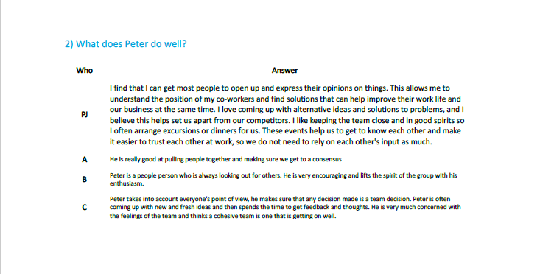
360 Feedback report
Notes:
Purpose of the report: to give a rounded perception of an individual by those around them.
Available for up to 8 people to answer a questionnaire about the same person, specifically thinking about the selected person's preferences.
Visuals around how others perceive us.
Non-confrontational: a way to reflect positives and challenges.
We can add bespoke questions pertinent to a team or organisation.
For example, it addresses if someone is leading with blue/red preference but seems to be leading with green/red preference.
In this middle visual the inner circle displays the person’s profile and the outer circle displays how they are perceived by those taking the questionnaire on their behalf.
This is a great second step after someone has first received their individual report.
This is a helpful report to show how someone has managed to flex and develop after coaching. Their individual preference profile may not have changed but with coaching others might perceive that they are operating more out of red or green preference, for example, because they're working to flex to these areas.

Slide 40

C-me Translations
Questionnaire & Reports
Spanish
Dutch
German
Russian
Simplified Chinese
Korean
Japanese
Hindi
Questionnaire only
French
Cards
Arabic
Youth version
Coming soon: Korean; Simplified Chinese;
Spanish
Notes:
Please check with C-me what the latest list of available translations are as these are being updated regularly.
Read Slide.

Slide 41
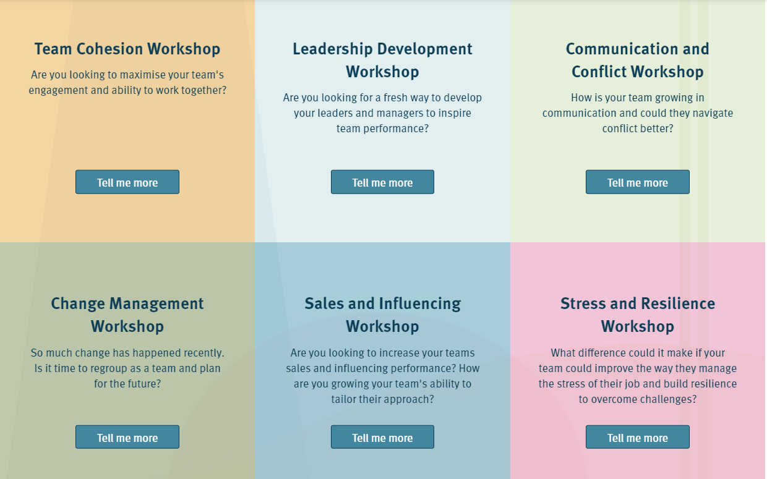
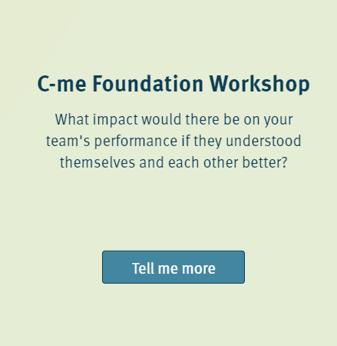
Additional Workshop topics
Notes:
This slide displays over ‘deeper-dive’ workshop options – We do the easy work for you. Details will be sent to you. C-me Foundation information already available for you to access free of charge. Just a small fee for additional workshop material. This included, an agenda, power points slides with notes, training video and additional resources for each topic.

Slide 42
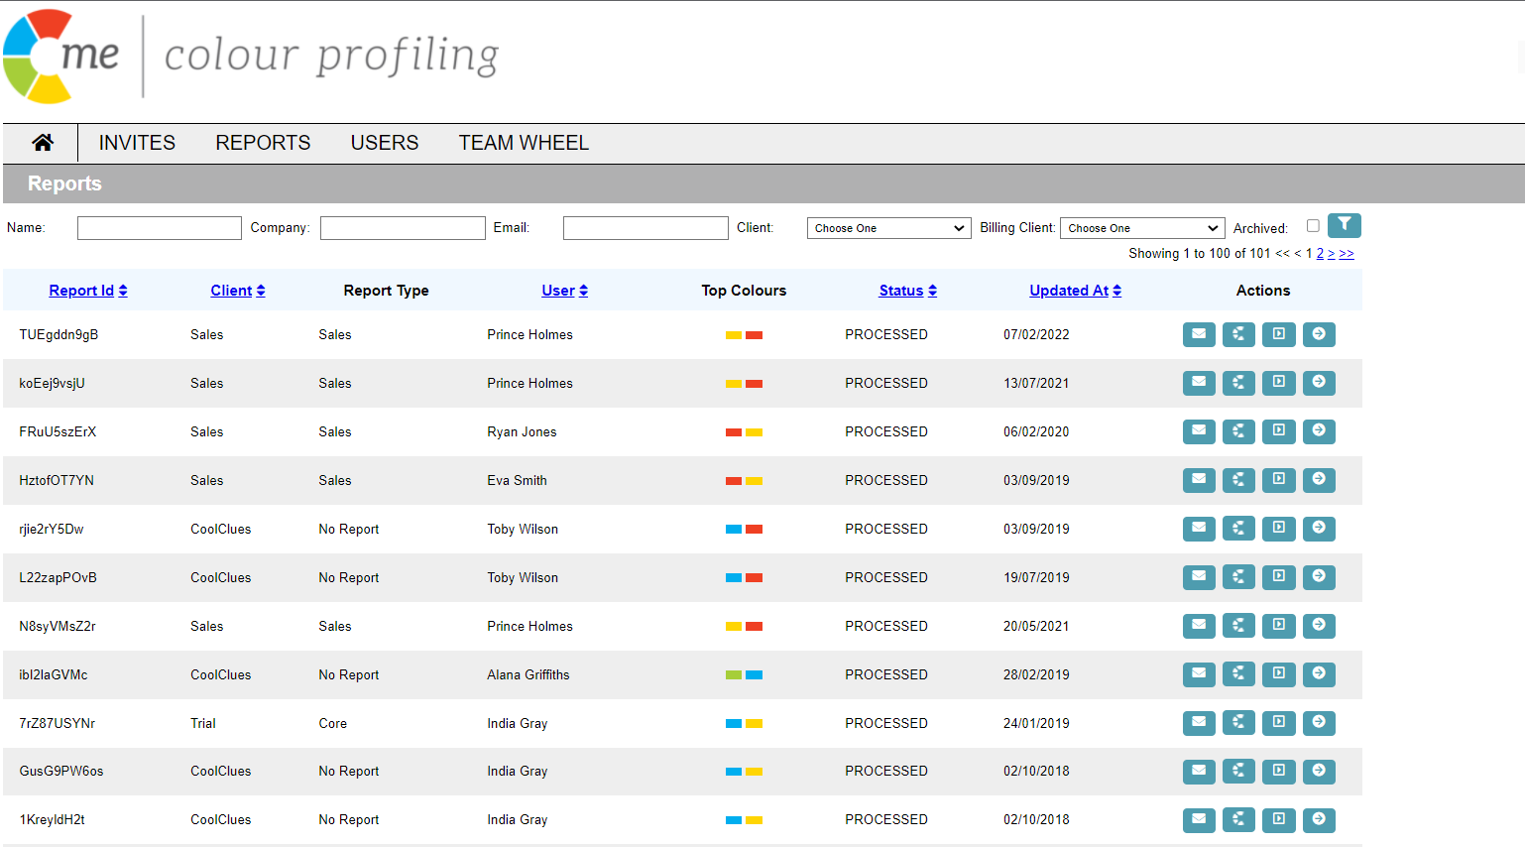
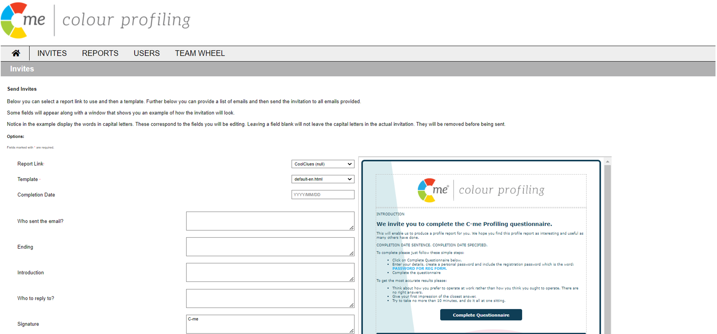
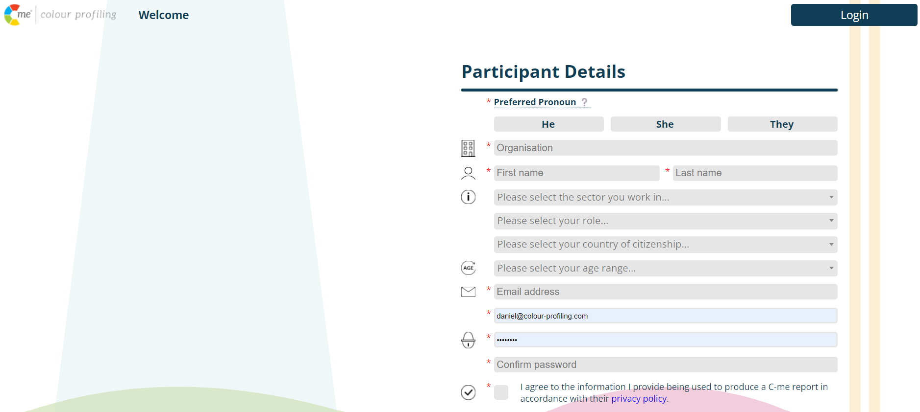
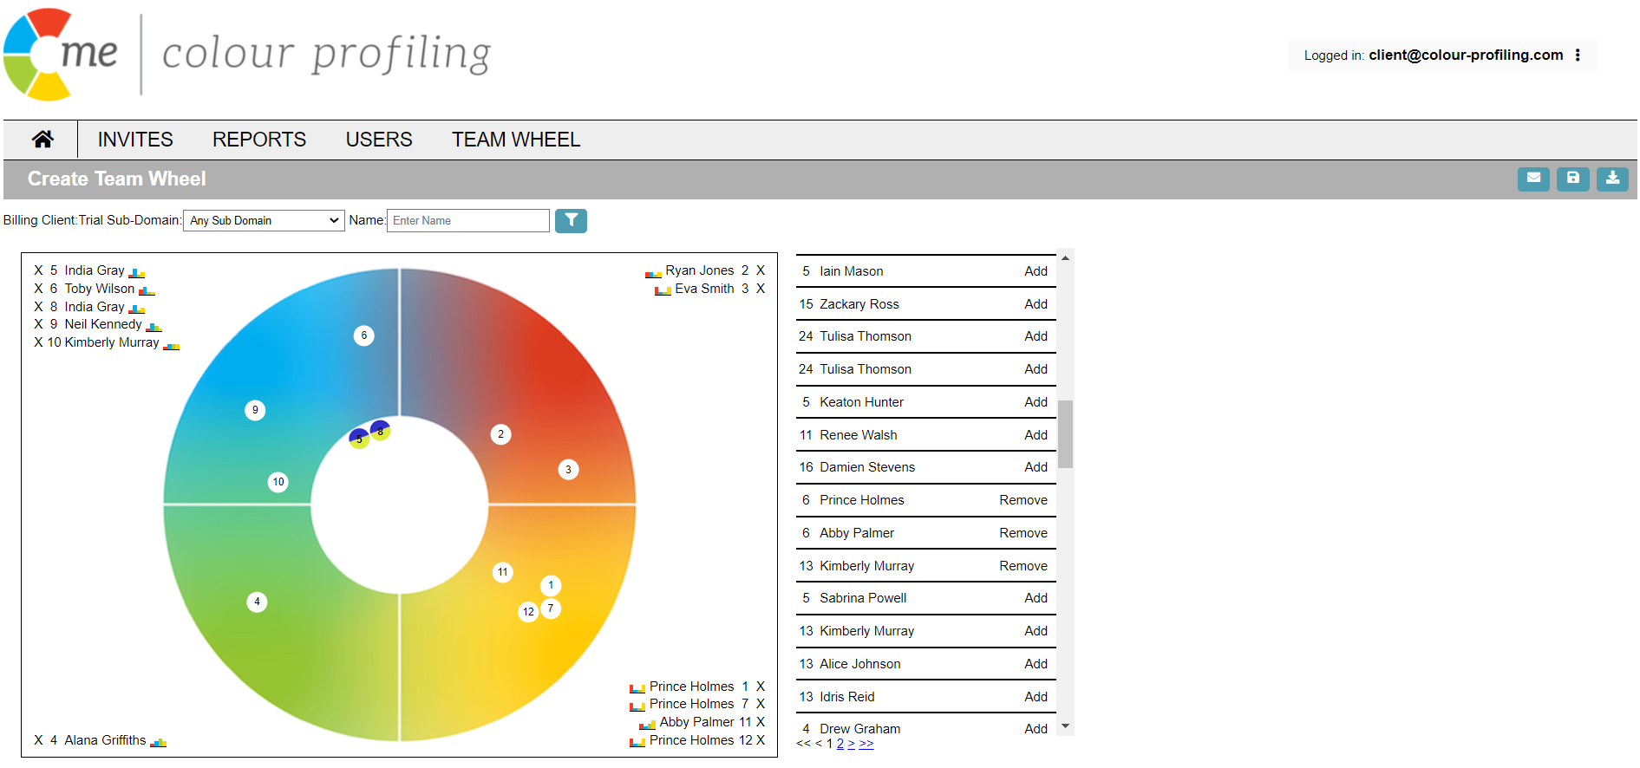
The Dashboard, link set up, profiles credits
Your brand
Notes:
A quick overview of the Dashboard, who is it useful for, setting you up a link and profile creits

Slide 43
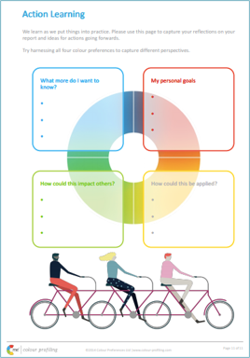
Action Planning
Page 11
What are your actions?
Follow up
Notes:
Action Plan
Creating actions to complete following the session will increase the impact of what you’ve learned – we encourage you to include this at the end of all workshops.
Please turn to page 11 of your report:
We have mapped action planning around our colour wheel:
Red – what personal goals are you going to set?
Yellow – what Innovative applications can you think of?
Green – what impact might this have on others – how can I leverage what I’ve learned to impact my team?
Blue – what theory and knowledge do I want to remember from this workshop?
ACTION: 5 minutes now to complete this page on your own.
FURTHER COMMENTS YOU MIGHT WANT TO MAKE:
You or your client might want to include this in a Personal Development Plan e.g. Stop, Start, Continue
Personal commitments: goal orientation, ambition
Innovative application: come up with creative ideas about how you can apply what you’ve learned today – home, team meetings, new ways to share or communicate insights, new ways to use your C.
Impact on others: how am I going to leverage this to impact on teams – ask other people to see their profiles, use in coaching or line management, take team wheel in to team meetings so all learning styles and colour preferences are being considered.
Theory & knowledge: what I want to remember from today –we’re all different and unique, how to spot bad day behaviours.
We’re encouraging people to think about the different perspective of action points and what action points look like with different colour lenses in mind.
ACTION: I’d like you each to put in the chat box one key action point you’ve put in your action learning?

Slide 44
Feedback:
Notes:
INSERT YOUR OWN QR CODE ON THIS SLIDE – SEE THE LINK ON THE SLIDE FOR WHERE TO CREATE THIS.
Take your camera, point it at the screen and it will take you to a google questionnaire to answer a few questions about today.
Could you please complete that now.
I will also post a link in the chat if this doesn’t work.
WAIT FOR THEM TO COMPLETE THE QUESTIONNAIRE, DON'T RUSH ON.

Slide 45






Colour-profiling.com
Thank you and please stay in touch!
@colourprofiling
@cmeprofiling
Cmecolourprofiling
@C-me Colour Profiling
Notes:
Opportunity to thank your guests.
INSERT YOUR OWN LINKS HERE ON THIS SLIDE.

