Slide 1


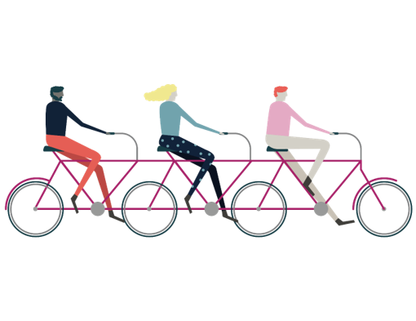
Welcome to your
Activator Slides
Part 1
Behaviour profiling to help you, your team or organisation harness natural talent and build long-term success.

Slide 2
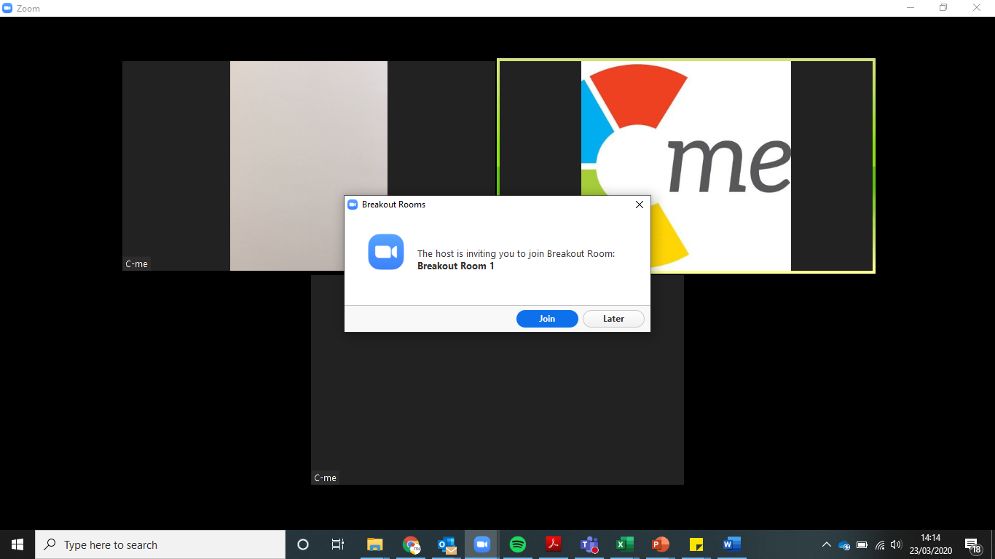
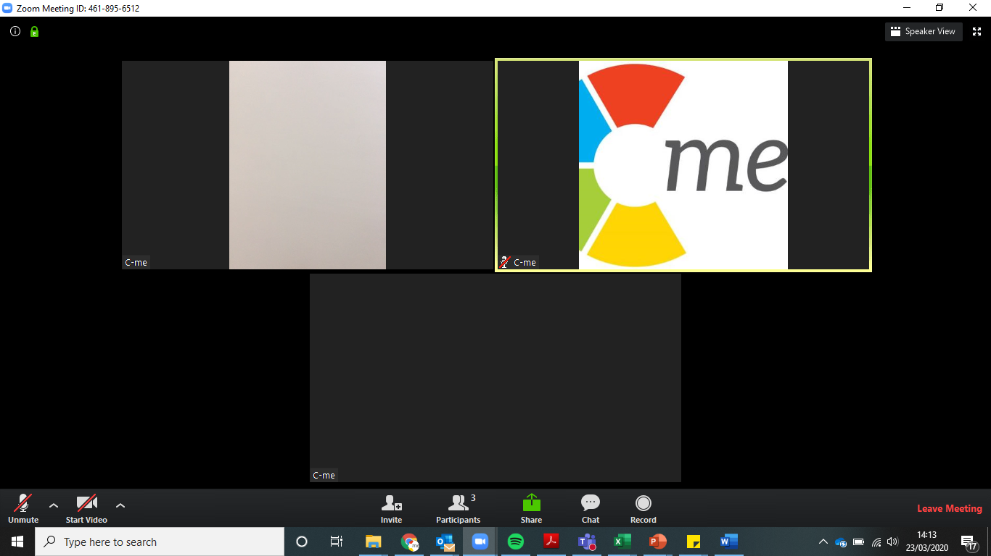
How to use Zoom
Breakout Rooms
Microphone and Camera
Notes:
We are aware that video conferencing is now a normality in life but we just want to run through some ground rules to make sure that everyone has a great experience and that the quality is good for everyone.
The next few slides contain information on how we’re going to use Zoom today.
1ST APPEAR:
Camera
Microphone
2ND APPEAR:
Breakout rooms: Great opportunity to interact - we’ll be using them to meet new people.

Slide 3
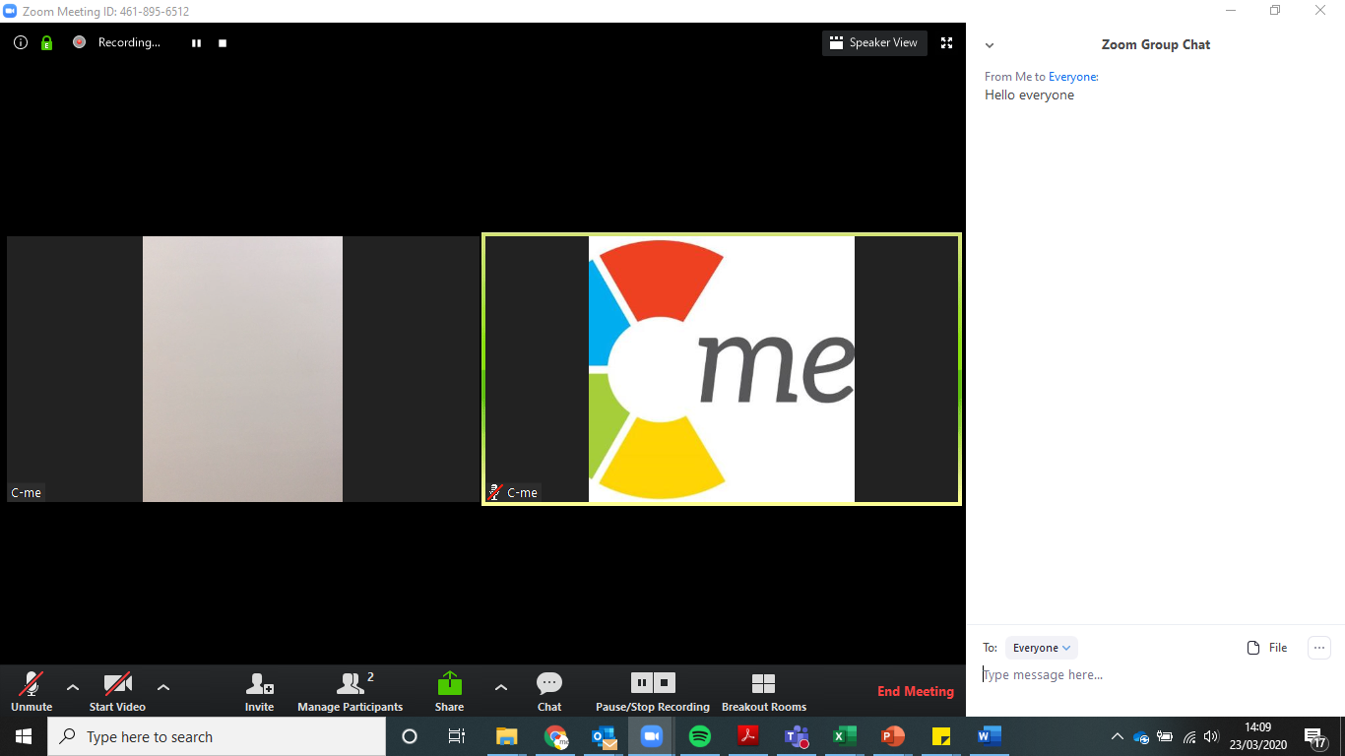
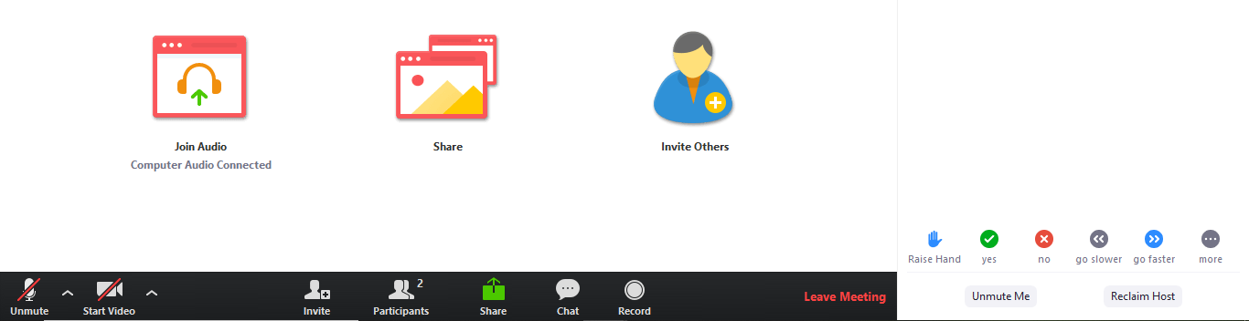
How to use Zoom
Chat and file sharing box
Participant icon
Raise hand icon
Notes:
1ST APPEAR:
ACTION - Chat: Why not say ‘hello’ on the chat – we’re using this to increase participation.
2ND APPEAR:
Participation icon & raise hand icon: hit that now, it will eventually disappear but you can hit it again to take your hand down. We will invite you to share your learnings during the session this way.

Slide 4

Aims
Give you a language for describing behavioural difference​
​
Explore and discuss your C-me report​
Apply learning to your current team working​
What are yours?
Notes:
Here are some of our aims for our time together - READ SLIDE
What are yours?
ACTION: INVITE ATTENDEES TO WRITE IN CHAT BOX
YOU MAY WANT TO COPY THESE DOWN TO REVIEW AT THE END OF YOUR WORKSHOP.

Slide 5
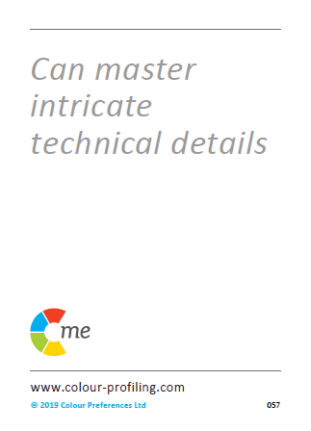
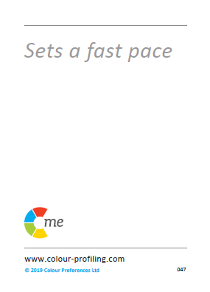
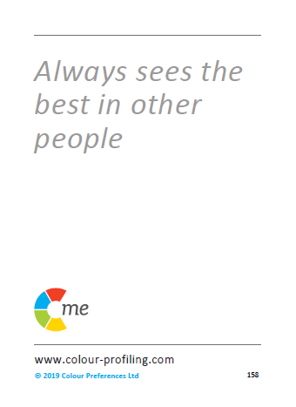
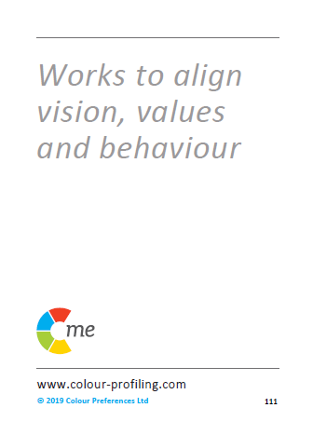
C-me virtual card game
The purpose of this game is to introduce you to the language and colours of C-me.
Notes:
Chapter 5 has more information in your manual on how to run the game, including variations.
When delivering workshops and coaching we keep things highly interactive with the goal of bringing tangible actions and solutions which can be brought in to the working and even personal life of individuals straight away.
We want to teach then quickly help people apply what they have learnt.
Our aim with this game:
Giving people a hands-on, interactive introduction to the statements on the cards, which are associated with the 4 colour quadrants on our colour wheel.
ACTION - RUN THE GAME: For this exercise you will need a pen and paper.

Slide 6
C-me virtual card game
1.
2.
3.
4.
5.
6.
7.
8.
9.
10.
11.
12.
13.
14.
15.
16.
Notes:
ACTION: Please recreate this grid on your paper, drawing three columns with the numbers 1-16 down the side in the first column.
N.B. Whilst your clients are drawing the grid, it’s helpful for you to draw the grid at the same time in order to get your pace right.

Slide 7
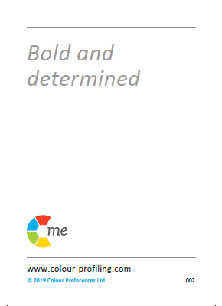
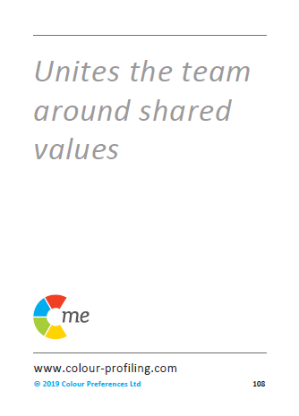

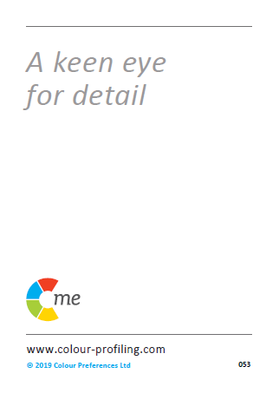
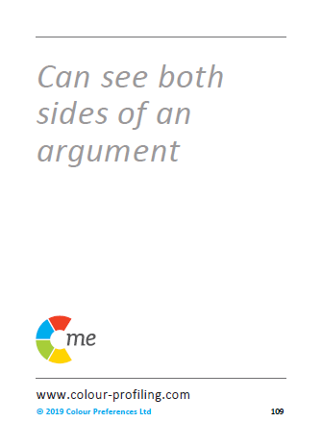
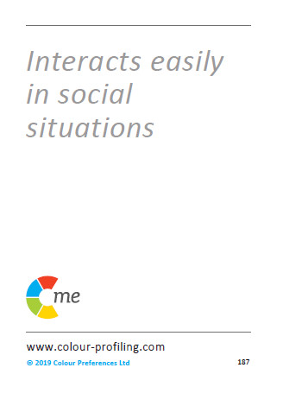
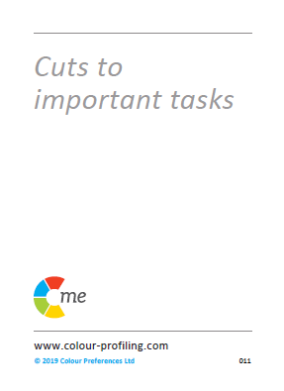

1.
2.
3.
4.
5.
6.
7.
8.
Notes:
Read out the 16 statements (each one corresponds to a number from 1-16). New card appears after every ‘click’.
ACTION: If the statement on the card describes you, put a tick for ‘Yes’ in the second column next to the corresponding card number.
If not, put a cross for ‘No’.
Don’t think too much about the statements - just go with your gut response. This is just a game.

Slide 8
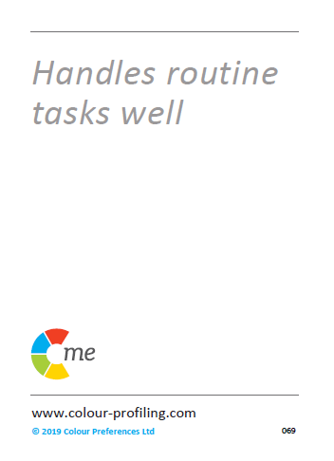
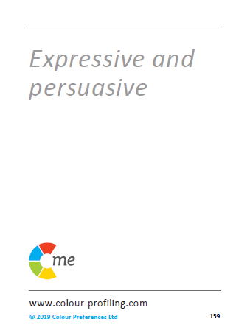
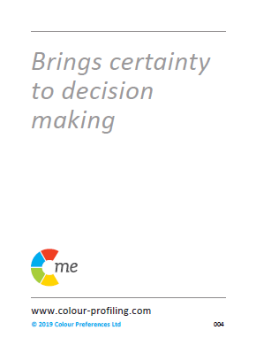

9.
10.
11.
12.
13.
14.
15.
16.
Notes:
Continue to read the statements.

Slide 9

C-me virtual card game
1.
2.
3.
4. | x
5. | x
6.
7.
8. | x
9. | x
10.
11.
12. | x
13.
14. | x
15. | x
16.
Notes:
Part 1 is complete!
You should now have a table that looks something like this.
Now let’s complete the right-hand column.

Slide 10
1.
2.
3.
4.
5.
6.
7.
8.
Notes:
Click to reveal the colour of each of the 16 cards, one at a time.
ACTION: As I reveal the colours of the cards please write the first letter of the colour in the 3rd column, next to the corresponding card number e.g. R, Y, G, B

Slide 11
9.
10.
11.
12.
13.
14.
15.
16.
Notes:
Continue to reveal card colours.

Slide 12
C-me virtual card game
1. |  | Red
2. |  | Green
3. |  | Yellow
4. | x | Blue
5. | x | Green
6. |  | Yellow
7. |  | Red
8. | x | Blue
9. | x | Blue
10. |  | Yellow
11. |  | Yellow
12. | x | Red
13. |  | Red
14. | x | Blue
15. | x | Green
16. |  | Green
Total number of 'Yes' cards
Reds | 3
Yellows | 4
Greens | 2
Blues | 0
Notes:
ACTION: Please add up the ticks (your 'yes' cards for each colour) and add the totals in the box like this on the right.
GIVE THEM A MOMENT TO DRAW THE SECOND TABLE ON THE RIGHT OF THE SCREEN AND TALLY UP THEIR CARDS.
N.B. One of the great things about this game is it engages people into action before listening for too long. The idea is to start the session with energy and active learning.

Slide 13
C-me virtual card game
How many different colour cards have you ticked? 1…2…3…4?
What do you think this tells us?
What are your top two colour cards?
Notes:
How many different colour cards have you ticked? (4 x ’Click’ to reveal number options).
ACTION: in the chat list how many colours you have? 1, 2, 3, or 4?
What do you think this tells us? EITHER INVITE PEOPLE TO WRITE IN THE CHAT OR SPEAK OUT LOUD.
ANSWER: There may be a preference but we are all a blend of more than one colour.
ACTION: In the chat put your top 2 colours.
We’ll come back to this when we look at the Team Wheel, which displays our leading colours and how they interact.

Slide 14

Notes:
Briefly introduce the concept of the colour wheel (N.B. opportunity to return to this in more detail later in the workshop).
Blended colour wheel – it reflects that we flex our behaviours and move around the wheel. Colours blend, numbers and letters don't. This is a non-binary approach.
We have grouped similar behaviours by colour and then mapped these onto the colour Wheel.
N.B. The closer your position is to colleagues, the more behaviours you are likely to have in common.
N.B. The further you are from a colleague, the more you may differ in your perception of the "right" way to do things.
N.B. Those on the opposite side of the wheel may be more difficult to understand.
IF YOU’RE RUNNING THE CARD GAME IN A ROOM IT’S GOOD TO HAVE ONE CORNER OF THE ROOM REPRESENTED BY EACH COLOUR. AS A VISUAL REPRESENTATION OF THE WHEEL.
SEE CHAPTER 5 IN ACCREDITATION MANUAL TO SEE HOW THIS WORKS.

Slide 15
Good day/resilient strengths
  Energetic and enthusiastic
  Positive outlook
  Fast paced
  Sees the opportunities
  A real excitement for life
  Embraces change
  Sociable and outgoing
  Inspirational and visionary
  Not afraid to take risks
  Spontaneous and imaginative
On a bad day
  May miss details
  Can appear disorganised
  Jumps between ideas
  Can be idealistic and impractical
  Lax time management
  Everything to excess
  Inclined to talk too much
Notes:
LOOKING AT EACH COLOUR GROUP IN MORE DETAIL.
Read out the statements on the cards.
1st APPEAR: “Good day/resilient strengths” - we're not speaking of competence but more about a person’s “happy space” where they perform best, for longest.
ACTION: Please put in the chat some other words you would use to describe yellow preference behaviour on a good day.
N.B. Focus only on the positive things people write (this is a time to celebrate this colour energy).
Once you've acknowledged their response, reveal the list we have.
2nd APPEAR: We also all have “bad day behaviours”
ACTION: Again, in the chat, please list behaviours those with a yellow preference could display on a not-so-good day.
N.B. Keep an eye out for when people write 'leader' for any of the colours. This is the perfect opportunity to pick this up and say "that's an interesting observation, we'll address this in a minute". Later make the point that you can lead from any position on the wheel.

Slide 16
Good day/resilient strengths
  Respects others' values
  Supportive and loyal
  Builds consensus
  Generous
  Works for democratic solutions
  Tactful and diplomatic
  Dedicated to the team
  Considerate and attentive
  Tolerant and open-minded
  Reliable and dependable
On a bad day
  Appears to lack urgency
  Can be indecisive
  Often self-critical
  Procrastinates
  Slow to venture an option
  Difficulty setting priorities
  Constantly checking consensus
Notes:
Repeat exercise for GREEN preference behaviour:
Read out the statements on the cards.
1st ACTION: please put in the chat some other words you would use to describe green preference behaviour.
2nd ACTION: And on a bad day what might green preference behaviour display?

Slide 17
On a bad day
  Tends to over analyse
  May appear aloof
  Tends to point out the downside
  Obsessive about the detail
  Slow to trust
  Lacks spontaneity
  Constrained by the rules
Good day/resilient strengths
  Logical and analytical
  Enjoys problem solving
  Realistic
  Sets high standards
  Methodical and systematic
  Sorts out the details
  Strong sense of duty
  Structured and disciplined
  Focuses on details
  Considers all the facts
Notes:
Repeat exercise for BLUE preference behaviour:
Read out the statements on the cards.
1st ACTION: please put in the chat some other words you would use to describe blue preference behaviour.
2nd ACTION: And on a bad day what might blue preference behaviour display?

Slide 18
On a bad day
  Can be intolerant
  Can dominate discussion
  Too focused on results
  Overly competitive
  Can be dismissive of others’ views
  May not be listening
  Action overrides planning
Good day/resilient strengths
  Bold and determined
  Drives hard for delivery
  Focuses on results
  Decisive
  Powerful advocate
  Confident
  Enjoys stretching goals
  Brings clear direction
  Sets a winning mentality
  Direct and to the point
Notes:
Repeat exercise for RED preference behaviour:
Read out the statements on the cards.
1st ACTION: please put in the chat some other words you would use to describe red preference behaviour.
2nd ACTION: And on a bad day what might red preference behaviour display?

Slide 19
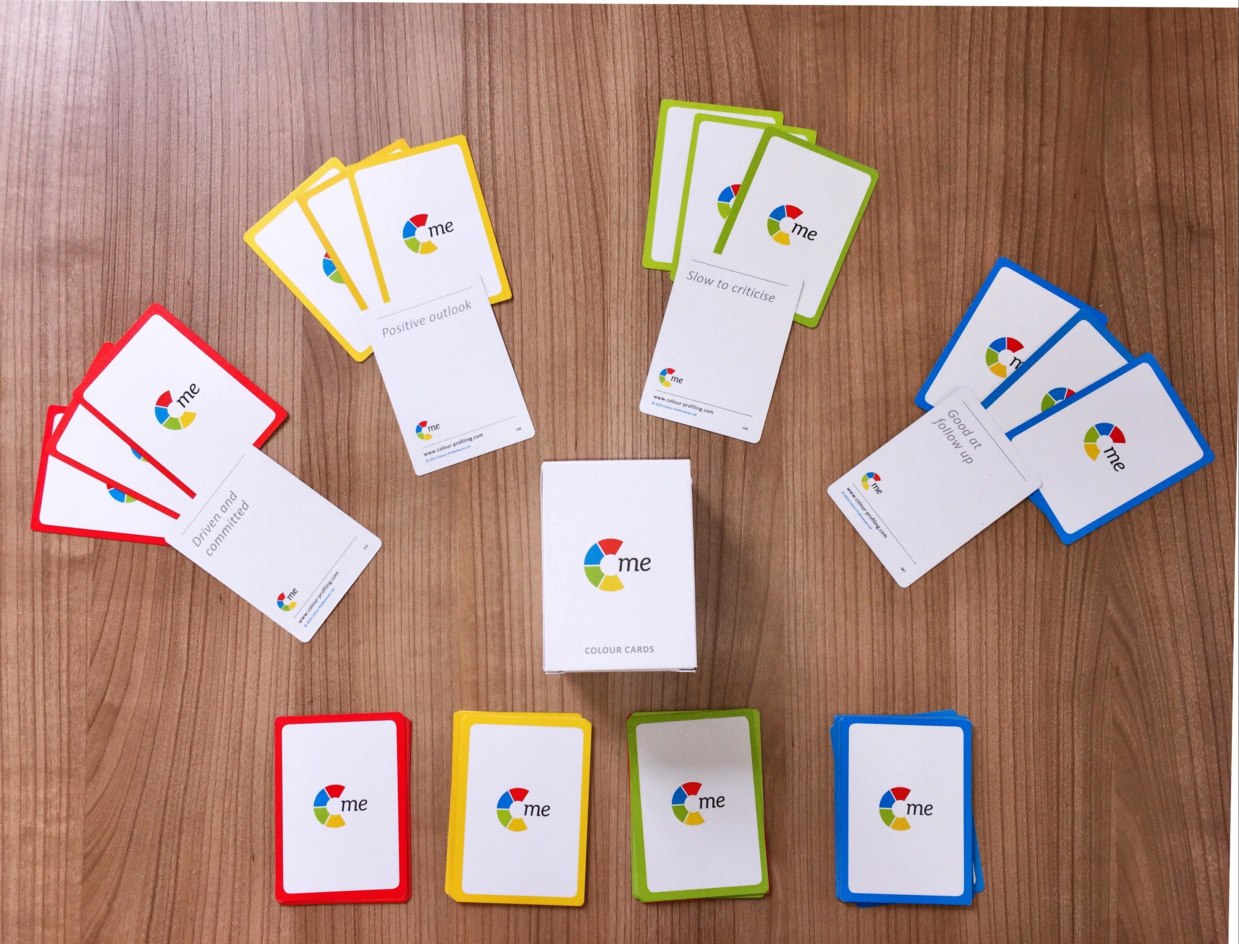
C-me card game
Notes:
SEE CHAPTER 5 IN YOUR ACCREDITATION MANUAL
This slide shows the cards you can purchase from C-me to run the card game face to face. On one side of the cards are statements, on the other side colours.
Game instructions:
Before your guests enter the room, create a pack of cards for each one of them with 3 of each of the colours cards e.g. 3 red, 3 yellow, 3 blue, 3 green (i.e. Total = 12 cards per person).
Shuffle the cards together and put them with statements face up, perhaps underneath their chair. One pack per person.
Before the workshop begins, we recommend you delegate 4 corners or spaces in the room to the 4 colours in the following order: Yellow, Green, Blue, Red. (Perhaps put a visual of each colour in each corner as a reminder).
Within 90 seconds of the start of your workshop, ask your attendees to pick up their pack of cards and read the statements on the front.
Then make a pile of the statement cards they feel describe them (YES pile) and a pile of the cards they don’t feel describe them or they aren’t sure of (NO pile).
Give them 1 minute to sort the pack into these two piles.
Ask them to leave the pile of ‘yes’ cards but pick up the pile of 'no' cards and then get them up on their feet and interacting together to try and give away their ‘no’ cards to others who do agree with those statements. Give them 3 minutes to do this.
Next ask your guests to combine their initial ‘yes’ cards and those they have accepted in the swap.
Instruct them to turn their cards over and count how many of each colour card they have.
Ask which colour they have the most of and then to go and stand in the matching colour corner in the room.
Starting with the yellow corner ask everyone in one colour group at a time to read their cards aloud to the rest of the group. (if you have a large group then only 3 statements per person or only a handful of people share)
Ask the rest of the group to feedback what they are hearing about that colour – on a good day/bad day. Go round the room.
TYPICAL QUESTIONS AT THIS POINT:
What if people have even numbers of two colours? Ask them to go to the corner with the least number of people in.
Why yellow first? Often most willing to contribute. Highest energy group.

Slide 20
Leadership/Management
Notes:
Time to address our judgements around leadership and management.
Often with groups we challenge people on assuming red = leadership.
Leadership & management is not just seen through red behaviour.
Leadership & management looks different with each colour.
There is no one ‘right’ way.
By this point in a workshop, your clients are starting to appreciate good and bad days for each colour preference – we’re wanting people to leave with greater behavioural intelligence.
NB: No matter what organisation it is, if the leader is leading with particular types of colour preference then that can become the hallmark of one preferred way of leading, instead we want to encourage people to grow in different leadership styles and behaviour preferences in management and leadership.
Possible action: Opportunity to explore what leadership style might look like for each colour preference. Reflect and discuss ideas.
So, what are the advantages of each management/leadership style around the wheel?
Red – visionary, quick decisive decisions, clear, bold ideas – bad day, may feel controlling, my way or the highway approach
Yellow –motivational, empower individuals – bad day, we’re flicking through too many ideas, flapping in the wind approach.
Green – nurturing, make sure whole team involved, collaboration – bad day, procrastination, so concerned with other’s feelings decisions never get made.
Blue – organised, clear timeline, strategic, timescales, resources etc, realist, high standards – bad day, things might take a long time to get done, micromanagement, analysing everything.

Slide 21

Choose your colour
Realistic
Focuses on details
Considers all the facts
Strong work ethic
Logical and analytical
Sets high standards
Brings clarity to complexity
Bold and determined
Drives hard for delivery
Focuses on results
Decisive
Brings clear direction
Powerful advocate
Enjoys a challenge
Tactful and diplomatic
Builds consensus
Dedicated to the team
Considerate and attentive
Reliable and dependable
Works until the job is done
Tolerant and open-minded
Energetic and enthusiastic
Positive outlook
Creative and innovative
Expressive and persuasive
Embraces change
Social and outgoing
Inspiration and visionary
Notes:
What people should roughly have in their minds or in the room on whiteboards =
a sense of what these colours represent,
what they feel are their strongest colours
that everyone is a blend of all 4 of the colours.
If you're running this in a room this will be where people are standing in the 4 corners around the room:
now we give them an opportunity to move to where THEY most IDENTIFY themselves being.
Or write it in the chat box.
We would emphasise at this point that the card game is just an estimate.
Completing of the questionnaire is the accurate take.
We often give out the profiles half way through the workshop, because we find that if people don’t know their own colour profile yet they can be more open minded to all colours.
It gives them opportunity to intuitively discern their own colours.
The learning curve for your clients:
Starting with single colour building blocks,
then moving on to the question of ‘how do they combine for me or for you?’ what does a personal blend look like.
We’re a unique blend so we’re not boxed in.

Slide 22

Organise a staff party
10 minutes in BOR's to design a party in designated colour preference
Notes:
SEE CHAPTER 5 IN YOUR ACCREDITATION MANUAL
Another ice breaker and an interesting way to explore the colour energies further and how they are played out in more than just words. Assign each colour group to plan a party! (CHOOSE ONE: Office Christmas Party/Lockdown Party/Santa Needs Help).
Aim: Reinforce values and behaviour of each colour preference.
When?
It can work virtually or in the room face-to-face.
During the colour card game, if you choose to group people in to colour preferences to share their statements.
Virtually: break people in to BORS, in the group of the top colour preference they identify with.
Ensure equal groups if possible (feel free to ask people to join the group of their second colour preference).
Give each group a flip chart to write out their ideas/or e.g. use Whiteboard function on Zoom.
Elect one spokesperson from each group. Then allow the lead of each group to share their screen and display the whiteboard. Or if you’re in the same room, to read out their ideas from the flipchart.
When running this live - watch what happens and see the behaviour being exhibited in each of the 4 corners body language, ideas they come up with:
Red corner: often people are decisive and clear with their plan
Yellow corner: they are coming up with so many ideas but with little concern for timeline or practicalities
Green corner: maybe took time to decide who would hold the pen but the party plan is concerned with everyone being included and a real sense of community
Blue corner: detailed list of timings and schedule.
At the end take a moment to stop and reflect with the group on what they’ve learned from the exercise.

Slide 23
1.
2.
3.
4.
C-me 360
card game
5.
6.
7.
8.
Notes:
Explain 360 card game…
Good exercise to start discussion on how we’re perceived by others in the team
Select one person in the group
The rest of the group then pick 2/3 cards which they feel best describe that person.
The selected person then gives some feedback about the cards that the rest of the group selected for them.
Each person in the group has a go.

Slide 24
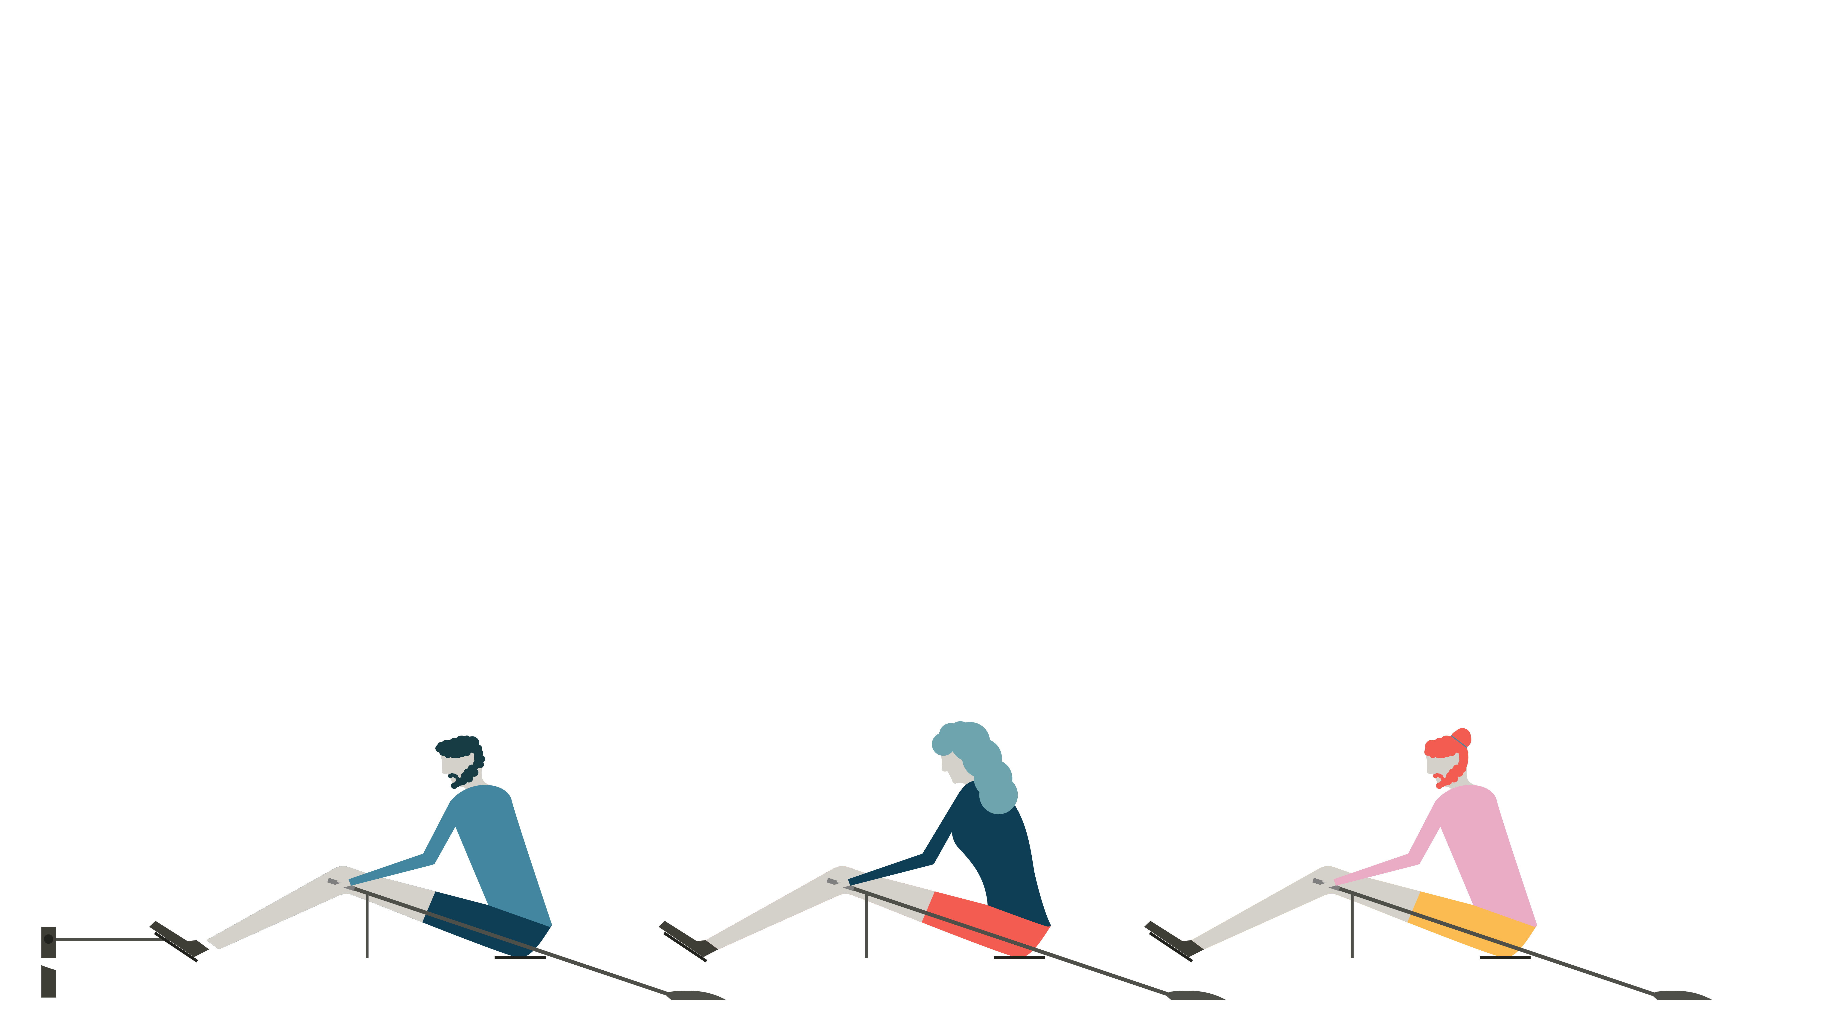
Introducing C-me
Individuals
Teams
Organisations
Notes:
For foundation workshops the first slide we normally use is to introduce C-Me, giving a short background and history of the tool.
C-me is an independent company which has been operating for 10 years specialising in behavioural profiling.
We grew out of our parent company, The Wilsher Group, which specialises in coaching and change management. The Wilsher Group was started over 30 years ago and has experience with large global clients, like Visa and M&S.
10 years ago they worked with a leading psychometric expert to draw together elements of profiling tools that had really been seen to have an impact and combine them with increased accuracy, accessible language and modern technology. The combination of focus on impactful application, underlying accuracy and ease of use led to the powerful tool that is C-me.
We have worked to develop a tool that is intuitive, memorable. The main focus of C-me is application so we have designed a report to be focussed on action in order to effect lasting change in:
Individuals
Teams
Organisations to perform at their best.

Slide 25























Notes:
C-me has a broad and rich pool of experience in different sectors including:
Education
Health & Fitness
Defense
Entertainment
Not-for-profit and FTSE 500 companies
Individuals
You may recognise some of the brands on this slide that we have worked with.
Our recent developments include a profile for Friends & Family, which is looking at our home life and community. The need for this report was highlighted during lockdown. We also developed a section on remote working.

Slide 26
Our Values
F
C-me is adaptable to meet the participant or organisation’s purposes, industry, and bespoke needs.
Flexible
A
The C-me method is underpinned by years of research, development work and practical learning.
Accurate
C
C-me makes all reports, workshops and communication simple and easy to understand.
Clear
E
The reports are quick to complete (just 10 minutes) and simple to understand.
Easy use
Notes:
We suggest picking out the key features that will resonate with your clients.
​
​

Slide 27

Impact on others
Behaviours
Personality
(values, beliefs)
Notes:
Emphasize that C-me focus on BEHAVIOURS, not personality.
We acknowledge that individuals have a range of behaviours they can choose from, but we seek to assess their preferred ways of working within this range.
Our behaviours impact others and can change.
We’re helping to bring realisation around our tendencies.
We do not label any specific behaviour as 'right' or 'wrong' but simply that individuals choose what feels 'right' for them.
Behaviour is easier to coach and adapt than personality.
We’re speaking to behaviours that emerge out of personality.
Personality tests are looking to assess the underlying personality traits, which can be hard, can come across as vague and boxed in.
Our USP as a tool is that we’re looking at observable behaviours, we’re not challenging people’s values but what behaviours someone is choosing to display and adapt in their context.
Our 35,000+ statements are behavioural.

Slide 28
How C-me compares to other profiling tools
 | Similarities | How C-Me differs
MBTI | Jungian underpinning Make use of preference indicators Seek to reduce conflict brought about by misunderstanding difference | Behaviour not personality Colour wheel avoids strict categorization (letters) and reflects individuals can flex. Individually tailored graphs instead of 1 of 16 types. Reported by users as being more memorable and therefore applicable to working life
Insights | Jungian underpinning Application of colours to Jungian quadrants Make use of preference indicators Use a colour wheel Include a conscious and unconscious measure | Greater emphasis on behaviour not personality Colours blend instead of boxing into a quadrant on the wheel Different algorithm to calculate 'natural' graph Different relationship with our accredited community
DISC | Jungian underpinning Application of colours to Jungian quadrants Recognise individuals are a combination of behaviour preferences, in differing degrees | Behaviour not personality Colours blend instead of boxing into a quadrant colour or letter
Notes:
Here are just a few of our key competitors in the market.
Please ask us for our information sheet with more comprehensive information on a wider group of competitors.
Across all three - C-Me is quicker to complete and colours/categories blend.

Slide 29
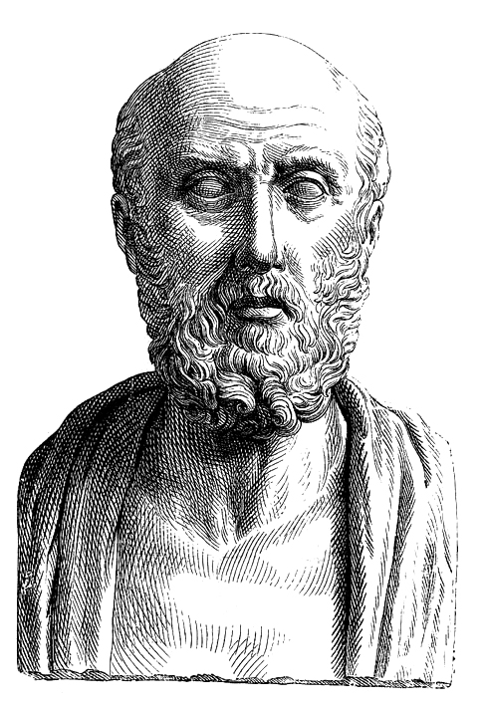
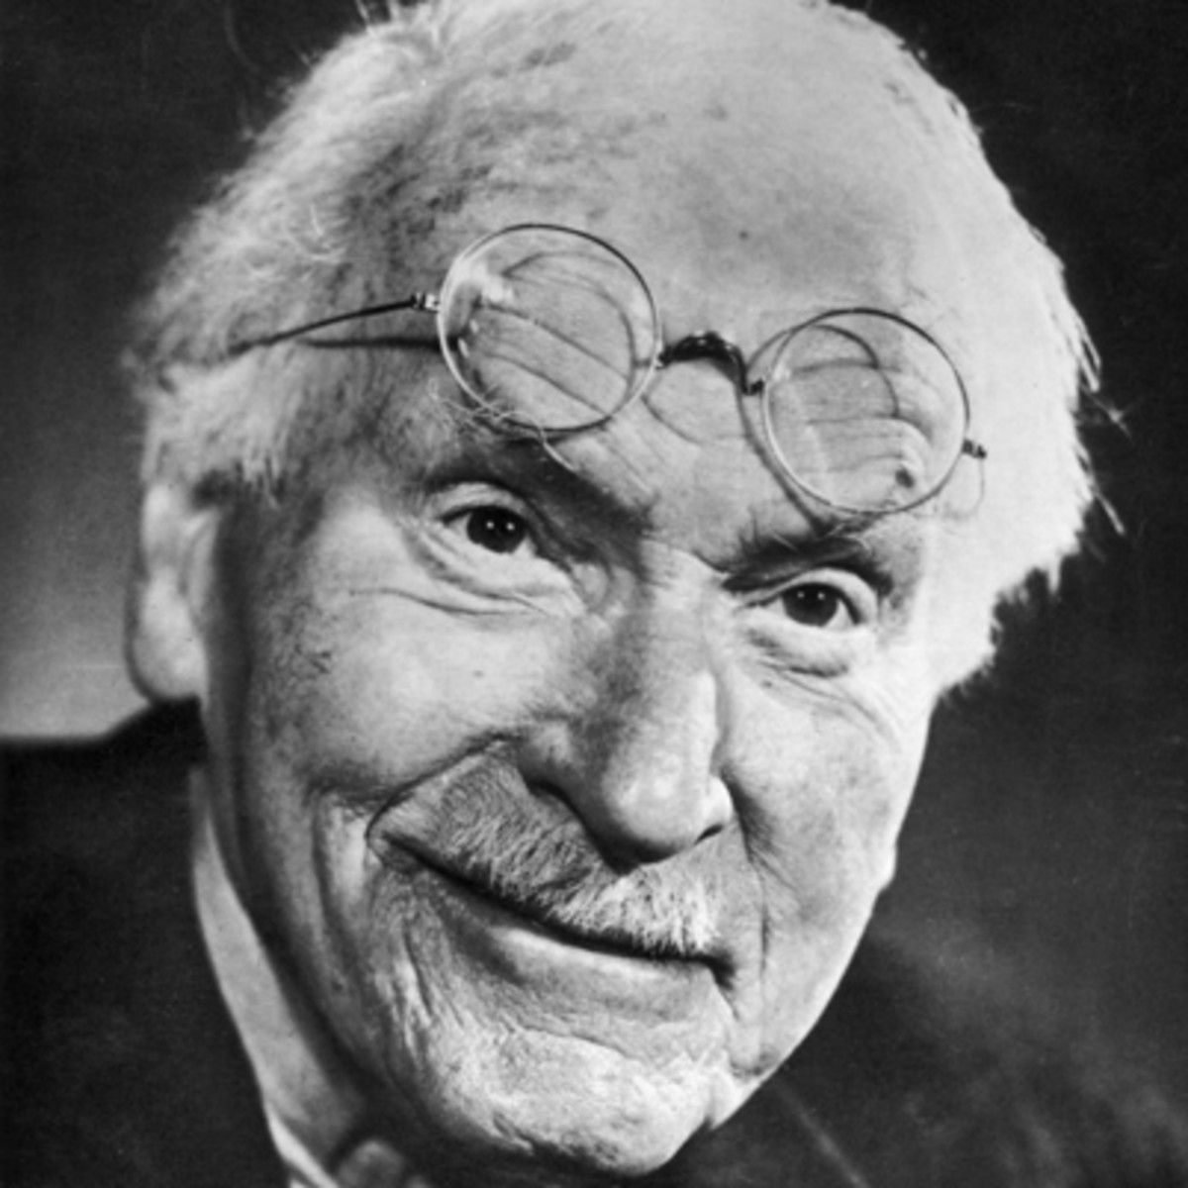

Key figures in the development of psychometric testing
Hippocrates
500 BC
Jung
1923
2013
Notes:
Summary slide: to contextualise where C-me fits and the background to psychometric testing.
Depending on the group:
Use this slide
Or the following more comprehensive one
Key figures in the development of psychometric testing
(N.B. For more information, please refer to the Accreditation manual).
Throughout history it has been observed that there are differences between people and how we interpret these differences.
Hippocrates in 500BC (Greek physician)
- Identified 4 different types of people based on where they lived, which he believed would affect temperament and the body fluid and bile responses.
- Modern development: WHY we are different.
Carl Jung early 1900s (Swiss psychiatrist and psychoanalyst)
- Jung was key in developing analytic psychology (now referred to as Jungian analysis).
- Developed an axis of psychology (thinking/feeling) - this axis displayed behaviour as a scale rather than as absolutes.
C-me was founded in 2013
- Developed our own more accurate algorithm (based on database of
35,000+ statements).
- Removed labels and numbers.
- Developed reports that speak to observable behaviour which we can shape.
- Assess Conscious and Unconscious preferences.
Why colour? Colours blends, whereas words and numbers don’t. They can leave people feeling boxed.

Slide 30
History
2013
Insights,
1993
Myers-Briggs (MBTI),
1962
Bonnstetter, 1984
Jung,
1923
Marston, 1928
led to DISC Personal profile system in 1994
Hippocrates,
500 BC
Notes:
Developmental history underpinning C-me.
Throughout history it has been observed that there is difference between people and how we interpret these differences.
Hippocrates in 400BC (Greek physician)
- Identified 4 different types of people based on where they lived, which he believed would affect temperament and the body fluid and bile responses.
- Modern development: WHY we are different.
Carl Jung early 1900s (Swiss psychiatrist and psychoanalyst)
- Jung was key in developing analytic psychology (now referred to as Jungian analysis).
- Developed an axis of psychology (thinking/feeling), this axis displayed behaviour as a scale rather than as absolutes.
Marston 1928
- His work led to the Development of DISC analysis.
Myers-Briggs 1962
- 16 personality types represented in the MBTI grid.
Bonnstetter 1984 (American)
- First person to apply Colour Wheel to psychometric testing.
- Used profiling to increase business effectiveness.
Insights 1993
- Similar to C-me but assigns labelling.
- Unconscious graph is not as accurate.
C-me was founded in 2013
- Developed our own more accurate algorithm (based on database of 35,000 statements).
- Removed labels and numbers.
- Developed reports that speak to observable behaviour which we can shape.
- Assess Conscious and Unconscious preferences.
Why colour? Colours blends, whereas words and numbers don’t. They can leave people feeling boxed.

Slide 31
C-me and the Jungian axis
THINKING preference
Objective, Analytical, Task orientated, Strong minded
Subjective, Personal, Considerate, Involved, Relationship orientated, Accommodating
FEELING preference
Notes:
Let's look at the axis C-me uses to represent Jungian psychology on the colour wheel - to give you clear understanding of how the colour wheel works.
(Chapter 5 of your accreditation manual provides further notes on the Jungian foundations of C-me).
HORIZONTAL AXIS: Looks at how we’re making our decisions and how we relate to different situations in life.
EXPLAIN THE SLIDE:
Top of wheel = THINKING PREFERENCE – ‘head’.
Bottom of wheel = FEELING PREFERENCE – ‘heart’.

Slide 32
C-me and the Jungian axis
Reflective preference
Extraverted preference
Observant
Inward focus
Depth
Thoughtful
Cautious
Action orientated
Outward focus
Breadth
Outspoken
Bold
Notes:
VERTICAL AXIS:
Right side of wheel = EXTRAVERTED PREFERENCE
Left side of wheel = REFLECTIVE PREFERENCE
Reflective (rather than introverted) – language changes and the meanings of words change in time. We have found that there aren’t as many negative associations with the word ‘reflective’ as there are with the word ‘introverted’ in our culture today.

Slide 33
Language
‘you are blue’ – NO
'your colour combination is...’ (e.g. yellow/red, red/blue etc) - YES
‘your top two colours are’ - YES
'you have a strong blue preference as part of your colour combination’ – YES
'I have a red/yellow preference’ - YES
'energy / behaviours / preferences' - YES
'flexing': part of making the most of our stronger preferences AND flexing to our lower colour preferences when needed/required.
Notes:
Language is an important part of communicating what we’re trying to teach:
READ SLIDE
There are no single colour preference people – no single colours ‘you are blue’ etc
‘Preference’ not person
Colour preferences are not an excuse to be inflexible: we need to learn to lean into our stronger colours when we can, which will be life giving, but also to flex into lower colours when needed by colleagues/family or our job.
We’re encouraging behavioural intelligence.

Slide 34
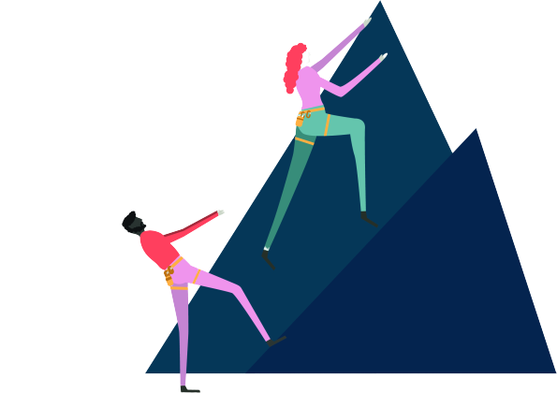
Session 2
Reading your graphs
Team wheel​
Exploring your Reports
Notes:
READ SLIDE

Slide 35
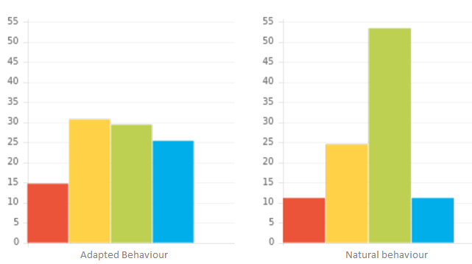
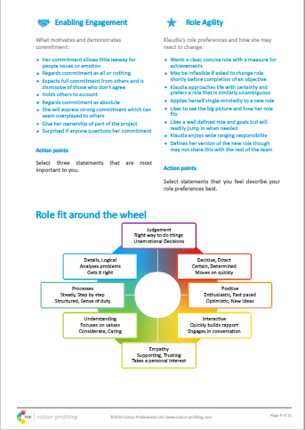
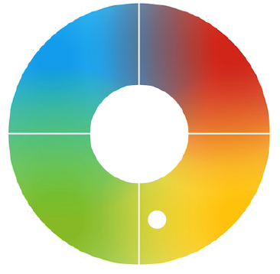
Displaying Behavioural Preferences
Notes:
We display information in 3 key ways in our reports:
Graphs.
The wheel position that summarises the graphs.
Statements and an overview N.B. Statements are bespoke to the profile and all based on the ADAPTED graph
In our most comprehensive High Performance Reports we also include diagrams for individuals to see where they sit in relation to others, helping them to identify their place in their team/organisation.

Slide 36
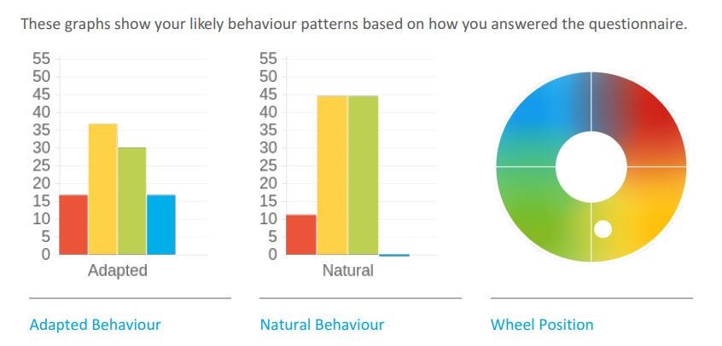
C-me Report Graphs
Notes:
Principles of C-me are encouraging people in an age when it is easy to pick out weaknesses.
If we do point out areas for development, we do this gently and always with encouragement for growth
When presenting the graphs - don’t get too stuck on the graphs, it’s a snapshot.
The graphs summarise the whole of the report - They are the prescription/the lens, through which we look at all the behaviours in our report.
See Accreditation Manual Chapter 4 for all this information
Brief Explanation of 3 graphs.
Adapted Behaviour
Conscious graph
How behaviours are adapted, modified in particular circumstances to do well in the world.
Metaphor: Like preparing yourself for a photo that the world will see #selfie.
Individual statements in profiles and Colour Wheel Position drawn from information from this Adapted graph.
Natural Behaviour
Less conscious graph.
Illustrating behaviours in situations of rest and stress - less filtered behaviour.
Revert to type behaviour.
Metaphor: Like having a photo taken of you across the room #nofilter.
Wheel Position
Not boxing you but highlighting colour balance and resilient behavioural colours.
Based on Adapted Graph.
The scale we use:
0-55 is the number scale we use to plot your answers.
Anything above 23 (approx.) we consider a resilient strength and a significant outcome to take notice of.
We really suggest you look at the order and not the exact number each one is.
There are two different algorithms working as you answer the questionnaire:
One is looking at your conscious answers, how you like to be seen by others and choose to behave.
The other is looking at your less-conscious answers. Behaviour that is less evident day-to-day.
The test works by reflecting how you ranked the statements, none of them will be an exact reflection of how you see yourself.
Key language to use:
It seems that this is your preferred choice,
From the answers you gave,
The choices you made.
Identifying when a colleague is operating on their left or right hand side of graph:
Once you know your colleague’s profiles (left and right graphs) you get to choose to alter the way you’re working to help them out.
Perhaps think how to flex in order to reduce their stress behaviour, cut them some slack
When to use the graphs
The graphs are good for coaching and when reviewing staff wellbeing
In recruitment when it may give you clues to what behaviour you might see come out more after the probation period and what you need to plan for.
In a workshop it’s usually enough to spend only a few minutes on this slide to explain that: Left is more filtered as we adapt to do well in the world and right is less conscious and when we’re under stress or at rest. You can also use this as an example to interpret graphs.
In a workshop
In the majority of our workshops we hand out reports during the workshop, it's up to you when you demonstrate reading a graph, before or after giving out reports.
Who to do this with in a workshop?​
Team leader or most senior person in the room.
Ask their permission before you do it.
This way you're building currency and giving the team language and confidence to have conversations within their own teams about their graphs. ​
​
Before the workshop consider the following:
Help yourself by having a read-through of their overview first and draw on some of those statements
In which half of the wheel does this profile sit – look at their leading colour
Look at where their top 2 colours sit on the wheel together – top/bottom or left/ right (where on axis) – what together might they be indicating?
Look at the difference between the adapted graph and the natural graph = to what degree are they adapting day-to-day/how much are they having to flex?
Often the closer the alignment of their adapted and natural graphs the stronger the report resonates.
Which colours are above 23? A 3% difference isn’t significant. We see resilience in 23 or more.
What +ve behaviours are they bringing?
What might they need to look out for?
Coaching questions to ask when reading the graphs:
Before you read the graphs - perhaps ask them first how they respond to the graphs?
You can invite others to speak in to the graphs before telling them whose graphs these are.​
Invite examples of behaviours this person displays which may support the graph (emphasise +ve and encouraging tone)​
DEMONSTRATE HOW TO READ THIS PERSON'S GRAPHS
Quotes from Overview:
You appear to be someone who is very affable, eloquent and easy to be with, not easily judging others even when they have opposite opinions to you.
You may be someone who most enjoys dealing with people and issues related to people.
Perhaps you're someone who enjoys juggling lots of tasks at any one time and being involved in a variety of projects that use your skills.
Your profile suggests that at times it might challenge you to say 'no' to others' requests.
Maybe you also find that when you're stressed you struggle to focus on one thing, maybe focussing on detail becomes difficult and figures may be more challenging to get a grasp of.”
From the way that you have answered the questionnaire in your Natural graph you are showing a preference for:
(Yellow, Green), leading with an extraverted and creative energy – intuitive in the way you makes decisions in life and not overly concerned with finalising all the details of a holiday for example or making a list of tasks.
The presence of such low blue preference doesn’t indicate that you are unable to perform activities normally associated with blue preference (e.g. details/deadlines) it just reflects your preference for the opposite.
Your Adapted graph is suggesting that:
You’re moderating your high yellow and green energy for ideas and gut instincts in order to bring up your red and particularly blue energy.
It shows a clear awareness of the need for details and pushing to deliver results whilst remaining encouraging and considerate of others.
Ask the person how they feel it resonates? Invite them to input their opinion to shape the outcome.
At this point you might ask the person to contribute by reading out some parts of their reports – Team Contribution. Strengths, Areas for Development to discuss as a team. We’ll go in to more detail about our report sections tomorrow.
If we were to address areas for development or awareness in this person’s graph:
With a profile like this your answers are indicating that you may find yourself:
Losing focus quickly
Perhaps sometimes you would prefer to brush over problems and details and if unable to do that it would require you to exert extra effort to deal with these things.
I wonder if there are times you have to consciously hold your tongue so that you don’t come across as talking too much.

Slide 37
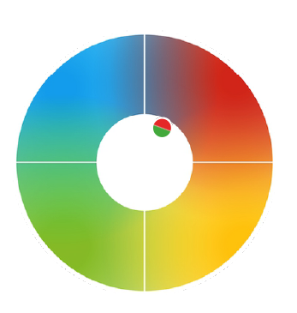
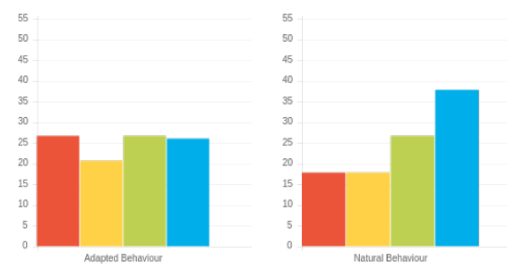
Cross Types
Notes:
SEE CHAPTER 4 OF YOUR ACCREDITATION MANUAL FOR AN EXPLANATION OF CROSS TYPES.
5-10% of respondents fall into this area.
Approximately half of cross-type participants will fall into a more usual pattern when they complete the questionnaire again in different conditions or circumstances. Examples of why this may be could be:
They completed when rushed or in an environment that wasn't relaxed.
They may be trying to show a pattern of behaviour, perhaps their interpretation of what is expected from the result.
They may be going through a current uncertainty in their work, position, career or home life.
They might not have entered into the spirit of the questionnaire, making more random selections.
They may be less clear of their preferences and struggle to answer the questions.
They may be thinking too hard about each question.
They may have just not wanted to complete the questionnaire and/or participate in the outcome.
Equally, the scores showing a cross type may describe their preferences completely. They may be confident of who they are and how they scored the questionnaire.
Generally the uncertainty is shown in graphs where colour scores are close, particularly when there is only a small difference between the second and third highest scores.

Slide 38
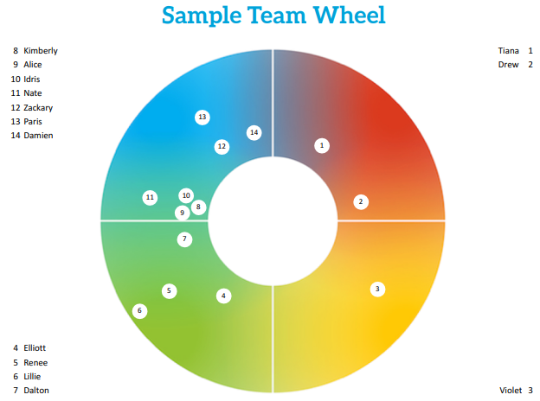
Notes:
SEE CHAPTER 3 IN YOUR ACCREDITATION MANUAL FOR NOTES ON THE TEAM WHEEL.
Powerful visual tool for asking questions of a group. Standardly wheel positions are taken from the adapted graph on individual reports but we do now have the ability to also include the natural graph, which we will talk more on later.
If you were physically with this team, after the card game we ask teams to physically make a wheel and stand where they think they’re likely to be.
Or another version: Stand where you feel you’re operating right now in this team (because with different days/projects people can move around the wheel).
It’s a powerful visual to demonstrate dynamic of a group.
We then later on recreate their actual team wheel and see if anyone has moved.
HOW TEAMS ARE PLOTTED ON THE WHEEL:
Inside rim to outside rim position – think of it like a cycle track, the smallest ring has the shortest distance to travel to the other colours, those on the outside rim have the furthest distance to travel to get to the other colours.
Depending on the number of the colours that are high/resilient, if only one they will be out on the rim. From this position it’s harder to flex to different wheel positions.
The majority of people have a two colour high preference and those are plotted in the centre of the wheel.
About 20% have a third colour high and this combination is more flexible so it’s much easier for them to flex so they sit towards the middle (inner rim) of the wheel.
ACTION: Let's look at how this sample team might behave if they were a working team: CHAT BOX/SHARE.
How do you think this team is likely to work?
What questions would you have asked of the team?
E.g. How do you think Violet (3) might feel being almost or totally alone in her quadrant?
What would the strengths of this team be?
What might they need to be aware of? Potential challenges?
Look at Jungian quadrant positioning (top/bottom and left/right):
Where is the dominant area of the wheel? What behaviour does this represent?
If this was a real team a key question would be – What is likely to be their preferred way of working and how does this compare to their reality? Do they get time to reflect/time to ideate/time to connect, if these are the dominant behaviours of this team?
Help them drill down to how their wheel is affecting how they're working. Help them pool ideas and see different perspectives.
Remember nothing is better or worse.
These team wheel PDFs come with an instruction page and suggested questions to ask the group to help you.
Useful for recruitment – people coming into the team, how are they going to fit. Is there a behaviour type you want in your team?
Personal coaching – do they need to flex in their role more, with certain team members, can they be coached to work more in their highest colours?
Onboarding new team members – what do they bring that’s different? Who might they naturally work with? Who has different preferred working styles to them?
Company timeline: Is it a start up, is it a mature organization, for example where is the organization in a life cycle, what does this team wheel look like through the different stages of change, what is this team looking to achieve?

Slide 39
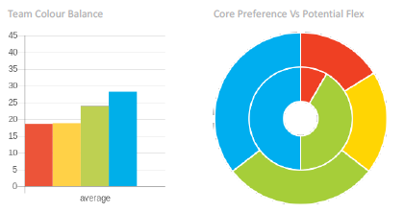
Notes:
Three different ways we can display team information:
1st graph is: Summary graph of all team’s adapted graphs in one.
2nd graph is: Inner circle is the primary colours (is plotted on the team wheel), secondary circle is any colour with over 23% score – so a resilient strength in their second or third colour.
3rd graph: Radar graph – explain on next slide

Slide 40
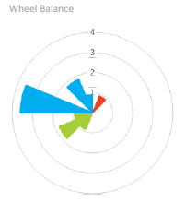
Notes:
Wheel Balance Radar graph - Final graph is for large data sets; when a standard team wheel would be too cluttered (realistically no more than 50 per side). Over 100 max for a wheel.

Slide 41
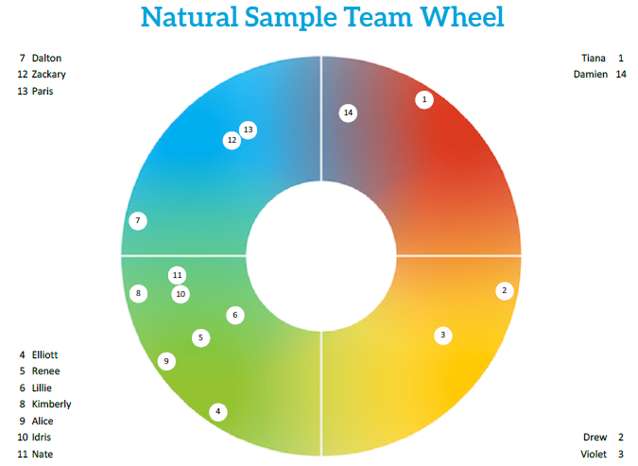
Adapted Wheel
Natural Wheel
Notes:
The Natural Team Wheel
This wheel is compiled using the data from individuals' natural graphs. It therefore represents their unmodified behavioural preference position. For the team as a whole then, it gives an overview of how the team is likely to approach things if their modus operandi is #nofilter.
Team Dynamic
Teams tend to adopt a less modified behavioural style when they are working under pressure or out of their comfort zone. This may be, for example, as a deadline approaches.
This wheel will therefore help a team to plan ahead, anticipating how to best manage those situations.
- What gaps are likely to emerge?
- What balls might be dropped as a result?
- Does the pace of the team speed up or slow down under pressure?
- Do people revert to the detail or miss it entirely!
Individuals- team members
On a more individual level it also gives the team awareness of one another’s less filtered behavioural style, at a glance. This can be used for a helpful discussion around handling setbacks and stress. When an individual’s behaviour is more extreme or surprising, this can therefore provide a helpful reference to assess if that may be due to their moving into a less modified zone. If this is indeed the case the key question is “why?”. What else is demanding the energy from them that would usually go into modifying their behaviour?
Or perhaps this is a positive thing – a relaxation of modification as they settle into the team for example. This is more likely for those who are new to the team where you would typically expect to see a higher degree of modification for the first 3-6 months as they adapt to the role.
When a colour preference is lacking in a team, i.e. an area of the adapted wheel is blank, the natural wheel can give helpful clues as to who is likely to be most comfortable moving into that space. Or perhaps for whom this would be least costly in terms of their energy.
The greater the overall difference between the natural and adapted team graphs, the greater the possibility that roles within the organization may need revisiting. the more a team as a whole are having to flex their natural behaviours, the more predisposed they may be to exerting extra effort in order to perform on a day to day basis. This may then give way to a potential rise in stress levels.
Managing the team
Managers can make use of the natural graph by assessing the extent that individuals and the team as a whole are having to modify behaviours. Locating the individuals whose positions on the natural and adapted graphs contrast most can highlight those that may need additional support but can also provide an indication of role fit. i.e. a person may be in the right team but not in the optimum role to bring their best and therefore contribute effectively to the whole.

Slide 42

Resilient Strengths
Realistic
Focuses on details
Considers all the facts
Strong work ethic
Logical and analytical
Sets high standards
Brings clarity to complexity
Bold and determined
Drives hard for delivery
Focuses on results
Decisive
Brings clear direction
Powerful advocate
Enjoys a challenge
Tactful and diplomatic
Builds consensus
Dedicated to the team
Considerate and attentive
Reliable and dependable
Works until the job is done
Tolerant and open-minded
Energetic and enthusiastic
Positive outlook
Creative and innovative
Expressive and persuasive
Embraces change
Social and outgoing
Inspiration and visionary
©2021 Colour Preferences Ltd | www.colour-profiling.com
Notes:
Looking at the individual colour blocks we can go in to more detail and look at the resilient strengths and development areas of each colour.
* Particularly important to dwell here if there is a value judgement being made in an organisation against one of the colours.
Example: a heavily dominant engineering orientated company that values blue preference behaviour but does not value yellow preference behaviour.
Key question: What might happen if we have no yellow preference?
Let them do the thinking: Perhaps there might be no innovation….We might not grow…
*Let’s take a moment to reiterate what we’re looking at is resilience not competence.
Resilience = where we perform at our best and for the longest time given any task.
Not about what we’re good at but what gives us life and energy.
Colour does give us clues as to where we gather energy and so if we’re in a role that demands our lowest colour we need to look at how to structure our day in practical ways to work effectively.

Slide 43
Areas for Development
Tends to over analyse
May appear aloof
Gives too much information
Obsessive about the detail
Slow to trust
Lacks spontaneity
Constrained by the rules
Overly competitive
Not diplomatic
Can dominate discussion
Too focused on results
Doesn’t know when to stop
May not be listening
Action overrides planning
Appears to lack urgency
Can be indecisive
Often self-critical
Procrastinates
Reluctant to change
Difficulty setting priorities
Constantly checking consensus
Can appear disorganised
Jumps between ideas
Can be idealistic and impractical
Loses interest quickly
Lax time management
Everything to excess
Inclined to talk too much
©2021 Colour Preferences Ltd | www.colour-profiling.com
Notes:
If you are looking to coach observable behaviours to help your clients grow then this is what we might look out for.
These are the bad day behaviours that are standardly areas that may need to be worked on or strengthened for each colour preference.
I like to think of it like weight lifting, some muscles take some working out to get stronger.
So it’s not that you can’t operate out of all the other colour strengths but that you may need training.
Our unique selling point as a tool is that we’re looking at observable behaviours, we’re not challenging people’s values or beliefs but what behaviours someone is choosing to display and adapt in their context.
It is easier to coach and adapt behaviour than personality.

Slide 44
Explore, Filter, Share
Overview (Page 4)
  Read through your Overview
  Highlight statements that resonate with you
Resilient Strengths and Team Contribution (Page 5 & 6)
  Pick 3 Resilient Strengths
  Pick 3 Team Contributions
  Pick 3 Areas For Development
Notes:
GIVE THEM TIME TO READ THEIR REPORTS, EITHER AT ONCE OR IN SECTIONS.

Slide 45
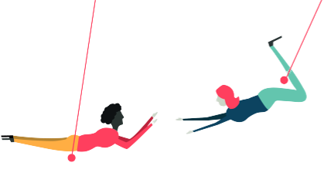
Questions
Notes:
PLACE SLIDE WHEREVER YOU WANT IN YOUR WORKSHOP.

Slide 46

Break
Coming up…
Notes:
PLACE THIS SLIDE WHEREVER YOU WANT TO TAKE A BREAK.

