Slide 1
Preparing for your C-me session
Note. Certain slides can be hidden (right click ‘Hide Slide’) depending on session needs. Certain slides will need editing for each session (see below)
Checklist:
C-me profile is needed.
Welcome Slide: Option to add Client’s/Team's logo/brand to Slide 3
Aims: Slide 7 (Remember to adjust if slide deck is modified in anyway)

Slide 2
Session Delivery
We encourage you to run through all the slides ahead of delivering them in slideshow mode. Some slides are static and others include animations. Please check that the animations work as expected.
Brief notes are provided below each slide to give delivery guidance.

Slide 3


C-me Foundation
Workshop
Helping teams communicate, collaborate and perform at their best
Notes:
If delivering remotely:
Welcome everyone on grid view (share slides later).
Give a very brief personal introduction
Purpose: The purpose of this workshop is ……
Programme: The timeline for today is ….
If recording session: Let the clients know at the start.

Slide 4

Introducing C-me …
3 levels of impact …
Individuals
Teams
Organisations
Notes:
C-me is an independent company, operating for over a decade, specialising in behavioural preference
Profiling.
We focus on three levels of impact:
Individuals: helping individuals to grow in self-awareness + apply what they’ve learnt to their personal
development (relevant both at work and at home).
Teams: this then naturally flows to understanding how we operate in the wider context, how behavioural
preference impacts our team or group dynamics.
Organisations: then looking more broadly at what affect that has on an organisation as a whole – with the
data gathered we can reflect this back on an operational level to understand how these dynamics might be
affecting culture as well as the overall organisational performance, helping to create positive change.
We’ve worked to develop a tool that is:
Intuitive,
memorable
and can effect immediate impact and sustainable change for both your employees and clients due to
our focus on action and simple application.
During the development of C-me our founders worked with a leading psychometric expert to draw the best
out of all the available psychometric testing tools, harnessing modern technology to echo our core face values:
flexibility, accuracy, clarity and ease of use.
Our goal is to help people understand themselves and others better, in a transformative way, beyond their first
encounter with their profile.
We’re committed to seeing sustainable and lasting impact, continually seeking to improve what’s available.
A decade or so down the line this remains our focus.

Slide 5
























Notes:
C-me has a broad and rich pool of experience in different sectors including: (suggest highlighting
those most relevant to your clients)
Education
Health & Fitness
Defence
Entertainment
Not-for-profit and FTSE 500 companies
Local schools and individuals.

Slide 6
Our values
F
C-me is adaptable to meet the participant or organisation’s purposes, industry, and bespoke needs.
lexible
A
The C-me method is underpinned by years of research, development work and practical learning.
ccurate
C
C-me makes all profiles, workshops and communication simple and easy to understand.
lear
E
asy to use
The profiles are quick to complete (just 10 minutes) and simple to understand.
Notes:
We suggest picking out the key features that will resonate with your clients.

Slide 7
Our aims for this session
01
Lay a foundation for how C-me works
02
Provide a language for describing behavioural difference
03
Explore and discuss your C-me profile
04
Apply learning to maximise personal performance and team dynamics
What are your aims? …..
Notes:
Check these aims are appropriate for your clients and tailor if necessary.
Give space for participants to share their session aims in the chat.

Slide 8

Session outline
01
Introduction to colour and behavioural profiling
02
Brief history of psychometric testing
03
Understanding your profile
04
Effective communication
05
Personal and team reflection
Notes:
Remember to amend this slide if you adapt the session content.

Slide 9
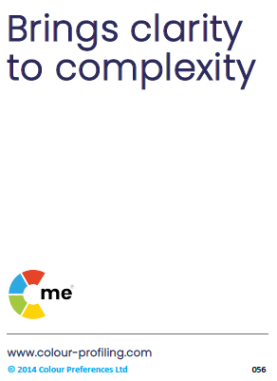
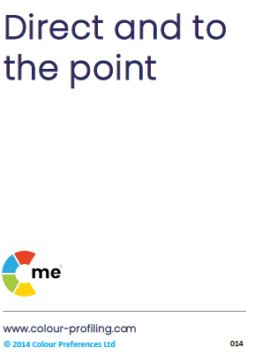
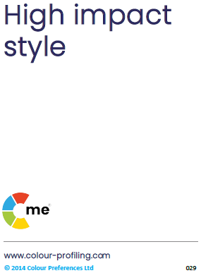
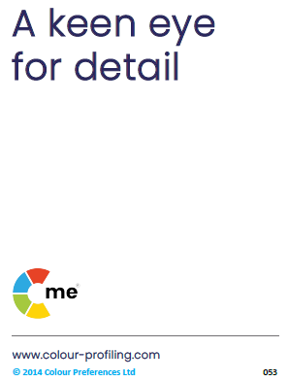

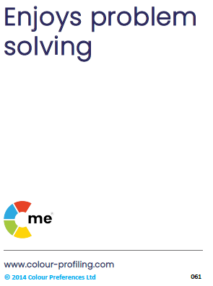
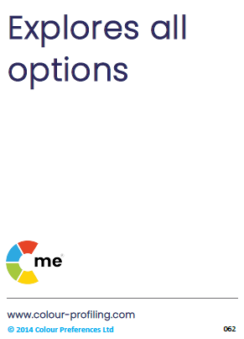
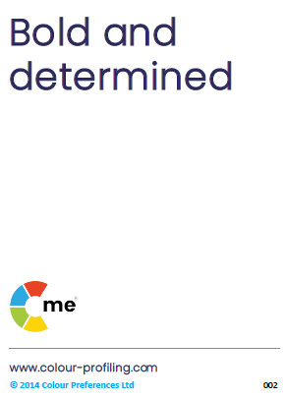
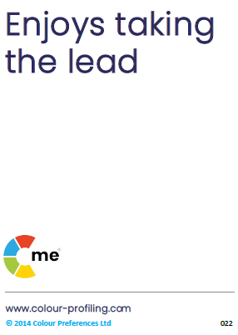
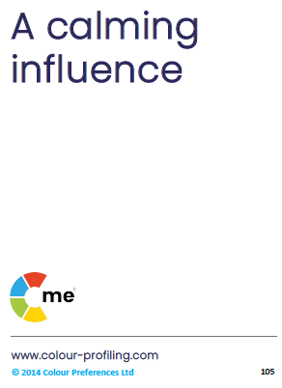
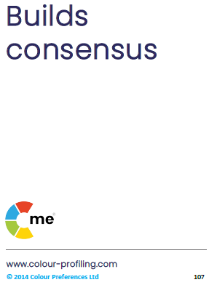
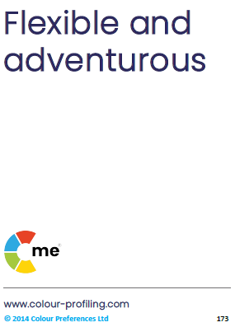
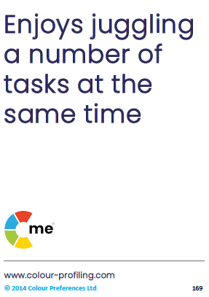
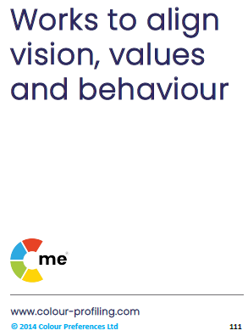
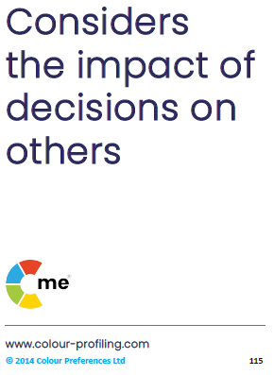
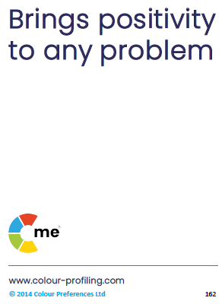
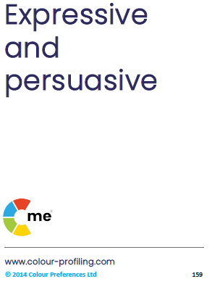
v
C-me preference around the wheel
Notes:
Let’s start by looking at the C-me colour wheel - the heart of
our approach to behavioural preference + how we represent them at C-me.
It’s a blended colour wheel – and this is important because it reflects that we flex our behaviours to move
around the wheel – the key here is that you can move, you're not stuck, there is room to develop and grow. Colours
blend, numbers and labels don’t.
This is a non-binary/non-dualistic approach – not boxing you in but giving you a common language to understand
preference diversity and improve communication.
We’ve grouped similar behaviours by colour and mapped them onto the wheel for learning purposes – we’ll unpack
this further as we go on.

Slide 10

Impact on others
Behaviours
Personality
values, beliefs
Notes:
Let's start with the foundations of C-me and the fundamental difference between C-me and other tools in this field:
Emphasize C-me’s focus on observable behaviours, not personality.
Known as behavioural preference profiling.
Exercise: Can someone explain to me why this is important and what impact you think that might have for you?
Our usp, is that we’re looking at observable behaviours, we’re not challenging people’s inherent values but
instead looking at what behaviours someone is choosing to display and adapt in the context they find themselves in.
We acknowledge that individuals have a range of behaviours they can choose from, but we seek to assess
their preferred ways of working, or what they might naturally lead with, within this range.
Our behaviours directly impact others and can be flexible to change - behaviour is easier to coach and adapt
than personality, which is often seen as fixed.
We’re helping to bring realisation around our tendencies - we’re speaking to behaviours that emerge from
our core beliefs, values and our personalities.
We don’t label any specific behaviour as 'right' or 'wrong’, but simply individuals choosing what feels
'right' for them.
Personality tests are looking to assess the underlying personality traits, which can be complex, often seem
vague and can leave individuals feeling boxed in.
Our bank of 1,000s of statements are based on behaviour.

Slide 11
C-me virtual card game
The purpose of this game is to introduce you to the language and colours of C-me
Notes:
Note. Use the following slides only if delivering remotely:
On this slide you will see the cards you can use if delivering in person (available to purchase
direct from C-me).
On one side of the cards are statements and on the other side are colours.
Foundational C-me activity.
Aim of the game: A hands-on, interactive introduction to the card statements, associated with the
4 colour quadrants on our colour wheel.
When delivering workshops, group exercises and coaching we aim to keep things highly interactive,
bringing tangible solutions, immediately transferrable to the lives of those taking part, both personally
and in the context of their working environment.
We want to teach them how to help people quickly put into practice what it is they’ve learnt.
Action - run the game … for this exercise you’ll need a pen and paper...
Refer to Accreditation Manual (Chapter 5) for more information on how to run the game, including
variations.

Slide 12
v
C-me virtual card game
1.
2.
3.
4.
5.
6.
7.
8.
9.
10.
11.
12.
13.
14.
15.
16.
Notes:
Action: recreate this grid on your paper, drawing three columns with the numbers 1-16 down
the side in the first column.
Note. Whilst your clients are drawing the grid, it’s helpful for you to draw the grid at the same
time in order to get your pace right.

Slide 13


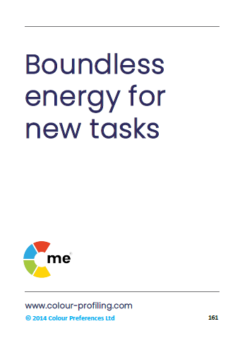

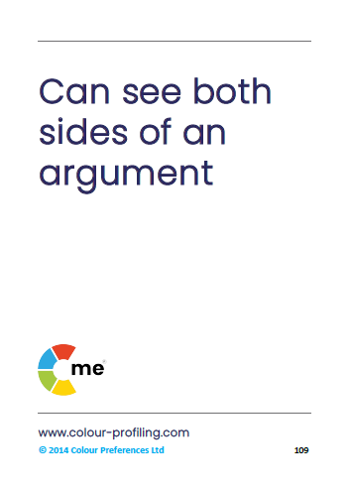
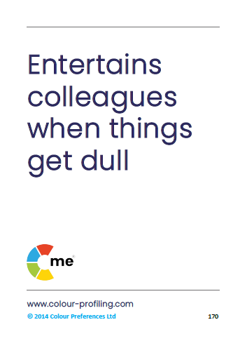
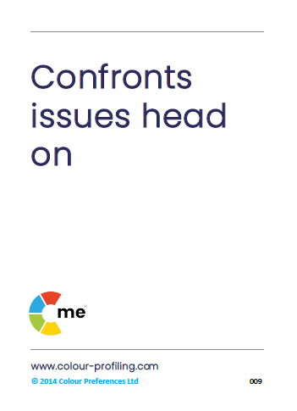

1
2
3
4
5
6
7
8
Notes:
Read out each card statement (each one corresponds to number 1-16 in grid).
New card will be revealed on each click.
Action: if the statement on the card describes you, insert a tick for ‘yes’ in the 2nd column on
your grids next to the corresponding card number, if not, insert a cross for ‘no’.
Try not to think too much about the statements - just go with your initial or gut response.
This is just a game to help familiarize you with the statements and help you to start to be
aware of what your natural preferences might be.

Slide 14
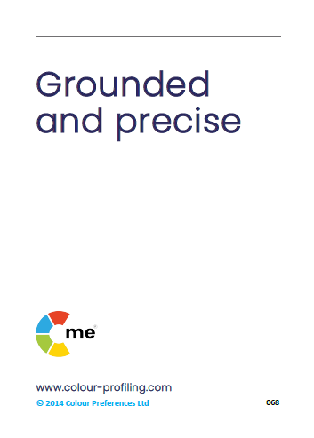

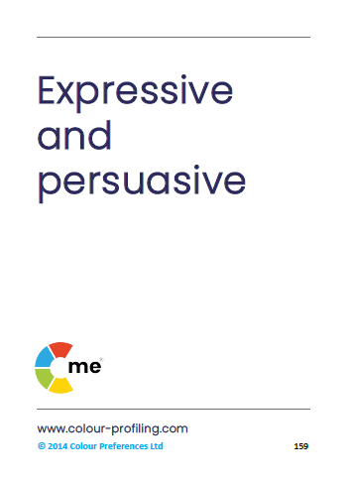

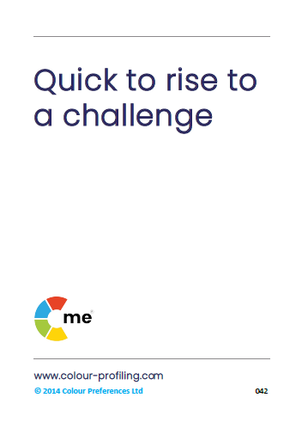
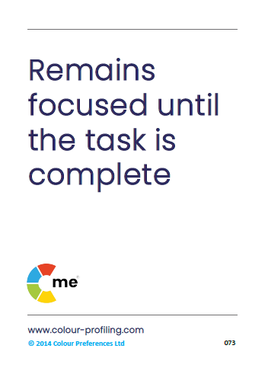

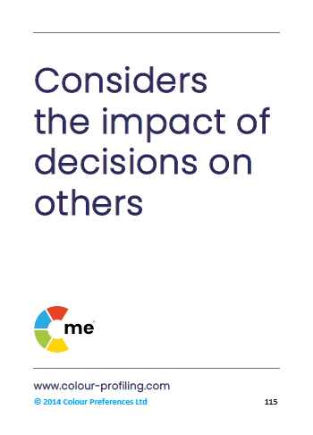
9
10
11
12
13
14
15
16

Slide 15
v
C-me virtual card game
1.
2.
3.
4.
5.
6.
7.
8.
9.
10.
11.
12.
13.
14.
15.
16.
Notes:
That’s the first part complete and you should now have a table that looks something like this.
We’ll now go through each statement and their associated colours, filling in the final column so you
can start to see the preferences you may have identified with as a first response.

Slide 16
1
2
3
4
5
6
7
8
Notes:
Reveal the colour preference of each card, one at a time, clicking through.
Action: as the colours are revealed, write the first letter of each colour in the final column
on your grids, alongside the corresponding card number: R, Y, G, B.

Slide 17
9
10
11
12
13
14
15
16

Slide 18
v
C-me virtual card game
1 |  | Red
2 |  | Green
3 |  | Yellow
4 |  | Blue
5 |  | Green
6 |  | Yellow
7 |  | Red
8 |  | Blue
9 |  | Blue
10 |  | Yellow
11 |  | Yellow
12 |  | Red
13 |  | Red
14 |  | Blue
15 |  | Green
16 |  | Green
Total number of ‘yes' cards
red | 3
yellow | 4
green | 2
blue | 0
Notes:
Action: add up the ticks, your ‘yes' cards for each colour and insert the totals in a box like this one, on
the right.
Note. The great thing about the card game is that it engages people in an activity almost immediately,
starting the session with energy and active learning.

Slide 19
C-me virtual card game
how many different colour preferences have you identified (ticked)
1?
2?
3?
4?
what might this tell us?
what are your top 2 colours?
Notes:
Of the four colours, how many are represented in those you’ve ticked? ’click’ to reveal number options.
Action: in the chat, list how many colours you have? 1, 2, 3, or 4?
‘What might this tell us?’ – essentially that although there may be a preference or leaning
towards one or two colours, that this isn’t binary, we are all actually a blend of each colour.
Action: include your top 2 colours in the chat.
We’ll come back to this again when looking at the team wheel which displays our position based
on these top two colours, illustrating how the different positions on the wheel may interact.

Slide 20


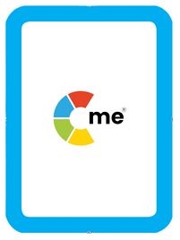


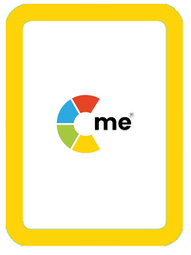

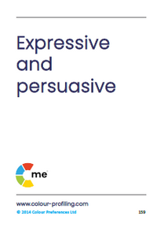
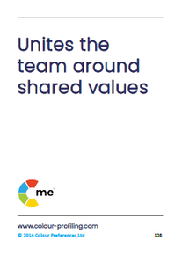
C-me card game in the room
Notes:
For running the card game face-to-face.
Explain that we sell packs of cards if they would like them. The cards have statements on one side
and the colour associated with that preference on the other side.
Game instructions:
Before individuals enter the room, create a selection of cards for each person that includes each of the
4 colours e.g. 3 red, 3 yellow, 3 blue, 3 green (i.e. total = 12 cards per person).
(208 cards in a pack so 17 people can play the game with one pack).
Shuffle each pack of 12 and put them with statements face up underneath their chairs, for example.
Before the workshop begins delegate a corner of the room or similar for each of the 4 colours: yellow,
green, blue, red (perhaps put a visual of each colour in each corner as a reminder).
Within 90 seconds of the start of your workshop, or as soon as you can, ask attendees to pick up their pack
of cards and read the statements on the front.
Then to make a pile of the statement cards they feel describe them (yes pile) + a pile of the cards they don’t
recognise or they aren’t sure of (no pile).
Give them 1 minute to sort the pack into two piles.
Ask them to leave the pile of ‘yes’ cards where they are but to pick up those they don’t recognise, the ‘no' cards
and on their feet again, interact with the other delegates to give away their ‘no’ cards to those that do resonate
with those statements. Give them 3 minutes to do this.
Next ask delegates to combine their initial ‘yes’ cards with those they have accepted in the swap.
Instruct them to turn their cards over and count how many of each colour they have.
Asking them which they have the most of, to then go and stand in the corner of the room associated with that
colour.
Starting with the yellow corner ask each group at a time to read their ‘yes’ cards, corresponding to their highest
colour, aloud to the rest of the group.
Ask the rest of the group to feed back what they are hearing about that colour preference – on a good day and
what that might look like on a bad day.
Go round the room.
Typical questions at this point:
What if people have even numbers of two colours? Ask them to go to the corner with the least number of
people in, for the purpose of the game.
Why yellow first? often most willing to contribute, high energy group.

Slide 21
v
C-me preference around the wheel
Notes:
At this point, your attendees are starting to personally identify with statements.
We’re now going to explore what behaviours might be grouped in each colour.
So again here we have the C-me colour wheel:
Key points to be communicated …
Blended colour wheel – colours blend where numbers don’t visually illustrating that we’re
all a blend of each.
We flex our behaviour as we move around the wheel.
This is a non-binary approach and not meant to box you in but instead to recognise what we have in
common and what we may find more difficult, unlocking group dynamics by understanding style and
preference.
We have grouped similar behaviours by colour and mapped these onto the colour wheel.
Note. The closer your position is to colleagues, the more behaviours you’re likely to have in common.
Note. The further you are from a colleague, the more you may differ in your perception of the "right"
way to do things.
Note. You may find it harder to understand those on the opposite side of the wheel.

Slide 22
v
Good day/
Resilient strengths
  Infectious energy
  Positive outlook
  Fast paced
  Sees the opportunities
  Interested in everything
  Embraces change
  Lively, sociable + fun
  Inspirational + visionary
  Not afraid to take risks
  Spontaneous + imaginative
On a bad day
  May miss important details
  Can appear disorganised
  May have a short attention span
  Poor time management
  Potential to ignore downsides
  Inclined to talk too much
  May not finish what they start
Notes:
So let's first explore each colour group and its associated behaviours in more detail.
Our aim is to check everyone is on the same page.
Read out the card statements.
1st reveal: “good day/resilient strengths” - define what a resilient strength is: less about competence
and more about a person’s “happy space” where they will perform best, for longest.
Exercise: please put in the chat some other words you might use to describe yellow preference
behaviour on a good day.
Note. when acknowledging their response, focus on the positive things people have written (this is a time
to celebrate this colour energy).
Once you've acknowledged their response, click to reveal the list on the slide : 2nd reveal.
3rd reveal: we also all have “bad day behaviours” again describe what we are talking about here. This
what you might see from this colour preference when things aren’t going well or they are under stress/
feeling overwhelmed.
Exercise: again, in the chat, please list behaviours those with a yellow preference might display when not
having such a great day.
Note. Keep an eye out for people writing 'leader’ at any point, associated with a specific colour.
Take the opportunity to flag this acknowledging "that's an interesting observation, we’ll come back to address
this shortly“. Later make the point that you can lead from any position on the wheel.

Slide 23
v
Good day/ Resilient strengths
  Respects others' values
  Follows through
  Generous
  Works for a democratic solution
  Tactful + diplomatic
  Can see both sides of an argument
  Team player
  Thoughtful + considerate
  Tolerant + open-minded
  Steady + reliable
On a bad day
  Appears to lack urgency
  Can be indecisive
  Often self-critical
  Tendency to procrastinate
  Slow to venture an opinion
  Finds prioritising difficult
  Spends too long in discussion
Notes:
Repeat exercise for green preference behaviour:
Read out the statements on the cards.
1st exercise: please put in the chat some other words you’d use to describe green preference
behaviour.
2nd exercise: and on a bad day what might green preference behaviour display?

Slide 24
v
Good day/ Resilient strengths
On a bad day
  Tendency to overanalyse
  Can be resistant to change
  Points out the downsides
  May obsess over the details
  Can slow the team down
  Lacks spontaneity
  Can be constrained by ‘the rules’
  Logical + analytical
  Prepares for contingencies
  Realistic
  Sets high standards
  Methodical + systematic
  Takes care of the details
  Strong sense of duty
  Structured + disciplined
  Takes a balanced view
  Considers all the facts
Notes:
Repeat exercise for blue preference behaviour:
Read out the statements on the cards.
1st exercise: please put in the chat some other words you’d use to describe blue preference
behaviour.
2nd exercise: and on a bad day what might blue preference behaviour display?

Slide 25
v
Good day/ Resilient strengths
  Quick to determine priorities
  Drives hard for delivery
  Focuses on results
  Pragmatic decision maker
  Powerful advocate for the team
  Confident + resourceful
  Enjoys setting challenging goals
  Brings clear direction
  Sets a fast pace
  Forges strategic partnerships
  Can be intolerant under pressure
  Dominates discussion
  Focus on results can appear ruthless
  Competitive streak can be overplayed
  Dismissive of others’ views
  Imposes seemingly impossible standards
  Need for action can override planning
On a bad day
Notes:
Repeat exercise for red preference behaviour:
Read out the statements on the cards.
1st exercise: please put in the chat some other words you’d use to describe red preference
behaviour.
2nd exercise: and on a bad day what might red preference behaviour display?
Reflect on this exercise – any questions?

Slide 26
v
Leadership + management
Notes:
Time to address our judgements around leadership and management.
Often people make the assumption that red preference makes for the best leaders or even that this is
what is needed to lead: red = leadership.
This is incorrect - in reality every colour preference brings unique strengths to leadership
and management.
There is no one ‘right’ way when it comes to leadership.
It looks different with every colour lens.
By this point in a workshop, delegates are starting to appreciate good and bad days for each colour
preference – we want to take that further, so that people leave with greater behavioural intelligence.
Note. No matter what organisation it is, if leadership only reflects a certain specific style or preference then
this runs the risk of becoming the hallmark of what constitutes leadership, becoming one dimensional and
shutting the door to opportunity and innovation.
We want organisations to flourish drawing on diversity and inclusivity to harness the full spectrum of what its people
have to offer, growing in diverse styles of leadership, drawing on different behavioural preferences, maximising
engagement and productivity across the organisation.
Exercise: what are the strengths of each leadership style around the wheel? chat box/discussion.
Red – good day: visionary, quick decisive action, clarity of purpose, bold strategies – bad day: may feel controlling
and impatient, total focus on task, with little consideration for ensuring people are following.
Yellow – motivational, empowering individuals, inspiring innovation – bad day: unfocused, overwhelmed by amount
of possibilities, juggling too many things with no set timelines.
Green – nurturing, make sure whole team involved, collaboration, focus on values, purpose and quality – bad day:
procrastination, prolonged decision making in an effort to involve and gain agreement from everyone.
Blue – organised, clear timelines, realistic, ensures follow through, grounded, high standards – bad day: over analysis
creating a bottle neck, tension between timelines and needing to explore options, micromanagement, potentially slow
to delegate, lack of communication creating issue with buy-in.

Slide 27

v
Resilient strengths
Realistic
Drives hard for delivery
Strong work ethic
Focuses on results
Logical + analytical
Decisive
Brings clear direction
Sets high standards
Tactful + diplomatic
Positive outlook
Dedicated to the team
Embraces change
Highly values authenticity
Inspirational + visionary
Reliable + dependable
Social + outgoing
Notes:
This is a particularly important slide to dwell on if there is a value judgement being made in an
organisation, against one/some of the colours.
Example: A heavily dominant engineering orientated company that naturally values behaviour standardly
associated with blue preference and potentially places less value on behaviours normally associated with
yellow preference.
Key Question: What might happen if yellow preference behaviours weren’t present in this space?
Let them do the thinking: perhaps there might be no innovation … which might affect growth? … a lack
of creative solutions when faced with challenges or problems?
Let’s take a moment to look at the resilient strengths and development areas of each colour – remember
we’re looking at resilience not competence.
Resilience = where we perform at our best and for the longest time given any task.
Not about what we’re good at but about what gives us life and energy.
You may be very good at things that are normally associated with your lowest colour preference
but it may be draining for you to do this.
Example: Someone who is good at detailed, systematic administrative tasks but when their energy is low,
planning goes out the window, details are missed and balls are dropped. Competence is high but resilience is
low.
Colour does give us clues as to where we gather energy, so if we’re in a role that demands our lowest colour we need
to look at how to structure our day in practical ways to work effectively for longer.

Slide 28
v
Areas for development
Tendency to overanalyse
Overly competitive
Slow to trust
Too results focused
Wary of change
Undiplomatic
Too detail focused
Often interrupts others
Can be indecisive
Loose time management
Procrastinates
Quickly loses interest
Difficulty setting priorities
Can talk too much
Often self-critical
Jumps between ideas
Notes:
Good slide if you're looking to coach observable behaviours in order to help individuals and teams
grow.
These are the bad day behaviours where colour preference may be naturally weaker.
Think of it like weight-lifting, some muscles take some working out to strengthen and build
resilience.
It’s not that you can’t operate out of all colour strengths but simply that it may require training for it
to come more naturally.
C-me’s selling point is that it looks at observable behaviours. It’s not challenging people’s core values or
beliefs but the behaviours they are choosing to operate out of at any given time. It’s easier much easier to
coach or adapt behaviour than it is personality.

Slide 29

Guess the colour
Notes:
A fun game designed to recap and apply learning.
We have come up with our own ideas on celebrities and their potential colour preferences, hopefully we
have chosen those that are well known.
We encourage you to replace these with any others you think might work well.
You could choose fictional characters, celebrities or even car brands.
They could also be industry specific for bespoke sessions.
Action: using the chat box let us know what top 2 colours you recognise for each celebrity
if you’ve never heard of the celebrity then have a guess from the descriptions given.

Slide 30

Kier Starmer
Prime Minister
Notes:
Kier Starmer, British Prime Minister.
Detailed, values integrity, strong moral compass and sense of duty, hidden depths, will take as long as needed
to get things right.

Slide 31
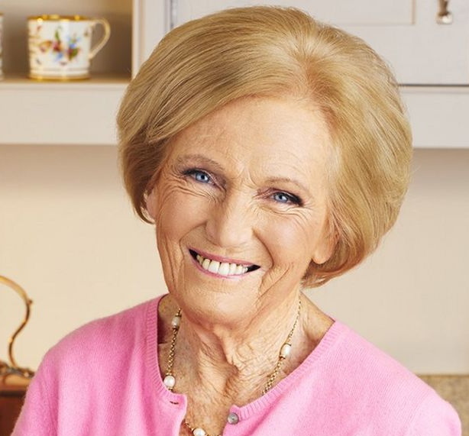
Mary Berry
Cook
Notes:
Mary Berry, Cook and TV personality.
Easygoing, humble, calm in a crisis, practical, methodical.

Slide 32

Gordon Ramsay
Chef
Notes:
Gordon Ramsay, Chef and TV personality.
Straight talking, direct, passionate about food, likes to take the lead, fast paced – doesn’t like wasting time.

Slide 33

Michelle Obama
Former First Lady
Notes:
Michelle Obama, Former First Lady to Barak Obama.
Confident, driven, thinks big, compassionate, advocate for social justice.

Slide 34
v
Background to psychometrics
Carl Jung
1923
C-me
2013
Notes:
Summary slide: to contextualise where C-me fits into the background of psychometric testing.
Throughout history it’s been observed that there are differences between us, as people and how we
behave. Much work has gone into interpreting those differences.
In particular, the work of Swiss psychiatrist, Carl Jung, has had a significant influence on the field of
psychometric testing. Specifically his work on rational functions, thinking and feeling and attitudes:
introversion or reflection and extraversion or expression.
This Jungian axes, displaying behaviour as a scale rather than absolutes underpins the C-me colour wheel.
We’ll go on to unpack how these axes can be mapped onto our wheel, giving another layer of interpretation.
C-me was founded in 2013
- Developing our own algorithms (drawing on a database of
thousands of statements).
- We removed labelling to echo our core values, preferring to talk about blends of colour
energies rather than pigeonholing into specific types. Concentrating on colour over labels
or titles helps to move away from this idea.
- Developing profiles that speak to observable behaviours that can flex and be shaped rather
than definitive outcomes.
- Assessing both conscious and unconscious preferences.

Slide 35
v
C-me and the Jungian axes
Thinking preference
Objective, Analytical, Task-orientated, Focused
Subjective, Personal, Considerate, Relationship-orientated
Feeling preference
Notes:
Let's look at the axes C-me uses to echo jungian psychology mapped onto the colour wheel - helping
to introduce another layer to interpreting the colour wheel.
(Note. the accreditation manual provides further notes on the Jungian underpinnings of C-me).
Exercise: can someone explain the difference between the thinking and feeling preference.
Action: reveal explanations.
Horizontal axis: looks at how we’re making our decisions and how we relate to different situations
in life.
Explain the slide:
Top of wheel = thinking preference – ‘head’.
Bottom of wheel = feeling preference – ‘heart’.
It's not that you can't do both but rather which one is likely to be your starting point.
Exercise: what are you likely to see if someone’s top two colours are both in one half of the
wheel? (more obvious or exaggerated leaning to one side).
What about if their two top colours straddle both sides? (will be more balanced, may not so easily be able
to tell what they might lead with).

Slide 36
v
C-me and the Jungian axes
Action orientated, Direct, Outward focus, Assertive, Vocal, Breadth
Reflective
preference
Expressive preference
Observant, Considered, Inward focus, Attentive, Thoughtful, Depth
Notes:
Vertical axis:
1st reveal:
Right side of wheel = expressive preference.
Left side of wheel = reflective preference.
Language changes and the meanings of words change in time. We have found that there aren’t as many negative
associations with the word ‘reflective’ as there are with the word ‘introverted’ in our culture today, the same goes
for expressive being less ‘loaded’ with negative baggage than extrovert can might sometimes seem.
2nd reveal
Action: reveal explanations.
Note. Sometimes top & bottom/left & right are more obvious to spot than someone’s colour prefence, before
you’ve seen their profile.

Slide 37
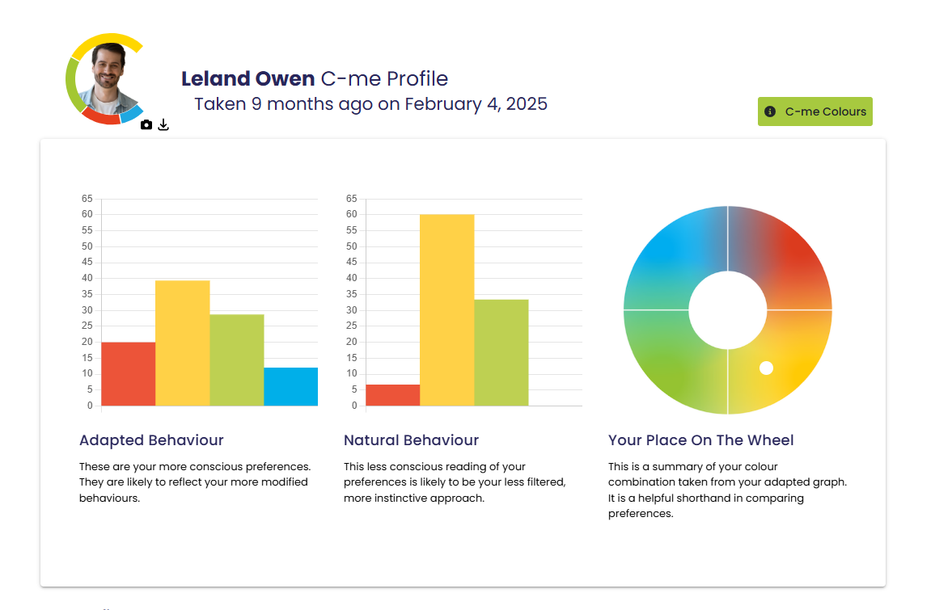
v
The graphs and the wheel
Notes:
This is how the graphs will be displayed in the platform, in the profile tab, when logging in, very similar to the
pdf profile, where you have this.
Below each graph is a short explanation to give context: read them out.
Often easier to think of more conscious and less conscious …
or modified and instinctive.
On the platform: you’ll also find your personalised c which you can upload a profile pic to and also
download.
Reiterate: the graphs summarise your profile - they are the prescription/the lens, through which
we view the behaviours represented by the statements in your profile.
Briefly summarise what the graphs and wheel represent:
Adapted behaviour
Conscious, more modified graph.
How behaviours are adapted or modified in particular circumstances to do well in the role/world.
Metaphor: like preparing yourself for a photo that the world will see #selfie, maybe using filters.
Individual statements in profiles, colour wheel position and personalised C drawn from the adapted graph.
Natural behaviour
Less conscious graph.
Illustrating behaviours in situations of rest but also under pressure or stress - less filtered, more instinctive
behaviour.
Revert to type behaviour.
Metaphor: like having a candid photo taken of you, from across the room #nofilter.
Wheel position
Not boxing you in but highlighting colour balance and resilient behavioural preference.
Based on adapted graph.
The scale we use:
0-65 is the number scale we use to plot your graph.
Anything above 25 (approx.) we consider to be resilient and therefore more pronounced in terms
of associated preference .
The order of the colours is probably more significant than the exact number on the scale for each.
There are two different algorithms working as you answer the questionnaire:
One is looking at your conscious answers, those you most identified with.
The other is looking at your less-conscious answers, the order of the ranked statements.
Whilst it may be possible to manipulate the adapted graph by answering based on what might be expected,
it’s less likely to skew the outcome of the natural graph as the algorithm takes a more complex path through
the questionnaire answers.
Key language to use:
“It seems this is your preferred choice“.
“From the answers you gave your graphs show“.
“According to the choices you made“.
When to use the graphs
The graphs are good for coaching + reviewing staff wellbeing.
In recruitment - where it may give clues to behaviour you might expect to see expressed more as
Someone starts to settle into their role, what it may be helpful to plan for.
In a workshop - it’s usually enough to spend only a few minutes on this to explain that adapted is
more filtered to do well in whatever intended context and the natural is less conscious, potentially when
we’re under stress or similarly when relaxed, in a familiar environment.
Identifying when a colleague is operating more from their natural graph + could potentially be
experiencing stress – enabling you to flex to give them space or necessary support.
In your accreditation manual:
There are 24 possible graph combinations when looking at the order of the colours.
When the strength of each colour is taken into account there is an infinite variety of graphs – the
manual gives a useful summary of the types of graph you might see rather than a definitive description
of all possibilities.
The 16 standard graphs make up 95% of all profiles.
There are 8 further cross types possible – which we’ll look at further shortly.

Slide 38
v
Your position on the wheel
yellow/red
1
2
3
4
yellow/green
Notes:
Let's look at how the position on the wheel reflects the adapted graph and our personal colour blend:
Our profiles are a blend of all 4 colours, illustrated by 4 wheel positions in each quadrant for the 4 possible
combinations.
The second colour is the most important modifier which is why we often talk about the top two colours.
Position 1 and 2 – yellow/red both these positions represent yellow as top colour + red as 2nd (the only
difference between them will be the positions of their 3rd and 4th colour) how might this influence behaviour?
Position 3 and 4 - yellow/green - how might this be reflected in behaviour?

Slide 39
v
Your position on the wheel
1
2
3
6
4
5
7
Notes:
Within a colour quadrant, the position of your dot relative to the centre of the colour wheel (outside to inside) denotes
how many colours are particularly ‘strong’ or resilient on your adapted graph.
Position 1 (outside of colour wheel) = 1 colour high (high referring to over 25 on the graph).
Position 2 (middle of colour wheel) = 2 colour high.
Position 3 (inside of colour wheel) = 3 colour high.
Cross types
Position 4 red-green cross type – dot placed next to the most dominant colour to show which is the 1st + the 2nd colour.
Position 5 green-red cross type (green 1st red 2nd).
Position 6 blue-yellow cross type (blue 1st yellow 2nd).
Position 7 yellow-blue cross type (yellow 1st blue 2nd).
With a cross type their top two colours are technically psychological opposites.
Normally, a person’s top 2 colours will be 2 adjacent colour quadrants on the colour wheel e.g. red/blue or green/blue.
For around 8% of the population, their top two colours are on opposite sides of the colour wheel e.g. red/green or
blue/yellow.
Interestingly this number rose to 10% during covid 19 lockdowns.
One benefit of having a cross type profile? or having someone in your team who has a cross type profile? (those with
a cross type have the ability to switch between opposite colours with greater ease, often referred to as a 'bridging' profile).
One challenge (people don't always know which version of their colleagues they will meet leading people who are unaware of
their cross type preference to often feel misunderstood).
More information can be found in the accreditation manual, section 4.

Slide 40

Break

Slide 41

Exploring your profile…
Explore, filter, share
Stop, start, continue
Notes:
Introducing the explore, filter, share coaching model.
Explore the profile.
Filter what resonates most, you can use the notes sections to capture any thoughts you might have for example, where you
might want to re-phrase a statement to make it more resonant.
Share with others to get their take on how accurate they think your profile is, do they resonate with the same statements you
do?, unpacking where your opinions differ to understand each other better + increase self-awareness.
This works really well for personal development plans - looking at what individuals might want to
stop,
start,
continue.

Slide 42
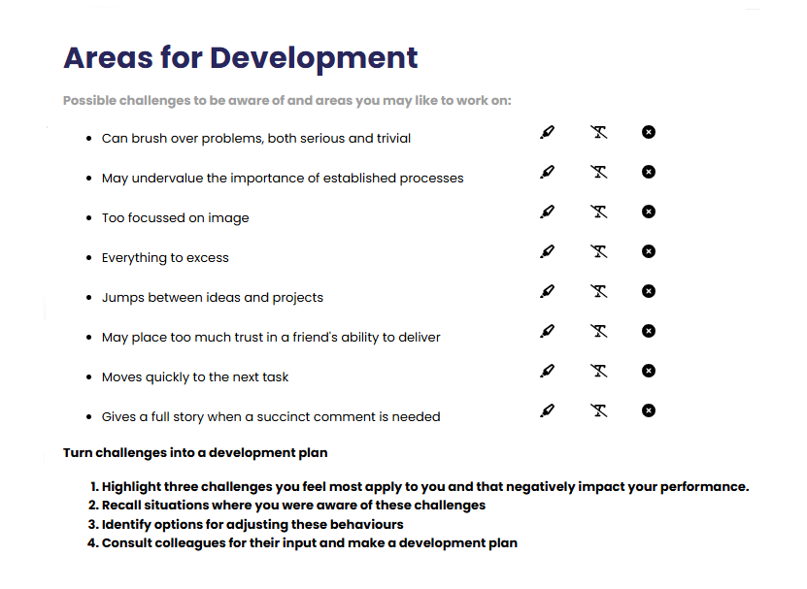
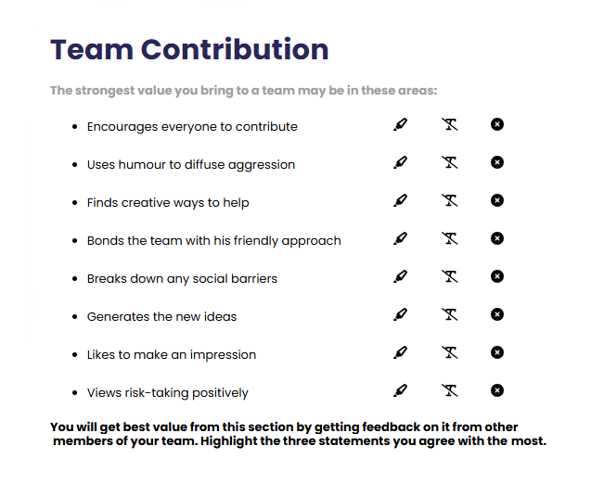
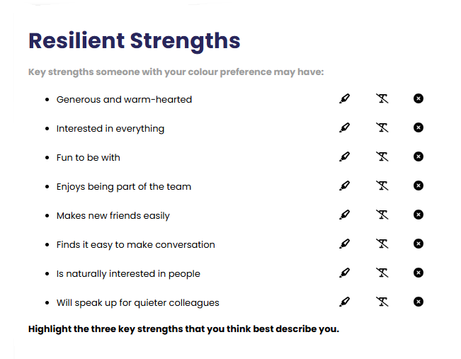
v
Your profile: Explore, filter, share
On your own: Explore, Filter, Share
Exercise 1: Read through and select 3 statements from each of the following:
  Resilient strengths.
  Team contributions.
  Areas for development.
What % of accuracy?
  Which of your colours have a score of 25+ on your adapted graph?
  Please come back ready to share …
Notes:
Opportunity for some personal reflection:
Resilient strengths
Areas for development
Team contribution
Outline principle of explore, filter, share.
The platform enables you to filter statements using the editing tools, highlighting statements
you agree with.
1st reveal:
Action: share the % accuracy of your profile in the chat box/out loud.
Speak into levels of accuracy:
For a long time we have been seeing 80-85% accuracy as a norm.
Part of our commitment to continuous improvement means we regularly revisit our statement
database, developing the quality of the statements and actioning any feedback received.
If for you resonance is lower than 70% we suggest sitting with your profile for a few months, sharing
with those close to you, before revisiting it afresh to see whether how you feel about it has changed,
whether feedback from colleagues and others has made a difference, whether it fits the context you
currently find yourself in.
If lower than 60% possible reasons for this that might be worth evaluating are:
Were you in a rush when you answered the questionnaire?
Did you answer the questionnaire based on another context other than work for example? (if this
was the context you were answering in).
Are you currently experiencing a significant time of change or transition? (maybe retake after things
have settled to see if this makes a difference).
Were you possibly overthinking what to select or second guessing your intuitive response?
Is it possible you flipped the scale for ranking? (this sometimes happens when people are in a hurry and
haven’t taken in the instructions).
2nd reveal
Action: share how many colours you have over 25 in the chat box/out loud (actually 23 but 25 easier to see on the graph)
Colours that have a score of 25 or over are considered resilient strengths.

Slide 43
Your profile: explore, filter, share
Share in pairs (5mins)
  Exercise 2: Introduce yourself ….
  Share 3 resilient strengths.
  Share 3 team contributions.
  Share 3 areas for development.
Stop … Start … Continue?
  What was valuable about this exercise and what did you learn?
Notes:
Spend 5mins in breakout rooms or in pairs sharing.
You’re now going to share in breakout rooms or in pairs the statements you found most identifiable i.e. those
statements you highlighted …
3 resilient strengths: what are the strengths that you’d like to use more?
3 team contributions: what does your team most need you to bring currently?
3 areas for development you’d like to work on.
Reflection
How valuable was that exercise for you?
What have you learned?

Slide 44

Communication

Slide 45
Communication
Miscommunication leads to:
Lost sales
18%
Missed performance goals
25%
Low morale
31%
Delay in completion of projects
44%
Higher stress level
52%
Economist Intelligence Unit 2018
Notes:
Introduce this slide however you feel it’s appropriate.
Economist Group - provide forecasting and advisory services through research and analysis.
Recent research on communications (Conducted in 2018)
500 senior leaders
Key findings: What they found was miscommunication leads to:
1. Tremendous impact in the workplace
2. Causes a communications barrier…. Different communication styles need to be
appreciated to bridge the barrier
3. There is a stark difference between the most effective communication tools and
the ones people actually use.

Slide 46
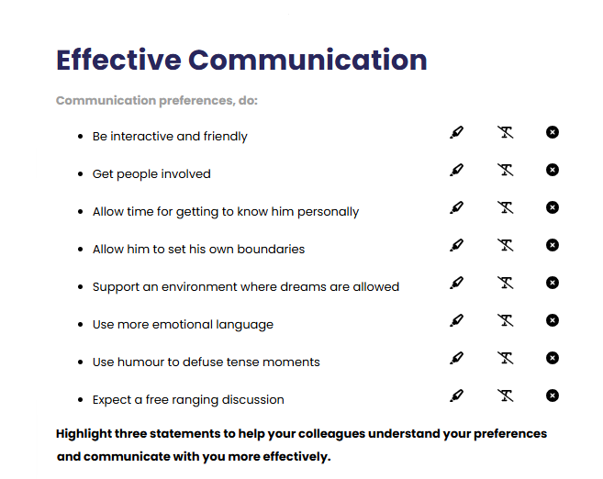
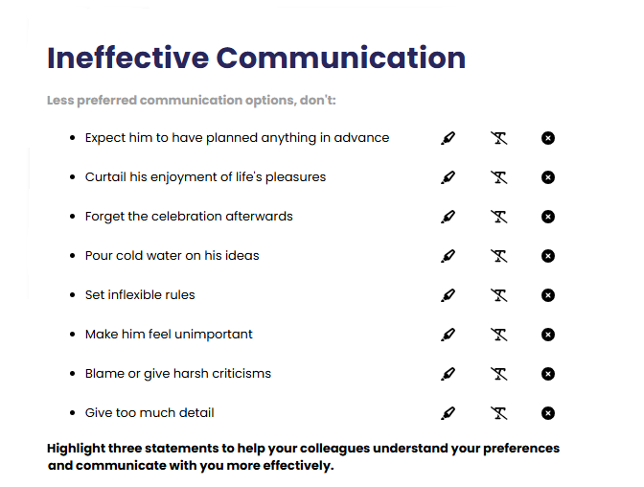
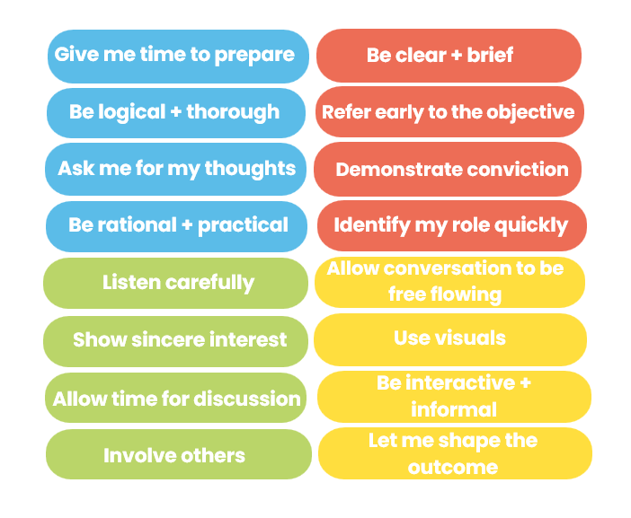
Exercise 3:
Communication
Select 2 effective ways to communicate with me.
Select 2 ineffective ways of communicating with me.
  What did you learn? Share and discuss …
Effective colourful communication
Notes:
Communication sections of the profile.
Improving team communication is one of the key ways to work together more effectively, when there are issues
with communication there is potential for far reaching problems to arise.
Use the communications sections from the profile or feel free to take statements from the diagram at the bottom
of the page if they suit you.
Feedback.
Action: in the chat box/verbally can you share what you got out of this exercise?

Slide 47



Exercise 4:
Effective communication in teams
Name | C’s | Do | Don’t
Elliott |  | Listen carefully to what he says Allow for an open discussion Be honest, he will quickly see through any pretence | Be overly competitive Stick coldly to the task Rush him
Tulisa |  | Concentrate on the facts but allow flexibility Have a clear purpose Include all the information | Be repetitive Bring decisions already made Attempt to exercise authority
Drew |  | Focus on action Involve him at every stage Allow him to change his mind | Forget the big picture Give extensive instructions Be defeatist
Notes:
Illustrate how teams can be proactive in being more effective in Communications.
Encourage the team to produce a similar grid for themselves, to help them share their communications dos
and don’ts within teams.
Use to:
Help prepare for meetings.
Negotiate with clients.
Influence to gain buy-in for ideas + projects.
See accreditation manual for template.
It includes a personalized c - visual snapshot of a person’s colour preference.
Possible action:
In the chat box/verbally - how might you use your c?
How would you use the effective comms grid?
Personalised c
In the platform you can include a profile pic + also download your c, making it usable:
In email footer.
As a profile pic in other apps.
On screensavers.
At desks or on office doors.
In the C-me for Outlook Add-in.

Slide 48
v
Exercise 5: Effective communication:
Do …
Give me time to prepare
Be clear + brief
Refer early to the objective
Be rational + practical
Demonstrate conviction
Ask me for my thoughts
Identify my role quickly
Be logical + thorough
Listen carefully
Allow conversation to be free flowing
Show sincere interest
Use visuals
Allow time for discussion
Be interactive + informal
Involve others
Let me shape the outcome
Notes:
Effective Colour Communication
You may need these slides handy if you are running a workshop for people to refer to during
exercises.
Colours have an influence both on what we do say but also on what we don’t say.
Action:
Identify your lowest 2 colours. Be aware that these will be other people’s highest colours. You may
therefore need to flex your approach in order to communicate more effectively with them.
Pick 2/3 specific bullet points from your lowest colour that you want to try to put into practice.

Slide 49
v
Ineffective communication:
Don’t …
Interrupt my thinking
Be impatient
Be flippant
Procrastinate
Skip over the facts
Slow down the pace
Stray from the agenda
Repeat yourself
Be abrupt
Restrain my ideas
Rush me
Overwhelm with detail
Openly criticise
Dampen my enthusiasm
Talk over me
Expect me to stick to rigid timescales
Notes:
Ineffective Colour Communication
Action: Again, looking at your lowest 2 colours, identify 2/3 specific statements that you may need to avoid in order
to communicate effectively with people of that colour preference.

Slide 50

Exercise 6: Communicating to influence
Selling staff party tickets
Practice communicating in your lowest colour preference (2mins each).
What did you learn?
Notes:
Refer to Accreditation Manual (Chapter 5) for ideas of alternative exercises.
An exercise in flexing and adapting our colour energies.
Needed in our everyday interactions.
We’re constantly trying to adapt to the needs of those around us to influence and get the job done.
We can always get better.
In this exercise you’re asking people to flex to their lowest colour preference.
Provide demonstration.
Action: in the chat box can you guess the colour I’m trying to flex to?
Role play: live or in BORs (if remote workshop).
Action:
You have 5mins (2 mins each, followed by feedback for each other).
Reflection
What did you learn? How easy/hard did you find it to flex?

Slide 51

Next steps

Slide 52
Personal reflection
What more do I want to know?
What are my personal goals?
Each colour has a different perspective on the focus for action.
Consider all 4 colours to reflect on what you have learnt today.
How could this impact others?
How can this be applied?
What do you want to stop … start … continue?
Notes:
Committing to actions to put into practice what we’ve covered over these sessions helps
to increase the impact of what you’ve learned.
We’ve mapped action planning around our wheel, illustrating how different elements look
through different colour lenses.
We all draw on all 4 colour energies in our daily lives, regardless of go to preferences, it’s just
that some we may have to be more intentional about than others …
Red – what personal goals are you going to set?
Yellow – what innovative applications can you think of?
Green – what impact might this have on others – how can I leverage what I’ve learned to impact
my team?
Blue – what theory and knowledge do I want to remember from this session?
STOP/START/CONTINUE: a helpful structure for reflection. What will you Start doing?
Stop doing? Continue doing?
Action: take 5mins now to complete this page.
Action: I’d like you all to enter in the chat box one key action point you’ve included in your plan …
Further comments you might want to make:
You or your client may want to include this in a personal development plan.
Personal commitments: goal orientation and ambition.
Innovative application: creative ideas around how you can apply what you’ve learned – at home, in meetings,
new ways to share or communicate insights, new ways to use your personalised C.
Impact on others: how can I leverage what I know to impact the teams I am a part of – share profiles and insights,
use to coach or line manage, use the team wheel for team meetings to create awareness of potential dynamics
and styles, enhancing comms and inclusivity.
Theory and knowledge: key takeaways from the sessions – we’re all different and unique? how to spot bad day
behaviours?

Slide 53
Team reflection
What more do we want to know?
What are our goals as a team?
Reflect on what you have learnt today through the lens of all 4 colours.
As a team what do you want to stop … start … continue?
What wider impact could this have?
How can we apply this?
Notes:
Opportunity for TEAM Reflection – vital to help embed the learning from this workshop in a collective way.
Encouragement to reflect on team group behaviours through the lens of all 4 colours (whilst we have a behavioural preference,
we are all a blend of all 4 colours).
STOP/START/CONTINUE: a helpful structure for reflection.

Slide 54
Thank you and please stay in touch
colour-profiling.com
@colourprofiling
@cmeprofiling
Cmecolourprofiling
@C-me Colour Profiling
Notes:
Opportunity to thank everyone.
INSERT YOUR OWN LINKS HERE ON THIS SLIDE.

