Slide 1
Preparing for your C-me session
Note. Certain slides can be hidden (right click ‘Hide Slide’) depending on session needs. Certain slides will need editing for each session (see below)
Checklist
Home Slide: Option to add Client’s logo/brand Slide 3
Aims: Adjust session Aims as appropriate for Client Slide 4
Insert Team Wheel Slides 8 and Team Graphs on Slide 9
C-me profile needed

Slide 2
Session Delivery
We encourage you to run through all the slides ahead of delivery in slideshow mode. Some slides are static and others include animations. Please check that animations work as expected.
Brief notes are provided below each slide to give guidance.

Slide 3


C-me Communication and Conflict Workshop
Helping teams communicate, collaborate and perform at their best
Notes:
If delivering remotely:
Welcome everyone on grid view (share slides later).
Give a very brief personal introduction
Purpose: The purpose of this workshop is ……
Programme: The timeline for today is ….
If recording the session: Let the clients know at the start.

Slide 4
Our aims for this session
01
Explore different communication styles
02
Gain key strategies to engage successfully in challenging conversations
03
Develop greater effectiveness in receiving feedback
04
Gain key strategies to help navigate confrontation and conflict
What are your aims? …..
Notes:
Check these aims are appropriate for your clients and tailor if necessary.
Click to reveal the question what are your aims? Give space for participants to share
their session aims in the chat.

Slide 5

  Exercise 1: Self-reflection
  How comfortable do you find communicating with others?
  What do you think you are like to talk to?
  How attentive are you as a listener?
Notes:
3 questions: revealed on each ‘click’

Slide 6


v
Remember C-me and the Jungian axes?
Thinking preference
Exercise 2: group reflection
How does behavioural preference impact how we communicate with others?
Reflective
preference
Expressive
preference
Feeling preference
Notes:
Reminder of the Jungian axes introduced in the Foundation Workshop
Let's look at the axes C-me uses to echo jungian psychology – helping
to introduce another layer to interpreting the colour wheel.

Slide 7
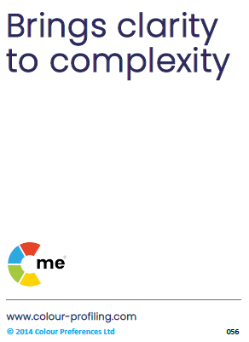
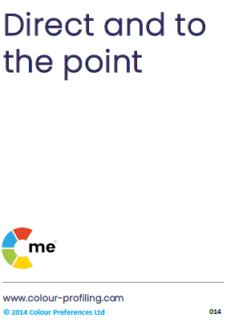
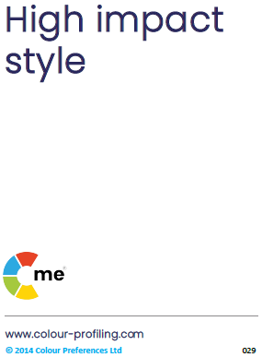

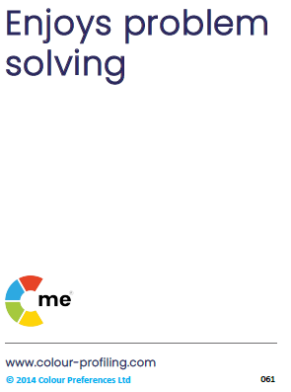


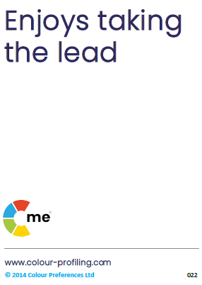
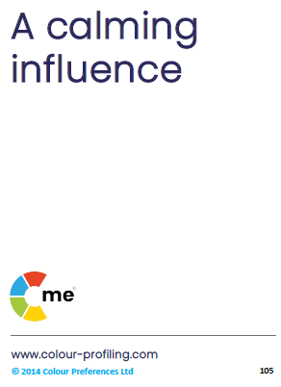
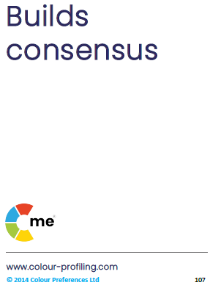
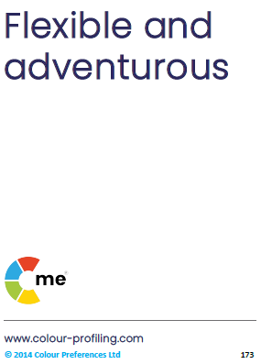
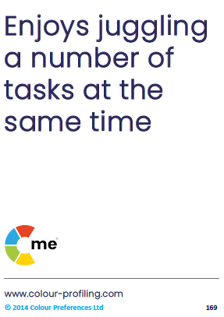
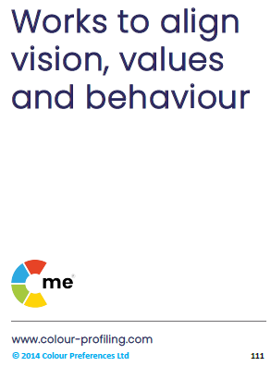
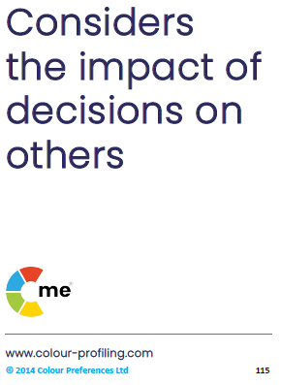
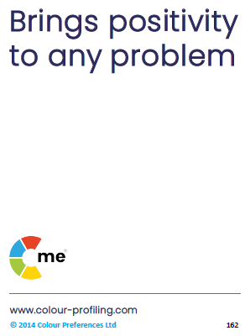
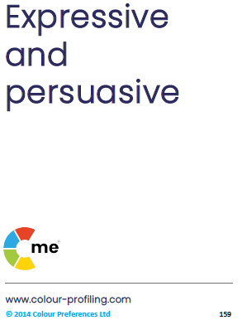
v
C-me preference around the wheel
Notes:
Let’s start by looking at the C-me colour wheel - the heart of
our approach to behavioural preference and how we represent them at C-me.
It’s a blended colour wheel – and this is important because it reflects that we
flex our behaviours to move around the wheel – the key here is that you can move, you're not stuck,
there is room to develop and grow. Colours blend, numbers and labels don’t.
This is a non-binary/non-dualistic approach – not boxing you in but giving you a common language
to understand preference diversity and improve communication.
We’ve grouped similar behaviours by colour and mapped them onto the wheel for learning purposes
– we’ll unpack this further as we go on.

Slide 8
v
Team wheel
Insert Team Wheel
Notes:
Reflect on team wheel
Questions to get discussion going:
What are the strengths of this team?
What other observations do you have?
How do the colour preferences of the team impact on team communications?
How do you see this playing out?

Slide 9
v
Team graphs
Insert Team graphs

Slide 10





v
Effective communication:
Do …
Give me time to prepare
Be clear + brief
Refer early to the objective
Be rational + practical
Demonstrate conviction
Ask me for my thoughts
Be logical + thorough
Identify my role quickly
Listen carefully
Allow conversation to be free flowing
Show sincere interest
Use visuals
Allow time for discussion
Be interactive + informal
Involve others
Let me shape the outcome
Notes:
Effective Colour Communication
Colours have an influence both on what we do say but also on what we don’t say.
Action:
Identify your lowest 2 colours. Be aware that these will be other people’s highest colours. You may therefore
need to flex your approach in order to communicate more effectively with them.
Pick 2/3 specific bullet points from your lowest colour that you want to try to put into practice.

Slide 11
v
Ineffective communication:
Don’t …
Interrupt my thinking
Be impatient
Be flippant
Procrastinate
Skip over the facts
Slow down the pace
Stray from the agenda
Repeat yourself
Be abrupt
Restrain my ideas
Rush me
Overwhelm with detail
Openly criticise
Dampen my enthusiasm
Talk over me
Expect me to stick to rigid timescales
Notes:
Ineffective Colour Communication
Action: Again, looking at your lowest 2 colours, identify 2/3 specific statements that you may need to avoid in order
to communicate effectively with people of that colour preference.

Slide 12

Exercise 3: Effective and ineffective communication
Referring to your profile:
Look at the effective and ineffective ways of communicating with you (your Dos and Don’ts)
Which 3 statements for each section most resonate?
Share in pairs
In your pairs, how could you flex to communicate more effectively with each other?
Notes:
Pairs could be individuals with different colour preferences to maximise the value of this exercise
Explore – your own statements
Filter – Choose your statements for this time
Share – with a colleague with whom you work closely
Stop, Start, Continue doing?

Slide 13



Effective communications in teams
Name | C’s | Do | Don’t
Elliott |  | Listen carefully to what he says Allow for an open discussion Be honest, he will quickly see through any pretence | Be overly competitive Stick coldly to the task Rush him
Tulisa |  | Concentrate on the facts but allow flexibility Have a clear purpose Include all the information | Be repetitive Bring decisions already made Attempt to exercise authority
Drew |  | Focus on action Involve him at every stage Allow him to change his mind | Forget the big picture Give extensive instructions Be defeatist
Notes:
Illustrate how teams can be proactive in communicating effectively.
Encourage the team to produce a similar grid for themselves to help them share their
communications dos + don’ts.
This is useful to:
Help prepare for meetings.
Negotiate with clients.
Influence to gain buy-in for ideas and projects.
It includes the individual’s personalised C – a visual snapshot of a person’s colour preference.
Possible action:
In the chat box/verbally - how might you use your C?
How could you use the effective comms grid?
Personalised C
In the platform you can include a profile pic and also download your C, making it usable …
in your email footer.
as a profile pic in other apps.
on screensavers.
at desks or on office doors.
in the C-me for Outlook Add-in.

Slide 14
Verbal style
Exercise 4: what can you learn about other preferences?
v
Pragmatic
Authoritative
Structured
Direct
Professional
Fast paced
Analytical
Unambiguous
Prepared
Assured
Collaborative
Dynamic
Diplomatic
Persuasive
Thoughtful
Spontaneous
Empathetic
Positive
Meaningful
Informal
Notes:
How do we like to talk to people based on our preferences?

Slide 15
v
Effective email communication
Be clear + succinct
Include all necessary detail
Include an agenda
Schedule any follow up in advance
Provide context + expectations for a response
Maintain focus
Use bullet points
Quickly outline the objective
Be succinct
Be specific about action needed
Enquire about them
Be collaborative
Show you value them
Be pragmatic
Give them time to reflect + respond
Be personal + engaging
Include visuals
Avoid too much detail
Ask for their feedback + ideas
A phone call is preferable where possible
Notes:
Non-verbal communications too: Email
Applicable to:
How do I lay out the email?
Do I send a preparation document for them beforehand? Or with the email?
Do I need to follow-up with a phone call?
This shows how C-me can be applied in a practical and tangible way.
Especially important now with increased hybrid working.

Slide 16

  Exercise 5: Effective email communication
Scenario: Arranging a meeting to discuss a project
Compose an email, flexing to a colour preference other than your own
Things to consider:
  Layout
  Types of information
  Preparation
  Follow up
Notes:
Set up the exercise as per the slide, working in small groups or BORS (breakout rooms).
Facilitator: Suggest putting the 4 ‘things to consider’ in the chat for ease of reference?
Things to consider:
Layout
Type of information
Preparation
Follow up
Share emails afterwards and coach one another to fine tune.

Slide 17

Reflection: personal experience of feedback
Think of a good experience you have had of receiving feedback. What was the impact?
Now think of a bad experience you’ve had. What was the impact?
Notes:
Exercise – as per the slide
Group discussion, BORs or use Chat

Slide 18




v
How might your experience of feedback relate to your colour preference?
Notes:
Opportunity to reflect on individual colour preferences and the impact this can have on
what they ‘see’ as effective feedback
NB
1st ‘C’ = Reflective preference
2nd ‘C’ = Expressive preference
3rd ‘C’ = Feelings driven preference
4th ‘C’ = Thinking driven preference

Slide 19

Break

Slide 20

  Exercise 6: Challenging conversations
Consider a challenging conversation you’ve had … What did you learn?
Think of a time when you needed to have a challenging conversation but avoided it …
  What stopped you?
  What were the consequences?
Notes:
2 questions: revealed on each ‘click’

Slide 21

Challenging Conversations
Contributors and Consequences
Three factors that can contribute to challenging conversations:
1. Critical outcomes
Prioritising outcomes over relationship
2. Strong opinions
Prioritising opinion over attentive listening
3. High emotions
Prioritising feelings over careful thinking
How might different colour preferences respond to these factors?
Notes:
Animated to reveal Factor 1, followed by consequence, then Factor 2 and it's consequence
and so on.
Discussion starter:
When there are critical outcomes at stake:
What might be the consequence if we prioritise the outcome above anything else?
What about when there are strong opinions in the mix?
High emotions?
How might our different colour preferences come into play here?
The next slide may help unpack this further.

Slide 22
v
Challenging Conversations
Self-protective Responses
“Silence”
Flight (freeze)
“Violence”
Fight (deflect)
Notes:
Difficult conversations can trigger two contrasting “safety issues”
Reveal 1: Silence: Flight or freeze
Reveal 2: Violence: Fight or deflect
Reveal 3: C-me wheel

Slide 23
v
Likely responses: bad day behaviours
Overly focused on the problem
Withdraws
Goes quiet
Can be intimidating
Unable to hold their judgement
Lacks filter
Silent treatment
Holds back
Avoids difficult conversations
Avoids discomfort
Settles for an ‘easy’ resolution
Can play down issues
Notes:
Each click – These “bad day" behaviours can be negative contributors to communicating effectively.
They may be some of the causes of challenging conversations and could also be the outcome of
challenging conversations.
Invite comments.

Slide 24
v
Likely responses: good day behaviours
Wants to be clear about goals
Will name the uncomfortable truth
Honest + direct
Specific
Reasonable
Pragmatic approach
Empathy
Actively listens
Willing to explore different views
Optimistic about the future
Looks for a ‘win-win’ situation
Will want to explore + share ideas
Notes:
Animated to reveal each colour quadrant
These “good day " behaviours around the wheel can be positive contributors to communicating
effectively.
We can flex our behaviours to speak to others’ colour preferences to help ease tensions.
For the best outcome to a challenging conversation in a group, all 4 colour preferences need to be
represented, with everyone bringing their natural resilient strengths to the table.
Discuss.

Slide 25
v
Response to being challenged
Will carefully review all info
May withdraw
Will give a logical answer
Will look to respond swiftly
Moves on quickly
May become confrontational
Uncomfortable with direct challenge
May take it personally
Will be able to see both sides
Can feel demoralised
Will look for positives
Will play down challenge to diffuse
Notes:
Ask individuals to guess what statements they might expect to see for each of the
4 colours represented on the wheel.

Slide 26
v
Listening priorities
Appreciates logical process
Seeks detailed clarification
Will hear + recall specific details
Appreciates clarity + brevity
Listens for progress made
Keen to contribute a workable solution
Wants to understand the reasons why
Will look for shared values
Will look to create a safe, relaxed atmosphere
Will be interested in ideas + opportunities
Will want to be encouraging
Will look for ways to engage + connect
Notes:
How we listen impacts crucial conversations. Each colour will have different listening
priorities. It is good to be aware of our own preference priorities as well as those of the other person.
Discuss.
All of the statements are positive but some are nuanced as they potentially could have a flip side to
watch out for …

Slide 27
Healthy conflict
Compete
Win – Lose
Collaborate
Finding a creative 3rd way
Win - Win
Compromise
Low form of
Win - Win
My needs
Avoid
Lose - Lose
Your needs
Accommodate
Lose - Win
Notes:
Aim of healthy conflict:
to help both sides grow
to find a positive outcome
to see progression
Work through the slide, describing the relationship between “My Needs” and “Your Needs”
1. My needs low/Your needs low = AVOID conflict = Lose-Lose (neither party can grow)
2. My needs high/Your needs low = COMPETE in conflict = Win-Lose (I get my way and you lose out)
3. My needs low/Your needs high = ACCOMODATE in conflict = Lose-Win (I give way to your needs but the issues aren’t dealt with)
4. My needs medium/Your needs medium = COMPROMISE in conflict = Low form of win (meeting in the middle/agreeing to disagree)
5. My needs high/Your needs high = COLLABORATE in conflict = Win-Win (finding the best way forward, with honesty and integrity)

Slide 28
  Exercise 7: Healthy conflict
AVOID – COMPETE – ACCOMMODATE – COMPROMISE - COLLABORATE
Which word best describes how you tend to tackle conflict?
How does your approach to conflict change in different scenarios?
How does this reflect your colour preference?
What action would you like to take to COLLABORATE better?
Notes:
Chance to explore these questions in the group and allow for reflection/sharing

Slide 29
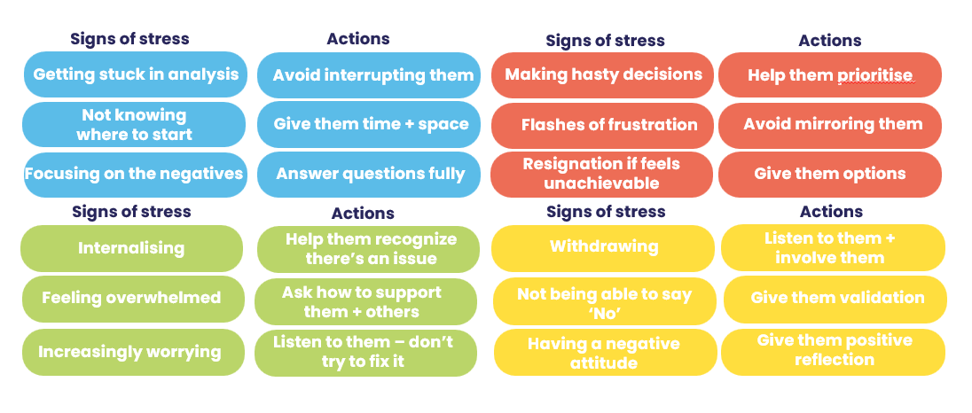
Exercise 8: Diffusing tension
Referring to your profile:
Think of a relationship where there’s tension. How might both your colour preferences be impacting that tension?
What actions could you take to flex your behaviour to diffuse the tension?
Notes:
You’ll find the stress and resilience visual in your profiles under the positive ways of handling setbacks section

Slide 30


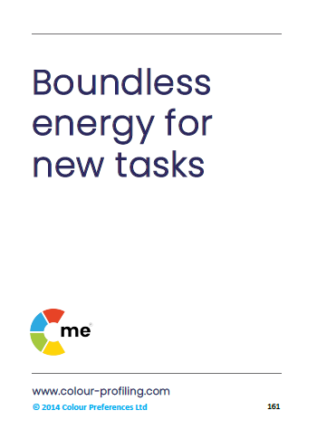

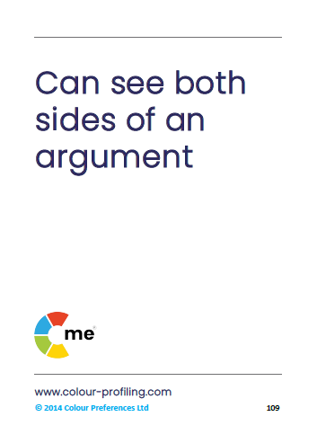
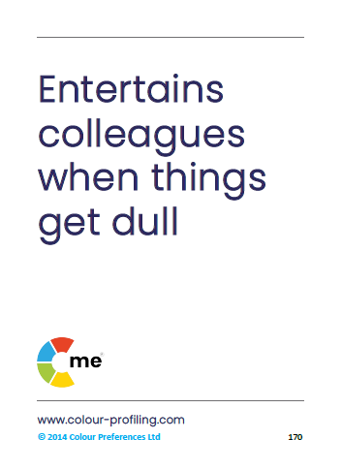


1
2
3
4
C-me 360
card game
5
6
7
8
Notes:
Explain 360 card game
Good exercise to start discussion on how we’re perceived by others in the team
Select one person in the group
The rest of the group then pick 2/3 cards which they feel best describe that person.
The selected person then gives some feedback about the cards that the rest of the
group selected for them.
Each person in the group has a go.
ACTION: Ask people to guess statements for one of the facilitators.

Slide 31
1
2
3
4
C-me 360
card game
5
6
7
8
Notes:
Reveal the colours for each card.

Slide 32
Personal reflection
What more do I want to know?
What are my personal goals?
Each colour has a different perspective on the focus for action.
Consider all 4 colours to reflect on what you have learnt today.
How could this impact others?
How can this be applied?
What do you want to stop … start … continue?
Notes:
Committing to actions to put into practice what we’ve covered over these sessions helps
to increase the impact of what you’ve learned.
We’ve mapped action planning around our wheel, illustrating how different elements look
through different colour lenses.
We all draw on all 4 colour energies in our daily lives, regardless of go to preferences, it’s just
that some we may have to be more intentional about than others …
Red – what personal goals are you going to set?
Yellow – what innovative applications can you think of?
Green – what impact might this have on others – how can I leverage what I’ve learned to impact
my team?
Blue – what theory and knowledge do I want to remember from this session?
STOP/START/CONTINUE: a helpful structure for reflection. What will you Start doing? Stop doing?
Continue doing?
Action: take 5mins now to complete this page.
Action: I’d like you all to enter in the chat box one key action point you’ve included in your plan …

Slide 33
Team reflection
What more do we want to know?
What are our goals as a team?
Reflect on what you have learnt today through the lens of all 4 colours.
As a team what do you want to stop … start … continue?
What wider impact could this have?
How can we apply this?
Notes:
Opportunity for TEAM Reflection – vital to help embed the learning from this workshop in a collective way.
Encouragement to reflect on team group behaviours through the lens of all 4 colours (whilst we have a behavioural
preference, we are all a blend of all 4 colours).
STOP/START/CONTINUE: a helpful structure for reflection.

Slide 34





Thank you and please stay in touch
colour-profiling.com
@colourprofiling
@cmeprofiling
Cmecolourprofiling
@C-me Colour Profiling
Notes:
Opportunity to thank everyone.
Insert your own links on this slide.

