Slide 1
Preparing for your C-me session
Note. Certain slides can be hidden (right click ‘Hide Slide’) depending on session needs. Certain slides will need editing for each session (see below)
Checklist
C-me profile needed
Home Slide: Option to add Client’s logo/brand Slide 3
Insert Team Wheel Slide 36
Insert bespoke Team Graphs Slide 37.

Slide 2
Session Delivery
We encourage you to run through all the slides ahead of delivery in slideshow mode. Some slides are static and others include animations. Please check that animations work as expected.
Brief notes are provided below each slide to give guidance.

Slide 3


C-me Stress and Resilience Workshop
Helping teams communicate, collaborate and perform at their best
Notes:
If delivering remotely:
Welcome everyone on grid view (share slides later).
Give a very brief personal introduction
Purpose: The purpose of this workshop is ……
Programme: The timeline for today is ….
If recording the session: Let the clients know at the start.

Slide 4
Our aims for this session
01
Better understand resilience in the context of C-me
02
Learn to spot the signs of stress in ourselves and others
03
Reflect on the impact of stress on our behaviours
04
Grow in our ability to adapt our behaviour to build resilience
What are your aims? …..
Notes:
Check these aims are appropriate for your clients and tailor if necessary.
Give space for participants to share their session aims in the chat.

Slide 5


Impact on others
Behaviours
Personality
values, beliefs
Notes:
Let's start with the foundations of C-me and the fundamental difference between C-me
and other tools in this field:
Emphasize C-me’s focus on observable behaviours, not personality.
Known as behavioural preference profiling.
Exercise: Can someone explain to me why this is important and what impact you think
that might have for you?
Our usp, is that we’re looking at observable behaviours, we’re not challenging people’s
inherent values but instead looking at what behaviours someone is choosing to display and
adapt in the context they find themselves in.
We acknowledge that individuals have a range of behaviours they can choose from, but
we seek to assess their preferred ways of working, or what they might naturally lead with,
within this range.
Our behaviours directly impact others and can be flexible to change - behaviour is easier
to coach and adapt than personality, which is often seen as fixed.
We’re helping to bring realisation around our tendencies - we’re speaking to behaviours
that emerge from our core beliefs, values and our personalities.
We don’t label any specific behaviour as 'right' or 'wrong’, but simply individuals
choosing what feels 'right' for them.
Personality tests are looking to assess the underlying personality traits, which can be
complex, often seem vague and can leave individuals feeling boxed in.
Our bank of 1,000s of statements are based on behaviour.

Slide 6

Understanding Resilience
“The process of adapting well in the face of adversity, threats or significant stress”
American Psychological Association
From the Latin ‘resiliens’
- ‘to rebound’, to ‘bounce back’
Exercise 1: Reflect
How resilient do you feel you are as:
i) an individual ii) a team iii) an organisation?
What has happened recently that has tested your resilience?
Where have you seen colleagues respond effectively?
Notes:
What do you think Resilience is?
Why an elastic band? When stretched it will not break and will rebound back to its original size
once the pressure is off. If overstretched it will lose elasticity or even break.
These exercises can be done as individual reflection time or group discussion.

Slide 7
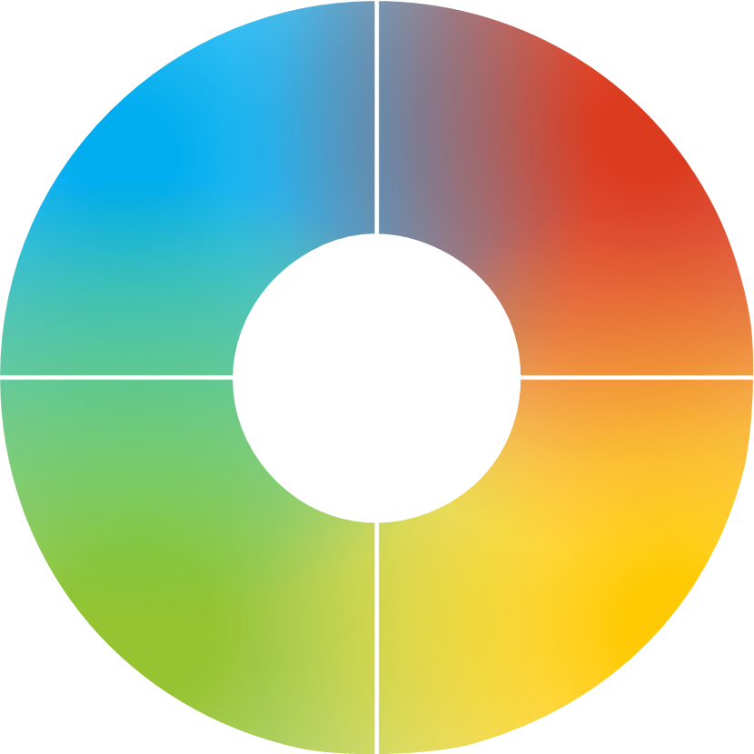
v
Resilient strengths
Realistic
Drives hard for delivery
Strong work ethic
Focuses on results
Logical + analytical
Decisive
Brings clear direction
Sets high standards
Tactful + diplomatic
Positive outlook
Dedicated to the team
Embraces change
Highly values authenticity
Inspirational + visionary
Reliable + dependable
Social + outgoing
Notes:
A summary of resilient strengths and development areas of each colour. Use after discussion
as a summary and remember we’re looking at resilience not competence.
Resilience = where we perform at our best and for the longest time given any task.
Not about what we’re good at but about what gives us life and energy.
You may be very good at things that are normally associated with your lowest colour preference
but it may be draining for you to do this.
Example: Someone who is good at detailed, systematic administrative tasks but when
their energy is low, planning goes out the window, details are missed and balls are dropped.
Competence is high but resilience is low.
Colour does give us clues as to where we gather energy, so if we’re in a role that demands our
lowest colour we need to look at how to structure our day in practical ways to work effectively
for longer.

Slide 8
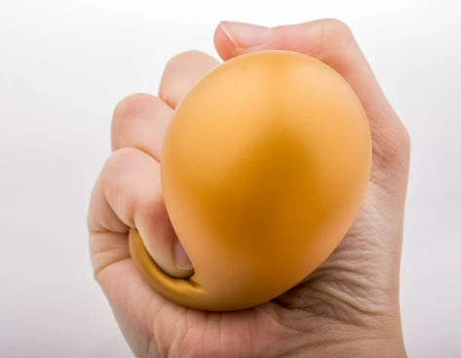
Understanding Stress
‘A state of mental or emotional strain or tension, resulting from adverse or demanding circumstances’
Oxford Dictionary 2016
From the Latin ‘stringere’
- ‘to draw tight’
Exercise 2: Reflect
How does stress impact:
You
Your team
Your organisation
Notes:
The aim is to begin to explore how stress impacts us in different ways.

Slide 9
v
Exercise 3: Stress Test
For each question, mark which statement best describes you
1.
2.
3.
4.
5.
6.
7.
8.
9.
Notes:
Action: Please recreate this grid on your paper, drawing two columns, with the numbers
1-9 down the left-hand column.
Note. Whilst your clients are drawing the grid, it’s helpful for you to draw the grid at the
same time in order to get your pace right.
A series of statements (labelled A,B,C,D) will appear on the screen. Identify the statement
that best describes your behaviour when under stress and write down that letter in the
right hand column next to the corresponding number.

Slide 10
  C-me stress test
Question 1 – When I’m stressed, I …
Become hypersensitive to my own and others' emotions.
Blurt out harsh words and critical statements about others.
Feel disapproved of, disliked and rejected by others.
Make up “logical plots” and rationalisations to explain situations.
Notes:
Allow clients time to read the slide and record their answer.

Slide 11
  C-me stress test
Question 2 – When I’m stressed, I …
Misinterpret comments from others as personal criticism.
Put others down by pointing out their mistakes.
Become disorganised, chaotic and rush around.
Become compulsive in search of the “truth”.

Slide 12
  C-me stress test
Question 3 – When I’m stressed, I …
Feel like a victim, unappreciated and used.
Make decisions too quickly and display knee jerk reactions.
Become forgetful and misplace things.
Turn to experts for advice, complaining if they don’t know everything.

Slide 13
  C-me stress test
Question 4 – When I’m stressed, I …
Become defensive and feel threatened.
Become increasingly impatient and irritable.
Become overemotional and argumentative.
Become concerned about not appearing “professional”.

Slide 14
  C-me stress test
Question 5 – When I’m stressed, I …
Become overly concerned about the welfare of others.
Become impatient with people who are not as quick.
Become fearful of other people’s disapproval.
Withdraw and become pessimistic seeing only the downside in everything.

Slide 15
  C-me stress test
Question 6 – When I’m stressed, I …
Become stubborn.
Start to micromanage and seek to control all outcomes.
Become manipulative and coercive.
Become excessively rigid and rulebound.

Slide 16
  C-me stress test
Question 7 – When I’m stressed, I …
Shut down and worry excessively.
Become inflexible in decision making (I am right).
Lose focus and become easily distracted.
Look for perfection rather than an 80/20 solution.

Slide 17
  C-me stress test
Question 8 – When I’m stressed, I …
Feel devalued as a human being.
Make caustic remarks about others.
Blame others for not appreciating me.
Engage in excessive logic.

Slide 18
  C-me stress test
Question 9 – When I’m stressed, I …
Feel fragile and needy.
Order people around.
Start to chase my tail but get very little done.
Become aloof and detached.

Slide 19
v
C-me stress test results
Example
A: Operating with Green preference under pressure
B: Operating with Red preference under pressure
C: Operating with Yellow preference under pressure
D: Operating with Blue preference under pressure
1. | A
2. | B
3. | B
4. | D
5. | A
6. | C
7. | C
8. | D
9. | B
Which 2 colours do you have most of?
Share what you have learned?
Notes:
You should have something that looks like this.
2nd Click: Action. Ask participants to ‘analyse’ their personal stress test.
The highest scoring colours suggest likely behaviours under stress.
Question. How do your results compare with your report graph?
Highlight the blend of colours in their answer choices.

Slide 20

v
Signs of stress
Becomes impatient + negative
Gets stuck in analysis
Feels overloaded + becomes distant
Gets frustrated + makes hasty decisions
Drives too hard + becomes hyper-focused
Gets discouraged + negative
Internalises + feels overwhelmed
Gets anxious, withdraws, goes quiet
Becomes less supportive
Becomes chaotic + easily distracted
Struggles to say ‘No’
Tends to ‘overcommunicate’
Notes:
Summary slide after discussion, to reinforce learning.
Starting with blue preference, what do you think the signs of stress are? Yellow preference next,
then Green preference, then Red preference.

Slide 21
v
Yerkes-Dodson Human Performance Curve
Performance
High performance
Stress zone
Boredom
Flip zone
Comfort
Stretch
Strain
Flip
Pressure
Notes:
The Yerkes–Dodson law is an empirical relationship between pressure and performance.
Originally developed by psychologists Robert M. Yerkes and John Dillingham Dodson in 1908.
The law dictates that performance increases with physiological or mental arousal, but only
up to a point.
The positions of High Performance, Stress and Flip zone are animated to appear on 3 clicks
as this curve is being explained.

Slide 22
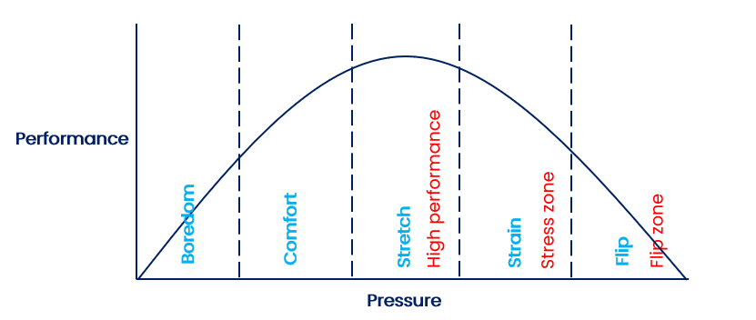
v
Yerkes-Dodson and C-me
1
2
3
1
2
3
Notes:
Mapping the Yerkes-Dodson Human Performance Curve onto the C-me Colour Wheel
1. High performance zone – playing to your resilient colour strengths
2. Stress zone – beginning to stray beyond the bounds of your resilient strengths (stress
is triggering ‘bad day’ behaviours)
3. Flip zone – Bad day behaviours are being played out in an extreme (now a long way
from operating in the High Perfomance Zone (best utilising resilient strengths)
Expanded in the next few slides
Note. C-me wheel is a behavioural tool – looking at probable behaviours and behavioural
styles (responses to stress are not ALWAYS predictable)

Slide 23
v
High performance (stretch zone)
Playing to your colour strengths
Focused
Decisive
Detailed
Determined
Organised
Action orientated
Critical thinker
Assertive
Intentional
Creative
Values focused
Inspiring
Supportive
Visionary
People focused
Positive
Notes:
Stretch zone.
Animated slide Red preference, Green preference, Blue preference, Yellow preference.

Slide 24
v
Triggers that take us into the stress zone
Incoherent plans
Insufficient preparation time
Last minute changes
Too many ideas
Loss of control
Too slow a pace
Too much detail
Endless discussion
Feeling rushed
Devaluing others
Conflict and tension
Undermining values
Exclusion
Disapproval or criticism
Too much focus on detail
Lack of collaboration or fun
Notes:
Starting with those of us with high Blue preference, what triggers stress in you? Yellow
preference next, then Green preference, then Red preference.
The arrows signify leaving the High Performance Zone, into the Stress Zone.

Slide 25
v
Observed behaviours in the stress zone
Negativity
Getting stuck in analysis
Overloaded
Unresponsive, distant
Frustration
Rushed decisions
Overly zealous
Impatience
Anxiety
Being overwhelmed
Internalising + distancing
Becoming less supportive
Chaotic decision making
Distraction
Inability to say ‘No’
Loss of creativity
Notes:
Possible to discuss link with "bad day" behaviours.
Green preference, Yellow preference, Red preference, Blue preference.
Which do you recognise in yourself? Other people you know well or work with?

Slide 26
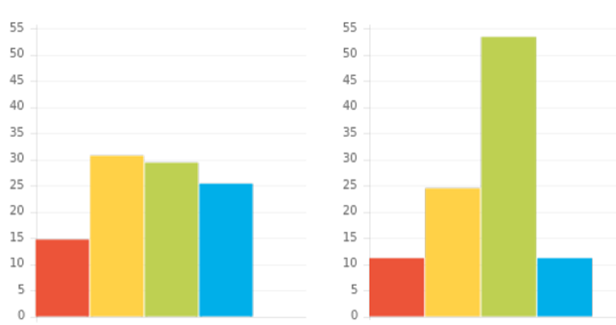
v
Stress zone
Note. unfiltered, less conscious graph
Adapted behaviour
Natural behaviour
Notes:
Stress leads us to ‘revert to type’ – unfiltered/less conscious behaviours - our natural
graph colour combination.

Slide 27
v
Flip zone – moving from stress to panic
Erratic
Uncalculated risks
Inability to prioritise
Overly emotional
Hypersensitive
Indecisive
Overly pushy
Impetuous
Callous
Becomes highly rigid
Fixated by details
Stops communicating
Notes:
Animated slide where colour boxes and arrows appear – Blue preference, Green preference,
Yellow preference, Red preference.
In panic mode, we enter the Flip Zone and our behaviours are perhaps surprisingly seen
coming from the opposite side of the wheel.
Sometimes in this zone we exhibit the "bad day" behaviours of that opposite colour, which
can surprise us and others.
Can you think of a situation where this has been true for you?

Slide 28

Break

Slide 29




v
Exercise 4: Stress and Colour Combination
How might stress play out for these colour combinations?
Person 1 Person 2 Person 3 Person 4
Notes:
Opportunity to reflect on individual colour preferences and the impact this can have on
what they ‘see’ as effective feedback
NB
1st ‘C’ = Reflective preference
2nd ‘C’ = Extrovert preference
3rd ‘C’ = Feelings driven preference
4th ‘C’ = Thinking driven preference

Slide 30
v
How do we manage/coach returning to the high performance zone?
Give them time + space
Answer questions fully
Present the facts
Avoid interrupting them
Avoid mirroring behaviour
Leave alone
Give options
Help them to prioritise
Listen – don’t fix
Revisit values
Help them identify the issue
Ask how to support them
Compliment successes
Involve them
Listen to them
Give them validation
Notes:
Each colour preference will respond well to managing or coaching back to high
performance in different styles.
You’ll find these approaches in the managing stress visual that accompanies both the positive
and less positive ways of handling setbacks sections in your profile.

Slide 31
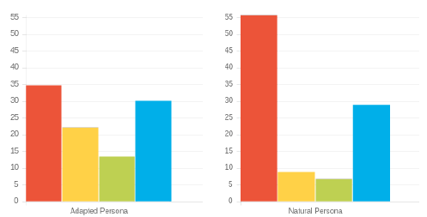
v
Exercise 5: Coaching back to high performance
How might stress be triggered?
How will this stress be displayed?
3. What behaviours should be avoided when supporting this person?
4. How could this person be coached back to high performance?
Notes:
Work through the slide exercise questions.
In this example:
Note. Naturally high Red preference – possible ‘bad day’ behaviours associated with
red preference that are likely to be shown under stress
Note. Higher Red/Blue preference in Natural suggests reverting to thinking/task type
under pressure (people/team/feelings may be forgotten)
Note. Steadier behavioural ‘balance’ of Adapted profile is likely to become more
pronounced and extreme under pressure.
Note. Refer to behaviours to avoid (slide 34) for ideas.
Coaching: Initially give space/provide options/perspective.
Later encourage leaning into Green/Yellow preference behaviours – valuing other
perspectives.

Slide 32



Coaching out of stress
Name | C’s | Do | Don’t
Elliott
Tulisa
Drew
Notes:
Illustrate how teams can be proactive in coaching one another out of stress and back
towards high performance.
This is a similar grid to the Dos and Don’ts of Communication.
Encourage the team to produce a similar grid for themselves.

Slide 33
v
Response to setbacks
How each colour is likely to respond
Looks for facts
Looks to sort it quickly
Will look for a logical solution
Decisive
May see worst in situation
Can appear rushed
Can feel overwhelmed
Will see the opportunities
Concerned for others first
Keen to work collaboratively
Reluctant to respond quickly
Can miss details
Notes:
Looking specifically at our verbal style
How do we like to talk to people?
How might other people prefer talking to us?

Slide 34
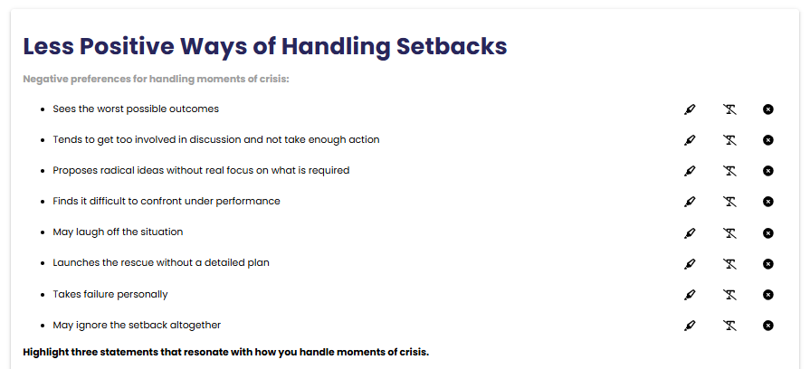
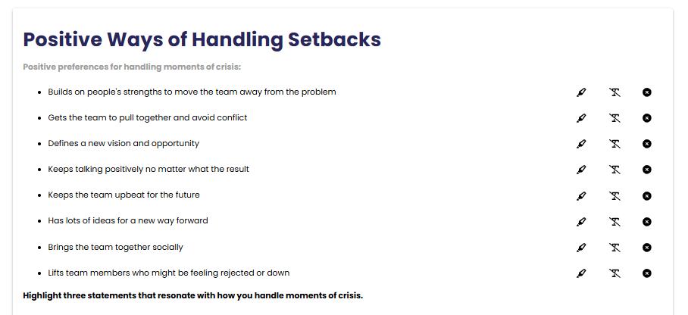
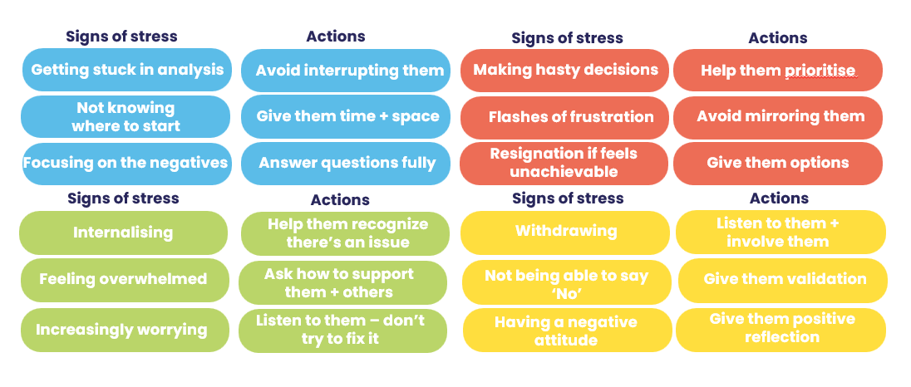
v
Handling setbacks
Exercise 5
Look at the Handling Setbacks section of your report
Pick two statements from each column that most resonate with you.
Share in pairs how an awareness of these things will help you better handle setbacks in the future.
Managing stress
Notes:
How are setbacks different from stress? What is a setback?
Refer to personal profiles setback sections.

Slide 35
v
Flexing behaviours to build resilience
Explore feelings
Find the fun in challenges
Value other perspectives
Stay connected to
purpose and life dreams
Take on tasks which
require attention
Commit to a task or decision
Stick to deadlines
and healthy routines
Utilise analysis and attention to detail
Notes:
Discuss: What do you notice about the most effective ways of building resilience?
To build resilience, try to lean into your natural opposite colour preference. Consciously
choosing to practice these skills that are less familiar to your colour preferences (flexing)
will help you perform better and will also build resilience for when things are more
pressured.

Slide 36
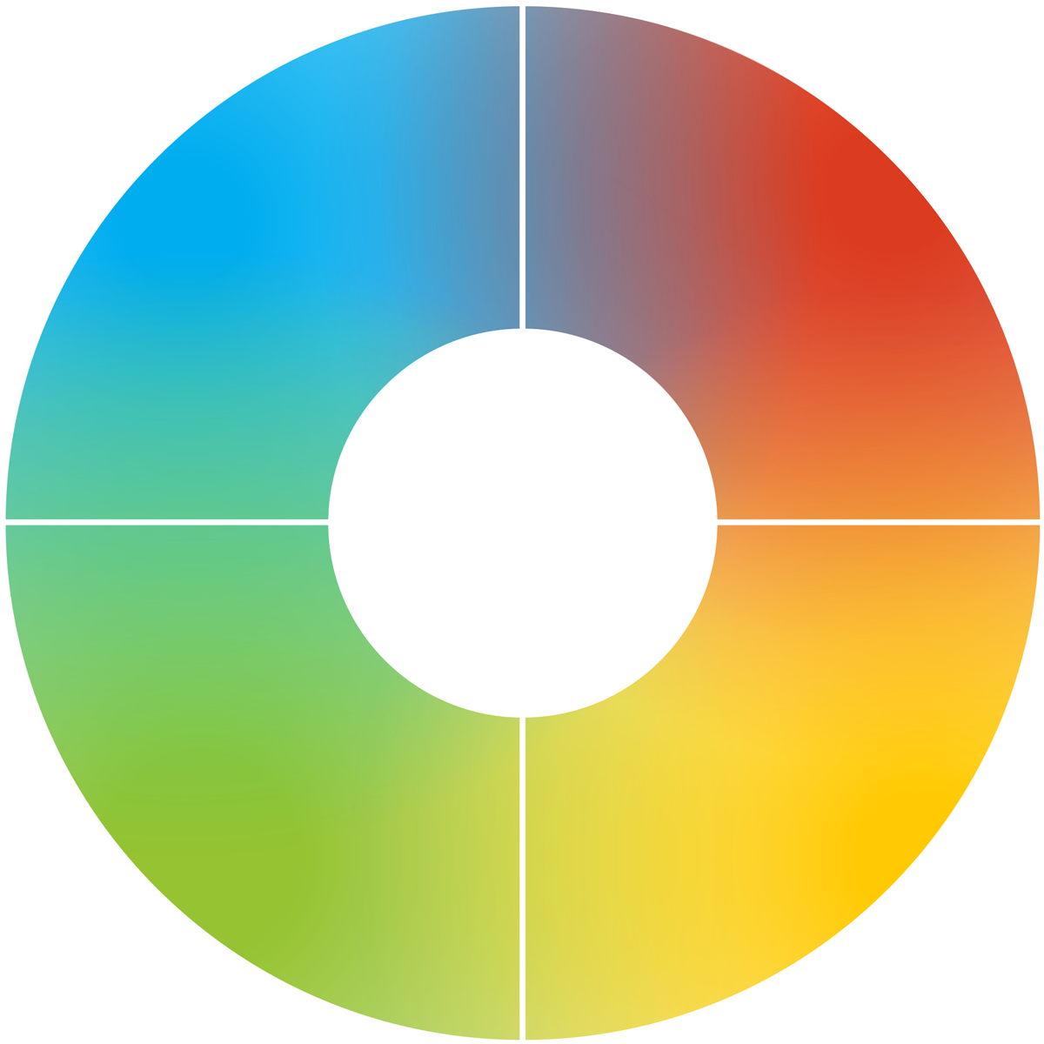
v
Reflecting on stress as a team
Team wheel
Reviewing last year and key projects, what have the stress points been for you as a team?
How does this relate to your team wheel?
Insert team wheel
What changes could you make, as a team, to handle these stress points better in the future?
Notes:
An opportunity here to apply the learning of this workshop to the team collectively.

Slide 37
v
Reflecting on stress as a team
Team graphs
What are the most likely triggers of stress for this team collectively?
As a team, what do you need to commit to intentionally in order to overcome this?
Insert team wheel
Notes:
The team graphs could reveal resilient/high scoring colour strengths that are not necessarily
being fully utilised currently. Addressing this can impact resilience for overcoming stress as
a team.

Slide 38
Personal reflection
What more do I want to know?
What are my personal goals?
Each colour has a different perspective on the focus for action.
Consider all 4 colours to reflect on what you have learnt today.
How could this impact others?
How can this be applied?
What do you want to stop … start … continue?
Notes:
Committing to actions to put into practice what we’ve covered over these sessions helps
to increase the impact of what you’ve learned.
We’ve mapped action planning around our wheel, illustrating how different elements look
through different colour lenses.
We all draw on all 4 colour energies in our daily lives, regardless of go to preferences, it’s just
that some we may have to be more intentional about than others …
Red – what personal goals are you going to set?
Yellow – what innovative applications can you think of?
Green – what impact might this have on others – how can I leverage what I’ve learned to impact
my team?
Blue – what theory and knowledge do I want to remember from this session?
STOP/START/CONTINUE: a helpful structure for reflection. What will you Start doing? Stop doing? Continue doing?
Action: take 5mins now to complete this page.
Action: I’d like you all to enter in the chat box one key action point you’ve included in your plan …

Slide 39
Team reflection
What more do we want to know?
What are our goals as a team?
Reflect on what you have learnt today through the lens of all 4 colours.
As a team what do you want to stop … start … continue?
What wider impact could this have?
How can we apply this?
Notes:
Opportunity for TEAM Reflection – vital to help embed the learning from this workshop
in a collective way.
Encouragement to reflect on team group behaviours through the lens of all 4 colours (whilst
we have a behavioural preference, we are all a blend of all 4 colours).
STOP/START/CONTINUE: a helpful structure for reflection.

Slide 40
Thank you and please stay in touch
colour-profiling.com
@colourprofiling
@cmeprofiling
Cmecolourprofiling
@C-me Colour Profiling
Notes:
Opportunity to thank everyone.
Insert your own links on this slide.

