Slide 1
Preparing for your C-me session
Note. Certain slides can be hidden (right click ‘Hide Slide’) depending on session needs. Certain slides will need editing for each session (see below)
Checklist
C-me profile needed including influencing sections
Home Slide: Option to add Client’s logo/brand Slide 3
Adjust session Aims as appropriate for Client Slide 4
Insert Team Wheel Slide 20

Slide 2
Session Delivery
We encourage you to run through all the slides ahead of delivering them in slideshow mode. Some slides are static and others include animations. Please check that the animations work as expected.
Brief notes are provided below each slide to give delivery guidance.

Slide 3


C-me Influencing with Impact Workshop
Helping teams communicate, collaborate + perform at their best
Notes:
If delivering remotely:
Welcome everyone on grid view (share slides later).
Give a very brief personal introduction
Purpose: The purpose of this workshop is ……
Programme: The timeline for today is ….
If recording session: Let the clients know at the start.

Slide 4
Our aims for this session
01
Recap colourful behaviours
02
Consider personal influencing strengths and improvement areas
03
Consider team influencing strengths and improvement areas
04
Review drivers and blockers around the wheel
05
Apply learning to maximise performance
What are your aims? …..
Notes:
Check these aims are appropriate for your clients and tailor if necessary.
Give space for participants to share their session aims in the chat.

Slide 5


v
Remember the C-me and Jungian axes?
Thinking preference
Recap
What are the 4 titles?
Reflective
preference
Expressive
preference
Feeling preference
Notes:
Reminder of C-me and the Jungian axes from Foundation Workshop. 2 clicks reveal the
labels for each axes.
The aim is to recap and will be expanded over the session.

Slide 6

v
Reflective/expressive behaviours
Thinks before responding
Takes time to commit
Uses fewer hand gestures
Needs more personal space
Thoughtful/slower pace
More measured
Non-judgemental
Tactful + diplomatic
Leaves room for others’ views
Deliberate/intentional
Asks questions
Actively listens
Responds quickly
May challenge more directly
Sounds ‘sure of facts’
May interrupt
Fills silences
Conversational
Spontaneous
Direct eye contact
Likely to stand closer
More animated
Future focused
Optimistic
Notes:
Reflective/Expressive Axis - Aim is to recap on how different colour behaviours show themselves.

Slide 7
v
Thinking/feeling behaviours
Business like
Self-contained/controlled
Pragmatic
Focused
Analytical
Structured/organised
More formal
Independent
Timescales are important
Body language is deliberate/measured
Asks pointed questions
Less facial expression/more controlled
Considerate/caring
Flexible
Shows feelings
Easy to get to know
Questions are less pointed
People come first
More emotional
Smiles more
More casual
Comfortable
Responsive
Sociable
Notes:
Thinking/Feeling Axis - Aim is to recap on how different colour behaviours show themselves.

Slide 8
v
Effective approach to influencing
Thinking preference
Exercise 1:
Considering we are all different, what are the implications for your approach to influencing and customer service?
Reflective
preference
Expressive
preference
Feeling preference
Notes:
Discuss and share in groups

Slide 9

v
Approach to influencing
Discernment
Accuracy
Right way of doing things
Thoroughly researches
Analyses the problem
Defines motive
Happy to close
Negotiator
Moves on quickly
Follows correct process
Keeps organised records
Timely reporting
Networker
Enthusiastic
Convincing presentation
Wins trust
Builds long term relationship
Considerate + thoughtful
Innovative ideas
Enthusiasm + energy
Builds rapport
Understands needs
Takes personal interest
Develops relationship
Notes:
Consider: Looking around the colour wheel, notice the very different influencing approaches different
colour preferences have.
How do other people in your sales team differ from yourself? In what ways might this complement you?

Slide 10


Reviewing your Personal Influencing Profile
Exercise 2:
  Overview section
  Influencing strengths and Improving your Influence sections
Explore
Filter
Share
Notes:
Overview of what we are going to cover in the next few slides.
Take 5 mins individually to read these areas of your report again.
Explore together in the context of influencing and customer service, answering the questions in your
report.
Explain the coaching process you will be leading them through: explore, filter, share.

Slide 11
v
Effective communication:
Do …
Give me time to prepare
Be clear + brief
Recap effective communication around the wheel.
Exercise 3:
Review your personalised statements in your profile
What comes most naturally to you when influencing others?
Share.
Refer early to the objective
Be rational + practical
Demonstrate conviction
Ask me for my thoughts
Be logical + thorough
Identify my role quickly
Listen carefully
Allow conversation to be free flowing
Show sincere interest
Use visuals
Allow time for discussion
Be interactive + informal
Involve others
Let me shape the outcome
Notes:
Fixed image on this slide are there as additional statements to select from as well as personalised report
statements.
Action: Review your personalised communication statements in your profile, through the lens of influencing. Which
statements best apply to you? Which ones do you think you most use in the context of negotiation, presentation
and provision of service? When you are in discussions with stakeholders? When you first make connection with a
potential customer or when approaching a new opportunity?
Give people 2 mins for self reflection and then split into groups. Sharing could be done in pairs or whole group, as
appropriate.

Slide 12
v
Ineffective communication:
Don’t …
Interrupt my thinking
Be impatient
Recap ineffective communication around the wheel.
Exercise 4:
Review your personalised statements in your profile.
Which statements most resonate for you?
Share.
Be flippant
Procrastinate
Skip over the facts
Slow down the pace
Repeat yourself
Stray from the agenda
Be abrupt
Restrain my ideas
Rush me
Overwhelm with detail
Dampen my enthusiasm
Openly criticise
Talk over me
Expect me to stick to rigid timescales
Notes:
Recap Ineffective Colour Communication around the wheel.
Action: Remind yourself of what you find most difficult in how others communicate with you. Recap how
communication can be very different depending on colour preference.
Review your personalised communication statements in your profile report through an influencing lens. Which
statements best apply to you in this context? Which ones do you think you most use in the context of negotiation,
influence and provision of customer service? When you are in discussion with stakeholders? When you first make
connection with a potential customer or when approaching a new opportunity?
Give people 2 mins for self reflection and then split into groups. Sharing could be done in pairs or whole group, as
appropriate.

Slide 13
Communication and Influence Around the Wheel
Exercise 5:
  Scenario: A client keeps stalling on making a commitment
  How would you naturally communicate with them?
  How could you flex your natural approach to connect more effectively with a stakeholder or potential client if their behavioural preference was: 1. Red/Blue
  2. Green/Yellow 3. Yellow/Red 4. Blue/Green 5. Red/Green
Notes:
Aim: Consider the need to "flex" communication styles in order to get the best from the other
person.
Think Jungian axes. We are beginning to introduce colour combination here too, looking at the top
two preferences.
Note.
1. Red/Blue = Thinking
2. Green/Yellow = Feeling
3. Yellow/Red = Expressive
4. Blue/Green = Reflective
5. Red/Green = Cross-type

Slide 14
Optimising performance
Performance = POTENTIAL minus INTERFERENCES
3 interferences:
1. CONFIDENCE – mindset is key
2. CREDIBILITY – believability/reputation
3. CONNECTION – build trust
How might YOUR colour preference impact these interferences?
Notes:
Eg. Someone with high Yellow/Red preference may have higher levels of confidence but may not
prioritise time to connect with the individual so may come across as a bit pushy.
Consider what interference might look like for each colour preference.

Slide 15
Exercise 6: Flexing to others’ preferences
Where might you have to flex in order to be more effective?
  Scenario 1 Negotiating with someone who has the opposite colour preference to you
  Scenario 2 Your client is not responding to any emails
  Scenario 3 The financial position has changed for someone you have been negotiating with and they are no longer able to commit to your services
Notes:
Discussion as whole team or in small groups:
Scenario 1: Simple scenario - flexing to preference on the opposite side of the wheel.
Scenario 2: More nuance needed in terms of communication skills. Your email communication
style will be shaped by your colour preference so may need more careful thought when flexing
for other preferences.
Scenario 3: Awareness and discernment needed in terms of driving for a result vs building the
relationship for future opportunities, depending on your colour preference.

Slide 16

Break

Slide 17
Coaching each other
The next slide will reflect on verbal style when influencing others.
Work in pairs to coach each other in the following 3 areas:
Provide examples of where your colour strengths have been a real asset
Provide observations of where your natural approach can hinder effective influencing
Where do you most intentionally need to develop in order to display greater flexing in your approach?
Notes:
Working in pairs to share real life scenarios where this has played out. Good for developing stronger
team dynamics and individual improvement and accountability.

Slide 18
v
Verbal style
Pragmatic
Authoritative
Exercise 7:
Your colour strengths
Possible hindrances
Flexing opportunity
Structured
Direct
Professional
Fast paced
Analytical
Unambiguous
Prepared
Assured
Collaborative
Dynamic
Diplomatic
Persuasive
Thoughtful
Spontaneous
Empathetic
Positive
Meaningful
Informal
Notes:
Personal reflection and then coaching each other on the following:
Provide examples of where your colour strengths have been a real asset.
Provide observations of where your natural approach can hinder effective influencing.
Where do you most intentionally need to develop in order to display greater flexing in your
approach?

Slide 19
v
Effective communication by email
Be clear + succinct
Include all necessary detail
Include an agenda
Schedule any follow up in advance
Provide context + expectations for a response
Maintain focus
Use bullet points
Quickly outline the objective
Be succinct
Be specific about action needed
Enquire about them
Be collaborative
Show you value them
Be pragmatic
Give them time to reflect + respond
Be personal + engaging
Include visuals
Avoid too much detail
Ask for their feedback + ideas
A phone call is preferable where possible
Notes:
Personal reflection and then coaching each other on the following:
Provide examples of where your colour strengths have been a real asset
Provide observations of where your natural approach can hinder effective influencing
Where do you most intentionally need to develop in order to display greater flexing
in your approach?

Slide 20
v
Team wheel
Exercise 8:
  What might be the natural influencing strengths of this Team?
  What might be their possible blinds spots in this context?
  Where might you have to show most flex as a team?
Insert Team Wheel
Notes:
Up until now, we have reflected on influencing from a personal point of view. We are now
moving on to consider this through a team lens.
Reflecting on your Sales Team Wheel, discuss:
What might be the natural influencing strengths of this team?
What might be their possible blind spots?
Where might you have to show most flex as a team? (Note. Look at the Team wheel graphs
which suggest areas for team flex)

Slide 21
v
Exercise 9: Influencing drivers
Efficiency savings
Streamlining processes
Saving money
Increasing stability
Providing security
Agenda for growth
Increasing profitability
Raising profile
Expanding market share
Generating tangible outcomes
Creating purposeful impact
Implementing values
Improving team wellbeing
Empowering employees
Growing engagement
Early adoption
Exciting innovation
New opportunities
Meeting new people
Forging new partnerships
Notes:
Reflect on Influencing Drivers for different colour preferences around the wheel. This can be done in
small groups or in pairs.
Think of a particular current potential opportunity.
What are the stakeholder’s key drivers you need to be aware of as part of the negotiation or presentation
in order to secure a commitment?
What implications does this have for your personal approach? Your team’s approach?
Share as a whole team as appropriate.

Slide 22
v
Exercise 10: influencing blockers
Lack of evidenced research
Lack of factual data
Demanding an immediate decision
Insufficiently clear process
Too slow to implement
Cost without tangible benefit
Lack of short- term results
Disconnected from strategy
Causing team conflict
Requires change too quickly
Not engaging stakeholders
Lack of alignment with values
Requires long term commitment
Out-dated technology
Limits future options + relationships
Lack of ‘big picture’ impact
Notes:
Reflect on Influencing Blockers for different colour preferences around the wheel. This can be done in small
groups or in pairs.
Think of a particular current opportunity.
What are the stakeholder’s key blockers you need to be aware of as part of the negotiation or presentation in
order to secure a commitment?
What implications does this have for your personal approach? Your team’s approach?
Share as a whole team as appropriate.

Slide 23
v
Securing a commitment
Ensure they’ve got space to make a well reasoned decision
Make sure they have all the info they need and answer their questions carefully
Avoid applying pressure or rushing them
Focus on solutions + present clear options
Be assertive + upfront about what you want – apply some pressure
Create an urgent business case
Give sufficient time to make a decision + don’t pressure them
Give them time to check consensus
Communicate what support will be offered along the customer journey
Clarify the window of opportunity – apply some pressure
Emphasise the vision and what you can make possible
Give time to fostering the relationship
Notes:
For information only - This slide provides some suggestions for the most effective ways of securing a
commitment for each of the 4 colour preferences.
Reflect: How can this speak to a potential opportunity you are experiencing currently. What changes,
if any, will you make?

Slide 24
Planning your presentation checklist
Know your own profile What are your natural communication strengths and blindspots
Consider your audience What is their (likely) colour preference
‘Flex’ your presentation What do ‘they’ most need to think/feel?
Review as you go Is your approach connecting? What could you do to adjust?
Record learning for others What went well? What didn’t go so well? What would you differently next time?
Notes:
Personal reflection. In reviewing the planning checklist...
Where are your natural strengths?
Where do you need to be most intentional?
What might you adjust in future?

Slide 25
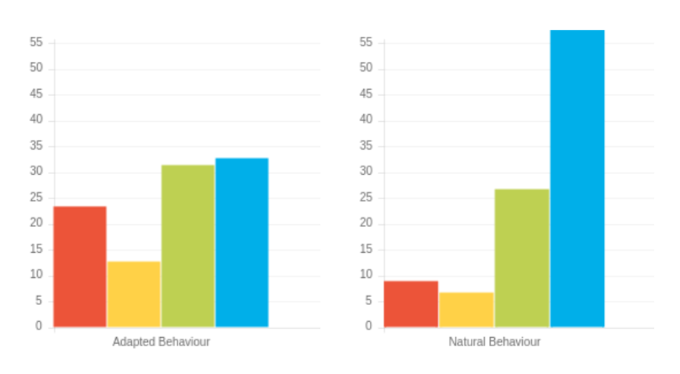
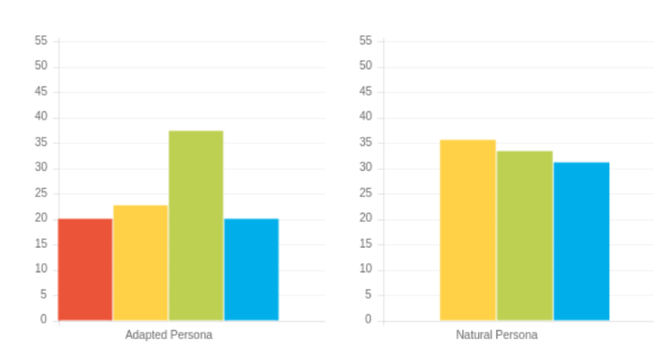
Exercise 11: Planning your Presentation
1
Reflecting on the two profiles on the right.
What are the probable needs, motivations and communication preferences?
What will you need to ensure you do to enhance the negotiation process for them?
2
Notes:
Embedding the "planning your presentation" idea and pulling together everything we have explored
in the Workshop.
Work in pairs.

Slide 26
Action planning
What more do I want to know?
What are my personal goals?
Reflect on what you’ve learnt today through the lens of all 4 colours.
What was the most helpful insight you gained?
What one thing do you need to watch out for in order to ensure optimal effectiveness in negotiation + influencing?
How could this impact others?
How can this be applied?
What do you want to stop … start … continue?
Notes:
Opportunity for TEAM Reflection – vital to help embed the learning from this workshop in a collective
way.
We’ve mapped action planning around our wheel, illustrating how different elements look through
different colour lenses.
We all draw on all 4 colour energies in our daily lives, regardless of go to preferences, it’s just that some
we may have to be more intentional about than others …
Red – what personal goals are you going to set?
Yellow – what Innovative applications can you think of?
Green – what impact might this have on others – how can I leverage what I’ve learned to impact my team?
Blue – what theory and knowledge do I want to remember from this session?
Stop/Start/Continue: a helpful structure for reflection. What will you Start doing? Stop doing? Continue
doing?
The thing you may decide you want to stop may be something that reflects your highest colour preference.
Also, the thing you may decide to start may be drawing on another colour other than your top colour
preference.
Action: take 5mins now to complete this page.
Action: I’d like you all to enter in the chat box one key action point you’ve included in your plan …

Slide 27
Thank you and please stay in touch
colour-profiling.com
@colourprofiling
@cmeprofiling
Cmecolourprofiling
@C-me Colour Profiling
Notes:
Opportunity to thank everyone.
Insert your own links on this slide.

