Slide 1
Preparing for your C-me session
Note. Certain slides can be hidden (right click ‘Hide Slide’) depending on session needs. Certain slides will need editing for each session (see below)
Checklist
Home Slide: Option to add Client’s logo/brand Slide 3
Exercise 5: Insert bespoke scenarios Slides 11 & 22
Insert bespoke Team Wheel and Team Graphs Slide 9.

Slide 2
Session Delivery
We encourage you to run through all the slides ahead of delivery in slideshow mode. Some slides are static and others include animations. Please check that animations work as expected.
Brief notes are provided below each slide to give guidance.

Slide 3


C-me Change Management Workshop
Helping teams communicate, collaborate and perform at their best
Notes:
If delivering remotely:
Welcome everyone on grid view (share slides later).
Give a very brief personal introduction
Purpose: The purpose of this workshop is ……
Programme: The timeline for today is ….
If recording session: Let the clients know at the start.

Slide 4
Our aims for this session
01
Reflect on specific contributions of each team member
02
Consider the 4 pillars of high performing teams and assess how robust your team are in relation to handling setbacks, change and recruitment
03
Understand how to maximise engagement and buy-in
04
Personal and team reflection
What are your aims? …..
Notes:
Check these aims are appropriate for your clients and tailor if necessary.
Give space for participants to share their session aims in the chat.

Slide 5










v
Natural team contribution
Focuses on the task in hand
Spots the flaw in the plan
Holds the team accountable
Attends to the detail
Questions the team’s methods
Focuses on getting things right
Sets stretching goals
Confronts poor performance
Gets on with the job
Keeps the team to process
Brings organisation skills
Prepares for all eventualities
Motivates the team
Encourages all to participate
Explores new ways to tackle problems
Builds consensus
Ensures everyone has a say
Focuses on values
Promotes a positive approach
Spreads warmth + energy
Inspires the team
Keeps the team together
Remembers the good things
Supports those who need it
Notes:
Recap: ALL have something to bring to the team. Can also refer to individual statements on Team Contribution in the profile and/or Team Wheel to support this recap.
Additional questions to consider:
For your team, are there particular contributions that are perhaps overlooked?
What does the newest member of your team bring to the team?
Which colour preference is least represented in your team?
Does that impact the value that colour preference brings?

Slide 6
v
4 Pillars of high performing teams
10 -
5 -
FLEXIBILITY
Focus + adaptation
HONESTY
Tricky conversations
RESILIENCE
Handling setbacks
COMMITMENT
Bought into journey
1 -
RELATIONSHIPS
Notes:
Outline the 4 Pillars of High Performing Teams
Each "click" reveals new pillar.
A commitment to the culture that sits underneath a team will make the difference between Performance and High Performance
Each Pillar is linked to a section of profile
Commitment – Enabling Engagement section
Flexibility – Role Agility section
Honesty – Effective and Ineffective Communication sections
Resilience – Handling Setbacks sections
Fifth “click” RELATIONSHIPS – that underpin all 4 pillars
Final Click – reveals scale. What would you score yourself/your team for each of the 4 pillars? (1 = low, 10 = high)

Slide 7
  Exercise 1:
  Reflecting on your profile
For each of the 4 pillars (Commitment, Flexibility, Honesty, Resilience):
On a scale of 1-10 (10 = high), how would you score yourself for each pillar?
What are the barriers to your scores being higher?
Reflecting on your profile, how could you improve your performance?
Notes:
Encourage referral to their individual profiles for statements to consider as they answer the questions

Slide 8

  Exercise 2:
  Reflecting on your team’s performance
For each of the 4 pillars (Commitment, Flexibility, Honesty, Resilience):
On a scale of 1-10 (10 = high), how would you score your team for each pillar and the reason why?
Notes:
Encourage each team member to share their scoring for the team individually to see the variety of
scores. Encourage them not to change the answers based on hearing other people's scores.
This could be done in pairs or small groups if the group is large or to encourage more honesty.

Slide 9

v
Exercise 3: High performance as a team
Insert Team Wheel and Team Graphs
Notes:
Invite reflection and discussion on team wheel
Which of the 4 pillars come naturally to this team in order to be High Performing?
Which come less naturally to this team in order to be High Performing?

Slide 10
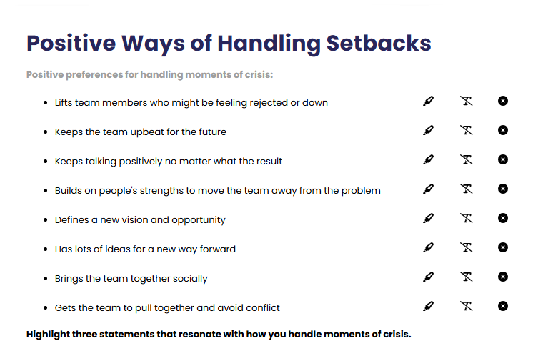
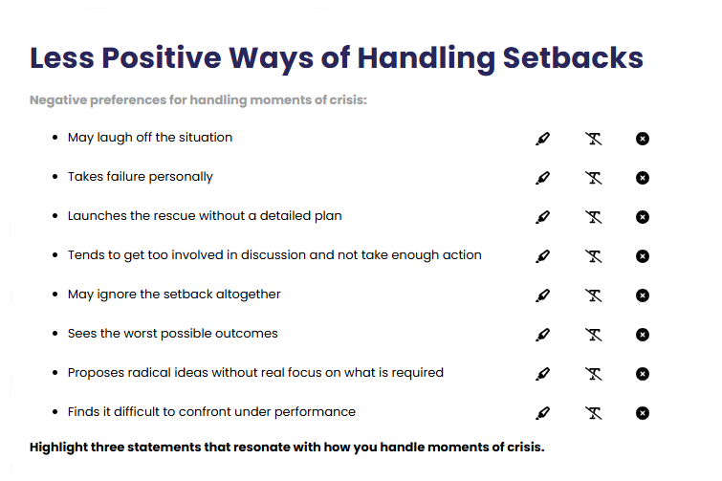
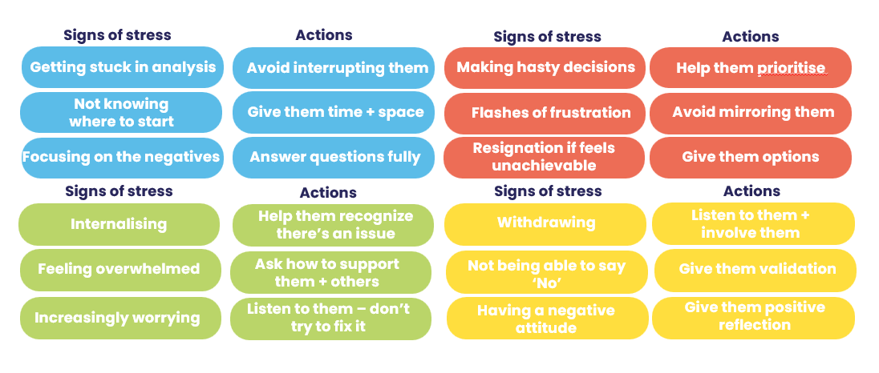
Handling setbacks
Exercise 4:
Team challenges
Referring to your own statements, how could you improve your team’s ability to handle setbacks?
Managing stress
What would the outcome of this be for your team?
Notes:
Each person's contribution to improving things as a whole

Slide 11
v
  Exercise 5:
  Team challenges
  What would it look like for your team to implement the 4 pillars for each of the following scenarios?
  1. An attitude issue
COMMITMENT
Bought into journey
FLEXIBILITY
Focus + adaptation
HONESTY
Tricky conversations
RESILIENCE
Handling setbacks
  2. A significant team loss
  3. A collective team mistake
Notes:
Construct a scenario that touches on these 3 issues:
1. Collective team motivation
2. Sudden loss of a valuable team member
3. A situation where the team felt the impact of mistakes that had been made

Slide 12

Handling Change
  Exercise 6: Team challenges
  What have been your most positive and negative experiences of change initiatives?
  How might this link to your colour preference?
Notes:
Invite reflection and discussion in pairs

Slide 13
Kübler-Ross Model of Change
Integration
Denial
Decision
MORALE
+
PERFORMANCE
Frustration
Shock
Experiment
Depression
TIME
Notes:
1st reveal:
Kübler-Ross model is sometimes called the Stages of Grief Model
Named after the psychiatrist Elisabeth Kubler-Ross
First published in her 1969 book “Death and Dying”
Has been widely applied to business and change management
Looks at how morale and performance fluctuates through various stages of change over time
2nd reveal: Stages appear
We will all go through these different stages at different times.
Different colour preferences will go through them at different speeds and have different places where they are most likely to get “stuck”

Slide 14









v
C-me and change
Planned, safe, improving, evidenced
Ambitious, fast, beneficial, impactful
Unplanned, risky, disruptive, unknown
Small, slow, low growth
Values driven, people minded, long term
Innovative, vision led, connecting people
Top-down, hurried, financially driven
Time consuming, unclear, impersonal
Notes:
Ticks = Positive ways that Colour Preference responds to change
Crosses = Change dynamics that will cause that Colour Preference frustration

Slide 15

v
Recruitment change: new team members
Exercise 7:
team challenges
How could an awareness of colour preference bring value to your recruitment process?
Notes:
Mention the Recruitment profile – a great resource
Invite discussion
New members of the team will cause change and adjustment. Knowing the colour preference of new team members can help with faster integration and relationship building.

Slide 16

Break

Slide 17
v
Maximising engagement fuels commitment
COMMITMENT
Bought into journey
FLEXIBILITY
Focus + adaptation
HONESTY
Tricky conversations
RESILIENCE
Handling setbacks
Notes:
Focus here on the first 2 pillars
Note.
Honesty – for tricky conversations: Covered in Comms and Conflict Workshop
Resilience – handling setbacks: Covered in Stress and Resilience Workshop

Slide 18
v
How could you maximise the contributions made to your team from each of the different colour preferences?
Notes:
Invite discussion
Note. Next slide reveals some ‘answers’

Slide 19
v
C-me and maximising engagement
Communicate key info in advance
Communicate early
Clarify need + show benefit
Make the logical case for change
Invite to lead
Ask for help identifying risks + optimising likelihood for success
Communicate in small groups
Sell the vision + communicate with energy
Invite feedback
Invite ideas
Invite necessary support
Focus on the positives

Slide 20
v
C-me and decreasing engagement
Gloss over details
Silence disagreement
Display too much emotion
Tell them last
Clarify need + show benefit
Imagine that the vision sells itself
Surprise them
Mask truth behind change agenda
Leave them out of new intiatives
Forget people impact
Let them abandon current tasks
Launch publicly first
Dampen creativity

Slide 21
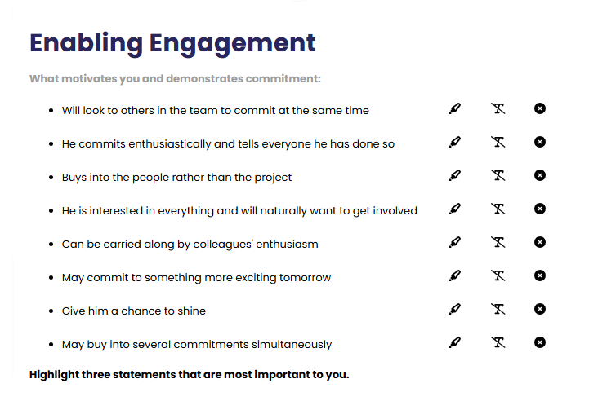
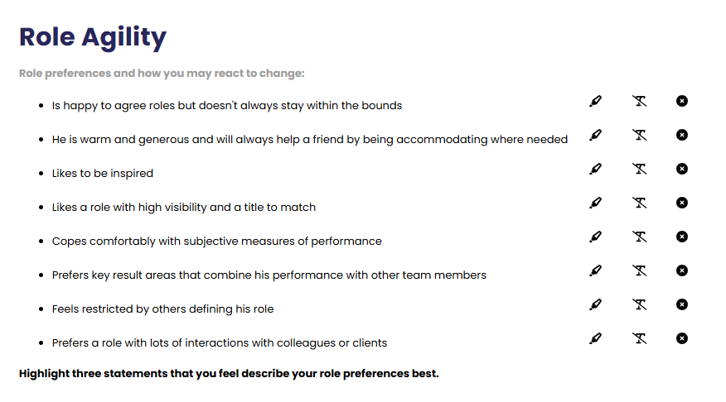
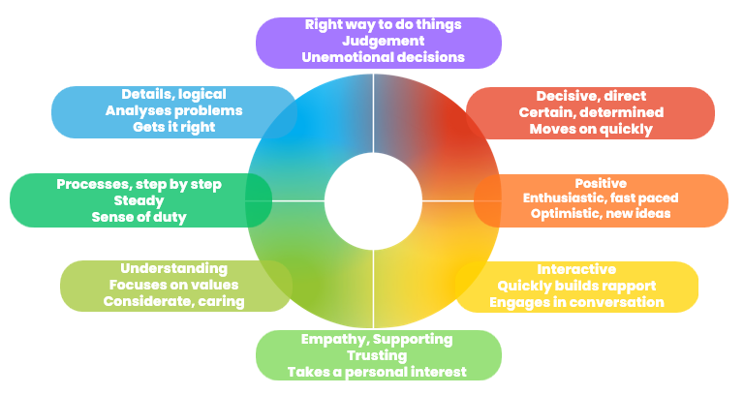
Engagement
  Exercise 8:
  Maximising engagement
  Pick 2 actions you’d like to focus on from the Enabling Engagement section in your profile.
  Share in pairs
Role fit around the wheel …
  Focus on a different colour preference combination to your own. What could you do to help this person maximise their engagement?
Notes:
Explore/Filter/Share

Slide 22
  Exercise 9:
  Colour preference and buy-in
  In the following scenarios, which colour preference is likely to buy-in first?
  New growth strategy
  Communications Innovation
  Culture Change
  Purchasing new tech equipment
  National growth plan

Slide 23
v
C-me collaboration model
High trust requirement
Innovative (some risk)
COLLABORATION
Strategic (give up a bit/gain a lot)
People capability and opportunity focused
Collaborative leverage
TRUE VALUE
Significant gains
Some trust required
Win/win
CO-OPERATION
Some leverage 1 + 1 = 3
Part process part people
Teamwork
WORKING TOGETHER
Marginal gains
PERFORMANCE
Low trust requirement
Low risk/reward
EFFICIENCY
No waste solutions
Mainly about process
Individual
PROCESS
Minimal gains
Notes:
Explain the Collaboration Model
A bit like Maslow’s Hierarchy of needs, if a lower level is threatened, collaboration reduces
As you work up the stages (1-3), performance increases.
Note. Each click reveals explanation of next stage
Invite discussion on what stage the team feels they spend most of their time in.
What might it take to increase the amount of time spent in the co-operation and particularly
the collaboration stages?

Slide 24
v
Exercise 10: Collaboration model
Imagine you were given 10 units to allocate between the 3 levels, how might you apportion those units to represent the amount of time and effort your organisation and team currently spend in each level?
As an example, many organisations
would apportion along the
lines of:
6 or 7 in efficiency
2 or 3 in co-operation
0 or 1 in collaboration
High trust requirement
Innovative (some risk)
COLLABORATION
Strategic (give up a bit/gain a lot)
People capability and opportunity focused
Collaborative leverage
TRUE VALUE
Significant gains
PERFORMANCE
Some trust required
Win/win
CO-OPERATION
Some leverage 1 + 1 = 3
Part process part people
Teamwork
WORKING TOGETHER
Marginal gains
Low trust requirement
Low risk/reward
EFFICIENCY
No waste solutions
Mainly about process
Individual
PROCESS
Minimal gains
Notes:
Exercise to assess the level of collaboration in your team/organisation

Slide 25
Personal reflection
What more do I want to know?
What are my personal goals?
Each colour has a different perspective on the focus for action.
Consider all 4 colours to reflect on what you have learnt today.
How could this impact others?
How can this be applied?
What do you want to stop … start … continue?
Notes:
Committing to actions to put into practice what we’ve covered over these sessions helps
to increase the impact of what you’ve learned.
We’ve mapped action planning around our wheel, illustrating how different elements look
through different colour lenses.
We all draw on all 4 colour energies in our daily lives, regardless of go to preferences, it’s just
that some we may have to be more intentional about than others …
Red – what personal goals are you going to set?
Yellow – what innovative applications can you think of?
Green – what impact might this have on others – how can I leverage what I’ve learned to impact
my team?
Blue – what theory and knowledge do I want to remember from this session?
STOP/START/CONTINUE: a helpful structure for reflection. What will you Start doing? Stop doing? Continue doing?
Action: take 5mins now to complete this page.
Action: I’d like you all to enter in the chat box one key action point you’ve included in your plan …

Slide 26
Team reflection
What more do we want to know?
What are our goals as a team?
Reflect on what you have learnt today through the lens of all 4 colours.
As a team what do you want to stop … start … continue?
What wider impact could this have?
How can we apply this?
Notes:
Opportunity for TEAM Reflection – vital to help embed the learning from this workshop in a collective way.
Encouragement to reflect on team group behaviours through the lens of all 4 colours (whilst we have a behavioural preference, we are all a blend of all 4 colours).
STOP/START/CONTINUE: a helpful structure for reflection.

Slide 27





Thank you and please stay in touch
colour-profiling.com
@colourprofiling
@cmeprofiling
Cmecolourprofiling
@C-me Colour Profiling
Notes:
Opportunity to thank everyone.
Insert your own links on this slide.

