Slide 1
Preparing for your C-me session
N.B. Certain slides can be hidden (right click ‘Hide Slide’) depending on session needs N.B. Certain slides will need editing for EVERY different delivery (see below)
N.B. C-me highly recommends that the group have completed the Communication Workshop before this one
CHECKLIST
You will need the High Performance or Core report for this workshop.
Welcome Slide: Option to add Client’s / Team's logo/brand Slide 3
Session Aims: Slide 4 (Remember to adjust if slide deck is modified in anyway)
Insert Team Wheel Slides 6 & 24
Check Report Page for Team contributions Slide 10
Insert Colour Balance Graphs and Potential Flex Wheel Slide 11
N.B. This workshop contains less content, providing more space for reflection, group discussion & application

Slide 2
Session Delivery
We encourage you to run through all the slides ahead of delivering them in slideshow mode. Some slides are static and others include animations. Please check that these animations work.
Brief notes are provided below each slide to give delivery guidance.

Slide 3

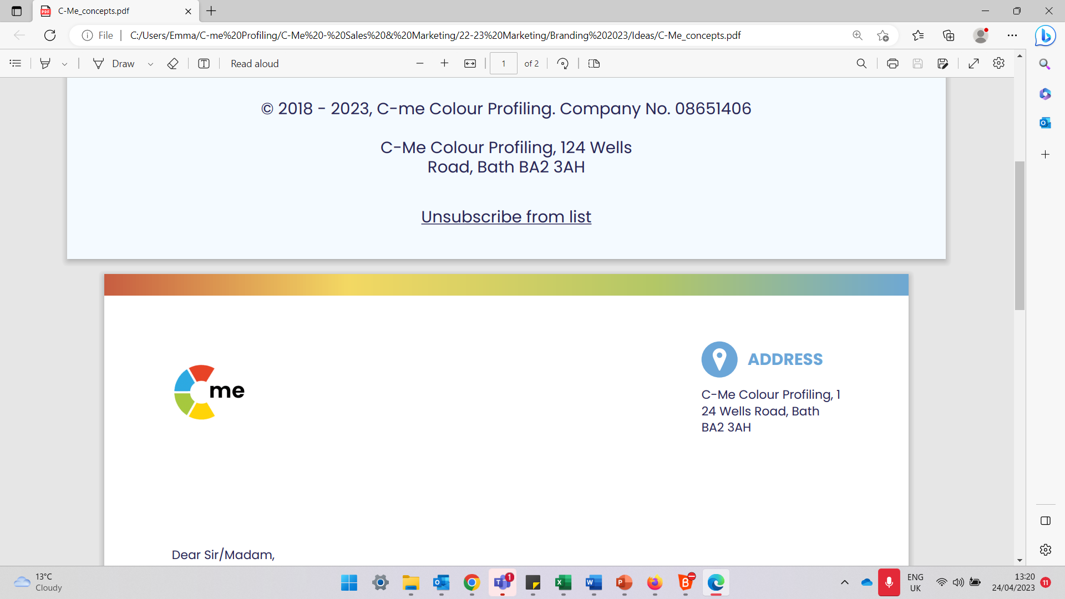
Team Cohesion
Building high performing individuals and teams
C-me, 124 Wells Road, Bath, BA2 3AH e: contact@colour-profiling.com t: 01225 721971
Notes:
If delivering remotely:
WELCOME everyone on grid view (share slides later).
Give a very brief personal introduction
PURPOSE: The purpose of this workshop is ……
PROGRAMME: The timeline for today is ….
If RECORDING SESSION: Let the clients know at the start.

Slide 4

Session Aims
Considering how team values impact culture
Appreciate and develop individual contributions to the team
Reflect on the role of colour preference in strategy planning
Apply the VVMM model to maximise team cohesion and strategy
What are your specific aims for this session?
Notes:
Check these aims are appropriate for your clients and tailor if necessary.
Give space for participants to share their session aims in the chat.

Slide 5
Exercise 1: Team Values
Does your team have an agreed set of values?
What are they?
Discuss
Notes:
Aim – Conversation starter about Team values
List team's values on white board or flip chart.

Slide 6
Exercise 2: ​Your Team's Values
1. Reflecting on your team's values, how does each colour preference live these out?
Insert Team Wheel
2. To what extent are your team's values shaping the culture and performance?
Notes:
Using the Team Wheel positions for reflection on Team Values, as appropriate.

Slide 7
Owned
VALUES
Reinforced by LANGUAGE and BEHAVIOURS
Shapes
CULTURE
Drives
PERFORMANCE
Reinforces
Reinforces
Notes:
Animated stages
Ideally Values need to be owned by the whole team and are kept alive by being reinforced through language and behaviour. If values are not owned, they are only lip service!
This, in turn, shapes team culture, which drives team performance.
Each stage of the process reinforces the next through a feedback loop.

Slide 8

Natural Team Contribution
Focuses on the task in hand
Spots the flaws in the plans
Holds the team accountable
Attends to the details
Questions the team’s methods
Focuses on getting things right
Sets stretching goals
Confronts poor performance
Gets on with the job
Keeps the team to the process
Brings organisational skills
Prepares for all eventualities
Motivates the team
Encourages all to participate
Tackles problems innovatively
Builds a consensus
Ensures everyone has their say
Focuses on values
Promotes a positive approach
Spreads warmth and energy
Inspires the team
Keeps the team together
Remembers the good things
Supports the less able members
Notes:
ALL have something to bring to the team.
To optimise team cohesion it is important to value the contributions made by every team member.
Key question - Are there contributions that might be more readily overlooked because of the current culture of your team?

Slide 9
Exercise 3: ​Appreciating other's contributions
In your groups, verbalise what you most appreciate about each other from one another's Team Contribution statements
Notes:
Groups can be whole, small or pairs, according to size of team and time allocation for this task.
Optional activity if appropriate to the team and if time allows
Each attendee has enough post-it notes for 1 for each person in the room
Each person uses 1 post-it per person and writes one thing they value about that person
When complete, the post-its can be handed to each other
Discuss the impact of the exercise as a team

Slide 10
Exercise 4: ​Self Reflection
Working in pairs, look at p5 in your report (Team Contribution)
1. Select 2 statements you feel you could do more of to contribute better to your team.
2. Ask your partner to select 2 statements from your report that they could see you contributing more of.
Notes:
Exercise to work through

Slide 11
Exercise 5: Flexing Behaviours
Insert Team Colour Balance Graph and Core Preference v Potential Flex Wheel
Notes:
Invite discussion
Looking at your core and potential flex graph, are their colour preferences your team members could flex into that would be of benefit, that are currently not as visible as they could be?
NB. The main team wheel highlights the top two colours but there are likely to be other colour strengths to be found in the Team Colour Balance graph and Core Preference and Potential Flex wheel.

Slide 12
Strategic planning as a team
Identify a current or forthcoming project being undertaken by your team

Slide 13

Exercise 6: Differing perspectives and questions
Notes:
Working individually, with the project in mind, write down questions each colour preference are likely to ask.

Slide 14
Exercise 6: Differing perspectives and questions
Are we clear about plan?
Can we improve it?
What have we missed?
Will we have an impact?
Will we hit targets?
Will we win?
Is our work meaningful?
Is it good for everyone?
Are values being upheld?
How new/disruptive is the project?
Could we innovate?
Will we be able to get enough people excited?
Notes:
Reveal C-me version of potential colour positioning for each of the 4 principle quadrants
If time invite comments/suggestions on blended colours between those quadrants.

Slide 15
Differing perspectives and questions
Is the product reliable?
How can we make it better?
How can we lower costs?
Are we clear about plan?
Can we improve it?
What have we missed?
Will we have an impact?
Will we hit targets?
Will we win?
Does everyone have clear roles?
Is the plan realistic?
Have we accounted for the ‘people’ factor?
Is the timing right?
How much currency do
we have in the brand?
How can inspire others to join us?
Is our work meaningful?
Is it good for everyone?
Are values being upheld?
How new/disruptive is the project?
Could we innovate?
Will we be able to get enough people excited?
What will incentivise key stakeholders?
What are they thinking?
What first milestone will we celebrate?
Notes:
Animated with 4 main quadrants first and then each colour blend between those.
What are the questions YOU tend not to ask? (related to your lowest colours?)
Who DOES ask those questions? How does that help the overall strategy?
Are there any questions you tend to miss as a team?

Slide 16
Break Time

Slide 17
C-me and the VVMM Model
MILESTONES
CLARIFYING priorities, goals, objectives, roles
Specific, time-bound objectives, assessing progress
MISSION
What we DO to realise the vision
Ensuring clarity and focus within teams
to help deliver the mission
M
M
M
M
VALUES
WHAT REALLY MATTERS to the individuals / team/organisation
Co-creating culture, team dynamics & learning
V
V
VISION
Visualising the IDEAL FUTURE
Connecting and engaging critical stakeholders
Notes:
The VVMM model is a helpful and holistic way to view strategy planning through the lens of all 4 colours.
Click through the animations
All of the VVMM sections are interconnected and ideally, when it comes to strategy, we have all 4 in balance.
NB. Each section is not just for individuals' colour preference but that colour is more likely to make that section of VVMM it's natural focus
Discussion questions to unpack the 4 elements of the model:
Where is your team clearer?
Naturally strongest?
Spending most time?

Slide 18
Building Cohesion and Strategy
Mission directs Milestones
Milestones progress Mission
MILESTONES
MISSION
M
M
M
M
Milestones quantify Values,
Values qualify Milestones
Mission achieves Vision
Vision directs Mission
V
V
VALUES
VISION
Values shape Vision
Vision affirms Values
Notes:
The different parts of VVMM impact each other. The correlation between them encourages us not to think in binary terms in terms of strategy.
Animated with wheel and 4 colour boxes on 1st click. Then bottom statement, top statement, left statement and finally right statement.
Additional information to aid understanding:
Values shape Vision – Values underpin the Vision and bring tone and sense
Vision affirms Values – Vision is the outworking of the Values
Mission directs Milestones – Mission is the destination for the Milestones
Milestones progress Mission – Milestones are markers of achievement en route to achieving the Mission
Milestones quantify Values – Milestones can be measurables of less tangible Values
Values qualify Milestones – Values bring purpose and potentially accountability to the actions performed in the Milestones
Mission achieves Vision – Mission is the key strategy(or strategies) or aim(s) that helps fulfill the wider Vision
Vision directs Mission – Vision is the bigger picture that shapes the key elements of the Mission

Slide 19
Building Cohesion and Strategy
MILESTONES
MISSION
M
M
M
M
Mission delivers Values
V
V
VALUES
VISION
Values bring purpose to Mission
Notes:
There is correlation between Mission and Values across the wheel too.
Mission delivers Values – Mission brings practical action to the outworking of the Values
Values bring purpose to Mission – Values underpin the Mission and bring accountability for the less measurables

Slide 20
Building Cohesion and Strategy
MILESTONES
MISSION
M
M
M
M
Milestones measure the Vision
V
V
VALUES
VISION
Vision inspires Milestones
Notes:
There is correlation between Milestones and Vision across the wheel too
Milestones measure the Vision – Milestones are the measurable stepping stones to get to the bigger Vision
Vision inspires Milestones – Vision is the bigger picture of possibility and Milestones are the detailed markers of how the Vision is achieved

Slide 21
Exercise 7
What are the implications if one area of VVMM is weaker or not considered in your strategy? How might team cohesion be affected?
Which sections of VVMM bring most purpose and engagement for you?
Which sections stretch you to improve and bring innovation to your work?
M
M
V
V
Notes:
Animated 3 questions – 1 for whole team and 2 &3 for individuals
Allow for open discussion for differences in the team in how they respond to different elements of VVMM
Key message: All working in harmony brings best cohesion and strategy.

Slide 22
The VVMM Model: an example
MILESTONES
Grow overall turnover by 50% in year 1 (2021)
Complete migration to co-operative model (2022)
Take all employees through the ILM coaching programme by end 2022
Have two enterprises self-sufficient by 2023
Launch first enterprise hub by end 2023
MISSION STATEMENT
To coach, develop and equip 1,000 social enterprise leaders to impact communities
M
M
M
M
VALUES
People before profit
Maximise personal growth opportunities
Excellence in everything
Customer first approach
Respect and embrace diversity
VISION STATEMENT
To equip people and empower them with skills and opportunities so that they can make a positive contribution to their community.
V
V
Notes:
Share this example slide

Slide 23
The VVMM Model: Your Team
Measurable MILESTONES
Clear MISSION STATEMENT
M
M
M
M
Agreed core VALUES
Inspiring VISION STATEMENT
V
V
Notes:
Give time to the team to work through each of the 4 boxes, outlining some possible responses to each of the 4 boxes for their own situation
NB. One section of VVMM may be weaker or less defined than another.

Slide 24
Team Reflection
Discuss the implications of your VVMM model for your team's cohesion and strategy.
What might you want to:
Insert Team Wheel
Stop?
Start?
Continue?
Notes:
Opportunity for TEAM Reflection – vital to help embed the learning from this workshop in a collective way.
STOP/START/CONTINUE: a helpful structure for reflection.

Slide 25
Personal Reflection
Reflect on what you have learnt today through the lens of all 4 colours.
What do you want to commit to for yourself?
Stop?
Start?
Continue?
Notes:
Opportunity for PERSONAL Reflection – vital to help embed the learning from this workshop.
STOP/START/CONTINUE: a helpful structure for reflection.
The thing you may decide you want to stop may be something that reflects your highest colour preference.
Also the thing you may decide to start may be drawing on another colour other than your top colour preference.

Slide 26





Colour-profiling.com
Thank you and please stay in touch!
@colourprofiling
@cmeprofiling
Cmecolourprofiling
@C-me Colour Profiling
Notes:
Opportunity to thank your guests.
INSERT YOUR OWN LINKS HERE ON THIS SLIDE.

