Slide 1
Preparing for your C-me session
N.B. Certain slides can be hidden (right click ‘Hide Slide’) depending on session needs N.B. Certain slides will need editing for EVERY different delivery (see below)
CHECKLIST
You will need the High Performance or Core report for this workshop.
Home Slide: Option to add Client’s / Team's logo/brand Slide 3
Insert correct Report Page Number for Exercise 5 Slide 34
Insert bespoke Team Wheel Slide 36
Insert bespoke Team graphs Slide 37

Slide 2
Session Delivery
We encourage you to run through all the slides ahead of delivering them in slideshow mode. Some slides are static and others include animations. Please check that these animations work and work as you are expecting.
Brief notes are provided below each slide for delivery guidance.

Slide 3

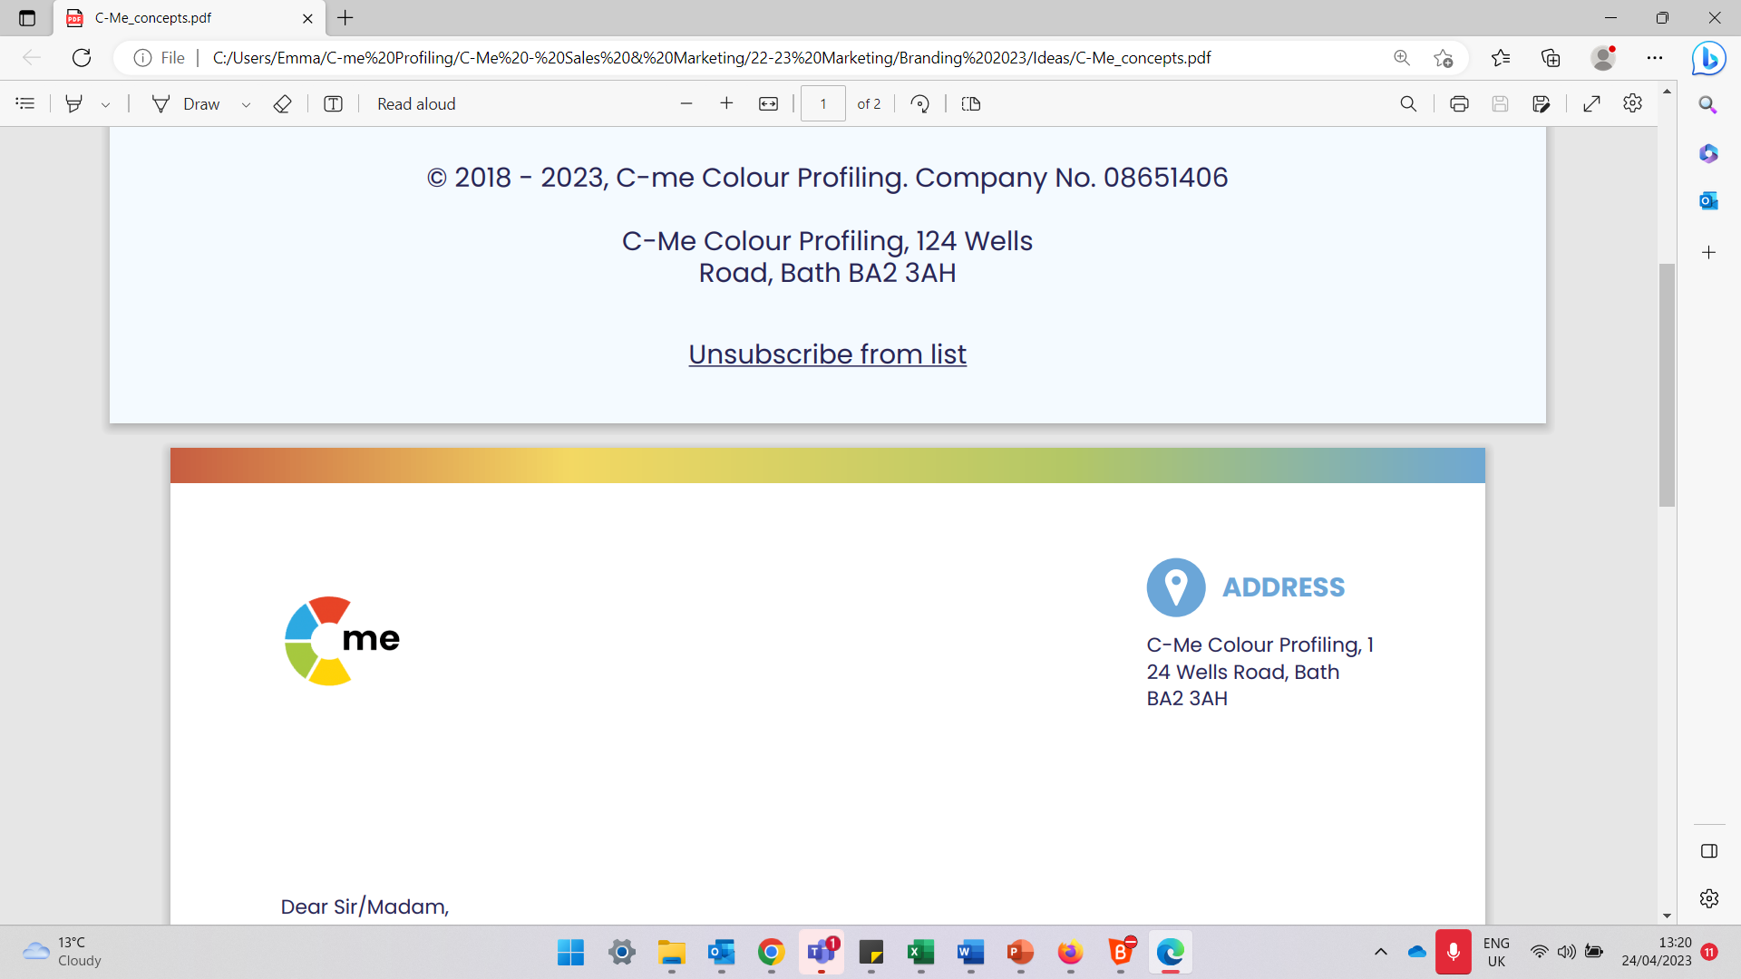
Stress & Resilience
Building high performing individuals and teams
C-me, 124 Wells Road, Bath, BA2 3AH e: contact@colour-profiling.com t: 01225 721971
Notes:
If delivering remotely:
WELCOME everyone on grid view (share slides later).
Give a very brief personal introduction
PURPOSE: The purpose of this workshop is ……
PROGRAMME: The timeline for today is ….
If RECORDING SESSION: Let the clients know at the start.

Slide 4

Session Aims
Better understand resilience in the context of C-me
Learn how to spot the signs of stress in self and others
Reflect on the impact of stress on our behaviours
Grow in our ability to adapt our behavior in order to build resilience
What are your specific aims for this session?
Notes:
Check these aims are appropriate for your clients and tailor if necessary.
Give space for participants to share their session aims in the chat/on flipchart.

Slide 5
Impact on others
Behaviours
Personality
(values, beliefs)
Notes:
Emphasize that C-me focus on BEHAVIOURS, not personality.

Slide 6
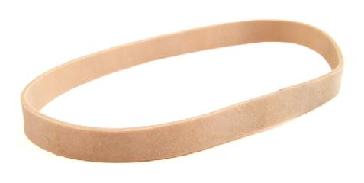
Understanding Resilience
“The process of adapting well in the face of adversity, threats or significant stress”
American Psychological Association
From the Latin ‘resiliens’
- ‘to rebound’, to ‘bounce back’
Exercise 1: Reflect
How resilient do you feel you are as:
i) an individual ii) a team iii) an organization?
What has happened recently that has tested your resilience?
Where have you seen colleagues respond effectively?
Notes:
What do you think Resilience is?
Why an elastic band? When stretched it will not break and will rebound back to it's original size when the pressure is off. If overstretched, will lose elasticity or even break!
These exercises can be done as individual reflection time or group discussion.

Slide 7

Resilient Strengths
Realistic
Focuses on details
Considers all the facts
Strong work ethic
Logical and analytical
Sets high standards
Brings clarity to complexity
Bold and determined
Drives hard for delivery
Focuses on results
Decisive
Brings clear direction
Powerful advocate
Enjoys a challenge
Tactful and diplomatic
Builds consensus
Dedicated to the team
Considerate and attentive
Reliable and dependable
Works until the job is done
Tolerant and open-minded
Energetic and enthusiastic
Positive outlook
Creative and innovative
Expressive and persuasive
Embraces change
Social and outgoing
Inspiration and visionary
Notes:
A summary of resilient strengths and development areas of each colour. Use after discussion as a summary and remember we’re looking at resilience not competence.
Resilience = where we perform at our best and for the longest time given any task.
Not about what we’re good at but what gives us life and energy.
You may be very good at things that are your lowest colour but it might drain you to do it.
Example: Someone who is good at detailed, systematic administrative tasks but when their energy is low, planning goes out the window, details are missed and balls are dropped. Competence is high but resilience is low.
Colour does give us clues as to where we gather energy, so if we’re in a role that demands our lowest colour we need to look at how to structure our day in practical ways to work effectively for longer.

Slide 8
Understanding Stress
‘A state of mental or emotional strain or tension, resulting from adverse or demanding circumstances’ Oxford Dictionary 2016
From the Latin ‘stringere’
- ‘to draw tight’
Exercise 2: Reflect
How does stress impact
  i) you?
  ii) your team?
  iii) your organisation?
Notes:
The aim is to begin to explore how stress impacts us in different ways

Slide 9
Exercise 3: Stress Test
For each question, mark which statement best describes you
1.
2.
3.
4.
5.
6.
7.
8.
9.
Notes:
ACTION: Please recreate this grid on your paper, drawing two columns, with the numbers 1-9 down the left-hand column.
N.B. Whilst your clients are drawing the grid, it’s helpful for you to draw the grid at the same time in order to get your pace right.
A series of statements (labelled A,B,C,D) will appear on the screen. Identify the statement that best describes your behaviour when under stress and write down that letter in the right hand column next to the corresponding number.

Slide 10
C-me Stress Test
Question 1 – When I am stressed, I …
Become hypersensitive to my own and others' emotions.
Blurt out harsh words and critical statements about others.
Feel disapproved of, disliked and rejected by others.
Make up “logical plots” and rationalisations to explain situations.
Notes:
Allow clients time to read the slide and record their answer.

Slide 11
C-me Stress Test
Question 2 – When I am stressed, I …
Misinterpret comments from others as personal criticism.
Put others down by pointing out their mistakes.
Become disorganised, chaotic and rush around.
Become compulsive in search of the “truth”.

Slide 12
C-me Stress Test
Question 3 – When I am stressed, I …
Feel like a victim, unappreciated and used.
Make decisions too quickly and display knee jerk reactions.
Become forgetful and misplace things.
Turn to experts for advice, complaining if they don’t know everything.

Slide 13
C-me Stress Test
Question 4 – When I am stressed, I …
Become defensive and feel threatened.
Become increasingly impatient and irritable.
Become over-emotional and argumentative.
Become concerned about not appearing “professional”.

Slide 14
C-me Stress Test
Question 5 – When I am stressed, I …
Become overly concerned about the welfare of others.
Become impatient with people who are not as quick.
Become fearful of other people’s disapproval.
Withdraw and become pessimistic seeing only the downside in everything.

Slide 15
C-me Stress Test
Question 6 – When I am stressed, I …
Become stubborn.
Start to micro-manage and seek to control all outcomes.
Become manipulative and coercive.
Become excessively rigid and rule-bound.

Slide 16
C-me Stress Test
Question 7 – When I am stressed, I …
Shut down and worry excessively.
Become inflexible in decision making (I am right).
Lose focus and become easily distracted.
Look for perfection rather than an 80/20 solution.

Slide 17
C-me Stress Test
Question 8 – When I am stressed, I …
Feel devalued as a human being.
Make caustic remarks about others.
Blame others for not appreciating me.
Engage in excessive logic.

Slide 18
C-me Stress Test
Question 9 – When I am stressed, I …
Feel fragile and needy.
Order people around.
Start to chase my tail but get very little done.
Become aloof and detached.

Slide 19
C-me Stress Test Results
A: Operating with Green preference under pressure
B: Operating with Red preference under pressure
C: Operating with Yellow preference under pressure
D: Operating with Blue preference under pressure
1. | A
2. | B
3. | B
4. | D
5. | A
6. | C
7. | C
8. | D
9. | B
Which 2 colours do you have most of?
Share what you have learned?
Notes:
You should have something that looks like this.
2nd Click: TASK: Ask participants to ‘analyse’ their personal stress test.
The highest scoring colours suggest likely behaviours under stress.
How do your results compare with your report graph?
Highlight the blend of colours in their answer choices.

Slide 20
Signs of stress
Becomes impatient and negative
Gets stuck in analysis
Feels overloaded and becomes distant
Gets frustrated & hasty in decision-making
Drives too hard & is over-focused
Gets discouraged & negative
Internalises & feels overwhelmed
Gets anxious, withdraws, goes quiet
Becomes less supportive
Becomes chaotic & easily distracted
Struggles to say ‘no’
Tends to over-communicate
Notes:
Summary slide after discussion, to reinforce learning.
Starting with blue preference, what do you thing the signs of stress are? Yellow preference next, then Green preference, then Red preference.

Slide 21
Yerkes-Dodson Human Performance Curve
Performance
High performance
Boredom
Stress zone
Flip zone
Comfort
Stretch
Strain
Flip
Pressure
Notes:
The Yerkes–Dodson law is an empirical relationship between pressure and performance.
Originally developed by psychologists Robert M. Yerkes and John Dillingham Dodson in 1908.
The law dictates that performance increases with physiological or mental arousal, but only up to a point.
The positions of High Performance, Stress and Flip zone are animated to appear on 3 clicks as this curve is being explained.

Slide 22
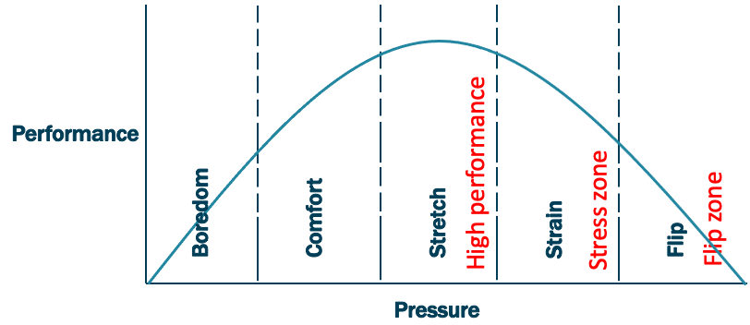
Yerkes-Dodson and C-me
1
2
3
1
2
3
Notes:
Mapping the Yerkes-Dodson Human Performance Curve onto the C-me Colour Wheel
1. High performance zone – playing to your resilient colour strengths
2. Stress zone – beginning to stray beyond the bounds of your resilient strengths (stress is triggering ‘bad day’ behaviours)
3. Flip zone – Bad day behaviours are being played out in an extreme (now a long way from operating in the High Perfomance Zone (best utilising resilient strengths)
Expanded in the next few slides
N.B. C-me wheel is a behavioural tool – looking at probable behaviours and behavioural styles (responses to stress are not ALWAYS predictable!)

Slide 23
High Performance (Stretch Zone)
Playing to your colour strengths
Focused
Detailed
Organised
Reflective
Critical thinker
Decisive
Determined
Action orientated
Confident
Assertive
Supportive
Values focused
Intentional
Considerate
People orientated
Creative
Inspiring
Motivated
Visionary
Positive
Notes:
Stretch zone.
Animated slide Red preference, Green preference, Blue preference, Yellow preference.

Slide 24
Triggers that take us into the stress zone
Incoherent plans
Insufficient preparation time
Last minute changes
Too many ideas
Loss of control
Too slow a pace
Too much detail
Endless discussion
Feeling rushed
Devaluing of others
Conflict & tension
Undermining of values
Exclusion
Disapproval or criticism
Too much focus on detail
Lack of collaboration or fun
Notes:
Starting with those of us with high Blue preference, what triggers stress in you? Yellow preference next, then Green preference, then Red preference.
The arrows signify leaving the High Performance Zone, into the Stress Zone.

Slide 25
Observed behaviours in the stress zone
Negativity
Getting stuck in analysis
Overloaded
Unresponsive, distant
Frustration
Rushed decisions
Overly zealous
Impatience
Anxiety
Being overwhelmed
Internalising & distancing
Becoming less supportive
Chaotic decision making
Distraction
Inability to say ‘no’
Loss of creativity
Notes:
Possible to discuss link with "bad day" behaviours.
Green preference, Yellow preference, Red preference, Blue preference.
Which do you recognise in yourself? Other people you know well or work with?

Slide 26
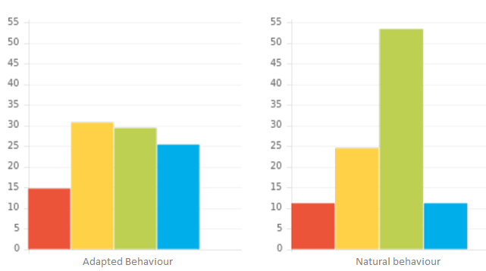
Stress Zone
N.B. Unfiltered, less-conscious graph
Notes:
Stress leads us to ‘revert to type’ – unfiltered / less conscious behaviours. We see our natural graph colours exhibiting.

Slide 27
Flip Zone – Moving from stress to panic
Erratic
Uncalculated risks
Inability to prioritise
Overly emotional
Hyper-sensitive
Indecisive
Overly ‘pushy’
Impetuous
Callous
Becomes highly rigid
Fixated by details
Stops communicating
Notes:
Animated slide where colour boxes and arrows appear – Blue preference, Green preference, Yellow preference, Red preference.
In panic mode, we enter the Flip Zone and our behaviours are perhaps surprisingly seen coming from the opposite side of the wheel.
Sometimes in this zone we exhibit the "bad day" behaviours of that opposite colour, which can surprise us and others!
Can you think of a situation where this has been true for you?

Slide 28
Break Time

Slide 29




Exercise 4: Stress and Colour Combination
How might stress play out for these colour combinations?
Person 1 Person 2 Person 3 Person 4
Notes:
Group Discussion on how the second colour can impact stress triggers and responses.
NB. There is always more nuance than looking through the lens of 4 colours only.
1st ‘C’ = Reflective preference
2nd ‘C’ = Extrovert preference
3rd ‘C’ = Feelings driven preference
4th ‘C’ = Thinking driven preference

Slide 30
How do we manage/coach?
Returning to the High Performance Zone
Give them time & space
Answer questions fully
Present the facts
Avoid interrupting them
Avoid mirroring behaviour
Leave alone
Give options
Help them to prioritise
Listen don’t fix
Re-visit the values
Help them recognise issue
Ask how to support them
Compliment successes
Involve them
Listen to them
Give them validation
Notes:
Each colour preference will respond well to managing or coaching back to high performance in different styles.
The fixed image in the HP+ Report on the Setbacks and Stress page has these suggested approaches too.

Slide 31
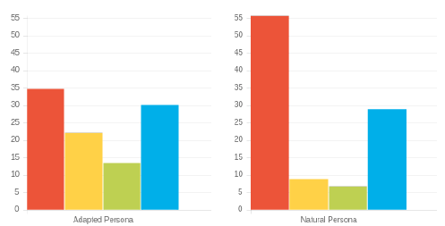
Exercise 5: Coaching back to high performance
How might stress be triggered?
How will this stress be displayed?
3. What behaviours should be avoided when supporting this person?
4. How could this person be coached back to High Performance?
Adapted Behaviour
Natural Behaviour
Notes:
Work through the slide exercise questions.
In this example:
N.B. Naturally high Red Preference – possible ‘bad day’ behaviours associated with red preference that are likely to be shown under stress
N.B. Higher R/B preference in Natural suggests reverting to thinking/task type under pressure (people/team/feelings may get forgotten)
N.B. Steadier behavioural ‘balance’ of Adapted profile is likely to become more pronounced and extreme under pressure.
N.B. Refer to behaviours to avoid (slide 34) for ideas on what to avoid doing.
COACHING:
Initially give space/provide options/perspective
Later encourage leaning into G/Y preference behaviours – valuing other perspectives.

Slide 32



Coaching out of stress
Name | C’s | Do | Don’t
Jonny
Sally
Fred
Notes:
Illustrate how teams can be proactive in coaching one another out of Stress and back towards High Performance. This is a similar grid to the Do's and Don'ts of communication. Encourage Team to create their own grid.

Slide 33
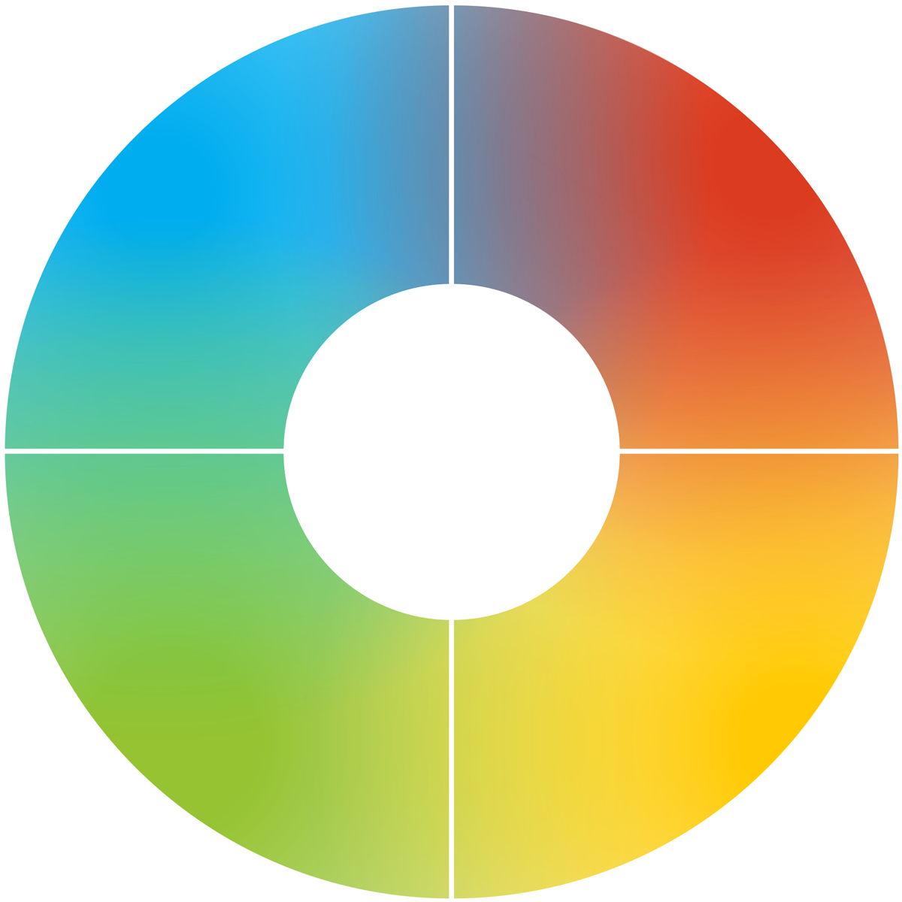
Response to setbacks
How each colour preference is likely to respond
Looks for facts
Will look for a logical solution
May see worst in a situation
Looks to sort it quickly
Decisive
Can appear rushed
Can feel overwhelmed
Concerned for others first
Reluctant to respond quickly
Will see the opportunities
Keen to work collaboratively
Can miss details
Notes:
Looking specifically at our verbal style
- How do we like to talk to people?
- How might other people prefer talking to us?

Slide 34
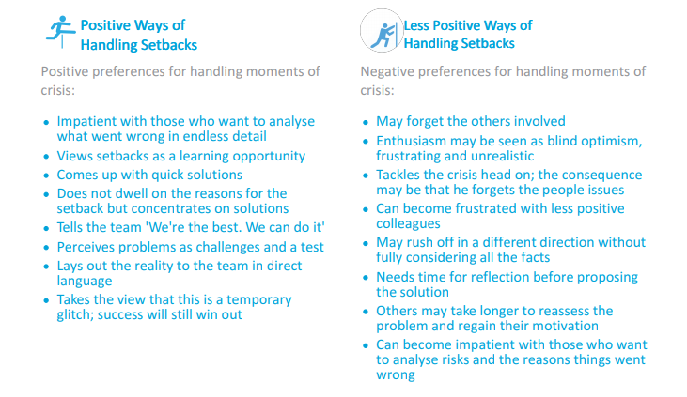
Handling setbacks
Exercise 5
Look at the Handling Setbacks section of your report – page ?
Pick two statements from each column that most resonate with you.
Share in pairs how an awareness of these things will help you better handle setbacks in the future.
Notes:
How are setbacks different from stress? What is a setback?
Refer to personal High Performance Reports P10 to complete the exercise.

Slide 35
Flexing behaviours to build resilience
Explore feelings
Find the fun in challenges
Value other perspectives
Stay connected to
purpose and life dreams
Take on tasks which
require attention
Commit to a task or decision
Stick to deadlines
and healthy routines
Utilise analysis and attention to detail
Notes:
DISCUSS: What do you notice about the most effective ways of building resilience?
To build resilience, try to lean into your natural opposite colour preference. Consciously choosing to practice these skills that are less familiar to your colour preferences (flexing) will help you perform better and will also build resilience for when things are under more pressure.

Slide 36
Reflecting on stress as a team
Team wheel
Reviewing last year and key projects, what have the stress points been for you as a team?
How does this relate to your team wheel?
What changes could you make to handle these stress points better as a team in the future?
Insert team wheel
Notes:
An opportunity here to apply the learning of this workshop to the team collectively.

Slide 37
Reflecting on stress as a team
Team graphs
What are the most likely triggers of stress for this team collectively?
What do you need to commit to intentionally as a team in order to overcome this?
Insert team graphs
Notes:
The team graphs could reveal resilient/high scoring colour strengths that are not necessarily being fully utilised currently. Addressing this can impact resilience for overcoming stress as a team.

Slide 38
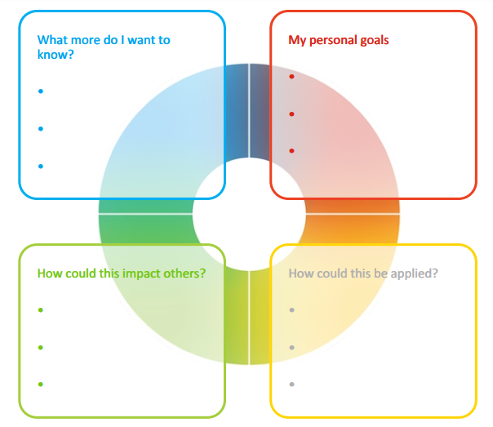
Final Reflection
Each colour has a different perspective on the focus for action. Consider all 4 colours to reflect on what you have learnt today.
What do you want to commit to Stop, Start and Continue
        Personally?
        As a Team?
Notes:
Opportunity for PERSONAL and TEAM Reflection – vital to help embed the learning from this workshop.
Encouragement to reflect on behaviours through the lens of all 4 colours (Whilst we have a behavioural preference, we are all a blend of all 4 colours) for Action Plans that are more thorough.
STOP/START/CONTINUE: a helpful structure for reflection. What will you Start doing? Stop doing? Continue doing?

Slide 39





Colour-profiling.com
Thank you and please stay in touch!
@colourprofiling
@cmeprofiling
Cmecolourprofiling
@C-me Colour Profiling
Notes:
Opportunity to thank your guests.
INSERT YOUR OWN LINKS HERE ON THIS SLIDE.

