Slide 1
Preparing for your C-me session
N.B. Certain slides can be hidden (right click ‘Hide Slide’) depending on session needs N.B. Certain slides will need editing for EVERY different delivery (see below)
CHECKLIST
To get the most out of this workshop we recommend using the High Performance report.
Home Slide: Option to add Client’s / Team's logo/brand Slide 3
Adjust Session Aims if appropriate Slide 4
If delivering face-to-face, hide slide 8
Select pairs for Exercise 3 in advance Slide 15 – see notes
Slides 17-19 are currently hidden as they are not needed in this workshop if the group have already done the Communication Workshop. If this is not the case and the slides are needed, be aware of additional delivery time needed.

Slide 2
Session Delivery
We encourage you to run through all the slides ahead of delivering them in slideshow mode. Some slides are static and others include animations. Please check that these animations work.
Brief notes are provided below each slide to give delivery guidance.

Slide 3

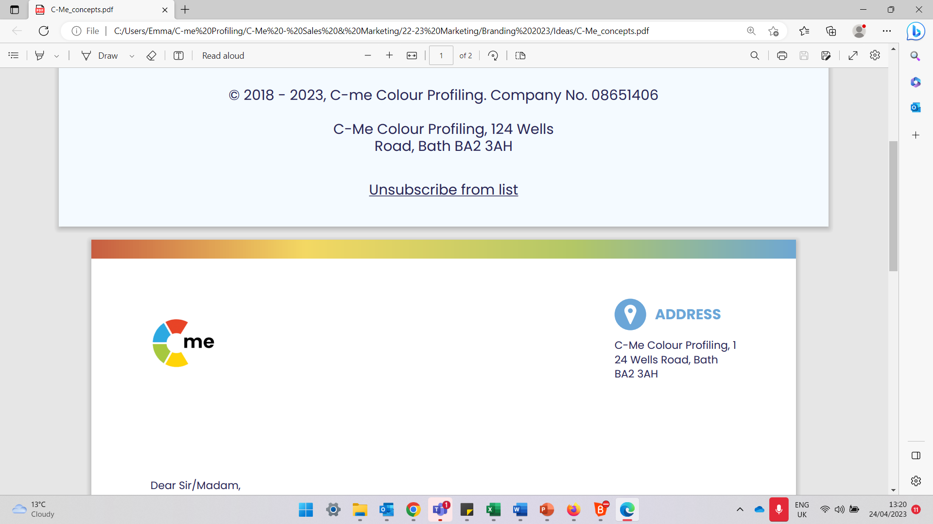
Leadership & Development
Building high performing individuals and teams
C-me, 124 Wells Road, Bath, BA2 3AH e: contact@colour-profiling.com t: 01225 721971
Notes:
If delivering remotely:
WELCOME everyone on grid view (share slides later).
Give a very brief personal introduction
PURPOSE: The purpose of this workshop is ……
PROGRAMME: The timeline for today is ….
If RECORDING SESSION: Let the clients know at the start.

Slide 4

Session Aims
Explore the specific leadership contributions of each colour preference
Reflect on your leadership in the context of your personal report
Consider how to best adapt your communication style and be more influential as a leader
Understand the impact of leadership style on communicating vision.
What specific questions are you bringing?
Notes:
Check these aims are appropriate for your clients and tailor if necessary.
Give space for participants to share their session aims in the chat.

Slide 5
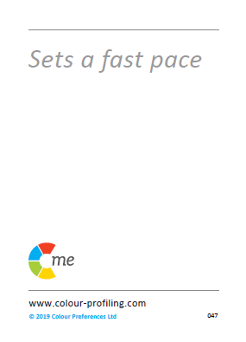
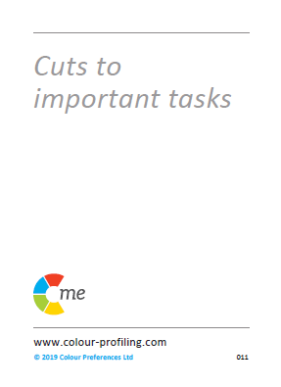



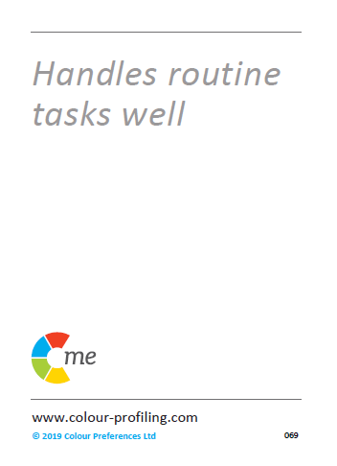
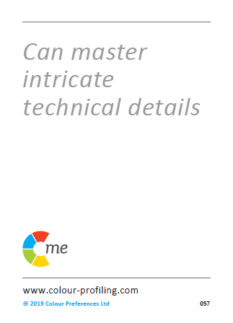
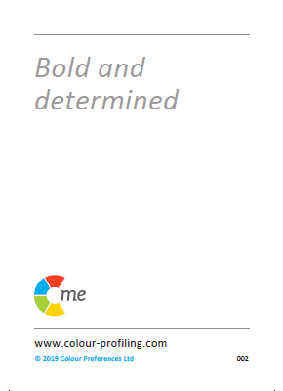
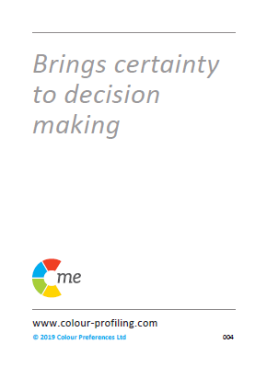
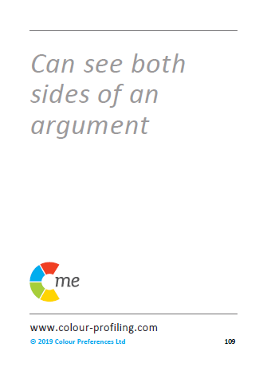
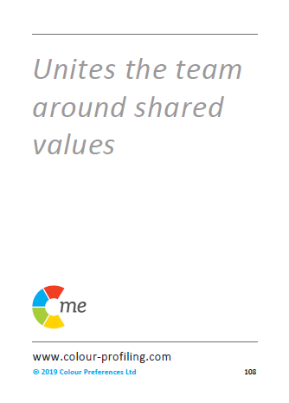
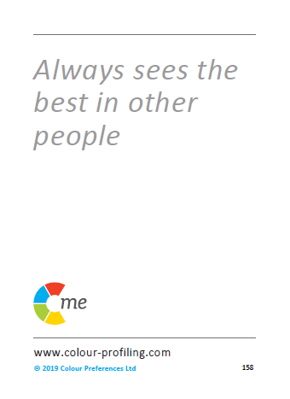

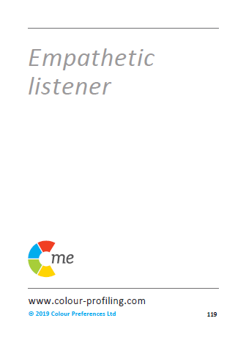
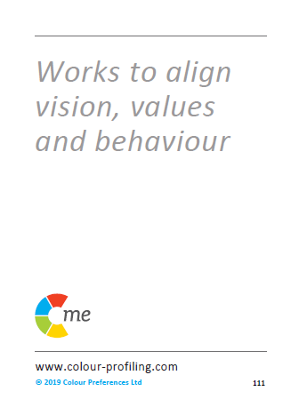
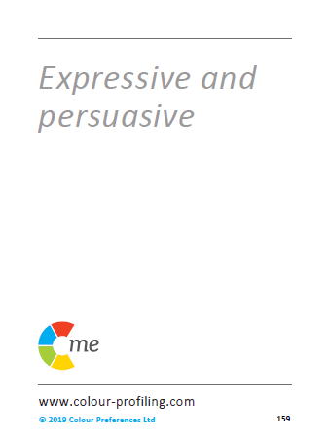
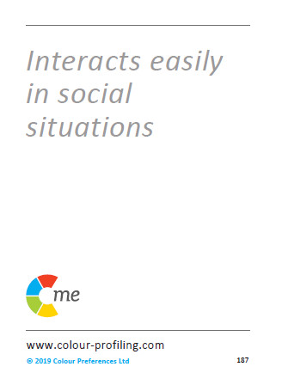
Notes:
Reminder that different behavioural preferences can be grouped into 4 principle colours, placed around a colour wheel

Slide 6

THINKING preference
REFLECTIVE preference
EXTROVERTED preference
FEELING preference
Notes:
Very brief recap:
How might the Jungian axes impact how a person leads?

Slide 7
360 Card Game
What do you observe about other team members?
Notes:
Focussing on one Leader at a time - What would you say are their top 2 colour preferences? Add to chat
Explain the 360 card game if Face-to-Face:
8 cards given to each attendee
Consider each Leader in the room
Give a leader the cards that you think best describe them – max of 3 cards per leader
If virtual session, use slide 8

Slide 8
1.
2.
3.
4.
5.
6.
7.
8.
Notes:
Animated slide – Whole group to consider a Leader and the resonance of statements with the individual.
ACTION: Identify the colours of the cards that you picked for that leader.
ACTION: Write those colours in the chat box/share with group.

Slide 9
Leadership & Management
Notes:
Very brief recap:
You can be an effective Leader/Manager from anywhere around the colour wheel.
You bring your own unique colour combination to your Leadership role.
No one colour combination is better for leadership than another.

Slide 10
Authentic Leadership Styles
Keeps the team on agenda
Good problem-solver
Hardworking and persevering
Strong sense of duty
Logical and analytical
Attends to the details
Initiates vital improvements
Sets high standards
Meets a challenge head on
Sets goals for the team
Thrives on competition
Works to tight deadlines
Explores all the “what ifs”
Well organised
Realistic
Brings common sense
Quick thinker
Builds enthusiasm
Visionary/sees big picture
Positive & inspirational
Works late until the job is done
Finds the low-risk route
Involves others
Supportive and loyal
Spontaneous and imaginative
Positive vision for the future
Thrives on variety
Friendly and optimistic
Sees the good in others
Flexible and tolerant
Builds lasting relationships
Team player
Notes:
Authentic leadership styles come in a range of colours!
Animated slide – starting with 4 colour quadrants (Y, G, B, R) and then blends accordingly.
Question - Considering your top 2 colours and your blend, which 3 statements best describe you? Share as whole group, small group or pairs. Aim is to explore leadership styles around the wheel.

Slide 11

Authentic Leadership Approaches
“Let’s deliver what we’ve promised!”
“Let’s do this right!”
“Let’s make a big impact!”
“Let’s set ourselves up for success!”
“Let’s get this show on the road!”
“Let’s do this together!” ​
“Let’s give it our best shot!”
“You’re the best team for the job!”
Notes:
Which statements do you use the most?
Considering the colour preferences of your team, which ones are they likely to want to hear?
What will you adjust in your communication as a result? Be specific!

Slide 12
The four postures of a leader
Take responsibility
Serve & empower
Train & equip
Set example
Notes:
Animated slide. The dark dot represents the Leader in the positioning of each approach
1. Taking responsibility for everyone you are leading – leadership "down" (not bossing people but taking responsibility)
2. Serving and empowering everyone you are leading – leadership "up"
3. Training and equipping those you lead – leading from behind (Management element)
4. Setting an example – leading from the front (Leadership)

Slide 13
Exercise 1: The four postures of a leader
Which of these postures is more intuitive for you?
Is that what others see in you?
Thinking of a current situation, how might you adapt your intuitive leadership style to better effect?
Take responsibility
Serve & empower
Train & equip
Set example
Notes:
Three questions for reflection (animated).
Can be discussed as whole group, in small groups or pairs.
NB. There is not one posture for each colour quadrant. It is a more nuanced conversation about which postures come instinctively to each leader and which they might need to be more conscious of.

Slide 14
Exercise 2: Explore & filter
Look at pages 5 & 6 of your own reports (Resilient Strengths, Team Contribution, Areas of Development, Blind Spots).
In the context of leadership, which statements most resonate with you?
How are you seeing these displayed in your leadership?
What might it feel like to be led by you?
Notes:
Personal reflection on these sections of the report in the context of Leadership, initially with a view to sharing in next exercise.

Slide 15
Exercise 3: Share
Working in pairs, look at your partner's statements and pick 2 that you feel best describe their leadership style.
Share how you see these qualities strengthening the whole team
Where do you see most room for growth?
Notes:
Share whatever resonates from your individual reflections on the 4 areas of your report.
Pairs could be of those with opposite or very different colour combinations or a pair who work closely together.
Opportunity to hear another Leader's perspective on your style.

Slide 16
Break Time

Slide 17
Effective Leadership Communication
Give facts, ideally in writing
Be rational and practical
Ask for their questions
Define the process
Be logical and thorough
Listen carefully to questions
Allow time to prepare
Demonstrate conviction
Identify their role quickly
Be direct and action focused
Present options
Focus on success
Be clear and brief
Refer early to the objective
Allow time for discussion
Be patient and sincere
Show genuine interest
Be generous
Be polite and courteous
Consider their opinions
Progress at their relaxed pace
Be interactive and friendly
Use visuals
Make it fun
Be light and fast paced
Make direct eye contact
Seek their views and ideas
Allow for an open discussion
Notes:
Effective Leadership Communication
- Different colours have very different preferences when it comes to effective leadership communication. We often communicate in the style we are most comfortable with, rather than what is necessarily best for the other person.
- ACTION: Take a moment to look at the quadrant you’re most comfortable with and look across to the other side of the wheel and take note of what is listed there. (For those of you who have a cross type profile – think what your lowest colour is or the colour at the bottom of your 'C' visual)

Slide 18
Ineffective Leadership Communication
Interrupt their thinking
Being unrealistic
Leaving things unfinished
Being flippant
Straying from the agenda
Skipping over the facts
Poorly evidenced conclusions
Impatience
Belittling accomplishments
Procrastination
Attempts to direct or overpower them
Focusing on too much detail
Slowing down the pace
Repetition
Expecting an instant decision
Being abrupt
Open criticism
Ruining team harmony
Being overly competitive
Talking over them
Rushing them
Preventing them dreaming
Cutting them off mid flow
Restraining their ideas
Overwhelming them with detail
Assuming they’re listening
Forcing them to follow process
Expected adherence to rigid timescales
Notes:
Ineffective Leadership Communication
This visual is again reinforcing colour preference behaviours and encouraging people to considering other colours than their own.
-ACTION: Take a moment to look at the quadrant you’re most comfortable with and look across to the other side of the wheel and take note of what is listed there. What does someone of opposite colour preference to you really not find helpful?
For those who are a cross type profile – use their lowest colour or the colour at the bottom of their 'C' visual

Slide 19
Verbal Style
Pragmatic
Structured
Prepared
Questioning
Analytical
Professional
Focused on detail
Authoritative
Direct
Fast paced
Responds quickly
Unambiguous
Forthright
Assured
Collaborative
Diplomatic
Thoughtful
Active listening
Non-judgemental
Empathetic
Meaningful
Dynamic
Persuasive
Spontaneous
Expressive
Positive possibilities
Energetic
Personal
Notes:
Recap verbal style
The most effective leaders learn to pick up nuance and the subtleties of differences in verbal style – not about what is said but how!
NB. Pause for brief reflection to allow attendees to consider situations that occur to them relating to this

Slide 20
Exercise 4: Explore, filter, share
Look at page 9 of your own reports
Enabling Engagement
Which 3 statements best describe what keeps you engaged and committed as a leader?
Role Agility
Which 3 statements best describe your role preferences and how you react to change?
In what ways does this impact your leadership?
Notes:
Personal reflection on these sections of the report in the context of Leadership

Slide 21
Being C.L.E.A.R. in our Leadership
Commit
Purpose and goal of the conversation
Review
Session and process
Action
Clarify next steps
Listen
Ask exploratory questions
Explore
Look at options
Notes:
Each Click – reveals next part of the C.L.E.A.R. Coaching Method for communicating as Managers and Leaders.
This process can be used in any topic or issue that needs addressing between a Leader and one of the team.
To develop your leadership further, in this exercise you are considering your own colour preferences and those of someone you coach.
When coaching others, it is beneficial to go through all 5 stages, not just the ones they more naturally focus on:
COMMIT – Clarifying goal or issue and the purpose of the conversation. A collaborative approach to this is best!
LISTEN – Ask open questions, collect detail and information and allow time for reflection. Reflect back what you have heard.
EXPLORE – Explore together the avenues available to get to the agreed goal, based on what you have just heard.
ACTION – Gain clarity on next steps to achieve agreed goal
REVIEW – 1. Session review - Ask for feedback on how they found the session and consider adjusting your style accordingly for next time.
2. Process review - Review ongoing progress. Give time for reflective input soon after the session for those who would value it.
As coaches, our different colour preferences make some of these stages more intuitive than others.
Which stages are intuitive for you?
Which ones do you need to flex to intentionally, for the sake of the Coachee?
Do these relate to your colour preferences?
Why CLEAR model over GROW model? Firstly, it makes explicit the importance of the wider dynamics, encouraging questions like "How did you find our conversation?", "What helps you learn?" and "What blocks your learning?".
Secondly the CLEAR model emphasises the importance of reviewing the session. This is a powerful tool for tuning our coaching to the evolving needs of the other person. It's easy when using the GROW model to feel that when we have done the wrap-up, we're finished. Making reviewing the coaching effectiveness one of the basic steps, as the CLEAR model does, reinforces the value and importance of this stage and allows for more consideration of the other person's preferences.

Slide 22
Exercise 4: Applying C.L.E.A.R. in our Leadership
Commit
Purpose and goal of the conversation
Think of someone you are currently leading:
What is their colour preference?
Which stages are they likely to want to focus on?
Which are they likely to want to skip over?​
Listen
Ask exploratory questions
Explore
Look at options
Action
Clarify next steps
Flexing involves adjusting our own preferences to support all 5 stages in order to maximise the outcomes of the conversation.
Review
Session and process
Notes:
Animated – to reveal the flexing statement at the bottom of the slide
As Leaders it is good to adjust ourselves to the preferences of others, potentially being more conscious of the process sections that are less conscious for the person concerned.

Slide 23
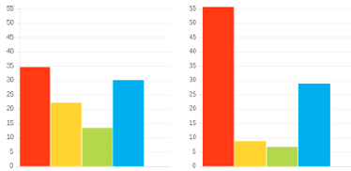
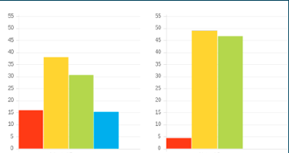
Exercise 5: Applying C.L.E.A.R.
Commit
Purpose and goal of the conversation
Profile 1
Listen
Ask exploratory questions
Explore
Look at options
Adapted Natural
Action
Clarify next steps
Profile 2
Review
Session and process
Adapted Natural
Notes:
In pairs, explore how the C.L.E.A.R. Method could be best adjusted for 2 different profiles.
N.B. Focus primarily on ADAPTED graph
N.B. But be aware of natural ‘unconscious’ graph and ‘revert to type’ behaviours

Slide 24
Personal Reflection
Consider 2 key team members with different colour preferences to you:
How will I adapt my day-to-day communication styles with them from now on?
What changes will you make in a coaching session with them next time?
Notes:
Give 3 mins for each individual to consider
Questions are animated

Slide 25
Vision
Each colour preference is likely to bring a different question of focus
HOW are we
doing it?
WHY are we
doing it?
HOW
WHY
WHO
WHAT
WHO will be
impacted?
WHAT can we do differently?
Notes:
Animated – each click reveals each colour
Each colour preference is likely to have a different question of focus with regards to vision.
So the question each colour preference would ask might be...
WHY - What is the goal?
WHAT - What are the options?
WHO – Who will be affected?
HOW – What is the process?
Great that we all have natural questions we would ask but we also need to ask the other questions intentionally in order for the whole picture to be created.

Slide 26
Effective Vision
Vision + Process
= ORDER
Vision + Decision
= PROGRESS
Vision + Collaboration
= BUY-IN
Vision + Ideas
= INSPIRATION
Notes:
Animated – each click reveals each colour
Each colour preference's contributions bring an important part of the Vision. Which come naturally to you? Who do you turn to for the others?

Slide 27
Ineffective Vision
Vision - Process
= CHAOS
Vision - Decision
= THEORY
Vision - Collaboration
= DISENGAGEMENT
Vision - Ideas
= LIMITATION
Notes:
Animated – each click reveals each colour
Vision without one of the key elements quickly becomes ineffective. Thoughts?

Slide 28
Exercise 6: Powerfully communicating vision
Vision involves taking people from HERE ..………...……………………. To THERE
What adjustments would you make when communicating vision to people with colour preferences different to your own?
Which might you want to be more aware of in your communication of vision?
How might this be impacting your team?
Notes:
Animated questions

Slide 29
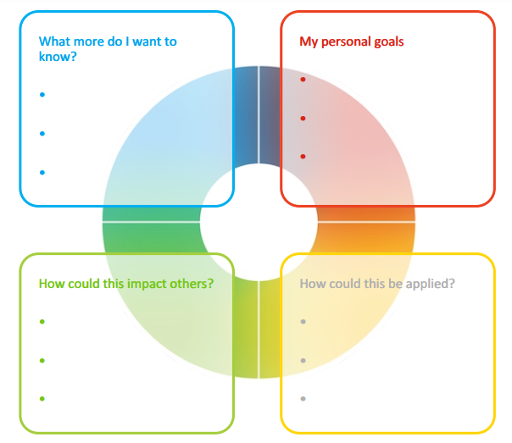
Final Reflection
What do people most appreciate about how you lead?​​
How can you better release the potential in others?
How will you lead differently in light of this workshop?​
Notes:
Opportunity for PERSONAL and TEAM Reflection – vital to help embed the learning from this workshop
Encouragement to reflect through the lens of all 4 colours (Whilst we have a behavioural preference, we are all a blend of all 4 colours) for Action Plans that are more thorough.

Slide 30





Colour-profiling.com
Thank you and please stay in touch!
@colourprofiling
@cmeprofiling
Cmecolourprofiling
@C-me Colour Profiling
Notes:
Opportunity to thank your guests.
INSERT YOUR OWN LINKS HERE ON THIS SLIDE.

