Slide 1
Preparing for your C-me session
N.B. Certain slides can be hidden (right click ‘Hide Slide’) depending on session needs
N.B. Certain slides will need editing for EVERY session (see below)
CHECKLIST
For this session you will need the High Performance profile with Influencing sections.
Home Slide: Option to add Client’s/Team's logo/brand Slide 3
Session Aims Slide 4 - remember to adjust if you adapt the slide deck
Insert their Team Wheel Slide 20

Slide 2
Session Delivery
We encourage you to run through all the slides ahead of delivering them in slideshow mode. Some slides are static and others include animations. Please check that these animations work.
Brief notes are provided below each slide to give delivery guidance.

Slide 3

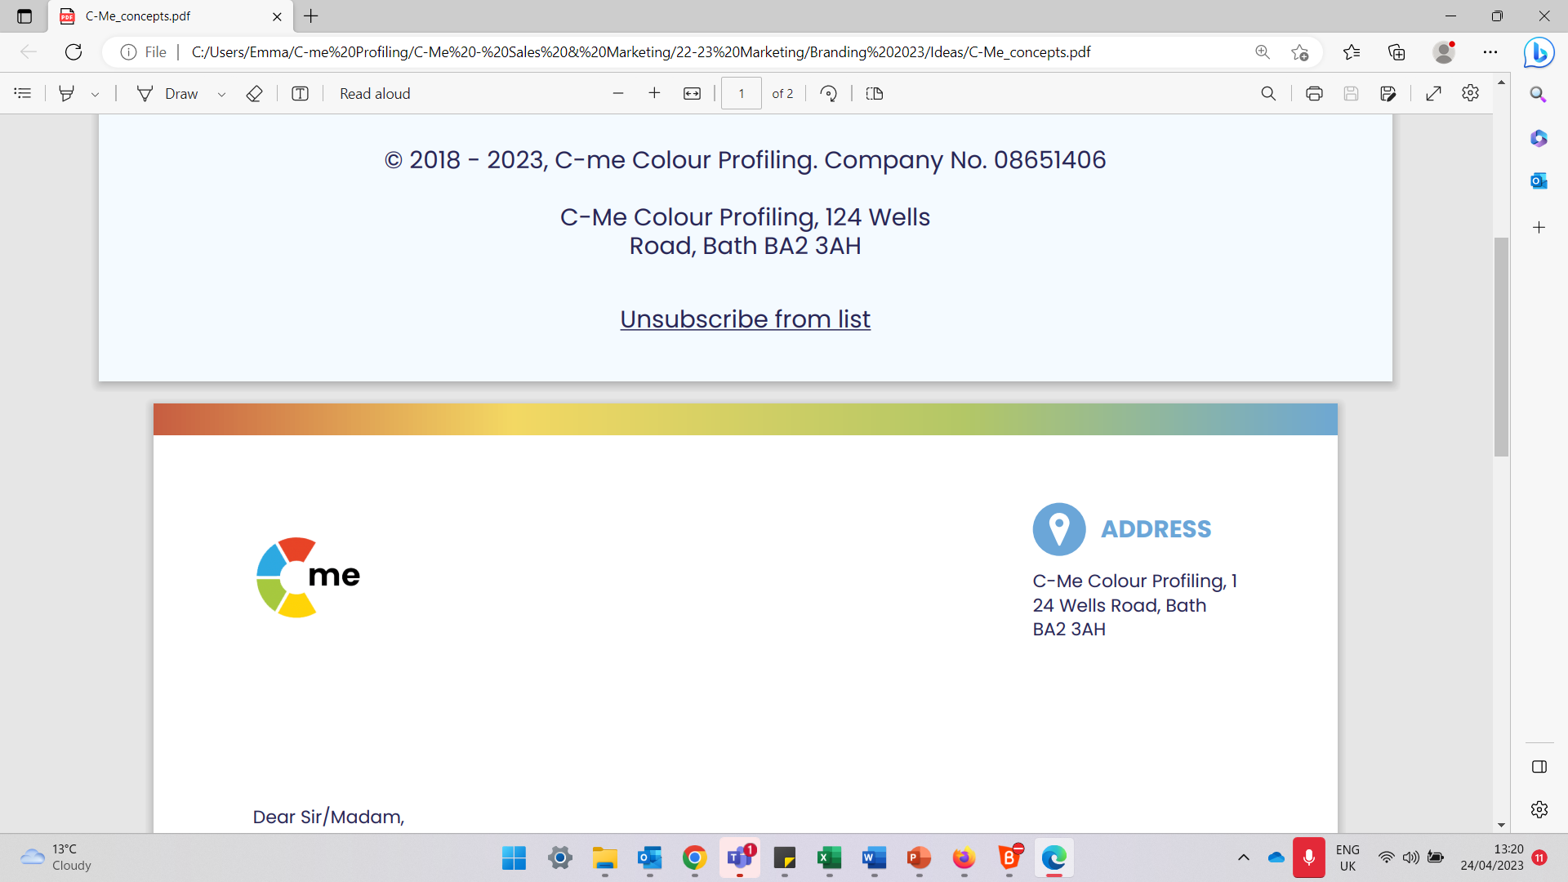
Influencing with Impact
Building high performing individuals and teams
C-me, 124 Wells Road, Bath, BA2 3AH e: contact@colour-profiling.com t: 01225 721971
Notes:
If delivering remotely:
WELCOME everyone on grid view (share slides later).
Give a very brief personal introduction
PURPOSE: The purpose of this workshop is ……
PROGRAMME: The timeline for today is ….
If RECORDING SESSION: Let the clients know at the start.

Slide 4

Session Aims
Recap Colourful Behaviours
Consider personal influencing strengths and blind spots
Consider team influencing strengths and blind spots
Review drivers and blockers around the wheel
Apply learning to maximise performance
What are your aims?
Notes:
Check these aims are appropriate for your clients and tailor if necessary.
Give space for participants to share their session aims in the chat.

Slide 5

Remember the C-me Axes?
Thinking preference
Recap
Here are the Jungian axes.
What are the 4 titles?
Reflective
preference
Extraverted
preference
Feeling preference
Notes:
Reminder of C-me Axes from Foundation Workshop. 2 clicks reveal the labels for each axes. The aim is to recap and will be expanded over the session.

Slide 6

Thinking/Feeling Behaviours
Business-like
Self-contained/controlled
Pragmatic/focused
Critical
Independent
Orderly and organised
Timescales are important
Body language more rigid
Asks pointed questions
Less facial expression
More formal
Considerate/caring
Flexible
Shows feelings
Easier to get to know
Questions are less pointed
People issues come first
More emotional
Smiles more
More casual
Comfortable
Responsive
People first
Notes:
Thinking/Feeling Axis - Aim is to recap on how different colour behaviours show themselves.

Slide 7
Reflective/Extravert Behaviours
Thinks before responding
Contributes more slowly
Takes time to commit
Leaves room for others' views
Less direct eye contact
Considerate and gentle
Quiet, even cautious
Fewer gestures
Needs more personal space
More diplomatic language
Thoughtful/Slower pace
Responds quickly
May interrupt/fills silences
Conversational
Spontaneous
Sounds sure of “facts”
Gives direct eye contact
Stands physically closer
More expressive
May show impatience
May challenge more directly
Future focused
More optimistic
©2014 Colour Preferences Ltd | www.colour-profiling.com
Notes:
Reflective/Extravert Axis - Aim is to recap on how different colour behaviours show themselves.

Slide 8
Effective Approach to Influencing
Thinking preference
Exercise 1:
Considering we are all different, what are the implications for your approach to influencing and customer service?
Reflective
preference
Extraverted
preference
Feeling preference
Notes:
Discuss and share in groups

Slide 9
Approach to Influencing
Discernment
Accurate
Right way to do things
Thorough in research
Analyses the problem
Defines motive
Happy to close
Negotiator
Moves on quickly
Follows correct process
Keeps records well
Timely reporting
Networker
Enthusiastic
Convincing presentation
Builds long term relationships
Considerate
Wins trust
Provides innovative ideas
Interactive
Builds rapport
Understands needs
Takes personal interest
Develops relationship
Notes:
Consider
Looking around the colour wheel, notice the very different influencing approaches different colour preferences have.
How do other people in your sales team differ from yourself? In what ways might this complement you?

Slide 10
Reviewing your Personal Influencing Profile
Exercise 2:
Overview (p4)
Influencing strengths and Improving your Influence (p10)
Explore Filter Share
Notes:
Overview of what we are going to cover in the next few slides.
Take 5 mins individually to read these areas of your report again
Explore together in the context of influencing and customer service, answering the questions in your report.
Explain the coaching process you will be leading them through: explore, filter, share

Slide 11

Effective Communication
Recap effective communication around the wheel.
Exercise 3:
Review your personalised statements (p7).
What comes most naturally to you when influencing others?
Share.
Give facts, ideally in writing
Be rational and practical
Ask for their questions
Define the process
Be logical and thorough
Listen carefully to questions
Allow time to prepare
Demonstrate conviction
Identify their role quickly
Be direct and action-focused
Present options
Focus on success
Be brief and clear
Refer early to the objective
Allow time for discussion
Be patient and sincere
Show genuine interest
Be generous
Be polite and courteous
Consider their opinions
Progress at their relaxed pace
Be interactive and friendly
Use visuals
Make it fun
Be light and fast paced
Make direct eye contact
Seek their views and ideas
Allow for an open discussion
Notes:
Fixed image on this slide are there as additional statements to select from as well as personalised report statements.
- ACTION: Review your personalised statements on p7 of your profile through the lens of influencing. Which statements best apply to you? Which ones do you think you most use in the context of negotiation, presentation and provision of service? When you are in discussions with stakeholders? When you first make connection with a potential customer or when approaching a new opportunity?
Give people 2 mins for self reflection and then split into groups. Sharing could be done in pairs or whole group, as appropriate.

Slide 12
Ineffective Communication
Interrupting their thinking
Being unrealistic
Leaving things unfinished
Being flippant
Straying from the agenda
Skipping over the facts
Poorly evidenced conclusions
Impatience
Belittling accomplishments
Procrastination
Attempts to direct or overpower them
Focusing on too much detail
Slowing down the pace
Repetition
Recap ineffective communication around the wheel.
Exercise 4:
Review your personalised statements (p7).
Which statements most resonate for you?
Share.
Expecting an instant decision
Being abrupt
Open criticism
Ruining team harmony
Being overly competitive
Talking over them
Rushing them
Preventing them dreaming
Cutting them off mid-flow
Restraining their ideas
Overwhelming with detail
Assuming they’re listening
Forcing them to follow process
Expecting adherence to rigid timescales
Notes:
Recap Ineffective Colour Communication around the wheel
- ACTION: Remind yourself of what you find most difficult in how others communicate with you. Recap how communication can be very different depending on colour preference.
Review your personalised statements on p7 of your profile report through an influencing lens. Which statements best apply to you in this context? Which ones do you think you most use in the context of negotiation, influence and provision of customer service? When you are in discussion with stakeholders? When you first make connection with a potential customer or when approaching a new opportunity?
Give people 2 mins for self reflection and then split into groups. Sharing could be done in pairs or whole group, as appropriate.

Slide 13
Communication and Influence Around the Wheel
Exercise 5:
  Scenario: A client keeps stalling on making a commitment
  How would you naturally communicate with them?
  How could you flex your natural approach to connect more effectively with a stakeholder or potential client if their behavioural preference was: 1. Red/Blue
  2. Green/Yellow 3. Yellow/Red 4. Blue/Green 5. Red/Green
Notes:
Aim – Consider the need to "flex" communication styles in order to get the best from the other person.
Think Jungian axes! We are beginning to introduce colour combination here too, looking at the top two preferences.
N.B.
1. Red/Blue = Thinking
2. Green/Yellow = Feeling
3. Yellow/Red = Extroverted
4. Blue/Green = Reflective
5. Red/Green = Cross-type

Slide 14
Optimising performance
Performance = POTENTIAL minus INTERFERENCES
3 interferences:
1. CONFIDENCE – mindset is key
2. CREDIBILITY – believability/reputation
3. CONNECTION – build trust
How might YOUR colour preference impact these interferences?
Notes:
Eg. Someone with high Yellow/Red preference may have higher levels of confidence but may not prioritise time to connect with the individual so may come across as a bit pushy.
Consider what interference might look like for each colour preference.

Slide 15
Exercise 6: Flexing to Others’ Preferences
Where might you have to flex in order to be more effective?
  Scenario 1 Negotiating with someone who has the opposite colour preference to you
  Scenario 2 Your client is not responding to any emails
  Scenario 3 The financial position has changed for someone you have been negotiating with and they are no longer able to commit to your services
Notes:
Discussion as whole team or in small groups:
Scenario 1 – Simple scenario - flexing to preference on the opposite side of the wheel.
Scenario 2 – More nuance needed in terms of communication skills. Your email communication style will be shaped by your colour preference so may need more careful thought when flexing for other preferences.
Scenario 3 – Awareness and discernment needed in terms of driving for a result vs building the relationship for future opportunities, depending on your colour preference.

Slide 16
Break Time

Slide 17
Coaching Each Other
The next slide will reflect on verbal style displayed when influencing others. Work in pairs to coach each other in the following 3 areas:
Provide examples of where your colour strengths have been a real asset
Provide observations of where your natural approach can hinder effective influencing
Where do you most intentionally need to develop in order to display greater flexing in your approach?
Notes:
Working in pairs to share real life scenarios where this has played out. Good for developing stronger team dynamics and individual improvement and accountability.

Slide 18
Verbal Style
Pragmatic
Structured
Prepared
Questioning
Analytical
Professional
Focused on detail
Authoritative
Direct
Fast paced
Responds quickly
Unambiguous
Forthright
Assured
Exercise 7:
Your colour strengths
Possible hindrances
Flexing opportunity
Collaborative
Diplomatic
Thoughtful
Active listening
Non-judgemental
Empathetic
Meaningful
Dynamic
Persuasive
Spontaneous
Expressive
Positive
Energetic
Personal
Notes:
Personal reflection and then coaching each other on the following:
Provide examples of where your colour strengths have been a real asset
Provide observations of where your natural approach can hinder effective influencing
Where do you most intentionally need to develop in order to display greater flexing in your approach?

Slide 19
Effective Communication by Email
Be clear and succinct
Include all necessary detail
Include an agenda
Schedule any follow up in advance
Provide context and expectations for a response
Maintain focus
Use bullet points
Quickly outline the objective
Be succinct
Detail action needed
Enquire about them
Be collaborative
Show you value them
Be pragmatic
Give them time to reflect and respond
Be personal and engaging
Include visuals
Avoid too much detail
Ask for their feedback and ideas
A call is preferable when possible
Notes:
Personal reflection and then coaching each other on the following:
Provide examples of where your colour strengths have been a real asset
Provide observations of where your natural approach can hinder effective influencing
Where do you most intentionally need to develop in order to display greater flexing in your approach?

Slide 20
Team Wheel
Exercise 8:
  What might be the natural influencing strengths of this Team?
  What might be their possible blinds spots in this context?
  Where might you have to show most flex as a team?
  Insert Team Wheel here
Notes:
Up until now, we have reflected on influencing from a personal point of view. We are now moving on to consider this through a team lens.
Reflecting on your Sales Team Wheel, discuss:
What might be the natural influencing strengths of this team?
What might be their possible blind spots?
Where might you have to show most flex as a team? (N.B. Look at the graphs on p2 of your Team Wheel which suggest areas for team flex)

Slide 21

Exercise 9: Influencing Drivers
Efficiency savings
Streamlining processes
Saving money
Increasing stability
Providing security
Agenda for growth
Increasing profitability
Raising profile
Expanding market share
Generating tangible outcomes
Creating purposeful impact
Implementing values
Improving team wellbeing
Empowering employees
Growing engagement
Early adoption
Exciting innovation
New opportunities
Meeting new people
Forging new partnerships
Notes:
Reflect on Influencing Drivers for different colour preferences around the wheel. This can be done in small groups or in pairs.
Think of a particular current potential opportunity.
What are the stakeholder’s KEY DRIVERS that you need to be aware of as part of the negotiation or presentation in order to secure a commitment?
What implications does this have for your personal approach? Your team’s approach?
Share as a whole team as appropriate.

Slide 22
Exercise 10: Influencing Blockers
Lack of evidenced research
Lack of factual data
Demanding an immediate decision
Insufficiently clear process
Too slow to implement
Cost without tangible benefit
Lack of short-term results
Disconnected from strategy
Causing team conflict
Requires change too fast
Not engaging stakeholders
Lack of alignment with values
Requires long-term commitment
Out-dated technology
Limits future options& relationships
Lack of ‘big picture’ impact
Notes:
Reflect on Influencing Blockers for different colour preferences around the wheel. This can be done in small groups or in pairs.
Think of a particular current opportunity.
What are the stakeholder’s KEY BLOCKERS that you need to be aware of as part of the negotiation or presentation in order to secure a commitment?
What implications does this have for your personal approach? Your team’s approach?
Share as a whole team as appropriate.

Slide 23
Securing a Commitment
Ensure they’ve got space to make a well-reasoned decision
Make sure they’ve got all the info they need and answer their questions carefully
Avoid applying pressure/rushing them
Focus on solutions and present clear options
Be assertive and upfront about what you want – apply some pressure
Create an urgent business case
Give sufficient time to make a decision and don’t pressure them
Give them time to check consensus
Communicate about what support will be offered along the customer journey
Clarify the window of opportunity – apply some pressure
Emphasise the vision and what you can make possible
Give time to fostering the relationship
Notes:
For information only - This slide provides some suggestions for the most effective ways of securing a commitment for each of the 4 colour preferences.
Reflect – How can this speak to a potential opportunity you are experiencing currently. What changes, if any, will you make?

Slide 24
Planning Your Presentation Checklist
Know your own profile – What are your natural communication strengths and blind spots?
Consider your audience – What is their (likely) colour preference?
‘Flex’ your presentation – What do they most need to think/feel?
Review as you go – Is your approach connecting? What could you do to adjust?
Record learning for others – What went well? What didn’t go so well?
– What would you do differently next time?
Notes:
Personal reflection. In reviewing the planning checklist...
Where are your natural strengths?
Where do you need to be most intentional?
What might you adjust in future?

Slide 25
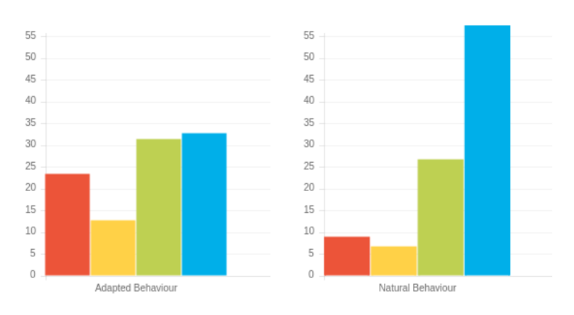
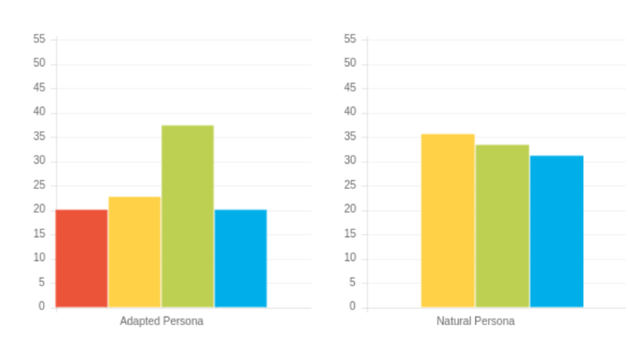
1
Exercise 11: Planning your Presentation
Reflecting on the two profiles on the right:
  What are their probable needs, motivations and communication preferences?
  What will you need to ensure you do to enhance the negotiation process for them?
2
©2014 Colour Preferences Ltd | www.colour-profiling.com
Notes:
Embedding the "planning your presentation" idea and pulling together everything we have explored in the Workshop.
Work in pairs.

Slide 26
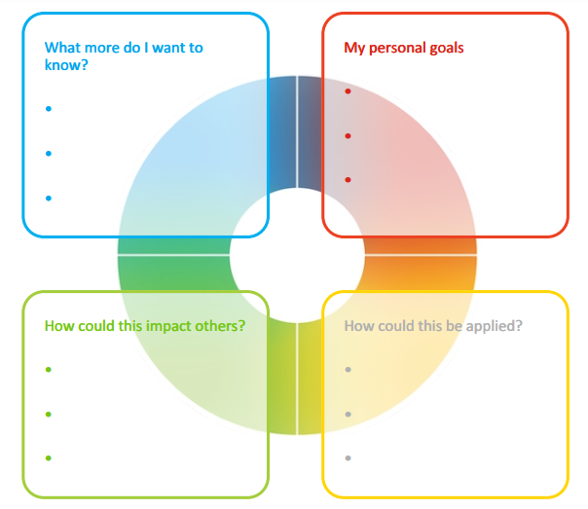
Action Planning
Reflect on what you have learnt today through the lens of all 4 colours.
What was the most helpful insight you have gained from this workshop?
What one thing do you need to watch out for in order to ensure optimal effectiveness in negotiation and influencing?
What do you want to commit to:
  Stop? Start? Continue?
Notes:
Opportunity for TEAM Reflection – vital to help embed the learning from this workshop in a collective way.
Encouragement to reflect on team group behaviours through the lens of all 4 colours (whilst we have a behavioural preference, we are all a blend of all 4 colours).
STOP/START/CONTINUE: a helpful structure for reflection.
The thing you may decide you want to stop may be something that reflects your highest colour preference.
Also the thing you may decide to start may be drawing on another colour other than your top colour preference.

Slide 27




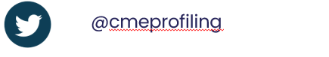
Colour-profiling.com
Thank you and please stay in touch!
@colourprofiling
Cmecolourprofiling
@C-me Colour Profiling

