Slide 1
Preparing for your C-me session
N.B. Certain slides can be hidden (right click ‘Hide Slide’) depending on session needs N.B. Certain slides will need editing for EVERY different delivery (see below)
CHECKLIST
You will need the High Performance or Core report for this workshop.
Welcome Slide: Option to add Client’s / Team's logo/brand Slide 3
Session Aims: Slide 7 (Remember to adjust if slide deck is modified in anyway)
Check Report Page for Slide 51
Insert Team Wheel Slide 58

Slide 2
Session Delivery
We encourage you to run through all the slides ahead of delivering them in slideshow mode. Some slides are static and others include animations. Please check that these animations work.
Brief notes are provided below each slide to give delivery guidance.

Slide 3

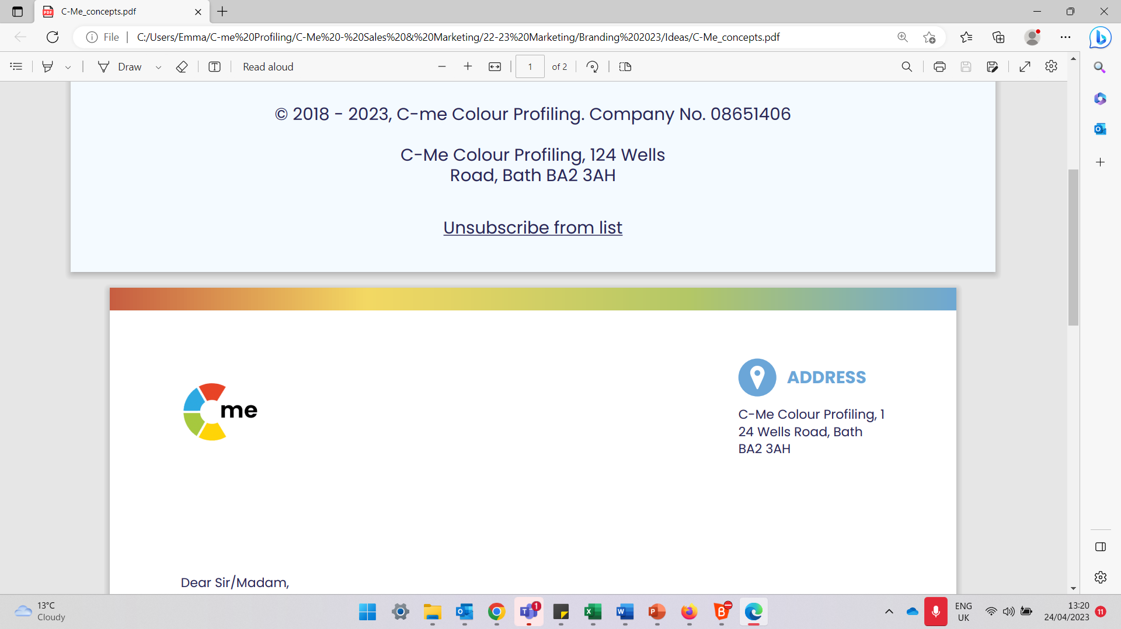
Welcome to your C-me Foundation Workshop
Building high performing individuals and teams
C-me, 124 Wells Road, Bath, BA2 3AH e: contact@colour-profiling.com t: 01225 721971
Notes:
If delivering remotely:
WELCOME everyone on grid view (share slides later).
Give a very brief personal introduction
PURPOSE: The purpose of this workshop is ……
PROGRAMME: The timeline for today is ….
If RECORDING SESSION: Let the clients know at the start.

Slide 4

Introducing C-me
Individuals
Teams
Organisations
Notes:
C-me is an independent company which has been operating for 10 years, specialising in behavioural profiling.
In combining modern technology with psychometric insights, C-me have worked to develop a tool that is intuitive, memorable and can effect lasting change in
Individuals
Teams
Organisations to perform at their best.
The main focus of C-Me is ‘application’: it is their aim to create great reports but realise you and our clients want to see lasting change and impact by changing behaviour.
So the report has been designed to be focussed on action and simple application, therefore ensuring your job is as simple as possible as well as effective.
​

Slide 5























Notes:
C-me has a broad and rich pool of experience in different sectors including: (suggest highlighting those most relevant to your clients)
Education
Health & Fitness
Defence
Entertainment
Not-for-profit and FTSE 500 companies
Local schools and individuals.

Slide 6
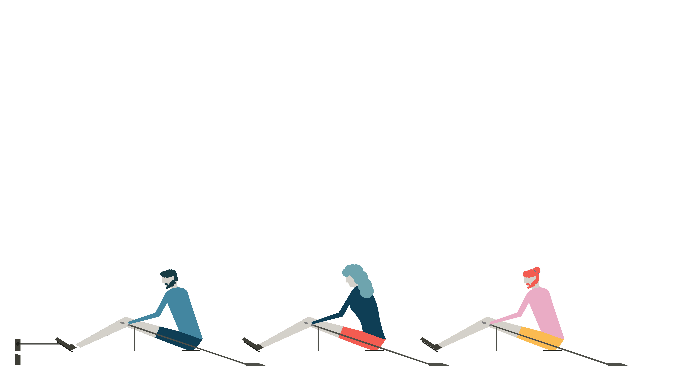
Our Values
F
C-me is adaptable to meet the participant or organisation’s purposes, industry, and bespoke needs.
Flexible
A
Accurate
The C-me method is underpinned by years of research, development work and practical learning.
C
Clear
C-me makes all reports, workshops and communication simple and easy to understand.
E
Easy use
The reports are quick to complete (just 10 minutes) and simple to understand.
Notes:
We suggest picking out the key features that will resonate with your clients.
​
​

Slide 7
Our Aims for this Session
Lay a foundation for how C-me works
Provide a language for describing behavioural difference
Explore and discuss your C-me Profile
Apply learning to maximize personal performance and team dynamics
What are your aims?
Notes:
Check these aims are appropriate for your clients and tailor if necessary.
Give space for participants to share their session aims in the chat.

Slide 8
Session Outline
Introduction to Colour and Behavioural Profiling
Brief history of psychometric testing
Understanding your profile
Effective communication
Personal and Team reflection
Notes:
Remember to amend this slide if you adapt the session content.

Slide 9
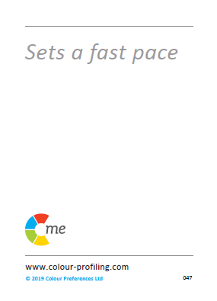
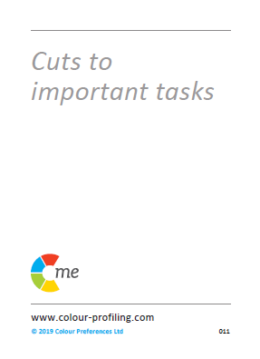
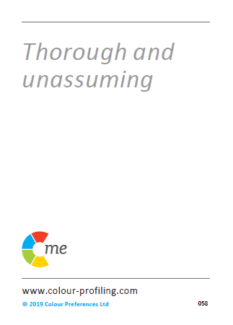
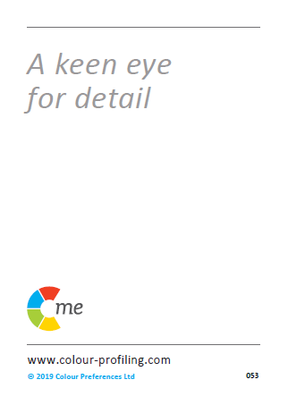

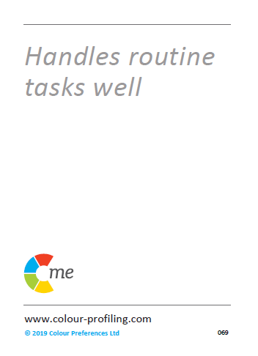
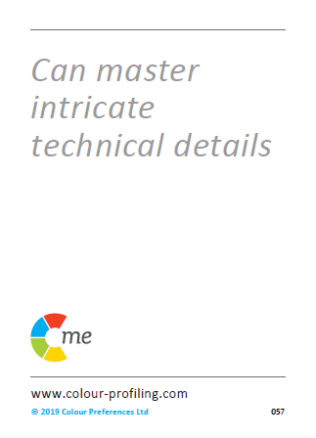

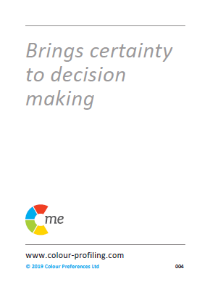
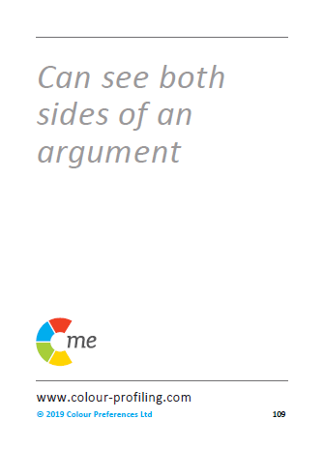
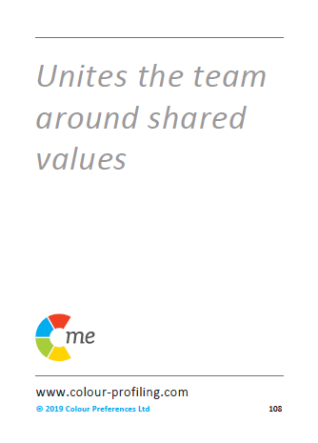
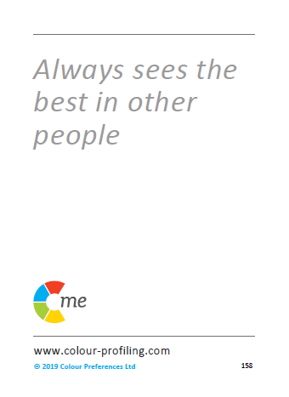


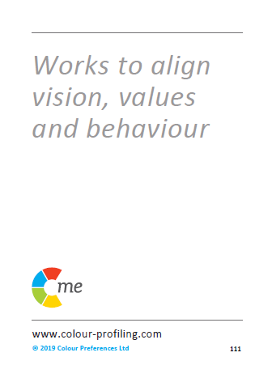
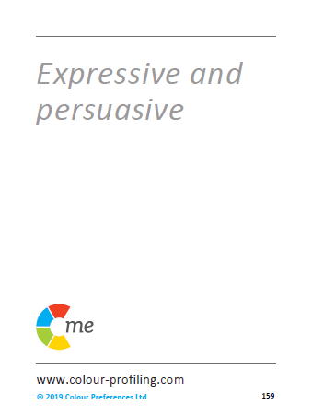
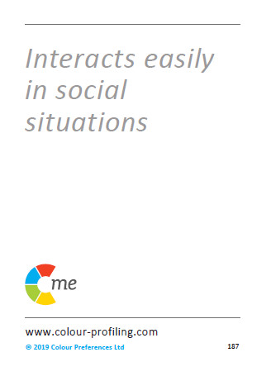
Notes:
Let's start today by looking at the C-me colour wheel – the heart of our approach to behaviours
Blended colour wheel – it reflects that we flex our behaviours and move around the wheel. Colours blend, numbers and letters don't. This is a non-binary approach.
We have grouped similar behaviours by colour and then mapped these onto the colour Wheel.

Slide 10
Impact on others
Behaviours
Personality
(values, beliefs)
Notes:
Emphasize that C-me focus on BEHAVIOURS, not personality.

Slide 11
C-me virtual card game
The purpose of this game is to introduce you to the language and colours of C-me.
Notes:
N.B. Use the following slides ONLY if delivering remotely:
On this slide you will see the cards you can use if delivering in person (available to purchase direct from C-me).
On one side of the cards are statements and on the other side are colours.
TODAY we are playing the Card Game REMOTELY.
Refer to Accreditation Manual (Chapter 5) for more information on how to run the game, including variations.
When delivering workshops and coaching we keep things highly interactive with the goal of bringing tangible actions and solutions which can be brought in to the working and even personal life of individuals straight away.
We want to teach then quickly help people apply what they have learnt.
Our aim with this game:
Giving people a hands-on, interactive introduction to the statements on the cards, which are associated with the 4 colour quadrants on our colour wheel.
ACTION - RUN THE GAME: For this exercise you will need a pen and paper:

Slide 12
C-me virtual card game
1.
2.
3.
4.
5.
6.
7.
8.
9.
10.
11.
12.
13.
14.
15.
16.
Notes:
ACTION: Please recreate this grid on your paper, drawing three columns with the numbers 1-16 down the side in the first column.
N.B. Whilst your clients are drawing the grid, it’s helpful for you to draw the grid at the same time in order to get your pace right.

Slide 13
1.
2.
3.
4.
5.
6.
7.
8.
Notes:
Read out the 16 statements (each one corresponds to a number from 1-16). New card appears after every ‘click’.
ACTION: If the statement on the card describes you, put a tick for ‘Yes’ in the second column next to the corresponding card number.
If not, put a cross for ‘No’.
Don’t think too much about the statements - just go with your gut response. This is just a game.

Slide 14
9.
10.
11.
12.
13.
14.
15.
16.

Slide 15

C-me virtual card game
1.
2.
3.
4. | x
5. | x
6.
7.
8. | x
9. | x
10.
11.
12. | x
13.
14. | x
15. | x
16.
Notes:
Part 1 is complete!
You should now have a table that looks something like this.
Now let’s complete the right-hand column.

Slide 16
1.
2.
3.
4.
5.
6.
7.
8.
Notes:
Reveal the colour of each of the 16 cards one at a time.
ACTION: As I reveal the colours of the cards please write the first letter of the colour in the 3rd column, next to the corresponding card number e.g. R, Y, G, B

Slide 17
9.
10.
11.
12.
13.
14.
15.
16.

Slide 18
C-me virtual card game
1. |  | Red
2. |  | Green
3. |  | Yellow
4. | x | Blue
5. | x | Green
6. |  | Yellow
7. |  | Red
8. | x | Blue
9. | x | Blue
10. |  | Yellow
11. |  | Yellow
12. | x | Red
13. |  | Red
14. | x | Blue
15. | x | Green
16. |  | Green
Total number of 'Yes' cards
Reds | 3
Yellows | 4
Greens | 2
Blues | 0
Notes:
ACTION: Please add up the ticks (your 'yes' cards for each colour) and add the totals in the box like this on the right.
N.B. One of the great things about this game is it engages people in to action before listening for too long. The idea is to to start the session with energy and active learning.

Slide 19
C-me virtual card game
1?
2?
3?
4?
How many different colour cards have you ticked?
What do you think this tells us?
What are your top two colour cards?
Notes:
How many different colour cards have you ticked? (4 x ’Click’ to reveal number options).
ACTION: in the chat, list how many colours you have? 1, 2, 3, or 4?
‘What do you think this tell us?’ - There may be a preference but we’re all a blend of more than one colour.
ACTION: In the chat, put your top 2 colours.
We’ll come back to this when we look at the Team Wheel, which displays our leading colours and how they interact.

Slide 20
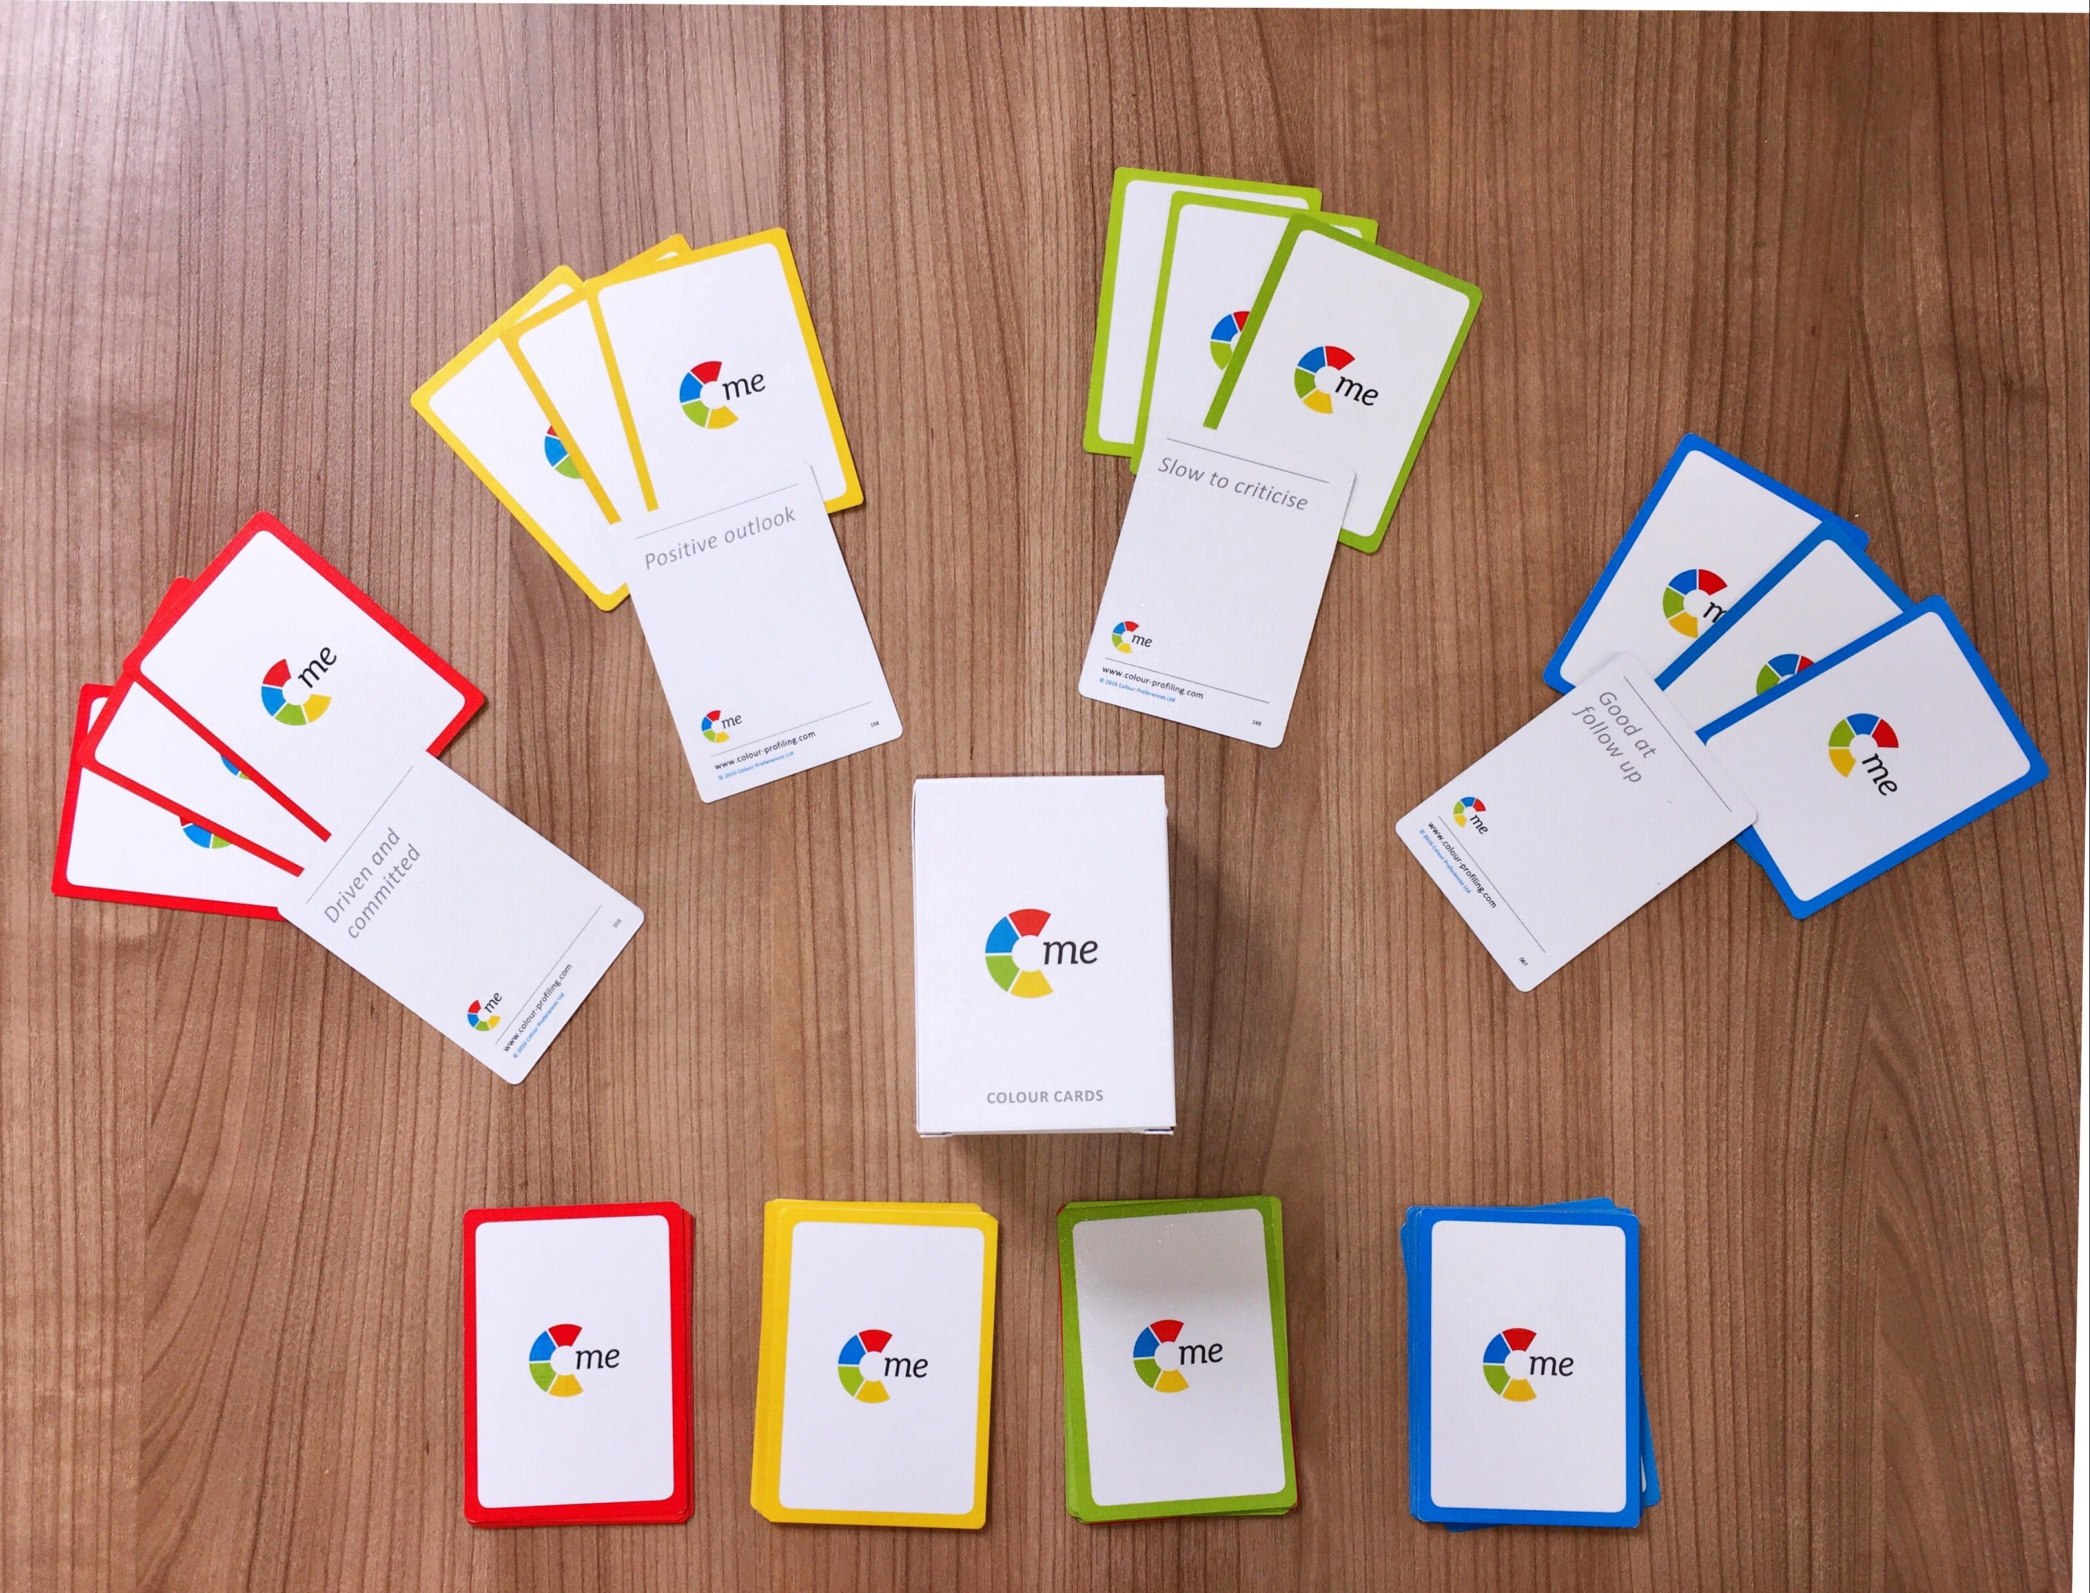
C-me card game
Notes:
FOR RUNNING THE CARD GAME FACE-TO-FACE
Explain: This is a picture of cards we sell if you would like them. On one side of the cards are statements and on the other side are colours.
Game instructions:
Before your guests enter the room, create a pack of cards for each one of them with 4 of each of the colours cards e.g. 4 red, 4 yellow, 4 blue, 4 green (i.e. Total = 16 cards per person).
Shuffle the cards together and put them with statements face up, perhaps underneath their chair. One pack per person.
Before the workshop begins we recommend you delegate 4 corners or spaces in the room to the 4 colours in the following order: Yellow, Green, Blue, Red. (Perhaps put a visual of each colour in each corner as a reminder).
Within 90 seconds of the start of your workshop, ask your attendees to pick up their pack of cards and read the statements on the front.
Then make a pile of the statement cards they feel describe them (YES pile) and a pile of the cards they don’t feel describe them or they aren’t sure of (NO pile).
Give them 1 minute to sort the pack into these two piles.
Ask them to leave the pile of ‘yes’ cards but pick up the pile of 'no' cards and then get them up on their feet and interacting together to try and give away their ‘no’ cards to others who do agree with those statements. Give them 3 minutes to do this.
Next ask your guests to combine their initial ‘yes’ cards and those they have accepted in the swap.
Instruct them to turn their cards over and count how many of each colour card they have.
Ask which colour they have the most of and then to go and stand in the matching colour corner in the room.
Starting with the yellow corner ask everyone in one colour group at a time to read their cards aloud to the rest of the group.
Ask the rest of the group to feedback what they are hearing about that colour – on a good day/bad day. Go round the room.
TYPICAL QUESTIONS AT THIS POINT:
What if people have even numbers of two colours? Ask them to go to the corner with the least number of people in.
Why yellow first? Often most willing to contribute. Highest energy group.

Slide 21
Notes:
At this point, your attendees are starting to personally identify with some of the statements. We are now going to explore what behaviours are grouped in each colour.
So again here we have the C-me colour wheel:
Blended colour wheel – it reflects that we flex our behaviours and move around the wheel. Colours blend, numbers and letters don't. This is a non-binary approach.
We have grouped similar behaviours by colour and then mapped these onto the colour Wheel.
N.B. The closer your position is to colleagues, the more behaviours you are likely to have in common.
N.B. The further you are from a colleague, the more you may differ in your perception of the "right" way to do things.
N.B. Those on the opposite side of the wheel may be more difficult to understand.

Slide 22
Good day/ resilient strengths
  Energetic and enthusiastic
  Positive outlook
  Fast paced
  Sees the opportunities
  A real excitement for life
  Embraces change
  Sociable and outgoing
  Inspirational and visionary
  Not afraid to take risks
  Spontaneous and imaginative
On a bad day
  May miss details
  Can appear disorganised
  Jumps between ideas
  Can be idealistic and impractical
  Lax time management
  Everything to excess
  Inclined to talk too much
Notes:
So let's explore each colour group and the associated behaviours in more detail:
Read out the statements on the cards.
1st APPEAR: “Good day/resilient strengths” - we're not speaking of competence but more about a person’s “happy space” where they perform best, for longest.
ACTION: Please put in the chat some other words you would use to describe yellow preference behaviour on a good day.
N.B. Focus only on the positive things people write (this is a time to celebrate this colour energy).
Once you've acknowledged their response, reveal the list we have.
2nd APPEAR: We also all have “bad day behaviours”
ACTION: Again, in the chat, please list behaviours those with a yellow preference could display on a not-so-good day.
N.B. Keep an eye out for when people write 'leader' for any of the colours. This is the perfect opportunity to pick this up and say "that's an interesting observation, we'll address this in a minute". Later make the point that you can lead from any position on the wheel.

Slide 23
Good day/ resilient strengths
  Respects others' values
  Supportive and loyal
  Builds consensus
  Generous
  Works for democratic solutions
  Tactful and diplomatic
  Dedicated to the team
  Considerate and attentive
  Tolerant and open-minded
  Reliable and dependable
On a bad day
  Appears to lack urgency
  Can be indecisive
  Often self-critical
  Procrastinates
  Slow to venture an option
  Difficulty setting priorities
  Constantly checking consensus
Notes:
Repeat exercise for GREEN preference behaviour:
Read out the statements on the cards.
1st ACTION: please put in the chat some other words you would use to describe green preference behaviour.
2nd ACTION: And on a bad day what might green preference behaviour display?

Slide 24
On a bad day
  Tends to over analyse
  May appear aloof
  Tends to point out the downside
  Obsessive about the detail
  Slow to trust
  Lacks spontaneity
  Constrained by the rules
Good day/ resilient strengths
  Logical and analytical
  Enjoys problem solving
  Realistic
  Sets high standards
  Methodical and systematic
  Sorts out the details
  Strong sense of duty
  Structured and disciplined
  Focuses on details
  Considers all the facts
Notes:
Repeat exercise for BLUE preference behaviour:
Read out the statements on the cards.
1st ACTION: please put in the chat some other words you would use to describe blue preference behaviour.
2nd ACTION: And on a bad day what might blue preference behaviour display?

Slide 25
On a bad day
  Can be intolerant
  Can dominate discussion
  Too focused on results
  Overly competitive
  Can be dismissive of others’ views
  May not be listening
  Action overrides planning
Good day/ resilient strengths
  Bold and determined
  Drives hard for delivery
  Focuses on results
  Decisive
  Powerful advocate
  Confident
  Enjoys stretching goals
  Brings clear direction
  Sets a winning mentality
  Direct and to the point
Notes:
Repeat exercise for RED preference behaviour:
Read out the statements on the cards.
1st ACTION: please put in the chat some other words you would use to describe red preference behaviour.
2nd ACTION: And on a bad day what might red preference behaviour display?

Slide 26
Leadership/Management
Notes:
Time to address our judgements around leadership and management.
Often with groups we challenge people on assuming red = leadership.
Leadership & management is not just seen through red behaviour.
Leadership & management looks different with each colour.
There is no one ‘right’ way.
By this point in a workshop, your clients are starting to appreciate good and bad days for each colour preference – we’re wanting people to leave with greater behavioural intelligence.
NB: No matter what organisation it is, if the leader is leading with particular types of colour preference then that can become the hallmark of one preferred way of leading, instead we want to encourage people to grow in different leadership styles and behaviour preferences in management and leadership.
POSSIBLE ACTION: Opportunity to explore each colour or invite discussion.
So what are the advantages of each management/leadership style around the wheel?
Red – visionary, quick decisive decision, clear, bold ideas – bad day may feel controlling, my way or the highway approach
Yellow –motivational, empower individuals – bad day, we’re flicking through too many ideas, flapping in the wind approach.
Green – nurturing, make sure whole team involved, collaboration – bad day, procrastination, so concerned with other’s feelings decisions never get made.
Blue – organised, clear timeline, strategic, timescales, resources etc, realist, high standards – bad day, things might take a long time to get done, micromanagement, analysing everything.

Slide 27

Resilient Strengths
  Realistic
  Focuses on details
  Considers all the facts
  Strong work ethic
  Logical and analytical
  Sets high standards
  Brings clarity to complexity
  Bold and determined
  Drives hard for delivery
  Focuses on results
  Decisive
  Brings clear direction
  Powerful advocate
  Enjoys a challenge
  Tactful and diplomatic
  Builds consensus
  Dedicated to the team
  Considerate and attentive
  Reliable and dependable
  Works until the job is done
  Tolerant and open-minded
  Energetic and enthusiastic
  Positive outlook
  Creative and innovative
  Expressive and persuasive
  Embraces change
  Social and outgoing
  Inspiration and visionary
©2021 Colour Preferences Ltd | www.colour-profiling.com
Notes:
This is a particularly important slide to dwell on if there is a value judgement being made in an organisation, against one/some of the colours.
Example: A Heavily dominant engineering orientated company that values blue behavioural preference but not yellow behavioural preference.
Key Question: What happens if we have no yellow preference?
Let them do the thinking: perhaps there might be no innovation … we might not grow …
Let’s take a moment to look at the resilient strengths and development areas of each colour – remember we’re looking at resilience not competence.
Resilience = where we perform at our best and for the longest time given any task.
Not about what we’re good at but what gives us life and energy.
You may be very good at things that are our lowest colour but it might drain you to do it.
Example: Someone who is good at detailed, systematic administrative tasks but when their energy is low, planning goes out the window, details are missed and balls are dropped. Competence is high but resilience is low.
Colour does give us clues as to where we gather energy, so if we’re in a role that demands our lowest colour we need to look at how to structure our day in practical ways to work effectively for longer.

Slide 28
Areas for Development
  Tends to over analyse
  May appear aloof
  Gives too much information
  Obsessive about the detail
  Slow to trust
  Lacks spontaneity
  Constrained by the rules
  Overly competitive
  Not diplomatic
  Can dominate discussion
  Too focused on results
  Doesn’t know when to stop
  May not be listening
  Action overrides planning
  Appears to lack urgency
  Can be indecisive
  Often self-critical
  Procrastinates
  Reluctant to change
  Difficulty setting priorities
  Constantly checking consensus
  Can appear disorganised
  Jumps between ideas
  Can be idealistic and impractical
  Loses interest quickly
  Lax time management
  Everything to excess
  Inclined to talk too much
©2021 Colour Preferences Ltd | www.colour-profiling.com
Notes:
Good slide if you're looking to coach observable behaviours to help your clients grow.
These are the bad day behaviours where colour preferences are naturally weaker.
Think of it like weight lifting, some muscles take some working out to get stronger.
So it’s not that you can’t operate out of all the other colour strengths but just that you may need training.
C-me’s selling point as a tool is that it’s looking at observable behaviours, it’s not challenging people’s values or beliefs but what behaviours someone is choosing to display and adapt in their context. It is easier to coach and adapt behaviour than personality.

Slide 29
Guess the Colour
Notes:
SELECT 4 OF THESE OPTIONS FOR YOUR WORKSHOP
A fun game designed to apply what your clients have learned so far
We have come up with a range of celebrities we hope most people will know, and who we think show a range of different colour combinations.
You could choose any character/celebrity or even car brands.
Could be industry specific.
ACTION: Using the chat box please write in what top 2 colours you think each celebrity displays. If you’ve never heard of the celebrity then have a guess from the description I give.

Slide 30

Kier Starmer
Prime Minister
Notes:
Kier Starmer
British Prime Minister
- Detailed, serious, once he has a view he is hard to change

Slide 31
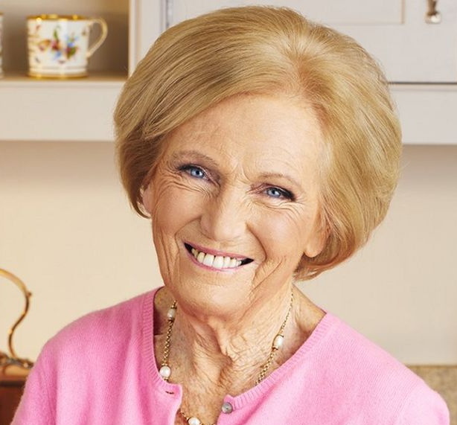
Mary Berry
Cook
Notes:
Mary Berry
Cook and TV personality
- Sociable/calm/gentle/methodical

Slide 32

Marcus Rashford
Footballer
Notes:
Marcus Rashford
Cross-type: Green/Red.
He leads with his Green but then challenges the status quo and isn't afraid to step forward and lead and do things differently.

Slide 33

Gordan Ramsay
Chef
Notes:
Gordon Ramsay
Cook and TV personality
- Straight talking, direct, loud, likes his own advice, enthusiastic

Slide 34

Michelle Obama
Former First Lady
Notes:
Michelle Obama
Former First Lady to Barak Obama
- Confident, driven, visionary, compassionate, advocate

Slide 35
Ferrari
Notes:
Ferrari
- Fast paced, driven, centre of attention, talk of the party, bold.

Slide 36
VW Camper Van
Notes:
VW Camper Van
- Fun, free-spirited, adventurous, relational, slower pace.

Slide 37
Toyota Hybrid
Notes:
Toyota Hybrid
- Environmentally friendly, family and business use, efficiency.

Slide 38
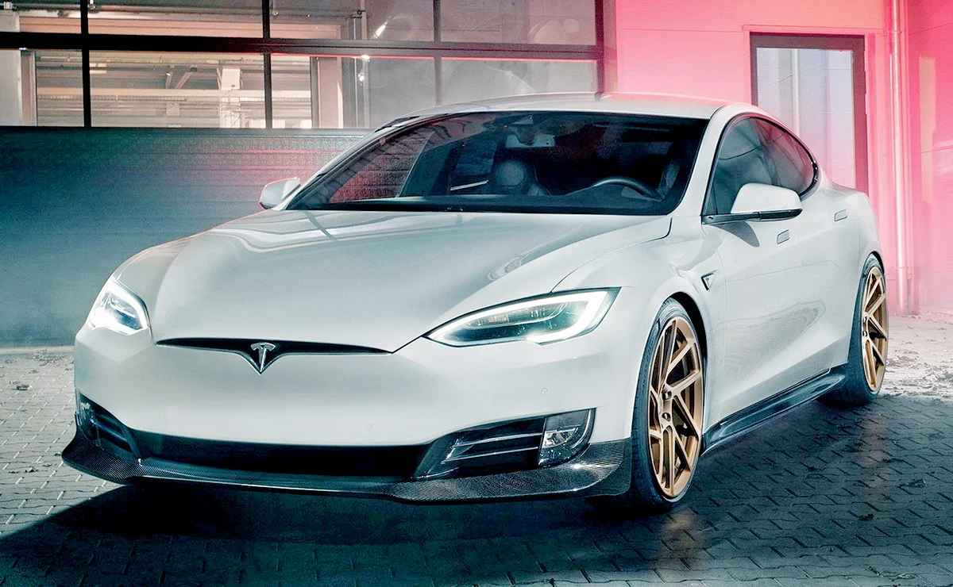
Tesla
Notes:
Tesla
- Precision, detail in styling, efficient, fast paced, high performance.

Slide 39
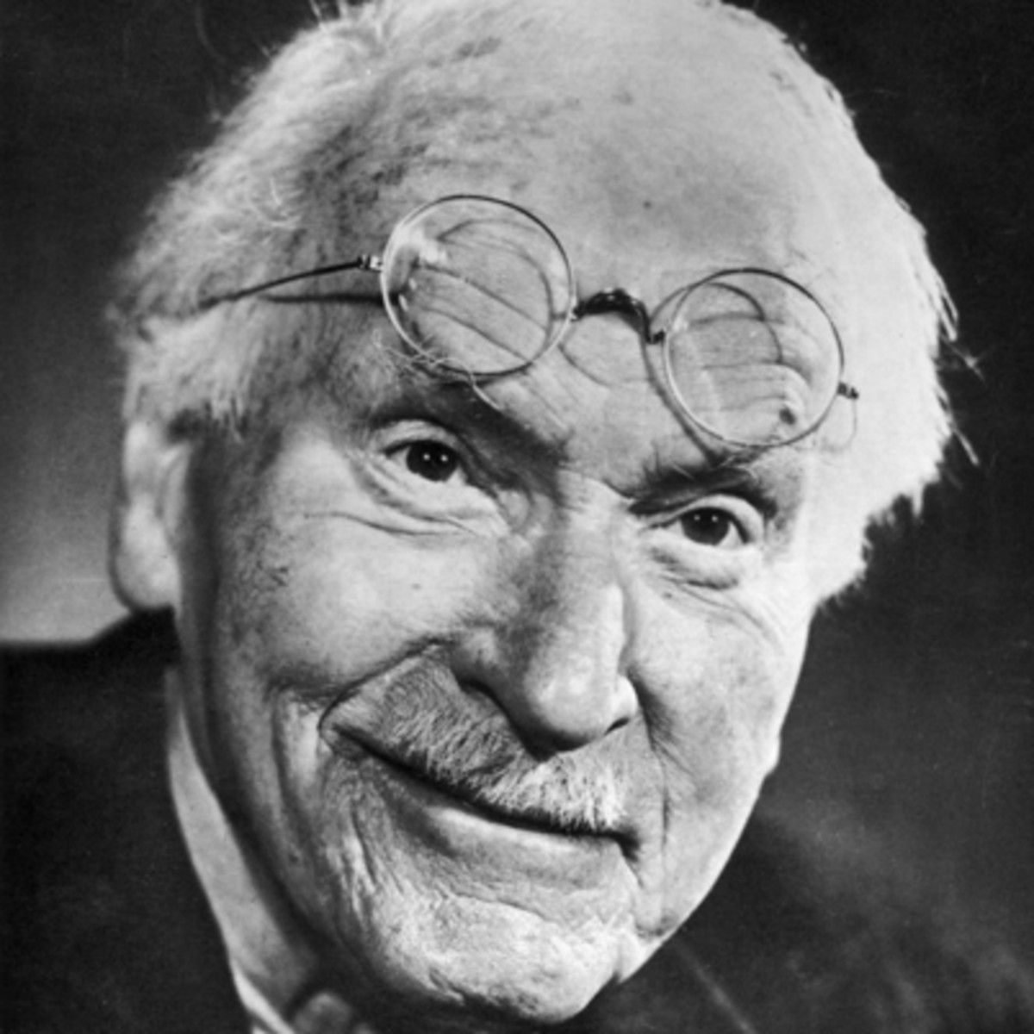
Key figures in the development
of psychometric testing
Jung 1923
2013
Notes:
Summary slide: to contextualise where C-me fits in to the background of psychometric testing.
Throughout history it has been observed that there are differences between people and how we interpret these differences (N.B. For more information, please refer to the Accreditation manual).
Carl Jung early 1900s (Swiss psychiatrist and psychoanalyst)
- Jung was key in developing analytic psychology (now referred to as Jungian analysis).
- Developed an axis of psychology (thinking/feeling) - this axis displayed behaviour as a scale rather than as absolutes.
C-me was founded in 2013
- Developed our own more accurate algorithm (based on database of
35,000+ statements).
- Removed labels and numbers.
- Developed reports that speak to observable behaviour which we can shape.
- Assess Conscious and Unconscious preferences.
Why colour? Colours blends, whereas words and numbers don’t. They can leave people feeling boxed.

Slide 40
C-me and the Jungian axis
THINKING preference
Objective, Analytical, Task orientated, Strong minded
Subjective, Personal, Considerate, Involved, Relationship orientated, Accommodating
FEELING preference
Notes:
Let's look at the axis C-me uses to represent Jungian psychology on the colour wheel - to give you clear understanding of how the colour wheel works.
(N.B. Chapter 5 of the Accreditation Manual provides further notes on the Jungian foundations of C-me).
HORIZONTAL AXIS: Looks at how we’re making our decisions and how we relate to different situations in life.
EXPLAIN THE SLIDE:
Top of wheel = THINKING PREFERENCE – ‘head’.
Bottom of wheel = FEELING PREFERENCE – ‘heart’.

Slide 41
C-me and the Jungian axis
Reflective preference
Extraverted preference
Observant
Inward focus
Depth
Thoughtful
Cautious
Action orientated
Outward focus
Breadth
Outspoken
Bold
Notes:
VERTICAL AXIS: Looks at what energises us and how we process information.
EXPLAIN THE SLIDE:
Right side of wheel = EXTRAVERTED PREFERENCE.
Left side of wheel = REFLECTIVE PREFERENCE (N.B. Reflective (not introverted) – language changes and the meanings of words change in time. We have found that there aren’t as many negative associations with the word ‘reflective’ as there are with the word ‘introverted’ in our culture today.
N.B. Sometimes top & bottom/left & right are more obvious than someone’s colours, until you see their profile.

Slide 42
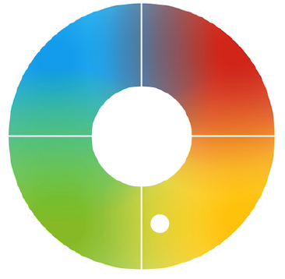
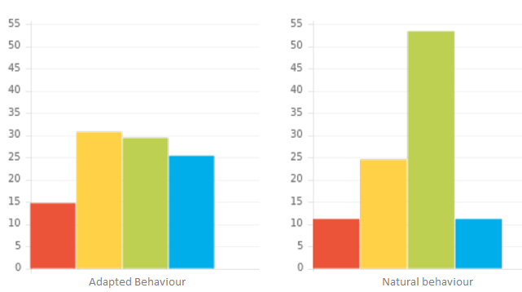
C-me Graphs
Notes:
The graphs summarise the whole of the report - They are the prescription/the lens, through which we look at all of the behaviours in our report.
Brief Explanation of 3 visuals.
Adapted Behaviour
Conscious, more filtered graph
How behaviours are adapted, modified in particular circumstances to do well in the world.
Metaphor: Like preparing yourself for a photo that the world will see #selfie.
Individual statements in profiles and Colour Wheel Position drawn from information from this Adapted graph.
Natural Behaviour
Less conscious graph.
Illustrating behaviours in situations of rest and stress - less filtered behaviour.
Revert to type behaviour.
Metaphor: Like having a photo taken of you across the room #nofilter.
Wheel Position
Not boxing you but highlighting colour balance and resilient behavioural colours.
Based on Adapted Graph.
The scale we use:
0-55 is the number scale we use to plot your answers.
Anything above 23 (approx.) we consider a resilient strength and a significant outcome to take notice of.
We really suggest you look at the order and not the exact number each one is.
There are two different algorithms working as you answer the questionnaire:
One is looking at your conscious answers, how you like to be seen by others and choose to behave.
The other is looking at your less-conscious answers. Behaviour that is less evident day-to-day.
The test works by reflecting how you ranked the statements, none of them will be an exact reflection of how you see yourself.
Key language to use:
it seems that this is your preferred choice,
from the answers you gave,
the choices you made.
Identifying when a colleague is operating from their adapted or natural graph:
Once you know your colleague’s profiles (adapted and natural graphs) you get to choose to alter the way you’re working to help them out.
Perhaps think how to flex in order to reduce their stress behaviour, cut them some slack
When to use the graphs
The graphs are good for coaching and reviewing staff wellbeing
In recruitment - where it may give you clues to the behaviour you might expect to see expressed more as someone starts to settle into their role, what you may need to plan for.
In a workshop - it’s usually enough to spend only a few minutes on this slide to explain that: Adapted is more filtered as we adapt to do well in the world and Natural is less conscious and when we’re under stress or similarly when at rest
In you Accreditation Manual:
There are 24 possible graph combinations when looking at the order of the colours
When the strength of each colour is taken into account there is an infinite variety of graphs – so in your Manual is a summary of the types of graph you are likely to meet rather than a definitive description of all possibilities.
The 16 Standard graphs make up 95% of all reports we meet
There are 8 further Cross types possible – let’s look at those on the next slide

Slide 43
C-me Report Graphs
Actual position
Notes:
Our profiles are a blend of all 4 colours.
Let's look at how the position on the wheel reflects the Adapted graph and our personal colour blend.
The second colour is the most important modifier.
ACTION: Reveal the dots.
Position 1 – Yellow top preference / Red and Green equal second
Position 2 - Yellow/Red. How might this influence behaviour.
Position 3 - What about if top two colours were Yellow/Green? How might this be reflected in behaviour?

Slide 44
C-me Report Graphs
©2021 Colour Preferences Ltd | www.colour-profiling.com
Notes:
Within a colour quadrant, the position relative to the center of ther Colour Wheel denotes how many colours are particularly strong on your Adapted Graph
Position 1 (outside of Colour Wheel) = 1 colour high (high referring to over 23 on the graph)
Position 2 (middle of Colour Wheel) = 2 colour high
Position 3 (inside of Colour Wheel) = 3 colour high
Position 4 (Red-Green Cross Type) = top two colours are technically psychological opposites
Position 5 Green-Red Cross type (if green stronger than red)
Position 6 Blue-Yellow Cross type
Position 5 Yellow-Blue Cross type (if yellow stronger than blue)
Cross Types
Normally, a person’s top 2 colours will be 2 adjacent colour quadrants on the colour wheel e.g. Red/Blue or Green/Blue.
For around 8% of the population, their top two colours are on opposite sides of the Colour Wheel e.g. Red/Green or Blue/Yellow.
This number has risen slightly to 10% during Covid 19 lockdowns -
On this slide, you can see how a Red/Green Cross Type is represented. Their positional dot is coloured half red, half green. It is then placed next to the Red quadrant to indicate that red is the top colour.
Cross types have the ability to switch between opposite colours with great ease.

Slide 45
Break Time

Slide 46
Exploring your report:
Explore, Filter, Share
Stop, Start, Continue
Notes:
Introduce them to Explore, Filter, Share coaching model:
Explore the report
Filter what resonates most and re-word phrases to tailor the report to you
Share with others in order to understand differences and increase self reflection
This fits really well for personal development plans - looking at what your client wants to
Stop
Start
Continue

Slide 47
Your Profile: Exercise 1
  On your own: Explore, Filter, Share
  Read through and select 3 statements from each of the following sections:
    - Resilient Strengths
    - Team Contributions
    - Areas for Development
  What % accuracy would you give your report?
  Which of your colours have a score of 23+ on your Adapted graph?
  Please come back ready to share
Notes:
Opportunity for some personal reflection.
Outline principle of: EXPLORE, FILTER, SHARE
ACTION: In the chat can you write down what initial % accuracy this report has for you?
SPEAK IN TO LEVELS OF ACCURACY:
We are regularly getting 80-85% accuracy as a norm. We’re always working on this, increasing our statement database.
IF LOWER THAN 70%
We suggest people work with the reports for a few months and see how accurate it is in context and with feedback from colleagues.
IF LOWER THAN 60% LIST POSSIBLE REASONS FOR THIS –
IN A RUSH,
THINKING OF ANOTHER CONTEXT,
GOING THROUGH A BIG TIME OF CHANGE (TRY AGAIN AFTER CHANGE HAS TAKEN PLACE)
SECOND GUESSING WHAT TO PUT,
GETTING THE SCALE WRONG ETC.
Colours that have a score of 23 or over are considered resilient strengths.

Slide 48
Exercise 2
In Pairs/Groups:
  Introduce yourself
  Share and discuss the 3 statements from each section
  Stop – Start – Continue?
  What was valuable about this exercise and what did you learn?
Notes:
PAIRS/GROUP EXERCISE as per the slide.
You’re now going to share in BORs what statements you resonated with.
3 Resilient Strengths: What are the strengths that you would like to use more?
3 Team Contributions: What are the strengths your team needs you to bring at the moment in your role?
3 Areas for Development you want to work on
SEND IN TO BORS FOR 5mins IN PAIRS
How valuable was that exercise for you?
What have you learned?

Slide 49
The Communication section of the report

Slide 50
Communication
Miscommunication leads to:
Lost sales
18%
Missed performance goals
25%
Low morale
31%
Delay in completion of projects
44%
Higher stress level
52%
Economist Intelligence Unit 2018
Notes:
Introduce this slide however you feel it’s appropriate.
Economist Group - provide forecasting and advisory services through research and analysis.
Recent research on communications (Conducted in 2018)
500 senior leaders
Key findings: What they found was miscommunication leads to:
1. Tremendous impact in the workplace
2. Causes a communications barrier…. Different communication styles need to be appreciated to bridge the barrier
3. There is a stark difference between the most effective communication tools and the ones people actually use.

Slide 51
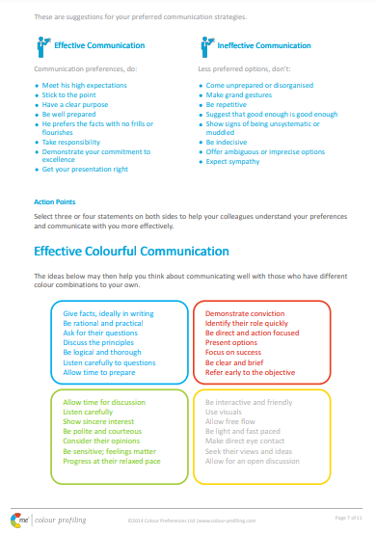
Communication: Exercise 3
  Turn to page X
  Select 2 effective ways for people to communicate best with you
  Select 2 ineffective ways for people to communicate with you
  What did you learn? Share and discuss
Notes:
Opportunity to share and learn about other people’s Communication Preferences.

Slide 52



Effective communications with Teams
Name | C’s | Do | Don’t
Jonny |  | Get people involved Value their opinion Direct eye contact | Make them follow process Return to the rule book Restrict free flowing ideas
Sally |  | Provide detail Be polite Keep timescale relaxed | Be overly competitive Stick coldly to the task Give vague instructions
Fred |  | Presents options Ask their advice Stick to matter in hand | Show frustration Focus on personal issues Delay conclusions
Notes:
Illustrate how teams can be proactive in being more effective in Communications.
Encourage the team to produce a similar grid for themselves, to help them share their communications DOs and DON’Ts:
See Accreditation Manual for template.
It includes a personalized C visual – a visual snapshot of a person’s colour preferences.
These can be included in email footers
Or on staff office doors
POSSIBLE ACTION:
In the chat box/verbally - how could you use the C?
How would you use the effective comms grid?

Slide 53
Effective Colour Communication
Give facts, ideally in writing
Be rational and practical
Ask for their questions
Define the process
Be logical and thorough
Listen carefully to questions
Allow time to prepare
Demonstrate conviction
Identify their role quickly
Be direct and action-focused
Present options
Focus on success
Be brief and clear
Refer early to the objective
Allow time for discussion
Be patient and sincere
Show genuine interest
Be generous
Be polite and courteous
Consider their opinions
Progress at their relaxed pace
Be interactive and friendly
Use visuals
Make it fun
Be light and fast paced
Make direct eye contact
Seek their views and ideas
Allow for an open discussion
Notes:
Effective Colour Communication
You may need these slides handy if you are running a workshop for people to refer to during exercises.
Colours have an influence both on what we do say but also on what we don’t say.
ACTION:
Identify your lowest 2 colours. Be aware that these will be other people’s highest colours. You may therefore need to flex your approach in order to communicate more effectively with them.
Pick 2/3 specific bullet points from your lowest colour that you want to try to put into practice.

Slide 54
Ineffective Colour Communication
Interrupting their thinking
Being unrealistic
Leaving things unfinished
Being flippant
Straying from the agenda
Skipping over the facts
Poorly evidenced conclusions
Impatience
Belittling accomplishments
Procrastination
Attempts to direct or overpower them
Focusing on too much detail
Slowing down the pace
Repetition
Expecting an instant decision
Being abrupt
Open criticism
Ruining team harmony
Being overly competitive
Talking over them
Rushing them
Preventing them dreaming
Cutting them off mid-flow
Restraining their ideas
Overwhelming with detail
Assuming they’re listening
Forcing them to follow process
Expected adherence to rigid timescales
Notes:
Ineffective Colour Communication
ACTION: Again, looking at your lowest 2 colours, identify 2/3 specific statements that you may need to avoid in order to communicate effectively with people of that colour preference.

Slide 55

Communicating to Influence
Exercise 6
Selling Staff Party Tickets
Practice communicating in your lowest colour preference (1 minute each)
What did you learn?
Notes:
Refer to Accreditation Manual (Chapter 5) for ideas of alternative exercises.
An exercise in flexing and adapting our colour energy.
This is needed every day in our working lives and personal lives.
We’re constantly trying to adapt to the needs of those around us to influence and get the job done.
We can always get better!
Provide demonstration.
Role play: live or in Breakout Rooms (if remote workshop).
FEEDBACK: What did you learn? How easy/hard did you find flexing?

Slide 56
Next steps

Slide 57
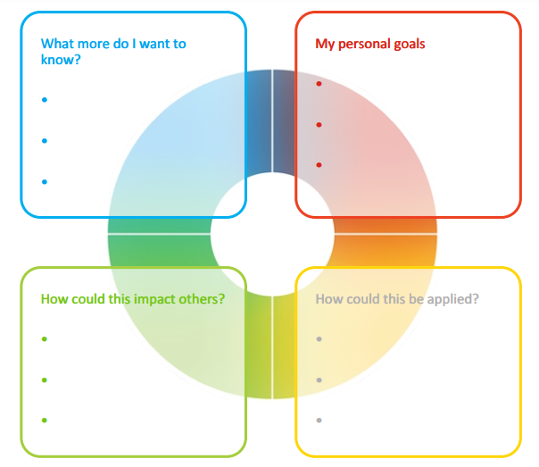
Personal Reflection
Each colour has a different perspective on the focus for action.
Consider all 4 colours to reflect on what you have learnt today.
What do you want to commit to Stop, Start and Continue?
Notes:
Opportunity for PERSONAL and TEAM Reflection – vital to help embed the learning from this workshop
Encouragement to reflect on behaviours through the lens of all 4 colours (Whilst we have a behavioural preference, we are all a blend of all 4 colours) for Action Plans that are more thorough.
STOP/START/CONTINUE: a helpful structure for reflection. What will you Start doing? Stop doing? Continue doing?

Slide 58
Team Reflection
Reflect on what you have learnt today through the lens of all 4 colours.
As a team, what do you want to:
Insert Team Wheel here
Stop?
Start?
Continue?
Notes:
Opportunity for TEAM Reflection – vital to help embed the learning from this workshop in a collective way.
Encouragement to reflect on team group behaviours through the lens of all 4 colours (whilst we have a behavioural preference, we are all a blend of all 4 colours).
STOP/START/CONTINUE: a helpful structure for reflection.

Slide 59





Colour-profiling.com
Thank you and please stay in touch!
@colourprofiling
@cmeprofiling
Cmecolourprofiling
@C-me Colour Profiling
Notes:
Opportunity to thank your guests.
INSERT YOUR OWN LINKS HERE ON THIS SLIDE.

