Slide 1
Preparing for your C-me session
N.B. Certain slides can be hidden (right click ‘Hide Slide’) depending on session needs N.B. Certain slides will need editing for EVERY different delivery (see below)
CHECKLIST
Home Slide: Option to add Client’s logo/brand Slide 3
Aims: Adjust session Aims as appropriate for Client Slide 4
Insert Team Wheel Slides 8 & 33 and Team Graphs on Slide 9
HP report or Core Report
©2014 Colour Preferences Ltd | www.colour-profiling.com

Slide 2
Session Delivery
Maximum benefit for this workshop will be gained by using an HP report
We encourage you to run through all the slides ahead of delivering them in slideshow mode. Some slides are static and others include animations. Please check that these animations work.
Brief notes are provided below each slide to give delivery guidance.

Slide 3

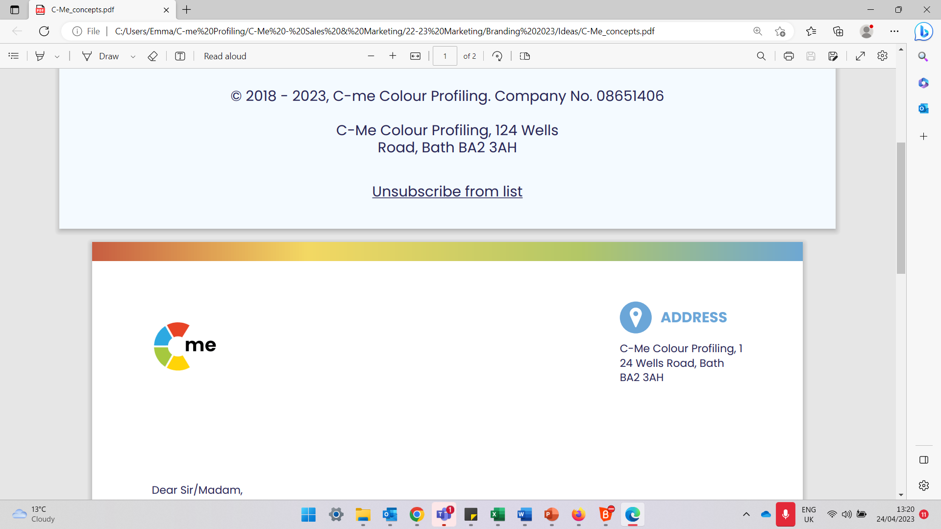
Communication & Conflict
Building high performing individuals and teams
C-me, 124 Wells Road, Bath, BA2 3AH e: contact@colour-profiling.com t: 01225 721971
Notes:
If delivering remotely:
WELCOME everyone on grid view (share slides later).
Give a very brief personal introduction
PURPOSE: The purpose of this workshop is ……
PROGRAMME: The timeline for today is ….
If RECORDING SESSION: Let the clients know at the start.

Slide 4

Session Aims
Explore different communication styles
Gain key strategies to engage successfully in challenging conversations
Develop greater effectiveness in receiving feedback
Gain key strategies to help navigate challenging conversations and conflict
What are your aims?
Notes:
Check these aims are appropriate for your clients and tailor if necessary
You may want to ask them their aims too

Slide 5
Exercise 1: Self-reflection
How comfortable do you find communicating with others?
What are you like to talk to?
How attentive are you as a listener?
Notes:
3 questions: revealed on each ‘click’

Slide 6

Remember the C-me Axes?
Thinking preference
Exercise 2:
Group Reflection
How does behavioural preference impact how we communicate with others?
Reflective
preference
Extraverted
preference
Feeling preference
Notes:
Reminder of C-me Axes from Foundation Workshop

Slide 7
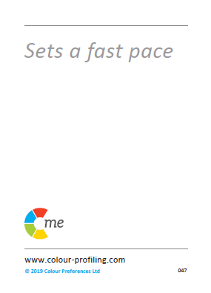
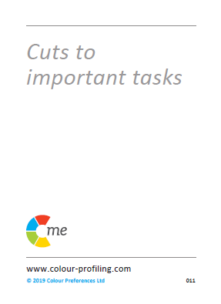


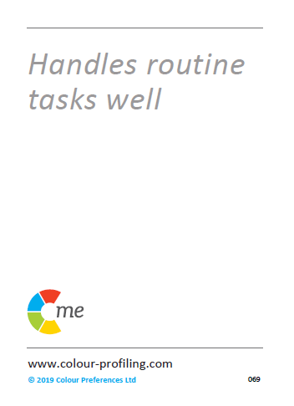
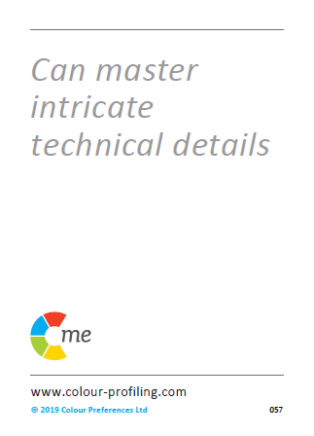
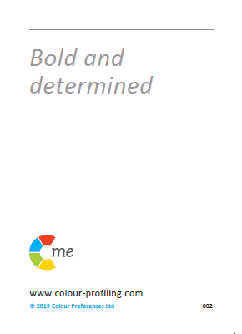
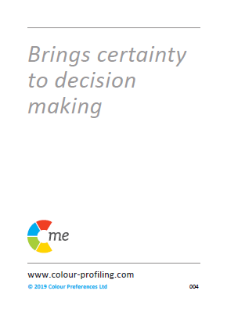
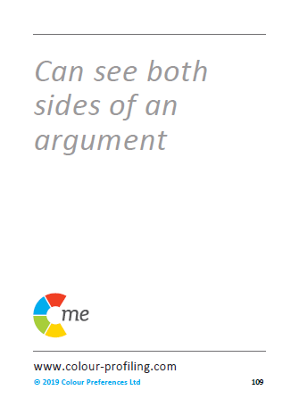
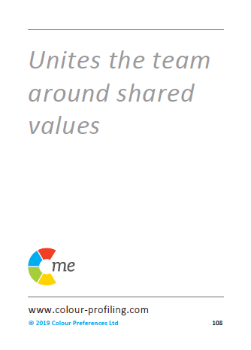
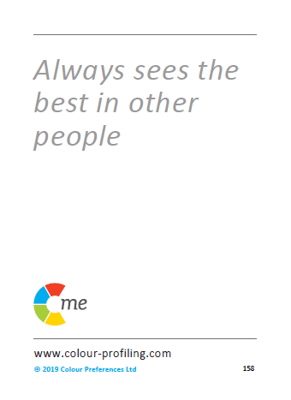

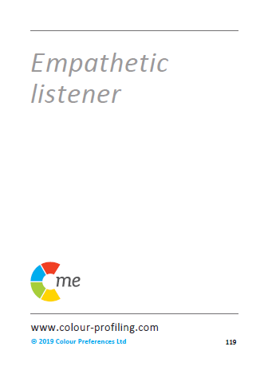
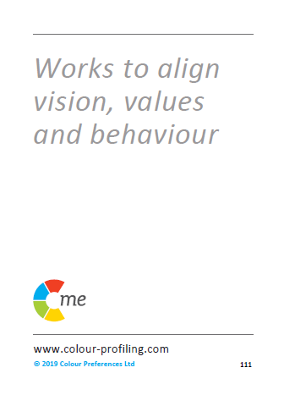
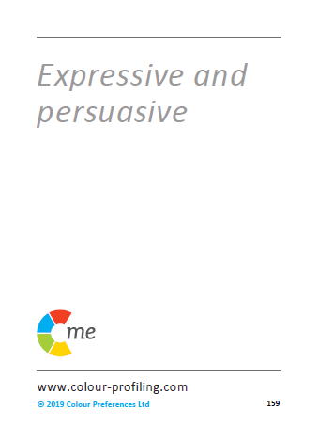
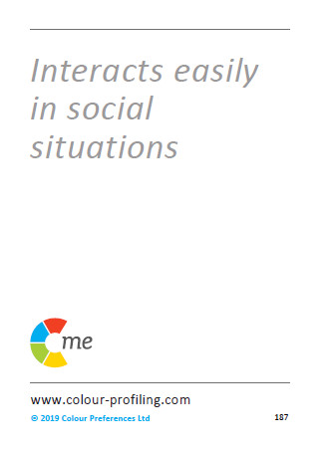
Notes:
Recap of Colour Wheel
Blended Wheel
Similar behaviours are grouped into the same colour quadrant
Importance of understanding self and others
Opportunity to flex

Slide 8
Insert Team Wheel Here
Notes:
Reflect on team wheel
Questions to get discussion going:
What are the strengths of this team?
What observations do you have of our team wheel?
How do our colour preferences impact our communication?
How do you see this playing out?

Slide 9
Insert Team Graphs Here
Notes:
Reflect on team wheel
Questions to get discussion going:
What are the strengths of this team?
What observations do you have of our team wheel?
How do our colour preferences impact our communication?
How do you see this playing out?

Slide 10

Effective Colour Communication
Give facts, ideally in writing
Be rational and practical
Ask for their questions
Define the process
Be logical and thorough
Listen carefully to questions
Allow time to prepare
Demonstrate conviction
Identify their role quickly
Be direct and action-focused
Present options
Focus on success
Be brief and clear
Refer early to the objective
Allow time for discussion
Be patient and sincere
Show genuine interest
Be generous
Be polite and courteous
Consider their opinions
Progress at their relaxed pace
Be interactive and friendly
Use visuals
Make it fun
Be light and fast paced
Make direct eye contact
Seek their views and ideas
Allow for an open discussion
Notes:
Effective Colour Communication
You may need these slides handy if you are running a workshop for people to refer to during exercises.
Colours have an influence both on what we do say but also on what we don’t say.
ACTION:
Identify your lowest 2 colours. Be aware that these will be other people’s highest colours. You may therefore need to flex your approach in order to communicate more effectively with them.
Pick 2/3 specific bullet points from your lowest colour that you want to try to put into practice.

Slide 11
Ineffective Colour Communication
Interrupting their thinking
Being unrealistic
Leaving things unfinished
Being flippant
Straying from the agenda
Skipping over the facts
Poorly evidenced conclusions
Impatience
Belittling accomplishments
Procrastination
Attempts to direct or overpower them
Focusing on too much detail
Slowing down the pace
Repetition
Expecting an instant decision
Being abrupt
Open criticism
Ruining team harmony
Being overly competitive
Talking over them
Rushing them
Preventing them dreaming
Cutting them off mid-flow
Restraining their ideas
Overwhelming with detail
Assuming they’re listening
Forcing them to follow process
Expected adherence to rigid timescales
Notes:
Ineffective Colour Communication
ACTION: Again, looking at your lowest 2 colours, identify 2/3 specific statements that you may need to avoid in order to communicate effectively with people of that colour preference.

Slide 12
Exercise 3:
Effective & ineffective communication
Refer to your HP report:
Look at the effective and ineffective ways to communicate with you.
Which 3 statements for each, most resonate at this time?
Share in pairs
What could you adjust in your approach to communication with the other person?
Notes:
Pairs could be individuals with different colour preferences to maximise the value of this exercise
Explore – your own statements
Filter – Choose your statements for this time
Share – with a colleague with whom you work closely
Stop: Start: Continue doing?

Slide 13



Effective communications with Teams
Name | C’s | Do | Don’t
Jonny |  | Get people involved Value their opinion Direct eye contact | Make them follow process Return to the rule book Restrict free flowing ideas
Sally |  | Provide detail Be polite Keep timescale relaxed | Be overly competitive Stick coldly to the task Give vague instructions
Fred |  | Presents options Ask their advice Stick to matter in hand | Show frustration Focus on personal issues Delay conclusions
Notes:
Illustrate how teams can be proactive in being more effective in Communications.
Encourage the team to produce a similar grid for themselves, to help them share their communications DOs and DON’Ts:
See Accreditation Manual for template.
It includes a personalized C visual – a visual snapshot of a person’s colour preferences.
These can be included in email footers
Or on staff office doors
POSSIBLE ACTION:
In the chat box/verbally - how could you use the C?
How would you use the effective comms grid?

Slide 14
Verbal Style
What can you learn about a colour preference different to your own?
Pragmatic
Structured
Prepared
Questioning
Analytical
Professional
Focused on detail
Authoritative
Direct
Fast paced
Responds quickly
Unambiguous
Forthright
Assured
Collaborative
Diplomatic
Thoughtful
Active listening
Non-judgemental
Empathetic
Meaningful
Dynamic
Persuasive
Spontaneous
Expressive
Positive possibilities
Energetic
Personal
Notes:
How do we like to talk to people?

Slide 15
Effective Communication by Email
Be clear and succinct
Include all necessary detail
Include an agenda
Schedule any follow up in advance
Provide context and expectations for a response
Maintain focus
Use bullet points
Quickly outline the objective
Be succinct
Detail action needed
Enquire about them
Be collaborative
Show you value them
Be pragmatic
Give them time to reflect and respond
Be personal and engaging
Include visuals
Avoid too much detail
Ask for their feedback and ideas
A call is preferable when possible
Notes:
Non-verbal communications too: Email
Applicable to:
How do I lay out the email?
Do I send a preparation document for them beforehand? Or with the email?
Do I need to follow-up with a phone call?
This is showing that C-me can be applied in a practical and tangible way.
Especially important at the moment with increased remote working – this is developed further in our ‘remote working’ webinar

Slide 16
Exercise 5: Effective Communication by Email
Scenario: Arranging a meeting to discuss a project
Compose an email, flexing to a colour preference different from your own
Things to consider:
  Layout
  Type of information
  Preparation
  Follow up
Notes:
Set up the Exercise as per the slide
Work in small groups or Break Out Rooms (if remote delivery)
Facilitator: Suggest putting the 4 ‘things to consider’ in the chat for ease of reference?
Things to consider:
Layout
Type of information
Preparation
Follow up
Share emails afterwards and coach one another to fine tune

Slide 17
Reflection: personal experience of feedback
Think of a good experience you have had of receiving feedback
What was the impact?
Think of a bad experience you have had of receiving feedback
What was the impact?
Notes:
EXERCISE – as per the slide
Group discussion, Break Out Rooms or use Chat

Slide 18




How might your experience of feedback relate to your colour preference?
Notes:
Opportunity to reflect on individual colour preferences and the impact this can have on what they ‘see’ as effective feedback
NB
1st ‘C’ = Reflective preference
2nd ‘C’ = Extrovert preference
3rd ‘C’ = Feelings driven preference
4th ‘C’ = Thinking driven preference

Slide 19
Break Time

Slide 20
Exercise 6: Challenging Conversations
Consider a challenging conversation that you have had. What did you learn from it?
When have you needed to have a challenging conversation but pulled out? What stopped you? What were the consequences?
Notes:
2 questions: revealed on each ‘click’

Slide 21
Challenging Conversations
Contributors and Consequences
Three factors that can contribute to challenging conversations:
1. Critical outcomes
Prioritising outcomes over relationship
2. Strong opinions
Prioritising opinion over attentive listening
3. High emotions
Prioritising feelings over careful thinking
How might different colour preferences respond to these factors?
Notes:
Animated to reveal consequence of Factor 1, then Factor 2 and it's consequence and so on.
Discussion starter:
When there are critical outcomes at stake, what might be the consequence if we prioritise the outcome above anything else?
What about when there are strong opinions in the mix?
High emotions?
How might our different colour preferences come into play here?
The next slide may help this discussion further.

Slide 22
Challenging Conversations
Self-protective Responses
“Silence”
Flight (freeze)
“Violence”
Fight (deflect)
Notes:
Difficult conversations can trigger two contrasting “safety issues”
REVEAL 1: Silence: Flight or freeze
REVEAL 2: Violence: Fight or deflect
REVEAL 3: C-me wheel

Slide 23
Likely Responses
Bad Day Behaviours
Overly focuses on problem
Withdraws
Goes quiet
Can be intimidating
Unable to suspend judgement
Lacks filters
Silent treatment
Holds back
Avoids difficult conversations
Avoids discomfort
Settles for ‘cheap’ resolution
Can play down issues
Notes:
EACH CLICK – These "Bad day " behaviours for each Colour Preference can be negative contributors to effective communication. They may be some of the causes of challenging conversations and could also be the outcome of challenging conversations.
Invite comments

Slide 24
Likely Responses
Good Day Behaviours
Be specific
Be reasonable
Show pragmatism
Be clear about goals
Name the uncomfortable truth
Be straight-up and honest
Be empathetic
Be slow to react
Explore different views
Articulate issues clearly
Show optimism about future
Aim for a win-win solution
Notes:
Animated to reveal each colour quadrant
These "Good day " behaviours for each colour preference can be positive contributors to effective communication.
We can flex our behaviours to the other person's colour preference in order to help ease tensions.
In a group challenging conversation, all 4 colour preferences need to be represented for the best outcome, so we need everyone to bring their natural resilient strengths to the conversation.
Discuss

Slide 25
Response to being challenged
How each colour preference is likely to respond
Checks details and facts
Can withdraw
Responds with a logical answer
Will look to respond quickly
Moves on fast
May become confrontational
Dislikes direct challenge
May take things personally
Able to see both sides
Can get demoralised
Looks for positives
Plays down challenge to diffuse
Notes:
Ask for guesses for each quadrant

Slide 26
Listening priorities
Colour preference diversity
Appreciates logical process
Seeks clarification of detail
Will hear and recall detail
Appreciates clarity and brevity
Listens for progress
Keen to contribute a solution
Recognises complexity
Is attuned to emotions
Helps people feel at ease
Seeks positives & opportunities
Aims to be encouraging
Looks to find common ground
Notes:
How we listen impacts crucial conversations. Each colour will have different listening priorities. It is good to be aware of our own colour preferences and then those of the other person in terms of their own priorities.
Discuss
All of the statements are positive but some are nuanced as they potentially could have a flip side to watch!

Slide 27
Healthy conflict
My needs
Your needs
Notes:
Aim of healthy conflict: to help both sides grow, find a positive outcome, see progression
Relationships between ”MY NEEDS” and “YOUR NEEDS”

Slide 28
Healthy conflict
Compete
Win – Lose
Collaborate
Finding a creative 3rd way
Win - Win
Compromise
Low form of
Win - Win
My needs
Avoid
Lose - Lose
Accommodate
Lose - Win
Your needs
Notes:
Work through the slide, describing the relationship between “My Needs” and “Your Needs”
1. My needs low/Your needs low = AVOID conflict = Lose-Lose (neither party can grow)
2. My needs high/Your needs low = COMPETE in conflict = Win-Lose (I get my way and you lose out)
3. My needs low/Your needs high = ACCOMODATE in conflict = Lose-Win (I let you have your way but issues not dealt with)
4. My needs medium/Your needs medium = COMPROMISE in conflict = Low form of win (Meet in the middle/agree to disagree)
5. My needs high/Your needs high = COLLABORATE in conflict = Win-Win (Find the best way forward, with honesty and integrity)

Slide 29
Exercise 7: Healthy conflict
AVOID – COMPETE – ACCOMMODATE – COMPROMISE - COLLABORATE
Which word best describes how you tend to tackle conflict?
How does your approach to conflict change in different scenarios?
How does this reflect your colour preference?
What action would you like to take to COLLABORATE better?
Notes:
Chance to explore these questions in the group and allow for reflection sharing

Slide 30
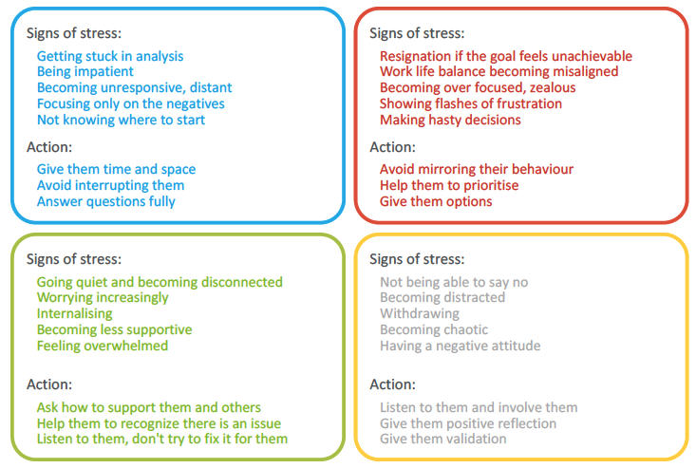
Exercise 8: Diffusing Tension
Referring to your HP report:
Think of a relationship where there is tension. Considering both of your colour preferences, how is this impacting the tension?
What actions could you flex towards in order to diffuse the tension?
Notes:
Using this report section with regards to communication

Slide 31
1.
2.
3.
4.
C-me 360
card game
5.
6.
7.
8.
Notes:
Explain 360 card game
Good exercise to start discussion on how we’re perceived by others in the team
Select one person in the group
The rest of the group then pick 2/3 cards which they feel best describe that person.
The selected person then gives some feedback about the cards that the rest of the group selected for them.
Each person in the group has a go.
ACTION: Ask people to guess statements for one of the facilitators.

Slide 32
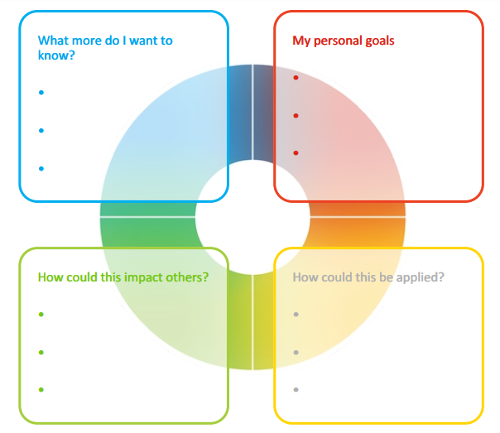
Personal Reflection
Consider all 4 colours to reflect on what you have learnt today.
What do you want to commit to Stop, Start and Continue?
Notes:
Opportunity for PERSONAL and TEAM Reflection – vital to help embed the learning from this workshop
Encouragement to reflect on behaviours through the lens of all 4 colours (Whilst we have a behavioural preference, we are all a blend of all 4 colours) for Action Plans that are more thorough.
STOP/START/CONTINUE: a helpful structure for reflection. What will you Start doing? Stop doing? Continue doing?

Slide 33
Team Reflection
Consider what you have learnt today through the lens of all 4 colours.
As a team, what do you want to
Insert Team Wheel Here
Stop?
Start?
Continue?
Notes:
Opportunity for TEAM Reflection – vital to help embed the learning from this workshop in a collective way.
Encouragement to reflect on team group behaviours through the lens of all 4 colours (whilst we have a behavioural preference, we are all a blend of all 4 colours).
STOP/START/CONTINUE: a helpful structure for reflection.

Slide 34





Colour-profiling.com
Thank you and please stay in touch!
@colourprofiling
@cmeprofiling
Cmecolourprofiling
@C-me Colour Profiling
Notes:
Opportunity to thank your guests.
INSERT YOUR OWN LINKS HERE ON THIS SLIDE.

