Slide 1
Customising your C-me session
N.B. Certain slides can be hidden (right click ‘Hide Slide’) depending on session needs N.B. Certain slides will need editing for EVERY different delivery (see below)
CHECKLIST
Home Slide: Option to add client’s/team's logo/brand Slide 3
Exercise 5: Insert bespoke scenarios Slides 11 & 22
Insert bespoke Team Wheel Slide 9 & 26 and Team Graphs Slide 9.

Slide 2
Session Delivery
We encourage you to run through all the slides ahead of delivering them in slideshow mode. Some slides are static and others include animations. Please check that these animations work.
Brief notes are provided below each slide to give delivery guidance.

Slide 3

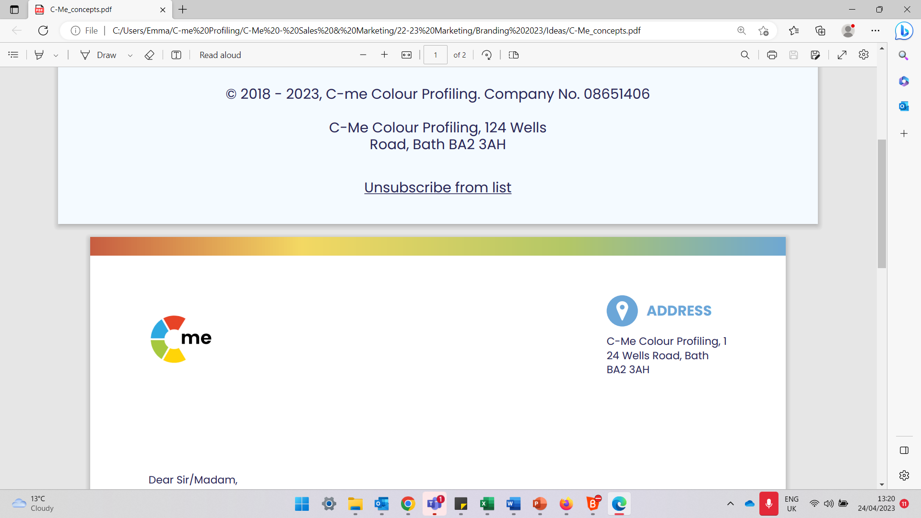
Change Management
Building high performing individuals and teams
C-me, 124 Wells Road, Bath, BA2 3AH e: contact@colour-profiling.com t: 01225 721971
Notes:
If delivering remotely:
WELCOME everyone on grid view (share slides later).
Give a very brief personal introduction
PURPOSE: The purpose of this workshop is ……
PROGRAMME: The timeline for today is ….
If RECORDING SESSION: Let the clients know at the start.

Slide 4

Our Aims for this session
Reflect on specific contributions of each team member
Consider the 4 pillars of high performing teams and assess the robustness of your team in relation to handling setbacks, change and recruitment
Understand how to maximise engagement and buy-in
Personal and Team reflection
What are your aims?
Notes:
Check these aims are appropriate for your clients and tailor if necessary.
Give space for participants to share their session aims in the chat.

Slide 5

Natural Team Contribution
Focuses on the task in hand
Spots the flaws in the plans
Holds the team accountable
Attends to the details
Questions the team’s methods
Focuses on getting things right
Sets stretching goals
Confronts poor performance
Gets on with the job
Keeps the team to the process
Brings organisational skills
Prepares for all eventualities
Motivates the team
Encourages all to participate
Explores new ways to tackle problems
Builds a consensus
Ensures everyone has their say
Focuses on values
Promotes a positive approach
Spreads warmth and energy
Inspires the team
Keeps the team together
Remembers the good things
Supports the less able members
Notes:
RECAP: ALL have something to bring to the team. Can also refer to individual statements on Team Contribution in HP report and/or Team Wheel to support this recap.
Additional questions to consider:
For your team, are there particular contributions that are perhaps overlooked?
What does the newest member of your team bring to the team?
Which colour preference is least represented in your team?
Does that impact the value that that colour preference brings?

Slide 6

4 Pillars of High Performing Teams
10 -
5 -
FLEXIBILITY
Focus & adaptation
HONESTY
Tricky conversations
COMMITMENT
Bought into journey
RESILIENCE
Handling setbacks
1 -
RELATIONSHIPS
Notes:
Outline the 4 Pillars of High Performing Teams
Each "click" reveals new pillar.
A commitment to the culture that sits underneath a team will make the difference between Performance and High Performance
Each Pillar is linked to a section of the High Performance Report
Commitment – Enabling Engagement (p9)
Flexibility – Role Agility (p9)
Honesty – Effective and Ineffective Communication (p7)
Resilience – Handling Setbacks (p10)
Fifth “click” RELATIONSHIPS – that underpin all 4 pillars
Final Click – reveals scale. What would you score yourself/your team for each of the 4 pillars? (1 = low, 10 = high)

Slide 7
Exercise 1:
Reflecting on your High Performance Report
For each of the 4 pillars (Commitment, Flexibility, Honesty, Resilience):
On a scale of 1-10 (10 = high), how would you score yourself for each pillar?
What are the barriers to your scores being higher?
Reflecting on your report, how could you improve your performance?
Notes:
Encourage referral to their individual reports for statements to consider as they answer the questions

Slide 8
Exercise 2:
Reflecting on your Team’s Performance
For each of the 4 pillars
(Commitment, Flexibility, Honesty, Resilience):
On a scale of 1-10 (10 = high), how would you score your team for each pillar and the reason why?
Notes:
Encourage each team member to share their scoring for the team individually to see the variety of scores. Encourage them not to change the answers based on hearing other people's scores!
This could be done in pairs or small groups if the group is large or to encourage more honesty.

Slide 9
Exercise 3:
High Performance as a Team
Insert Team Wheel and Team Graphs
Notes:
Invite reflection and discussion on team wheel
Which of the 4 pillars come naturally to this team in order to be High Performing?
Which come less naturally to this team in order to be High Performing?

Slide 10
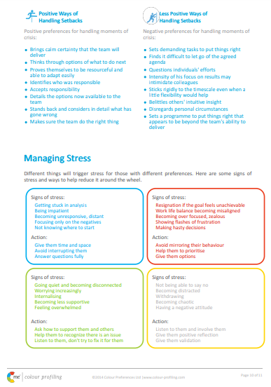
Handling Setbacks (p10)
Exercise 4:
Team challenges
Referring to your own statements, how could you improve your team’s ability to handle setbacks?
What would the outcome of this be for you team?
Notes:
Each person's contribution to improving things as a whole

Slide 11
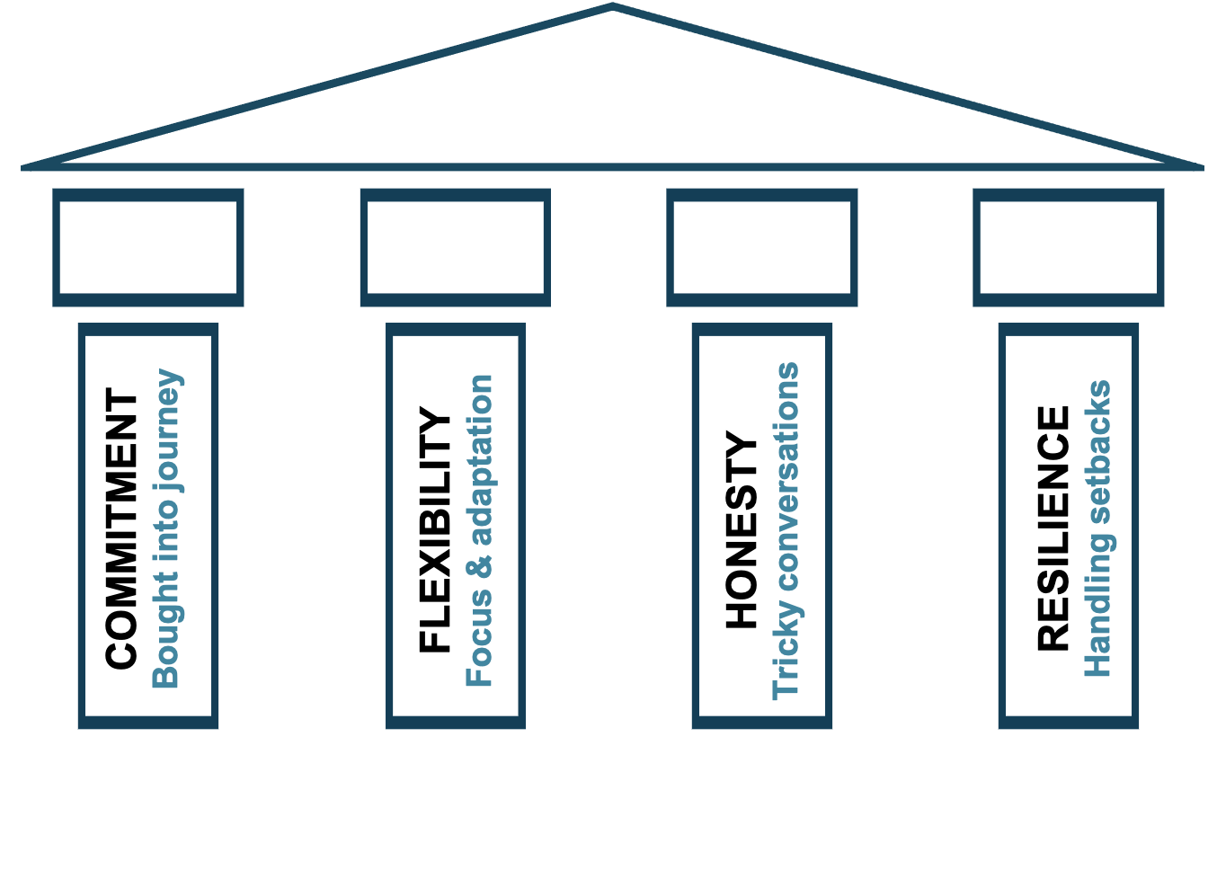
Handling Setbacks
  Exercise 5:
  Team challenges
  What would it look like for your team to implement the 4 pillars for each of the following scenarios?
  1. An attitude issue
  2. A significant team loss
  3. A collective team mistake
Notes:
Construct a scenario that touches on these 3 issues:
1. Collective team motivation
2. Sudden loss of a valuable team member
3. A situation where the team felt the impact of mistakes that had been made

Slide 12
Handling Change
  Exercise 6:
  Team challenges
  What have been your most positive and negative experiences of change initiatives?
  How might this link to your colour preference?
Notes:
Invite reflection and discussion in pairs

Slide 13
Kübler-Ross Model of Change
Integration
Denial
Decision
MORALE
&
PERFORMANCE
Frustration
Shock
Experiment
Depression
TIME
Notes:
1st reveal:
Kübler-Ross model is sometimes called the Stages of Grief Model
Named after the psychiatrist Elisabeth Kubler-Ross
First published in her 1969 book “Death and Dying”
Has been widely applied to business and change management
Looks at how morale and performance fluctuates through various stages of change over time
2nd reveal: Stages appear
We will all go through these different stages at different times.
Different colour preferences will go through them at different speeds and have different places where they are most likely to get “stuck”

Slide 14









C-me and Change
Planned, Safe, Improving, Evidenced
Unplanned, Risky, Disruptive, Unknown
Ambitious, Fast, Beneficial, Impactful
Small, Slow,
Low growth
Values-driven, People- minded, Long-term
Top-down, Hurried, Financially-driven
Innovative, Vision-led, Connecting people
Time-consuming, Unclear, Impersonal
Notes:
Ticks = Positive ways that Colour Preference responds to change
Crosses = Change dynamics that will cause that Colour Preference frustration

Slide 15

Recruitment Change: new team members
Exercise 7:
Team challenges
How could an awareness of colour preference bring value to your recruitment process?
Notes:
Mention the 3 page Recruitment Report – a great resource
Invite discussion
New members of the team will cause change and adjustment. Knowing the colour preference of new team members can help with faster integration and relationship building.

Slide 16
Break Time
Notes:
Place this slide wherever you want to take a break.

Slide 17
Maximising engagement fuels commitment
COMMITMENT
Bought into journey
FLEXIBILITY
Focus & adaptation
Honesty
Tricky conversations
RESILIENCE
Handling setbacks
Notes:
Focus here on the first 2 pillars
N.B.
Honesty – for tricky conversations: Covered in Comms and Conflict Workshop
Resilience – handling setbacks: Covered in Stress and Resilience Workshop

Slide 18
How could you maximise the contributions made to your team from each of the different colour preferences?
Notes:
Invite discussion
N.B. Next slide reveals some ‘answers’

Slide 19
C-me and Maximising Engagement
Communicate key info in advance
Make the logical case for change
Ask for help identifying risks and optimizing likelihood for success
Communicate early
Clarify need and show benefit
Invite to lead
Communicate in small groups
Invite feedback
Invite necessary support
Sell the vision and communicate with energy
Invite ideas
Focus on the positives

Slide 20
C-me and Decreasing Engagement
Gloss over details
Display too much emotion
Imagine that the vision sells itself
Silence disagreement
Tell them last
Surprise them
Mask truth behind change agenda
Forget people impact
Launch publicly first
Leave them out of new initiatives
Let them abandon current tasks
Dampen creativity

Slide 21
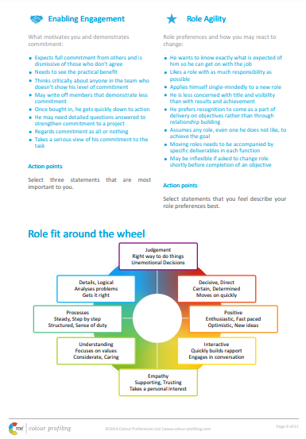
Engagement (p9)
  Exercise 8:
  Maximising engagement
  Pick 2 actions from your report under ‘Enabling Engagement’ that you would like to focus on.
  Share in pairs
  Then focus on a colour preference different to your own. What could you do to help this person maximise their engagement?
Notes:
Explore/Filter/Share

Slide 22
Exercise 9:
Colour Preference and Buy-in
Which colour preference is likely to “buy-in” first?
  New growth strategy
  Communications Innovation
  Culture Change
  Purchasing new tech equipment
  National growth plan

Slide 23
C-me’s Collaboration Model
High trust requirement
Innovative (Some risk)
COLLABORATION
Strategic (Give up a bit/gain a lot)
People capability and opportunity focused
Collaborative leverage
TRUE VALUE
Significant gains
Some trust required
Win/win
CO-OPERATION
Some leverage 1 + 1 = 3
Part process part people
Teamwork
WORKING TOGETHER
Marginal gains
PERFORMANCE
Low trust requirement
Low risk/reward
EFFICIENCY
No waste solutions
Mainly about process
Individual
PROCESS
Minimal gains
Notes:
Explain the Collaboration Model
A bit like Maslow’s Hierarchy of needs, if a lower level is threatened, collaboration reduces
As you work up the stages (1-3), performance increases.
N.B. Each Click reveals explanation of next stage
Invite discussion on what stage the team feels they are currently at.
What might it take to move one stage to the right?

Slide 24
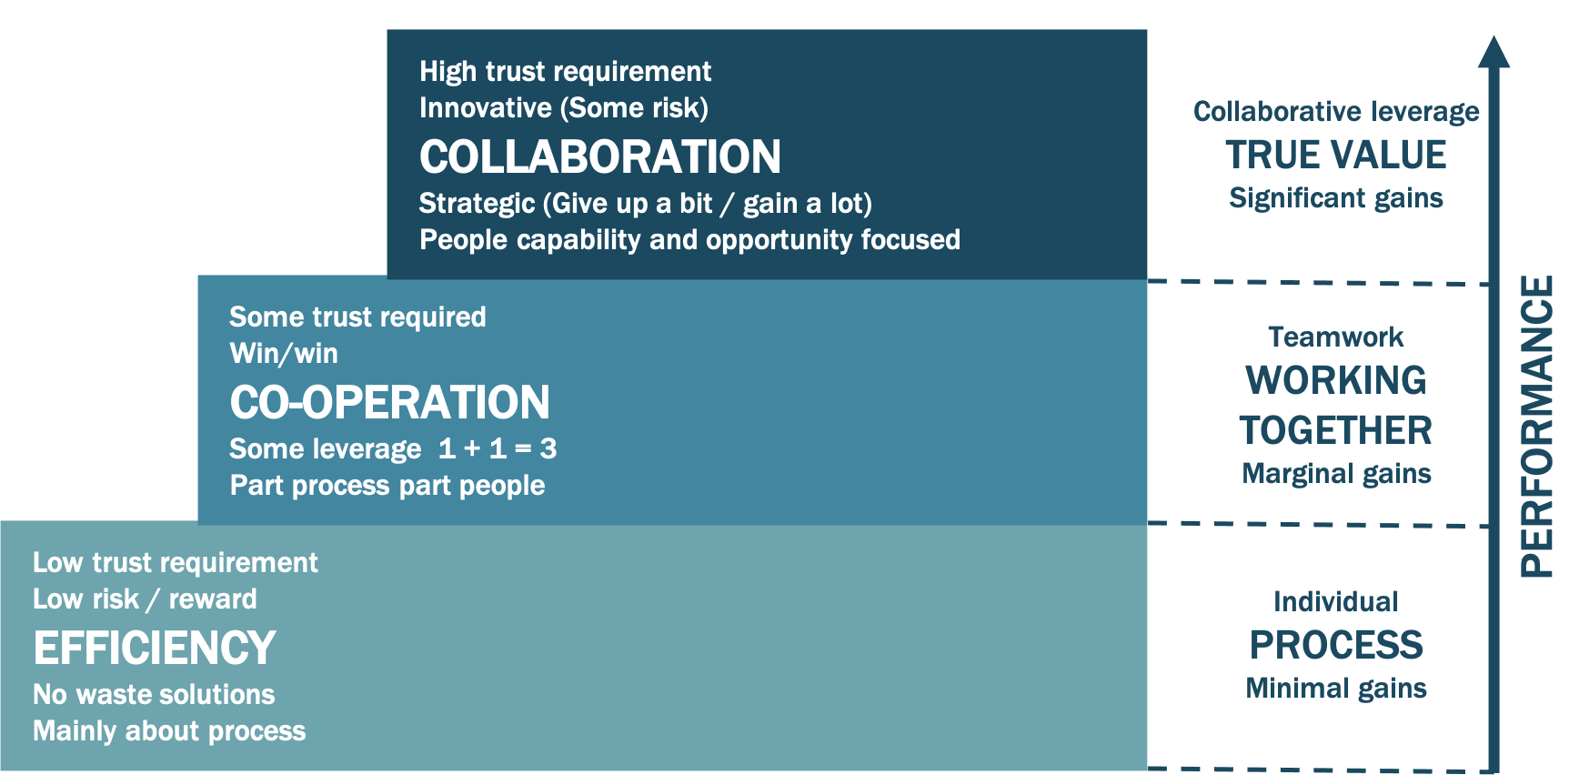
Collaboration Model
Imagine you were given 10 units to allocate between the 3 levels, how many units would represent the amount of time and effort your organization and team currently
spend in each level?
N.B. Many organizations
self-rate like this:
6 or 7 in efficiency
2 or 3 in co-operation
0 or 1 in collaboration
Notes:
Exercise to assess the level of collaboration in your team/organisation

Slide 25
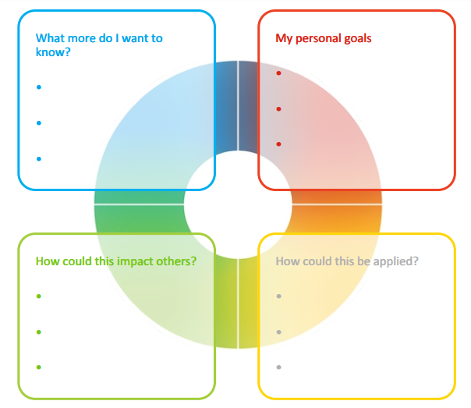
Personal Reflection
Each colour has a different perspective on the focus for action.
Consider all 4 colours to reflect on what you have learnt today.
What do you want to commit to Stop, Start and Continue?
Notes:
Opportunity for PERSONAL and TEAM Reflection – vital to help embed the learning from this workshop
Encouragement to reflect on behaviours through the lens of all 4 colours (Whilst we have a behavioural preference, we are all a blend of all 4 colours) for Action Plans that are more thorough.
STOP/START/CONTINUE: a helpful structure for reflection. What will you Start doing? Stop doing? Continue doing?

Slide 26
Team Reflection
Reflect on what you have learnt today through the lens of all 4 colours.
As a team, what do you want to:
Insert Team Wheel
Stop?
Start?
Continue?
Notes:
Opportunity for TEAM Reflection – vital to help embed the learning from this workshop in a collective way.
Encouragement to reflect on team group behaviours through the lens of all 4 colours (whilst we have a behavioural preference, we are all a blend of all 4 colours).
STOP/START/CONTINUE: a helpful structure for reflection.

Slide 27





Colour-profiling.com
Thank you and please stay in touch
@colourprofiling
@cmeprofiling
Cmecolourprofiling
@C-me Colour Profiling
Notes:
Opportunity to thank your guests.
INSERT YOUR OWN LINKS HERE ON THIS SLIDE.

