Slide 1
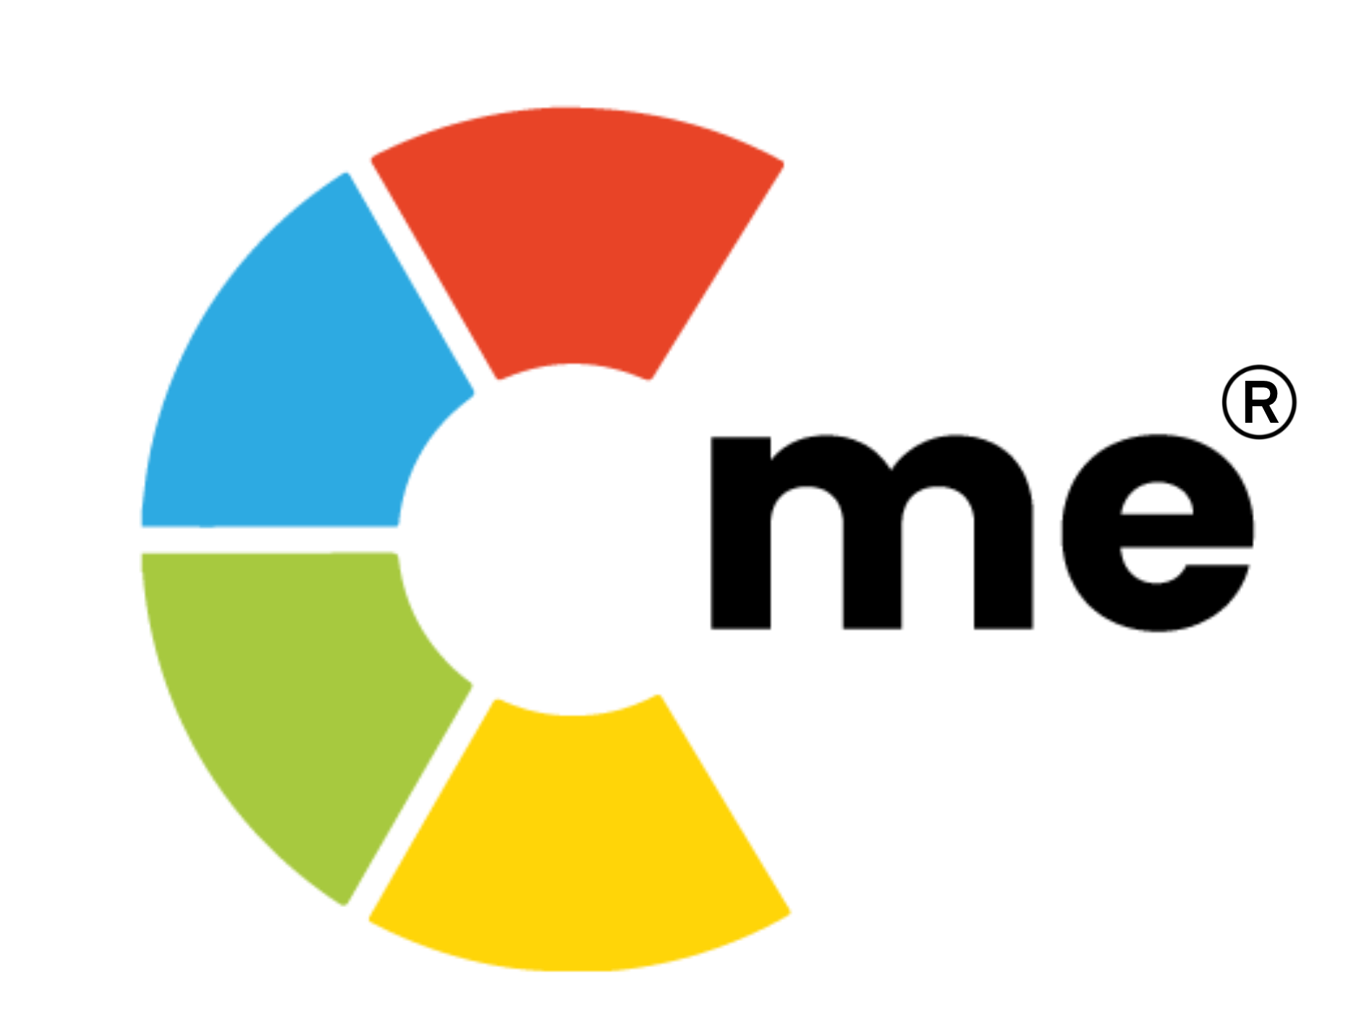
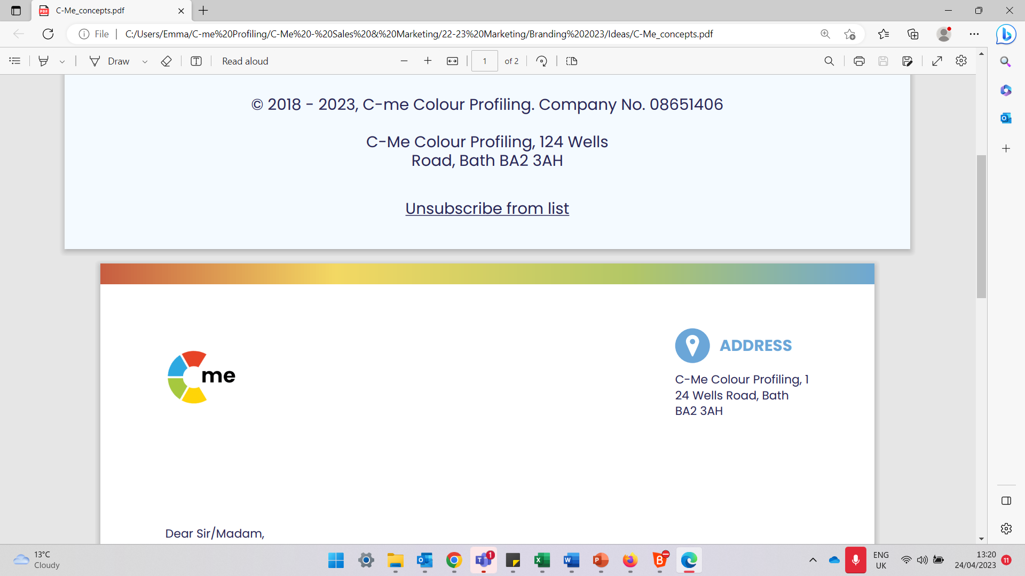
Influencing with Impact Workshop
Overview
Who is this workshop for?
This workshop is for teams who need to influence and negotiate to get buy in for their ideas, for a project or for their product, for example as well as being for teams that want to provide excellent, personalised customer service.
What are the benefits of this workshop?
Your team will:
Know how different people engage with change and what may cause them to get stuck
Understand individual strengths and potential development needs in this area
Explore effective influencing techniques for different audiences
Optimise communication with stakeholders
Consider how written and verbal communication styles can influence this area
Understand different clients’ potential drivers and blockers
Learn ways to practically apply these concepts to current situations and clients
Additional workshop options
Communication and Conflict
Stress and Resilience
Team Cohesion
Change Management
Leadership Development
C-me e: contact@colour-profiling.com
124 Wells Road, Bath, BA2 3AH t: 01225 721971

