Slide 1

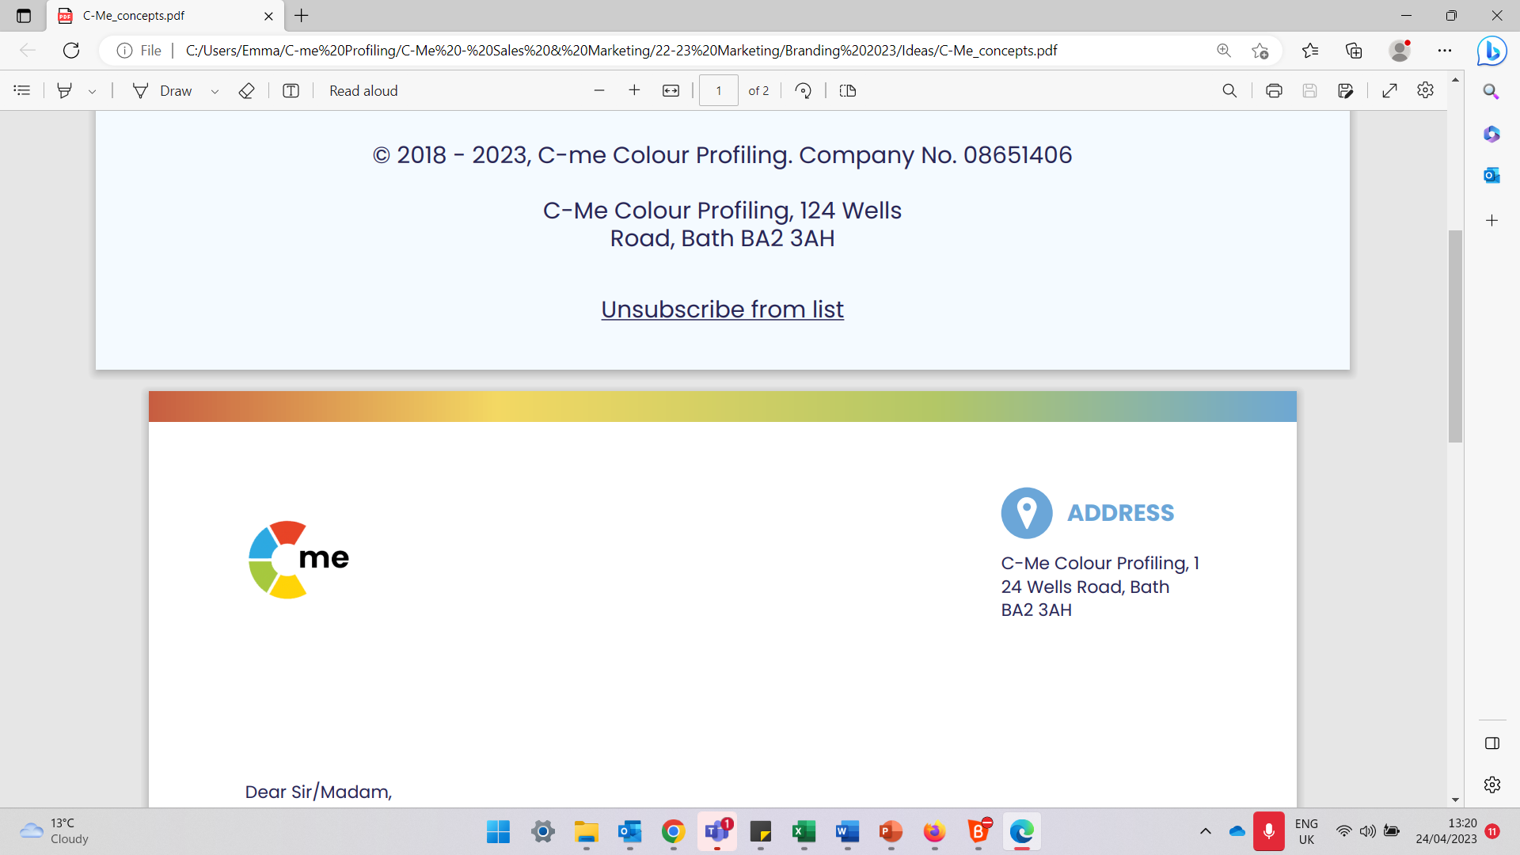
Influencing with Impact Workshop
Agenda (2hrs 30mins)
5 mins Aims
5 mins Reminder of Jungian axes
10 mins Colour Approach to Influencing – Exercise 1
10 mins Review of HP Influencer Report – Exercise 2
10 mins Effective and Ineffective Comms – Exercises 3 & 4
20 mins Influencing Scenarios – Exercises 5 & 6
10 mins BREAK
15 mins Verbal and non-verbal comms styles – Exercises 7 & 8
10 mins Your Team – Exercise 9
10 mins Influencing Drivers & Blockers – Exercise 10 & 11
10 mins Planning a Presentation – Exercise 12
15 mins Final Reflection
C-me e: contact@colour-profiling.com
124 Wells Road, Bath, BA2 3AH t: 01225 721971

